Slide 1



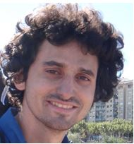


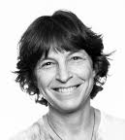

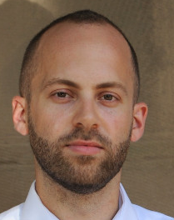
Fast Concurrent Data Sketches
Arik Rinberg, Alexander Spiegelman, Edward Bortnikov, Eshcar Hillel, Idit Keidar, Lee Rhodes, Hadar Serviansky
Notes:
Add Technion to slide

Slide 2







Real-Time Analytics Architecture
query
Data Store
Content Processing

Slide 3
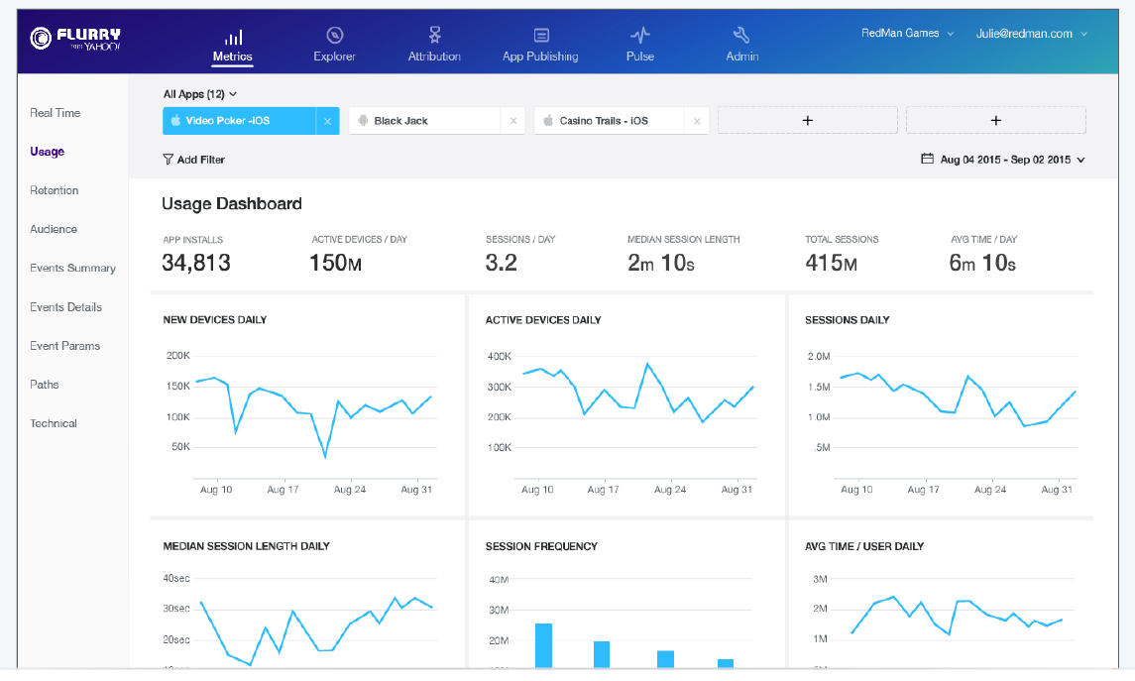
Motivation: Massive Real-Time Analytics
Real-time reports ~830,000 mobile apps on ~1.6 billion user devices

Slide 4


Sketches: Lean & Mean Aggregation
Fast
Small memory footprint
Statistical summary of large stream
Estimates some aggregate
#uniques
quantiles
heavy-hitters
Notes:
Blurry girl
Talking: Give examples for functions

Slide 5

Context: Open-Source DataSketches Library
Apache Incubating

Slide 6

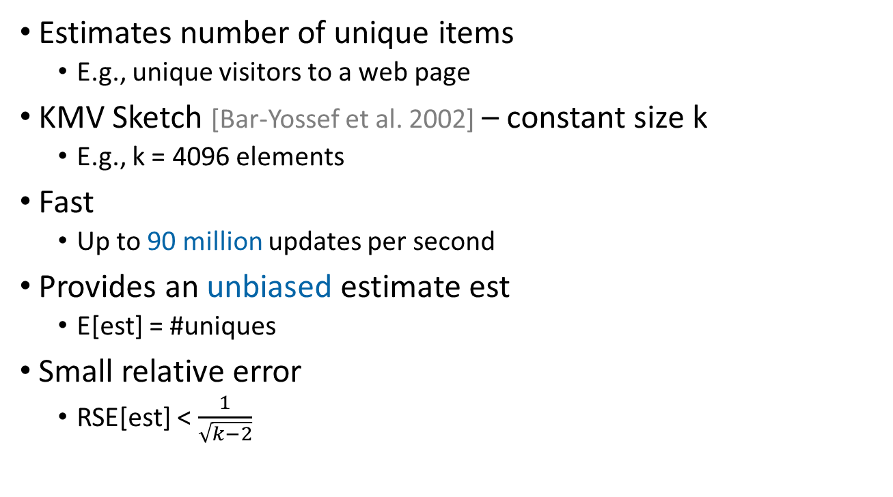
Example: $Θ$ Sketch
Estimates number of unique items
E.g., unique visitors to a web page
KMV Sketch [Bar-Yossef et al. 2002] – constant size k
E.g., k = 4096 elements
Fast
Up to 90 million updates per second
Provides an unbiased estimate est
E[est] = #uniques
Small relative error
RSE[est] < $\frac{1}{\sqrt{k−2}}$
Notes:
Talking: RSE

Slide 7


$Θ$ Sketch: Basic Idea
Hash unique elements into [0,1] uniformly at random
0
1

Slide 8
$Θ$ Sketch: Basic Idea
Hash unique elements into [0,1] uniformly at random
Try to estimate how many there are
0
1

Slide 9


$Θ$ Sketch: Basic Idea
Hash unique elements into [0,1] uniformly at random
Keep those smaller than $Θ$, for $0<Θ≤1$
In expectation, $\frac{1}{Θ}$ of the uniques in the stream
0
$$Θ$$
1
Notes:
Talking:
Story about queue to ski-lift. I was skiing. Queue is 1km, count first 10 meters, and multiply by 100.

Slide 10


$Θ$ Sketch: Basic Idea
Hash unique elements into [0,1] uniformly at random
Keep those smaller than $Θ$, for $0<Θ≤1$
In expectation, $\frac{1}{Θ}$ of the uniques in the stream
$Θ=k^{th}$minimum hash value seen (initially = 1)
0
$$Θ$$
1
K Minimum Values (KMV)

Slide 11

$Θ$ Sketch: Basic Idea
Hash unique elements into [0,1] uniformly at random
Keep those smaller than $Θ$, for $0<Θ≤1$
In expectation, $\frac{1}{Θ}$ of the uniques in the stream
$Θ=k^{th}$minimum hash value seen (initially = 1)
0
K Minimum Values
$$Θ$$
1

Slide 12

$Θ$ Sketch: Basic Idea
Hash unique elements into [0,1] uniformly at random
Keep those smaller than $Θ$, for $0<Θ≤1$
In expectation, $\frac{1}{Θ}$ of the uniques in the stream
$Θ=k^{th}$minimum hash value seen (initially = 1)
0
K Minimum Values
$$Θ$$
1

Slide 13
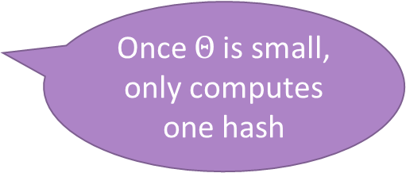
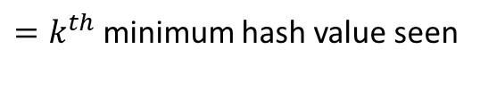
$Θ$ Sketch: Basic Idea
Hash unique elements into [0,1] uniformly at random
Keep those smaller than $Θ$, for $0<Θ≤1$
In expectation, $\frac{1}{Θ}$ of the uniques in the stream
Once $Θ$is small, only computes one hash
0
K Minimum Values
$$Θ$$
1
$=k^{th}$minimum hash value seen
Notes:
Talking: Theta is monotonically decreasing over time

Slide 14

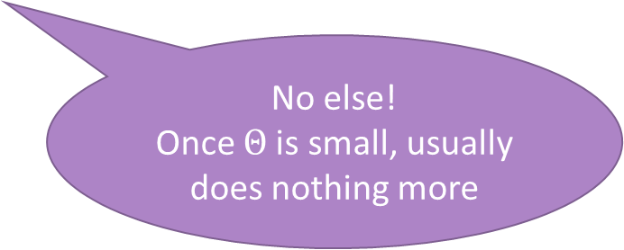

$Θ$ Sketch Processing
On incoming id
h = hash(id)
if h < $Θ$
add h to sketch
if |sketch| > k, remove largest
$Θ$ = largest hash in sketch
No else!
Once $Θ$is small, usually does nothing more
Notes:
Add between 15 and 16, add github issues with locks

Slide 15
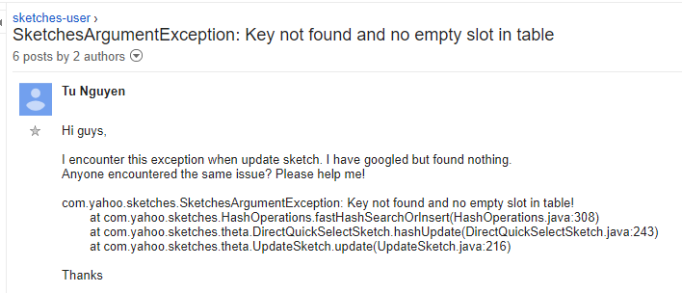

Today’s Sketches Aren’t Thread-Safe

Slide 16
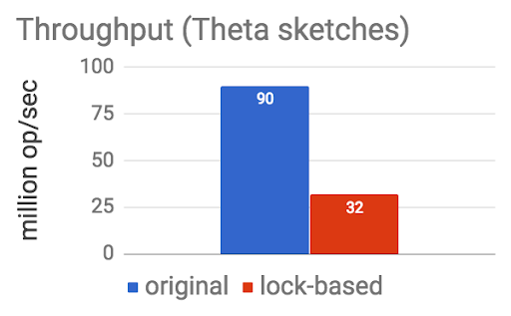
Today’s Sketches Aren’t Thread-Safe
Need protection:
try {
lock (sketch)
sketch.update(...);
} finally {
unlock (sketch)
}
But locks are costly:
Notes:
Single thread throughput

Slide 17

Concurrent Sketches - Goals
High ingestion throughput
Concurrent updates
Harness multi-cores for multi-threaded stream processing
Query freshness
Allow queries during updates
Ease-of-use
Library responsible for synchronization, not application
Enjoy sketch’s benefits
Fast
Bounded estimation error
Small memory footprint

Slide 18

Concurrent Sketches: Generic Architecture
Global Sketch
queries
snapshot
merge
buffer (small sketch)
. . .
buffer (small sketch)
update
update
Notes:
Instead of blue, picture of cpu.
Add animation of a merge
Talking: Explain architecture slowly

Slide 19
Bounding the error of small streams
Global Sketch
queries
snapshot
merge
buffer (small sketch)
. . .
buffer (small sketch)
b elements can be missed
update
update
Notes:
Instead of blue, picture of cpu.
Add animation of a merge
Talking: Explain architecture slowly

Slide 20





Example
Global Sketch
merge
buffer (size=2)
. . .
buffer (size=2)
update
update
$$a_{1}$$
$$a_{2}$$
$$a_{3}$$
$$a_{5}$$
$$a_{4}$$
Notes:
Example

Slide 21
Optimizations
Problem: Thread is idle during propagation
Solution: Use double buffering
Problem: Missing critical information
Solution: Piggyback on existing synchronization
Notes:
Talking:
Locality – each buffer is per thread
Sync – using an atomic bit once buffer is full
Share Info – e.g., local sketches use global Theta

Slide 22
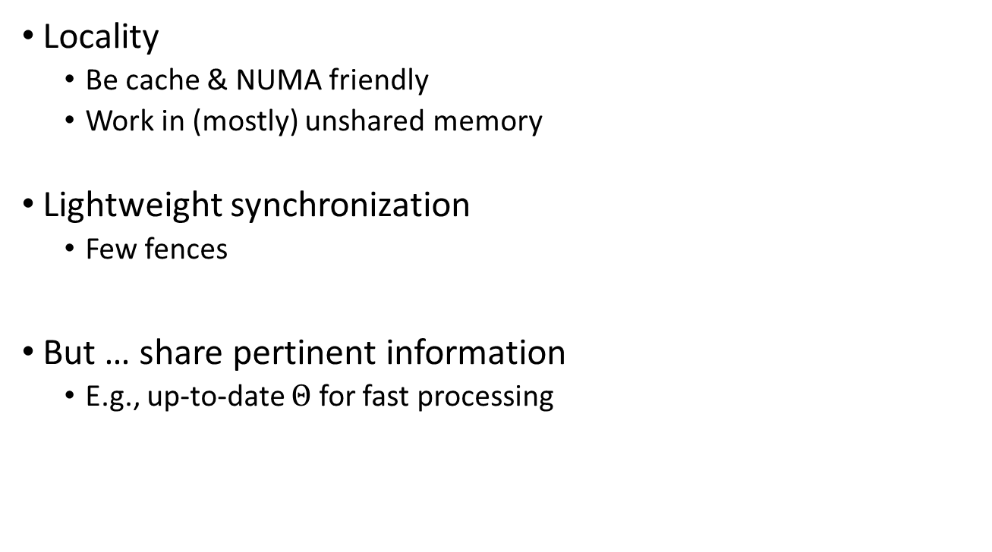
Keys to Performance
Locality
Be cache & NUMA friendly
Work in (mostly) unshared memory
Lightweight synchronization
Few fences
But … share pertinent information
E.g., up-to-date $Θ$ for fast processing
Notes:
Talking:
Locality – each buffer is per thread
Sync – using an atomic bit once buffer is full
Share Info – e.g., local sketches use global Theta

Slide 23
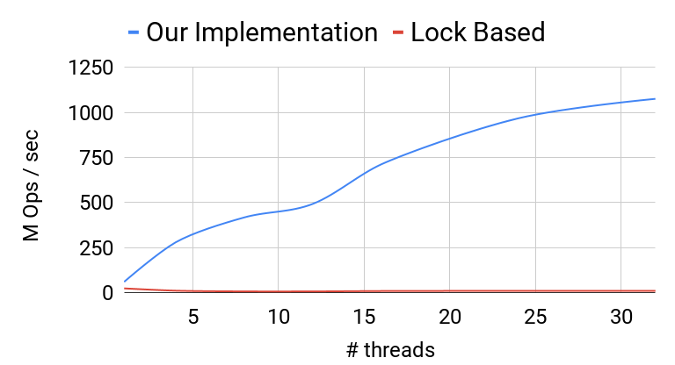
Update Throughput
Notes:
Talking: SotA was with lock

Slide 24
Space and Error
space & error bounds of sequential sketch
Global Sketch
buffer of b updates
buffer of b updates
. . .
buffer of b updates
b extra space
b elements missed by query (per buffer)
Notes:
Add chips also here.
Talking: Discuss eager propagation. Small stream induce large errors

Slide 25

Proof Overview
The proof in the full paper is based on:
$r$-relaxed semantics [Henzinger et al.]
Strong linearizability [Golab et al. ]
We then analyze the error of the relaxed specification.
Notes:
Rewrite slide to point to paper, based on r-relaxed and s.l. (with citations).
Important, we prove correctness w.r.t to a relaxed seq specification and bound the error.

Slide 26
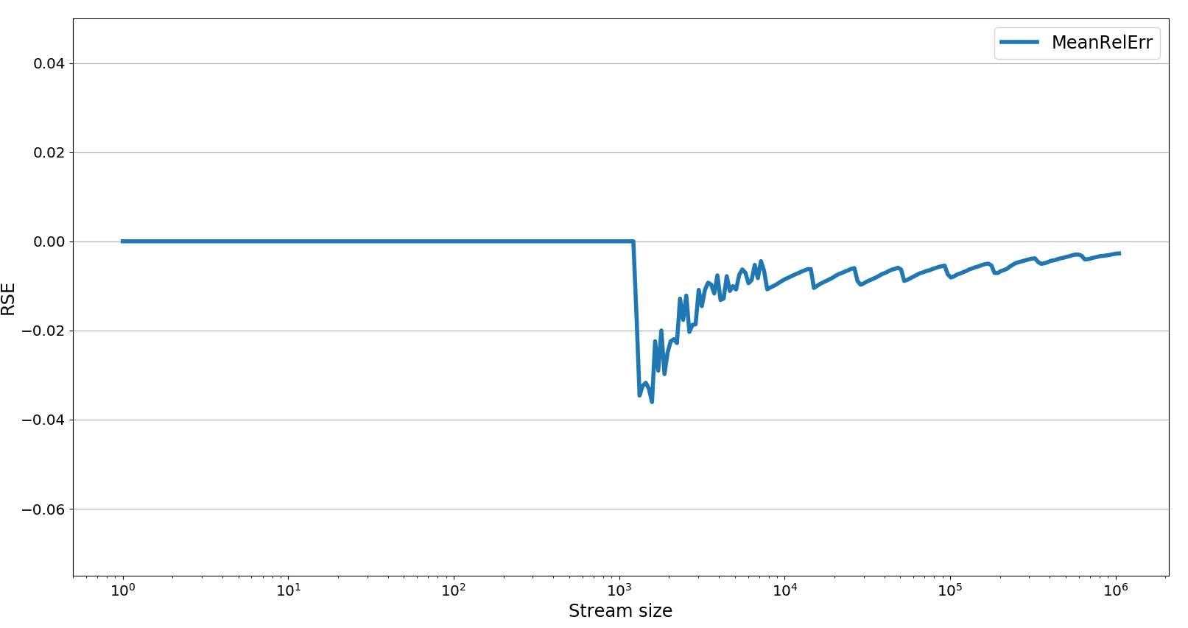
Empirical Evaluation

Slide 27
Summary: Concurrent Sketches
Generic solution based on composable sketches
Rigorous correctness proof using relaxed consistency
High ingestion throughput via concurrent updates
Harness multi-cores
Query freshness
Allow queries during updates
Ease-of-use
Library responsible for synchronization
Enjoy sketches’ benefits
Fast
Bounded estimation error
Small memory footprint
Now Available

