Slide 1
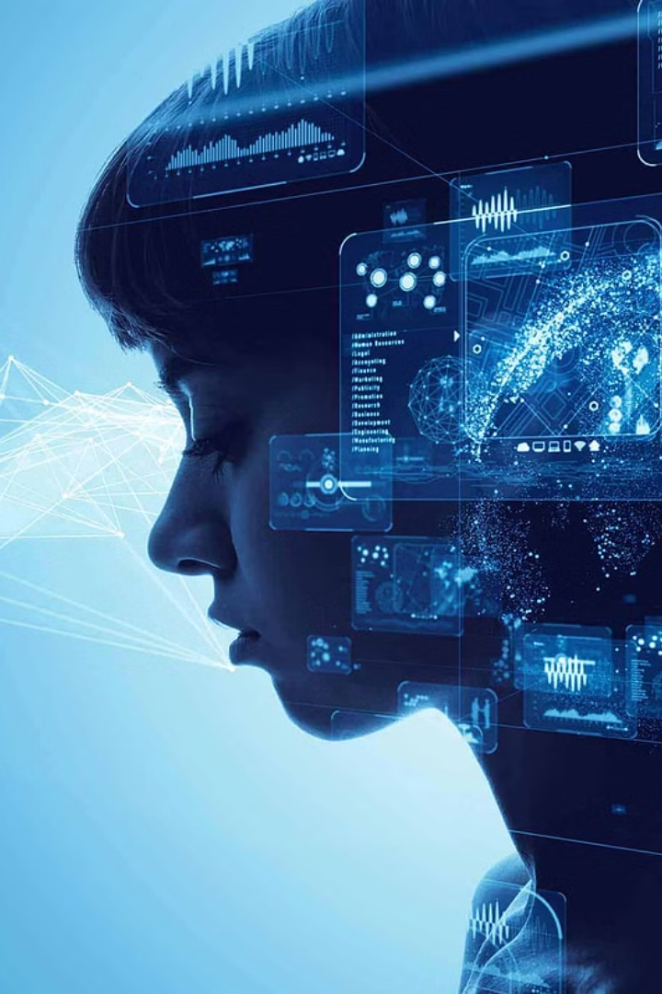
Welcome to Machine Learning Sessions

Slide 2
What is Machine Learning?
1
Subset of AI
Focuses on developing algorithms for systems to learn and make predictions.
2
Explicit Programming
Enables computers to learn without explicit programming.
3
Identifying Patterns
Uses algorithms to identify patterns, make decisions, and improve through experience.

Slide 3
Real-World Applications of ML
Healthcare
Finance
E-commerce and Retail
Applications include personalized medicine and better diagnosis.
Utilized for fraud detection and risk assessment.
Powers recommendation systems and optimizes pricing strategies.
Algorithms analyze large volumes of financial data.
Predictive models anticipate potential health issues.
Enhances inventory management and supply chain logistics.

Slide 4
ML in Transportation and Logistics
1
Optimizing Route Planning
2
Predictive Maintenance
3
Ride-sharing Platforms
Algorithms optimize route planning and vehicle scheduling.
Anticipates equipment failures and minimizes downtime.
Estimates ride fares and predicts demand.

Slide 5
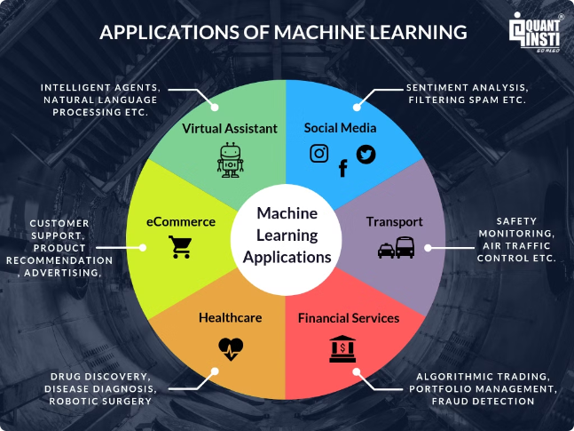



ML in Everyday Life
Email Filtering
ML algorithms power email spam filters.
Search Engines
Instrumental in ranking search results and understanding user intent.
Social Media Feeds
Employ ML to curate personalized feeds tailored to individual preferences.

Slide 6
Neglecting ML Advancement
Loss of Competitiveness
Ineffective Decision-Making
Limited Innovation
May hinder growth and prevent organizations from capitalizing on new market opportunities.
Organizations may lose their competitive edge in the market.
May lead to suboptimal decisions in critical fields.

Slide 7
Consequences of Neglecting ML
1
Security Vulnerabilities
2
Bias and Fairness Issues
3
Resource Inefficiencies
ML plays a crucial role in cybersecurity for threat detection.
ML algorithms can perpetuate biases present in training data.
ML algorithms can optimize resource allocation and energy consumption.

Slide 8
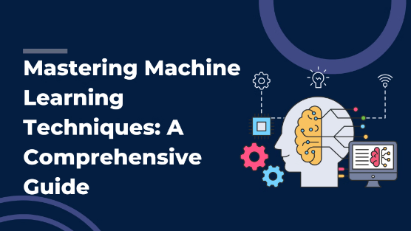
Mastering Machine Learning
1
Understanding Fundamentals
Build a solid understanding of key concepts and algorithms.
2
Learning Programming Languages
Acquire proficiency in Python and R, along with popular ML libraries.
3
Hands-on Practice
Gaining practical experience by working on projects and real-world datasets.

Slide 9



Strategic Roadmap for ML Mastery
Learning Programming
Data Analysis
Mastering Algorithms
Acquire proficiency in Python.
Learn techniques for data analysis and visualization.
Dive deep into various machine learning algorithms.

Slide 10
Integral Learning Objectives
Conceptual Understanding
Problem-solving Skills
Communication and Presentation
Develop a clear understanding of fundamental concepts.
Develop problem-solving skills by tackling real-world challenges.
Enhance communication skills to effectively communicate findings.

