Slide 1

Linear Regression
Linear Regression is a supervised learning algorithm in machine learning that supports finding the linear correlation among variables. The result or output of the regression problem is a real or continuous value.
Supervised learning involves training a model on a dataset that contains both input features and their corresponding output labels. In linear regression, the goal is to predict a continuous output variable based on one or more input features.

Slide 2
How can we use regression for a real life use case?
Linear regression is commonly used in many fields, including economics, finance, and social sciences, to analyze and predict trends in data.
Let's take some examples –
Predicting Wheat Production : Suppose if we have data of past 5-10 years on the quantity of wheat produced annually. With Linear regression, we will be able to predict what the wheat production would be this year or a year from now.
Health Monitoring for Heart Attack Risk : Linear regression can be utilized to analyze trends in blood pressure and sugar levels over time.
Natural Disaster Prediction : By analyzing seismic activity data, linear regression can provide insights into the probability of impending natural disasters like earthquakes or tsunamis.
Stock Market Forecasting : Linear regression can be applied to analyze historical stock data and predict the movement of stock prices in the future.

Slide 3
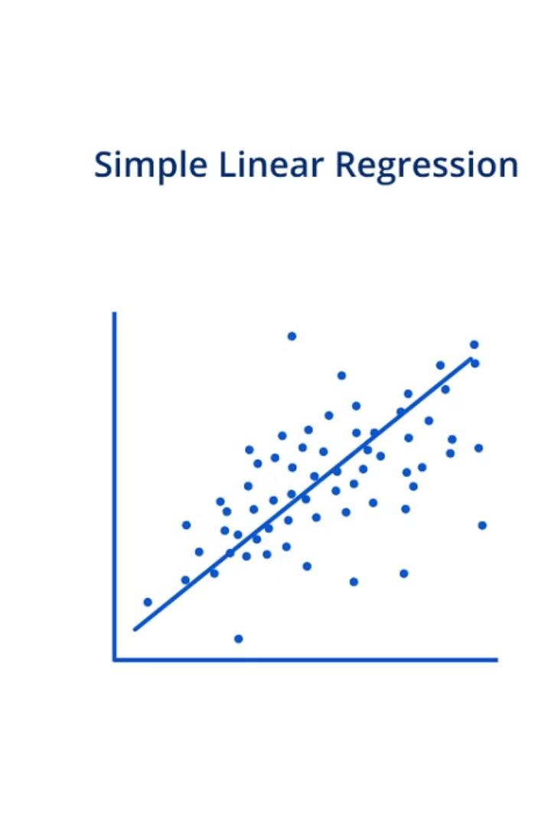
Simple Linear Regression
In a simple linear regression, there is only one independent variable and one dependent variable. It assumes that there is a linear relationship between the independent and dependent variables.

Slide 4
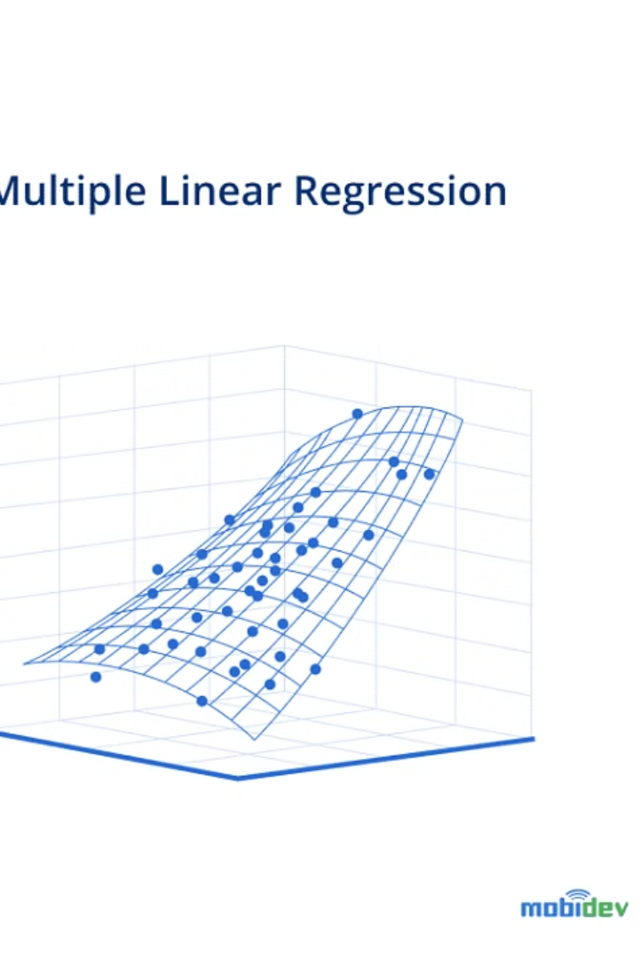
Multiple Linear Regression
In multiple linear regression there are multiple independent variables and one dependent variable. It assumes that there is a linear relationship between the dependent variable and each of the independent variables.

Slide 5
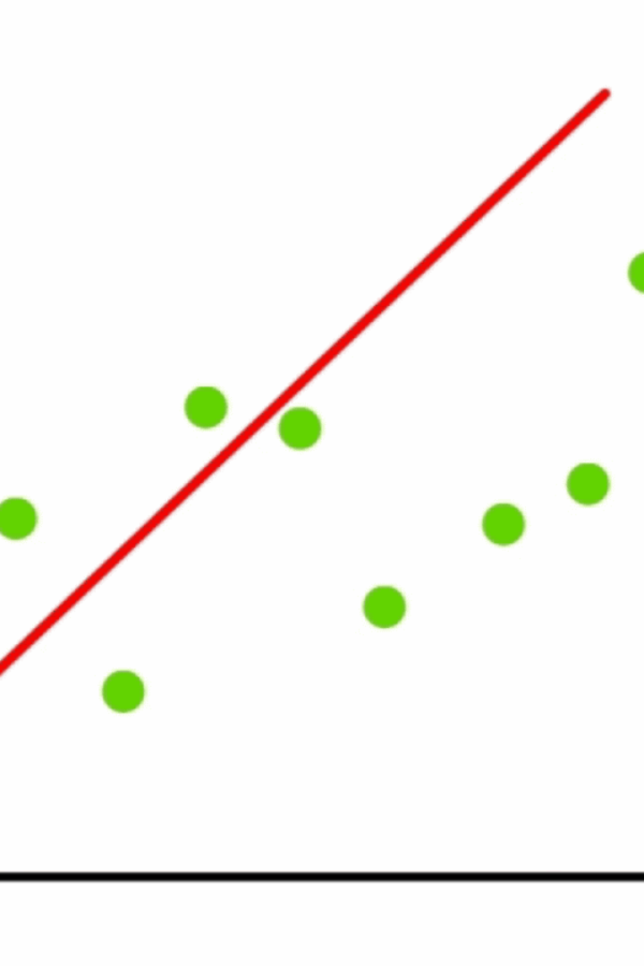
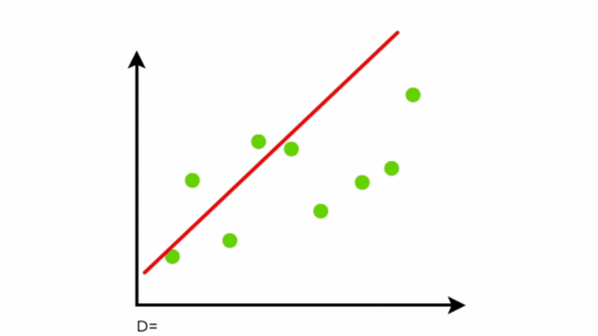
Working of Linear Regression!
Linear regression shows the linear relationship between the independent(predictor) variable i.e. X-axis and the dependent(output) variable i.e. Y-axis,
The red line is referred to as the best-fit straight line. Based on the given data points, we attempt to plot a line that fits the points the best.
To calculate best-fit line linear regression uses a traditional slope-intercept form which is given below,
Y = mx+c
Where Y =Dependent variable, c = constant/Intercept,
m = Slope/Intercept, X = Independent variable.
The goal of the linear regression algorithm is to get the best values for m and c to find the best fit line. The best fit line is a line that has the least error which means the error between predicted values and actual values should be minimum.

Slide 6
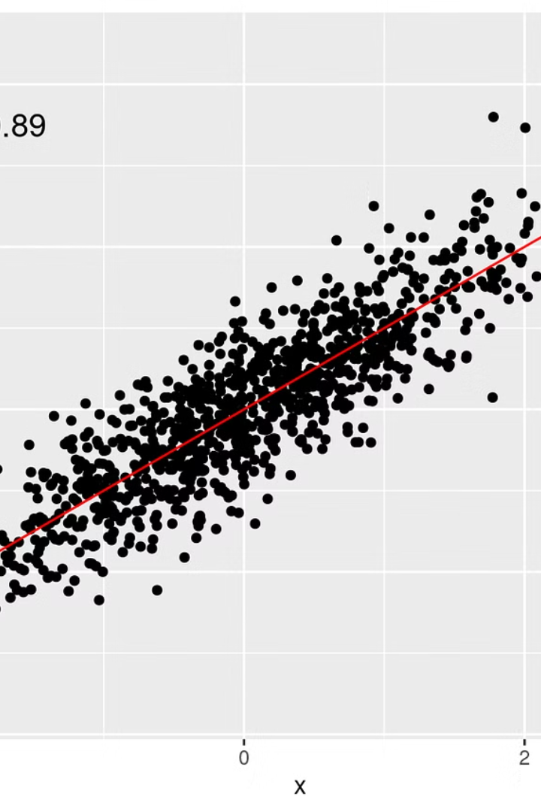
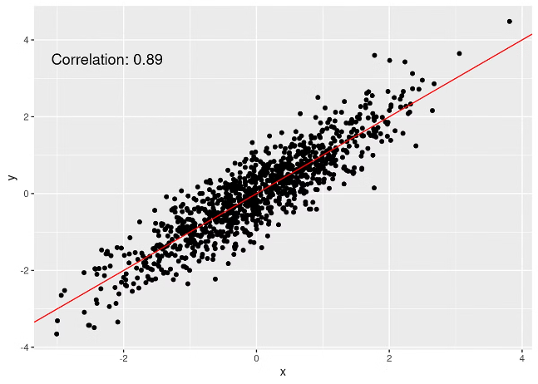
Regression Error Metrics
If all data points form a perfect linear line, we can derive an exact output (prediction) we are looking. But, in the real world, this is not the case. The data points do not exactly form a line. They are a bit scattered on the graph. Then, we make a line in such way that its at a least possible distance from the points as shown below:

Slide 7
Residuals and Model Evaluation
Linear regression tries to fit a line that produces the smallest difference between predicted and actual values, where these differences are unbiased as well. This difference or error is also known as residual. (Unbiased means there is no systematic pattern of distribution of the predicted values)
Residual = actual value — predicted value
e = y — ŷ
We can calculate the residual for every point in our data set, and each of these residuals will be of use in assessment. These residuals will play a significant role in judging the usefulness of a model.

Slide 8
Evaluation Metrics for a Linear Regression Model
R Square/Adjusted R Square
Mean Square Error (MSE)
Root Mean Square Error (RMSE)
Mean Absolute Error (MAE)

Slide 9
Regression Error Metrics
Mean Squared Error (MSE) - The most common metric for regression tasks is MSE. It is the average of the squared difference between the predicted and actual value. Since it is differentiable and has a convex shape, it is easier to optimize.
Root Mean Squared Error (RMSE) - This is the square root of the average of the squared difference of the predicted and actual value.
Mean Absolute Error(MAE) - MAE is a very simple metric which calculates the average of the absolute difference between the target value and the value predicted by the model. Not preferred in cases where outliers are prominent.
R2 Score (R2) - R2 score is a metric that tells the performance of your model, not the loss in an absolute sense that how many wells did your model perform. Basically R2 score calculates how much regression line is better than a mean line.

