Slide 1


Project Fortofolio
Machine Learning Classification of Iris Data Using Naive Bayes
Arika Norma Wahyu Dorroty
DFS 35.0 | January 2025

Slide 2
Data Source
Datasets that have been provided in Scikit-learn. Can be accessed at the link :
https://scikit-learn.org/1.5/datasets/toy_dataset.html

Slide 3
Introduction Data Iris
The famous Iris database, first used by Sir R.A. Fisher. The dataset is taken from Fisher’s paper. Note that it’s the same as in R, but not as in the UCI Machine Learning Repository, which has two wrong data points. This is perhaps the best known database to be found in the pattern recognition literature. Fisher’s paper is a classic in the field and is referenced frequently to this day. (See Duda & Hart, for example.) The data set contains 3 classes of 50 instances each, where each class refers to a type of iris plant. One class is linearly separable from the other 2; the latter are NOT linearly separable from each other.
Data Set Characteristics:
Number of Instances : 150 (50 in each of three classes)
Number of Attributes : 4 numeric, predictive attributes and the class
Attribute Information : sepal length in cm, sepal width in cm, petal length in cm, petal width in cm
class : Iris-Setosa, Iris-Versicolour, Iris-Virginica

Slide 4
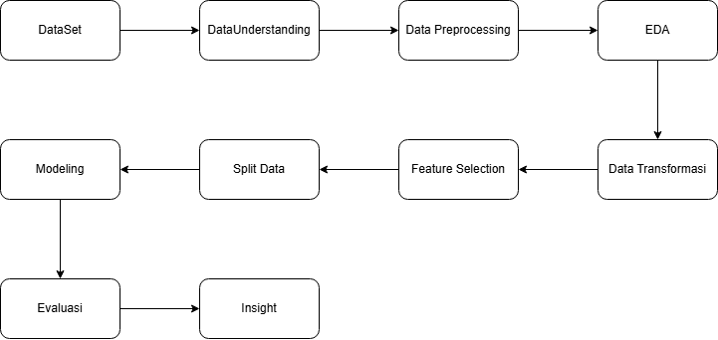
Research Methods

Slide 5
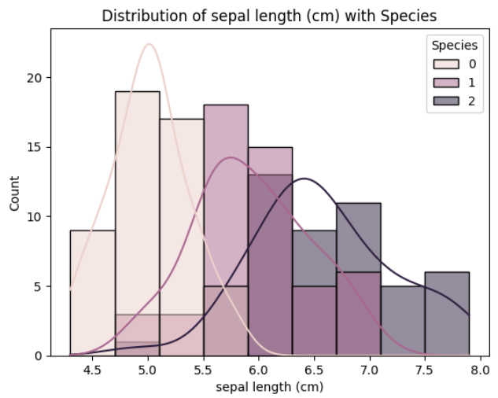
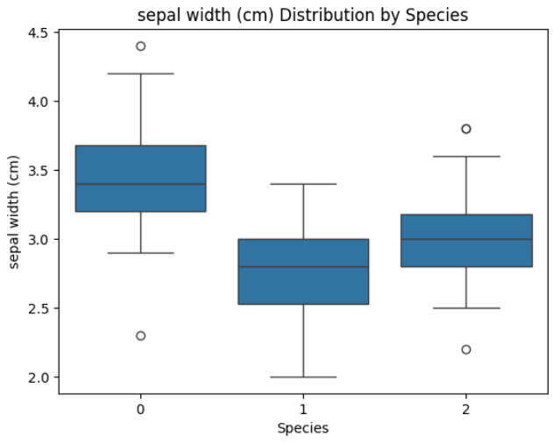

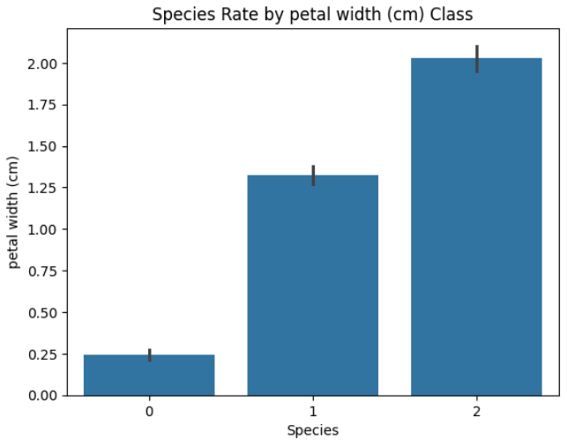
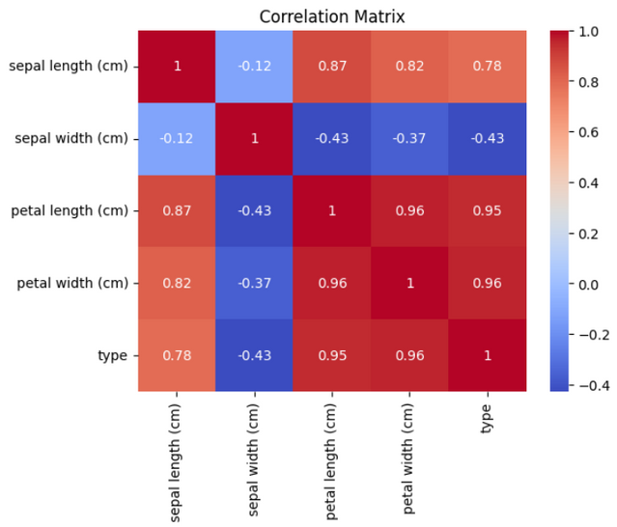
Results and Discussion
EDA

Slide 6



Results and Discussion
Evaluasi

Slide 7

Results and Discussion
Insight results draw conclusions from the EDA and Evaluation processes on machine learning classification with the naive bayes model.
The EDA results show the distribution using histoplot, boxplot, standard deviation, and correlation matrix.
The histoplot shows the distribution of shank length by species which shows that species 0 is higher than the other species.
The boxplot shows the distribution with outliers between sepai length and species resulting in species 1 having no outliers.
The histoplot with standard deviation shows results with better variation in the species 0 class.
The correlation matrix shows the relationship between columns in the data.
The evaluation results show that the performance of the naive bayes model is quite good with a score of 100%.
Insight

Slide 8
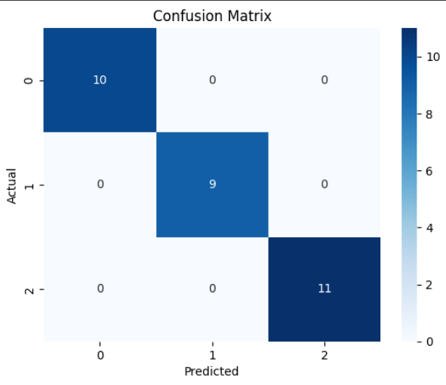
Conclusion
The conclusion results are shown with the confusion matrix as a visualization for actual data and predicted data on iris data. the conclusion of the classification results carried out that there is no wrong classification in class (0,1,2). besides that the model performs well in predicting with 100%.

Slide 9
Thank you
www.linkedin.com/in/arikanwd

