Slide 1
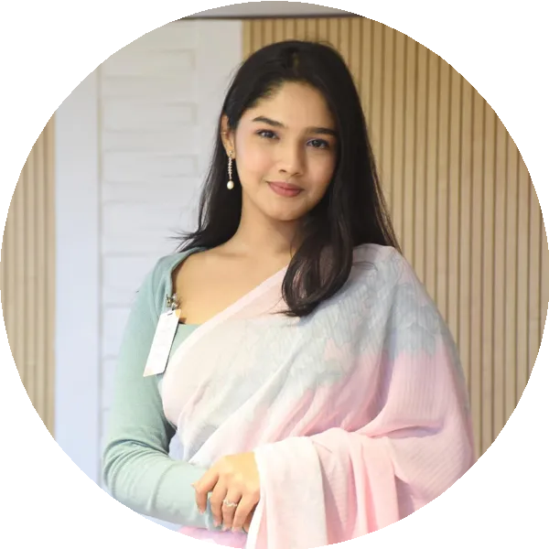
ARIN KHONDOKAR
arinkhondokar@gmail.com
+8801873228843
House - 4, Road - 1, Kallyanpur, Dhaka - 1216, Bangladesh
PROFILE
I have experience in working with International Organizations, Local businesses as well as different markets as I have been an Entrepreneur myself. I believe, I can fill in any position that needs human interaction.
Knowledgeable employee with experience gathering research information from print, online and direct sources. Obtains best possible interview responses by recruiting relevant subjects and preparing interview questions. Keeps up to date with new and updated research protocols. Motivated and hardworking student with excellent study skills and strong academic record. Applies education and personal talents to learn new subjects in detail and take on demanding assignments. Collaborates well on group projects and prepares diligently for presentations. Energetic and driven team player committed to assisting smooth running research projects. Works hard to review various sources to gather relevant information. Skilled at summarizing data, results and implications in clear and detailed reports. Organized research team member with background in report writing, information gathering and presentation preparation. Friendly, open and hardworking team player. Uses honed organization skills to set up and maintain accessible and easy-to-use research databases. Hardworking and passionate job seeker with strong organizational skills eager to secure entry-level corporate position. Ready to help team achieve company goals.
EDUCATION
May 2021 – May 2022
Dhaka, Bangladesh
EarthHouse International School,
General Certificate Of Secondary Education (GCSEs) Commerce ( Economics, Business and Accounting )
EarthHouse International School, Secondary Education Senior Secondary School Certificate (SSCE)
January 2020 –
June 2020
Dhaka, Bangladesh
January 2011 –
December 2019 Dhaka, Bangladesh
September 2022 – present
Dhaka, Bangladesh
Seabreeze International School, Primary Education First School Leaving Certificate (FSLC)
Independent University Bangladesh, INTERNATIONAL BUSINESS BBA

Slide 2
PROFESSIONAL EXPERIENCE
September 2023 – present
Dhaka, Bangladesh
Dr Razib Hayat Kahn, Research Assistant
Provided access to experimental data for faculty researcher or supervisor.
Created presentation slides and posters to help researchers present findings.
Wrote reports to summerise data and implications of results. Maintained accurate records of interviews, ethically maintaining confidentiality of subjects.
Prepared interview questions and recruited subjects to obtain best possible responses.
House Of Youth Dialogue (HYD), Head Of Marketing
I started working for HYD back in 2021 as a general memberKingdom and earned my way up to the head of their marketing department.
Trained over 50 staff members in the organization best practices, boosting website ranking by 10 spots.
Launched successful print and digital campaigns worth 1 million+ with aligned messaging across all channels.
Developed strategic partnerships with influencers and complementary brands. Consistently met campaign goals by developing clear, effective design briefs and providing creative guidance.
Improved social media presence, adding 10,000 followers on Instagram by creating contest promotion strategy.
Zaaya's Clothing Brand, Entrepreneur
Determined business plan, mission statement and vision.
Set company culture, facilitated communication and build cohesion between team members.
Sourced initial funding to get business off the ground.
Established business goals and objectives to provide organizational direction toward growth and prosperity.
Western Holidays Ltd., Management Trainee
Increased knowledge of company policies, protocols and processes proactively.
Participated in management meetings, workshops and other learning opportunities.
Created and gave presentations on various topics to senior management.
Promoted new ways of working and helped facilitate change across all company levels.
Supported management team with budget allocation and other daily tasks.
June 2021 – present London, UK
November 2020 – present
Dhaka, Bangladesh
January 2022 –
December 2022 Dhaka, Bangladesh

Slide 3
June 2019 –
January 2020 Kolkata, India
Indo-Bangla Friendship Forum, Executive Member
Worked as their representative in their India-Bangladesh programme here in Dhaka,Bangladesh.
Directed staffing requirements, managed priorities and coordinated workflows to uphold productivity objectives.
Offered expertise and guidance in public relations while supervising management team.
Guided company progress by defining, establishing and implementing organizational goals, policies and procedures.
Provided customers with outstanding service, extending relationships for future business opportunities.
Corpnatter BD, Executive Officer
Generated new ideas for their social ventures. Designed TV and print advertising campaigns.
Explored new marketing and branding partnerships with high-profile clients, enhancing company reach.
Realized greater team efficiency and effectiveness to continue significant year-on- year revenue growth.
January 2019 –
January 2020 Dhaka, Bangladesh
INTERESTS
Travelling Dancing
SKILLS
Shopping
Movies
Communication Leadership Digital Marketing
Office Skills (Word, Excel, Powerpoint, GITHUB, etc)
Time Management

