Slide 1
ML Ops Course Content
Datacamp

Slide 2
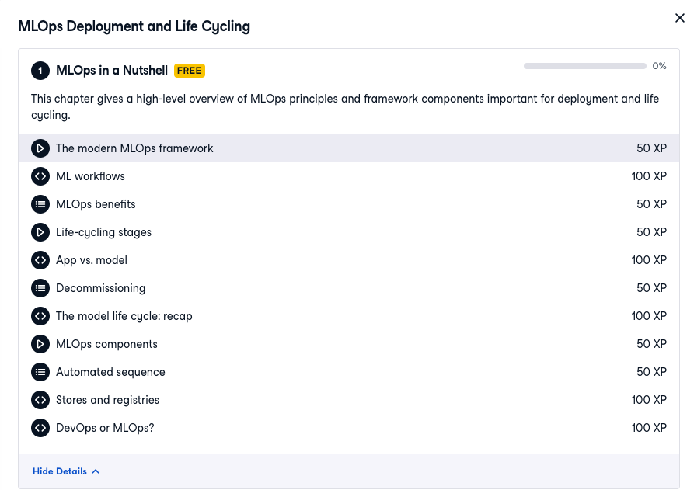

Slide 3
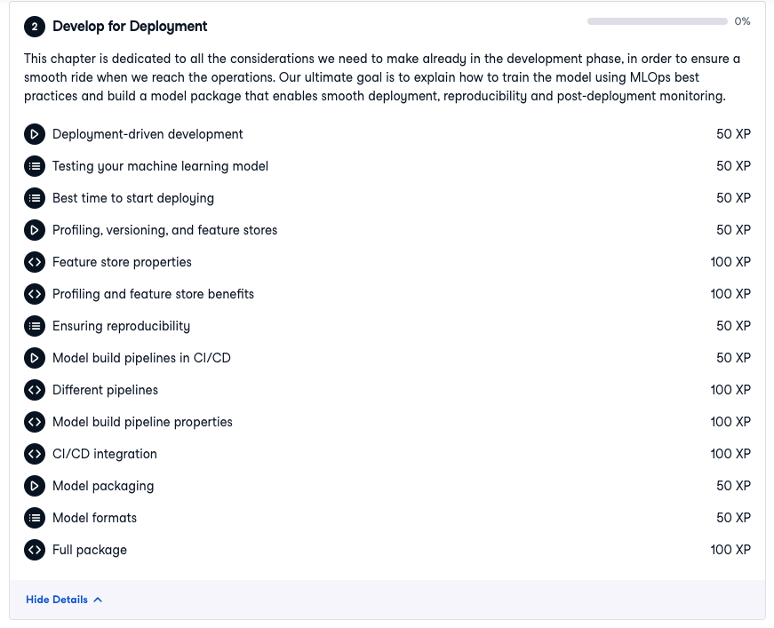

Slide 4
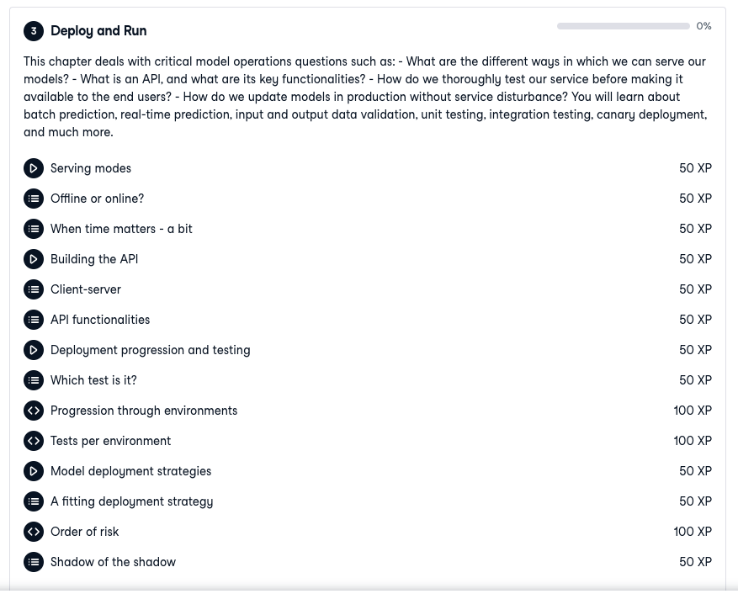

Slide 5
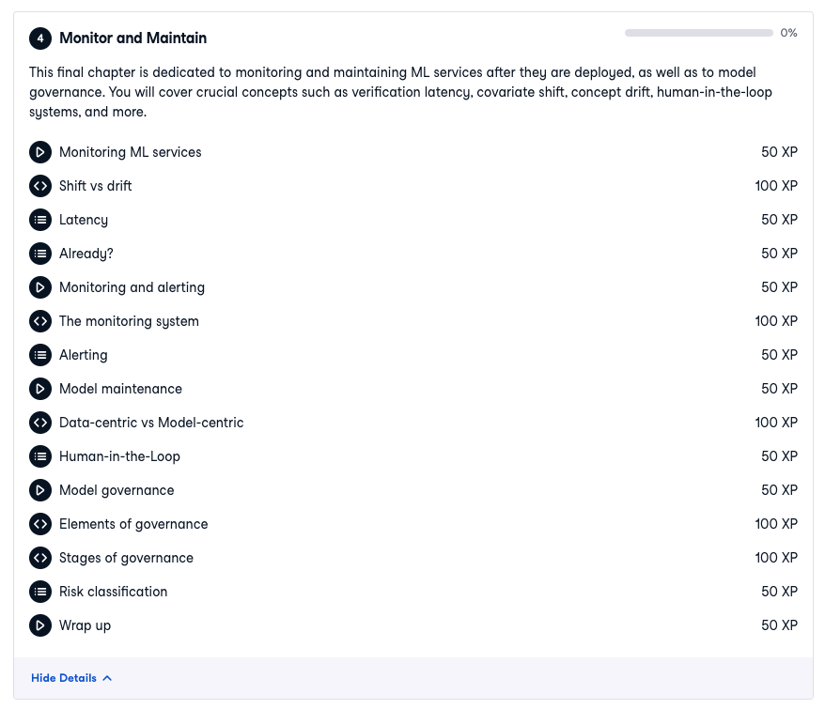

Slide 6
ML Ops Course Content
Udemy

Slide 7
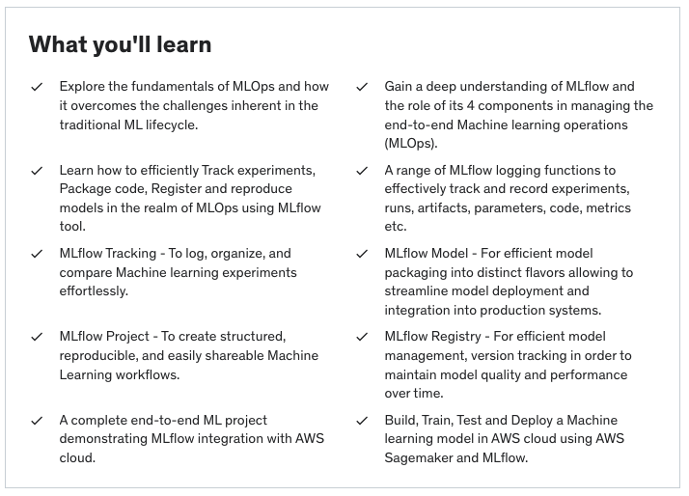
ML Ops Course Content

Slide 8
ML Model Deployment Course Content
Udemy

Slide 9
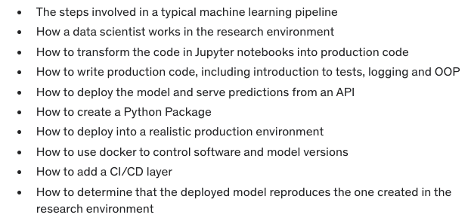
ML Model Deployment Course Content
What you will learn:

Slide 10
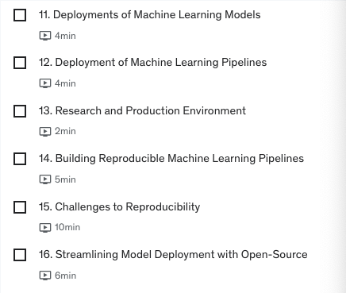
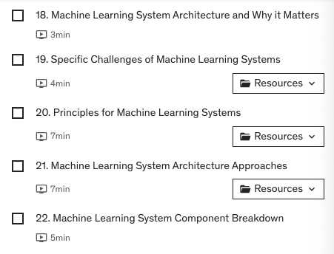
Overview of Model Deployment
ML System Architecture

Slide 11
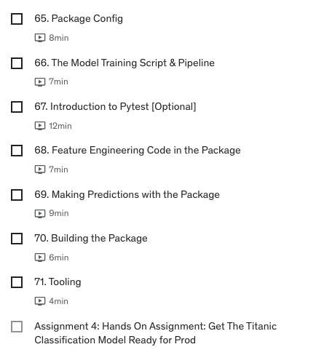
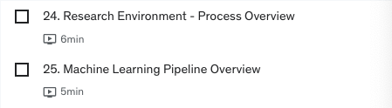
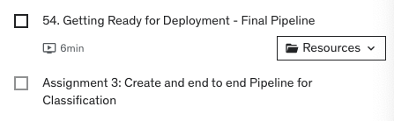
Research Environment – Developing a ML Model
Packaging ML Model for Production

Slide 12
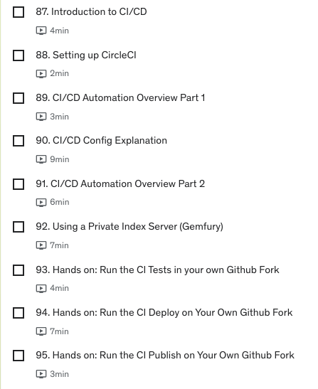
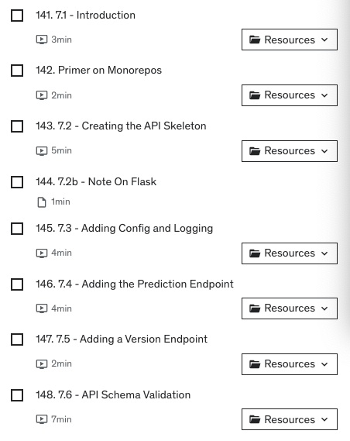
Continuous Integration and Deployment Pipeline
Serving ML Model via REST API

