Slide 1
Real estate Analysis
Home Sales in King County, WA, 2014-2015
Arina Karpova & Sara Morcillo

Slide 2
‘Economic is empowerment’
We need more Real State Transparency to become self-supporting.

Slide 3
Home Sales in King County, WA
King County is located in the U.S. state of Washington.
It is the most populous county in WA (with a population 2,269,675),^{[1]} and the 13th-most populous in the United States.
The county seat is Seattle,^{[2]} also the state's most populous city.
It is one of the most educationally advanced counties in the nation and approximately half of its population has a college degree.

Slide 4
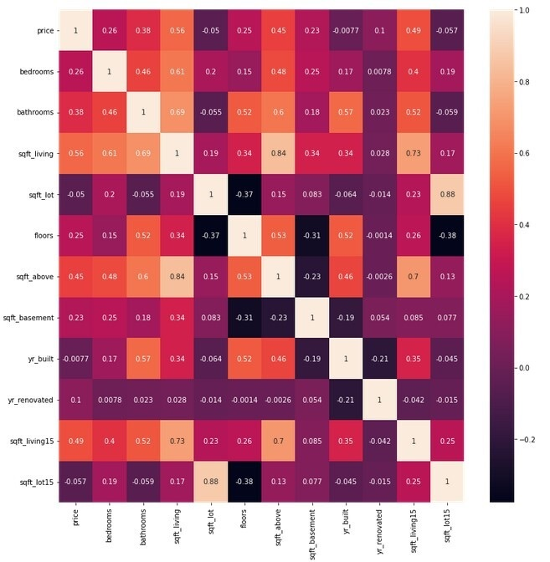

Data Set Introduction
Observations = 21,613
Variables = 21
Years = 2014-2015
Features
Correlation heatmap:
Sqft_lot &sqft_lot_15 and sqft_living & sqft_above are considered to be highly correlated as their coefficients are above 0.7

Slide 5
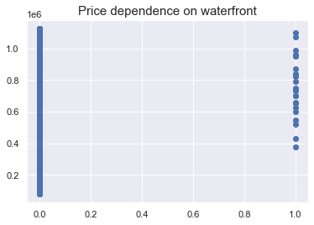
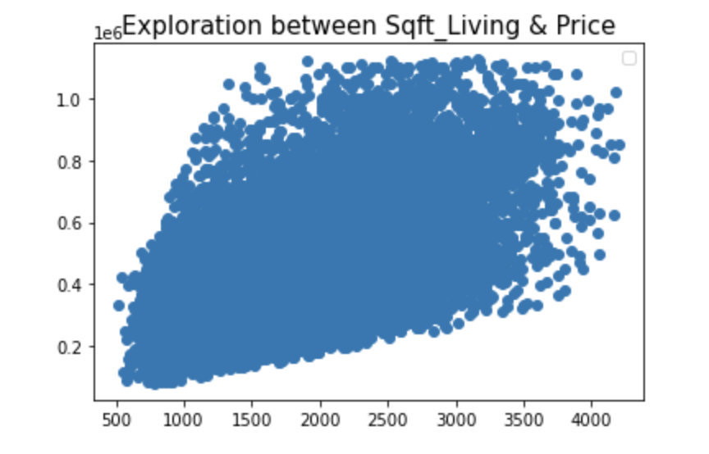
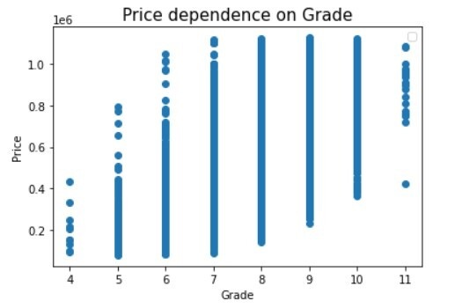
Plotting descriptive data
Price is highly dependent on sqft_living
Price is depending on Grade (quality of materials)
Year of construction by price shows a large dispersion of observations, but there is still a relation with the year of construction.
The are not so many houses with waterfront view but houses that have it are more expensive
New properties are priced higher
Focus in the next slide

Slide 6
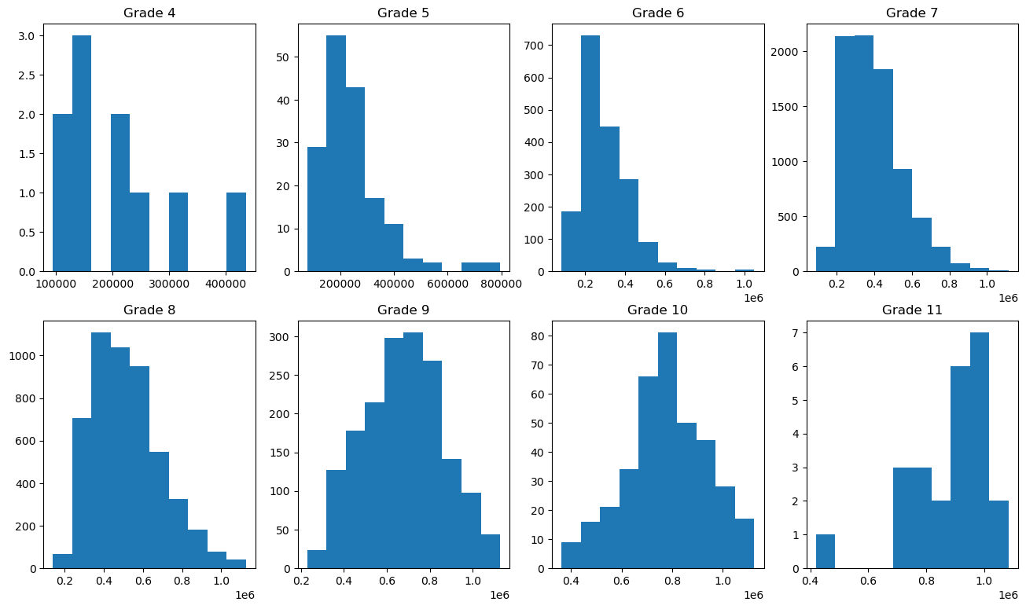
Plotting descriptive data
The distribution of prices is highly dependent on grades
Lower grades generally exhibit lower average prices

Slide 7
Predictive Model
Dropped 6 columns and encoding 3
Cleaning
- Lat, Long: we don’t need it because Zip Code provides better information .
- Id
- Date: there is no difference in price between 2014-2015
- Year renovated: because it is unimodal variable(only few houses were renovated).
- Sqft_lot: because it is highly correlated with sqft_lot_15 .
- Sqft_above: because it is in high correlation with sqft_living
Feature transformation
Binary encode: ZIP
Binary encode: Sqft basement
Label encode: Floors
Label encode: Condition

Slide 8
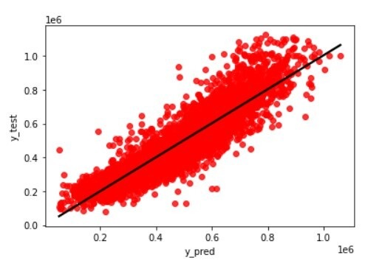
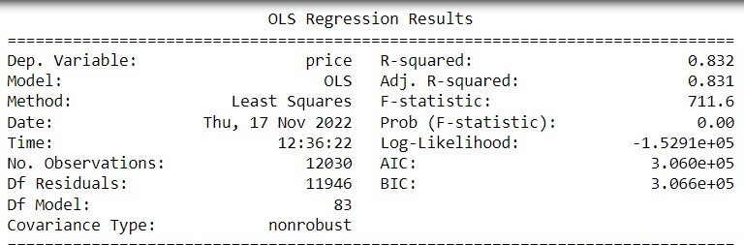
Accuracy
R2: 0.832
Our model is able to account approx. 83% of the variation in sales price of a property.
MAE = 58.845 $

Slide 9
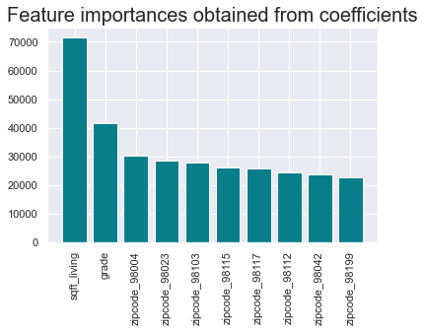
Sqft & location
Creating our model, we discovered that the size of property and the location are two most important factors that impact the price .
Encoding Zipcode has significantly improved our model.

Slide 10
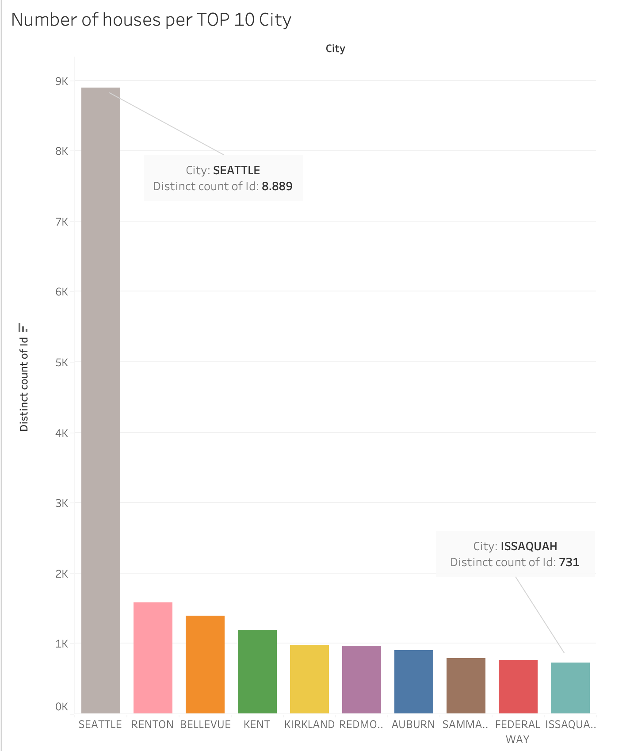

Number of sales houses for each City. The view is filtered on Top 10 City.

Slide 11
Price variation across region
Medina Avg. price

Slide 12


