Slide 1
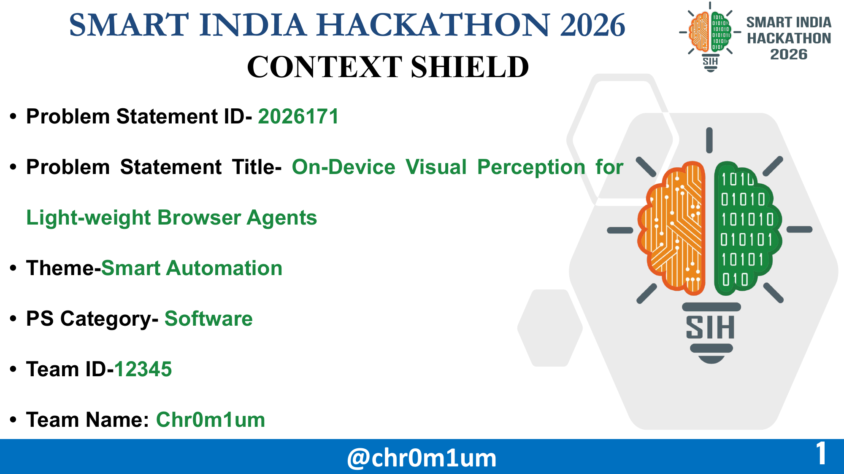


SIH26171
@chr0m1um
1
Notes:
Opening: Browser agents are useful only when users can trust what leaves their device.
Introduce ContextShield as a privacy-preserving browser agent boundary built by Chr0m1um.

Slide 2

CONTEXT SHIELD
Browser assistance with local perception and explicit control
THE PROBLEM
THE PRIVACY BOUNDARY
Useful context can expose
private information.
ON DEVICE | PLANNER CONTEXT
Email in the local vault traveller@example.test | Opaque reference LOCAL_EMAIL_…
Detected sensitive text or face pixels | Masked or omitted
Useful fares and controls | Safe labels + element IDs
Raw credentials / cookies | Excluded from context
Raw screens may contain identities and credentials. Untrusted page content can also redirect an agent’s actions [5,6].
OUR APPROACH
Read the screen locally.
Send sanitized context for planning.
Check permission before private actions.
Illustrative example with synthetic data and abbreviated handles.
This explains the design, not an observed network trace.
Every private fill needs one-use approval for an exact destination and field.
Approval releases a value only to the named webpage.
That webpage can then read it.
@chr0m1um
2
Notes:
ContextShield combines on-device visual processing with a checked execution boundary. The first boundary limits what the planner receives. The second controls when private values may enter a webpage. The native table is an illustrative synthetic example derived from the current schema and demo profile, not a captured network request. Opaque handles are abbreviated; the local demo profile uses traveller@example.test. A handle does not grant authority to read the underlying value. The protected fill requires extension-UI consent scoped to the current destination, field, action and page. Approved webpages can read or transmit inserted data. These design claims do not establish complete privacy coverage or universal prompt-injection prevention.
Contribution: integrating local visual/privacy processing with the same private-value release gate for model and local-controller proposals, plus separately verifiable event integrity. Comparative superiority over simpler agents remains to be measured.
Implementation evidence: https://github.com/Arindam636-prog/chr0m1um/blob/main/docs/RAILWAY-VALIDATION.md
Demo scope: https://github.com/Arindam636-prog/chr0m1um/blob/main/docs/RAILWAY-DEMO.md
Validation date: 18 September 2026.
[5] Edoardo Debenedetti, Jie Zhang, Mislav Balunović, Luca Beurer-Kellner, Marc Fischer and Florian Tramèr. AgentDojo: A Dynamic Environment to Evaluate Prompt Injection Attacks and Defenses for LLM Agents. NeurIPS 2024, Datasets and Benchmarks Track. DOI:10.52202/079017-2636.
https://proceedings.neurips.cc/paper_files/paper/2024/hash/97091a5177d8dc64b1da8bf3e1f6fb54-Abstract-Datasets_and_Benchmarks_Track.html
Scope: Published evidence that untrusted tool output can redirect tool-using agents and that utility and security need joint evaluation. ContextShield has not run AgentDojo.
[6] Qiusi Zhan, Zhixiang Liang, Zifan Ying and Daniel Kang. InjecAgent: Benchmarking Indirect Prompt Injections in Tool-Integrated Large Language Model Agents. Findings of ACL 2024, pp. 10471–10506. DOI:10.18653/v1/2024.findings-acl.624.
https://aclanthology.org/2024.findings-acl.624/
Scope: Supports the indirect-injection and exfiltration threat model. Its published attack results must not be represented as ContextShield results. ContextShield has not run InjecAgent.
[7] Jerome H. Saltzer and Michael D. Schroeder. The Protection of Information in Computer Systems. Proceedings of the IEEE 63(9), pp. 1278–1308, 1975. DOI:10.1109/PROC.1975.9939.
https://www.mit.edu/~Saltzer/publications/protection/index.html
Scope: Foundational principles include fail-safe defaults, complete mediation and least privilege. The mapping to our one-use private-fill gate is our engineering interpretation, not a formal security proof from this paper.
[8] Bruce Schneier and John Kelsey. Secure Audit Logs to Support Computer Forensics. ACM Transactions on Information and System Security, 1999. Author-hosted paper: https://www.schneier.com/wp-content/uploads/2016/02/paper-auditlogs.pdf.
https://www.schneier.com/academic/archives/1999/05/secure_audit_logs_to.html
Scope: Related work on detecting log modification and the importance of trust assumptions. Our SHA-256 chain and ephemeral ECDSA checkpoint do not implement this paper’s full forward-secure protocol, remote trust or compromise guarantees.

Slide 3










TECHNICAL APPROACH
ON-DEVICE TRUST ZONE
SERVER PLANNER
1 CAPTURE
2 PERCEIVE
3 PROTECT
4 REASON [3]
DOM, accessibility data
and visible pixels
YOLOX faces [1]
PP-OCR text [2]
Rampart contextual PII
Mask detected secrets.
Use LOCAL_* references.
Keep raw values locally.
Qwen compares sanitized
fares and proposes
a structured action.
OUTBOUND: sanitized task, safe elements and opaque handles
RETURN:
proposed
action only
7 VERIFY
6 EXECUTE
5 AUTHORIZE [7]
Observe the page again.
Confirm the expected change.
Stop safely on mismatch.
Resolve the approved value.
Fill only the authorized field.
Check field, origin and page.
Require one-use consent
before private-value release.
The server cannot
authorize a private fill.
8 AUDIT [8] Hash-link non-secret events and sign a checkpoint.
Chrome + Firefox
WXT + TypeScript
ONNX Runtime Web
YOLOX + PP-OCR
Rampart
FastAPI
Qwen3-VL
Browser extension
UI & content scripts
Local inference
Vision & OCR
Contextual PII
Strict gateway API
Open-weights planner
Signed local ledger: SHA-256 + ECDSA P-256. No credentials in blocks. Gate enforcement and audit are separate.
@chr0m1um
3
Notes:
The vertical divider is the device/server boundary. Capture, perception, protection, authorization, execution, verification and the action ledger all run on the device. The only server step is Qwen planning. Sanitized context leaves the device and a typed proposed action returns. The gate rechecks the destination and requires one-use approval before resolving a private value. It binds consent to the run, tab, document, origin, target, field type, task purpose, complete action and observed state. Live checks happen before release and again before insertion.
The source model assets are YOLOX face-only and PP-OCRv6 tiny, run through ONNX Runtime Web, plus local Rampart contextual PII. General visual UI understanding and detector accuracy are not established by the model-family references. Chrome was exercised; Firefox was built but not runtime-tested.
Railway-assisted mode uses Qwen for comparing sanitized fare buttons and a declared local adapter for other prepared screens. Both use this gate. Rehearsal is deterministic and DOM-only, with no Qwen, OCR or face inference. Full local visual privacy processing remains enabled in assisted mode.
Audit records allowed, blocked and execution events at their actual boundaries, not only at the end. Web Crypto SHA-256 chains non-secret event records. An ephemeral ECDSA P-256 key signs the session/count/head checkpoint. The log is not a distributed blockchain and does not identify malicious prompts by itself. A separately trusted retained checkpoint is required to detect wholesale log replacement or truncation. An attacker controlling the extension/device is outside this guarantee.
Additional implementation sources: extension/lib/security/privateFillGate.ts, extension/lib/security/actionLedger.ts, extension/lib/vault/secretVault.ts, extension/lib/actions/broker.ts, extension/public/models/README.md and extension/lib/agent/railwayRehearsal.ts in the local contextshield project.
Implementation evidence: https://github.com/Arindam636-prog/chr0m1um/blob/main/docs/RAILWAY-VALIDATION.md
Demo scope: https://github.com/Arindam636-prog/chr0m1um/blob/main/docs/RAILWAY-DEMO.md
Validation date: 18 September 2026.
[1] Zheng Ge, Songtao Liu, Feng Wang, Zeming Li and Jian Sun. YOLOX: Exceeding YOLO Series in 2021. arXiv:2107.08430, 2021.
https://arxiv.org/abs/2107.08430
Scope: Architecture-family reference. The paper reports general object detection, not privacy protection or our face-checkpoint accuracy.
[2] Yuning Du et al. PP-OCR: A Practical Ultra Lightweight OCR System. arXiv:2009.09941, 2020.
https://arxiv.org/abs/2009.09941
Scope: Historical OCR-family reference, not the source of the shipped PP-OCRv6 benchmark or model weights. The current pinned v6 assets and hashes are documented separately in the local model README.
[3] Shuai Bai et al. Qwen3-VL Technical Report. arXiv:2511.21631, 2025.
https://arxiv.org/abs/2511.21631
Scope: Background on the model family, not evidence that Qwen enforces our privacy policy or completes our railway task autonomously.
[7] Jerome H. Saltzer and Michael D. Schroeder. The Protection of Information in Computer Systems. Proceedings of the IEEE 63(9), pp. 1278–1308, 1975. DOI:10.1109/PROC.1975.9939.
https://www.mit.edu/~Saltzer/publications/protection/index.html
Scope: Foundational principles include fail-safe defaults, complete mediation and least privilege. The mapping to our one-use private-fill gate is our engineering interpretation, not a formal security proof from this paper.
[8] Bruce Schneier and John Kelsey. Secure Audit Logs to Support Computer Forensics. ACM Transactions on Information and System Security, 1999. Author-hosted paper: https://www.schneier.com/wp-content/uploads/2016/02/paper-auditlogs.pdf.
https://www.schneier.com/academic/archives/1999/05/secure_audit_logs_to.html
Scope: Related work on detecting log modification and the importance of trust assumptions. Our SHA-256 chain and ephemeral ECDSA checkpoint do not implement this paper’s full forward-secure protocol, remote trust or compromise guarantees.

Slide 4
FEASIBILITY AND VIABILITY
Working prototype with a defined validation path
WORKING TODAY
NEXT VALIDATION
Chrome extension + local inference
EVALUATION AREA | MEASUREMENT PLAN
Visual understanding | Annotated screenshots and visual-only tasks
PII detection | Precision / recall on unseen labelled data
Redaction quality | Sensitive regions missed and safe content retained
Client resources | Incremental RAM / CPU and cold / warm inference
End-to-end latency | Median / p95, task success and failures reported
DOM, face detection, OCR and PII filtering run on the device.
Qwen-assisted railway workflow
Qwen chooses fares. A local adapter handles the remaining known screens.
Permission checks and audit
Plans share one private-fill gate. A signed checkpoint anchors the event chain.
BEFORE WIDER DEPLOYMENT
Same tasks and hardware: DOM-only baseline versus full local perception. Report added utility and privacy cost.
Resolve dependency findings. Test Firefox, unseen pages and worker restarts. Audit network traffic and retain checkpoints independently.
Planned evaluation [4–6]. No benchmark score is claimed.
@chr0m1um
4
Notes:
The feasibility claims are supported by the dated local v1.5 validation report. The table is an evaluation plan and intentionally contains no invented result. Scope the held-out set before tuning and retain its annotations separately. Use the same browser, model version, hardware and task budget for each baseline. Compare DOM-only observations with full local perception on visual tasks as well as ordinary pages. For PII, count false positives and false negatives with fixed definitions. For redaction, measure undetected sensitive regions separately from mask rendering and quantify useful content retained. Report incremental memory and CPU over the browser-only baseline, plus cold and warm inference. For task latency report median and p95 with sample size, completion rate, failure counts, and the treatment of human consent time. Do not mix deterministic rehearsal durations with model-assisted task latency.
Security evaluation additionally needs attack-success rates and benign-task acceptance, not merely blocked attack counts. VisualWebArena, AgentDojo and InjecAgent are candidate external evaluations; none has been run on this product.
Remaining product work includes dependency advisories (the existing validation records four high-severity entries whose browser reachability is unestablished), Firefox runtime acceptance, worker suspension, unseen-site behavior, full egress capture and independently retained ledger checkpoints. Consent discloses data to the approved site; the site must itself be trusted. The demo is not a production deployment.
Implementation evidence: https://github.com/Arindam636-prog/chr0m1um/blob/main/docs/RAILWAY-VALIDATION.md
Demo scope: https://github.com/Arindam636-prog/chr0m1um/blob/main/docs/RAILWAY-DEMO.md
Validation date: 18 September 2026.
[4] Jing Yu Koh et al. VisualWebArena: Evaluating Multimodal Agents on Realistic Visual Web Tasks. ACL 2024, pp. 881–905. DOI:10.18653/v1/2024.acl-long.50.
https://aclanthology.org/2024.acl-long.50/
Scope: Provides motivation for multimodal observation and a future external evaluation framework. ContextShield has not run this benchmark.
[5] Edoardo Debenedetti, Jie Zhang, Mislav Balunović, Luca Beurer-Kellner, Marc Fischer and Florian Tramèr. AgentDojo: A Dynamic Environment to Evaluate Prompt Injection Attacks and Defenses for LLM Agents. NeurIPS 2024, Datasets and Benchmarks Track. DOI:10.52202/079017-2636.
https://proceedings.neurips.cc/paper_files/paper/2024/hash/97091a5177d8dc64b1da8bf3e1f6fb54-Abstract-Datasets_and_Benchmarks_Track.html
Scope: Published evidence that untrusted tool output can redirect tool-using agents and that utility and security need joint evaluation. ContextShield has not run AgentDojo.
[6] Qiusi Zhan, Zhixiang Liang, Zifan Ying and Daniel Kang. InjecAgent: Benchmarking Indirect Prompt Injections in Tool-Integrated Large Language Model Agents. Findings of ACL 2024, pp. 10471–10506. DOI:10.18653/v1/2024.findings-acl.624.
https://aclanthology.org/2024.findings-acl.624/
Scope: Supports the indirect-injection and exfiltration threat model. Its published attack results must not be represented as ContextShield results. ContextShield has not run InjecAgent.

Slide 5
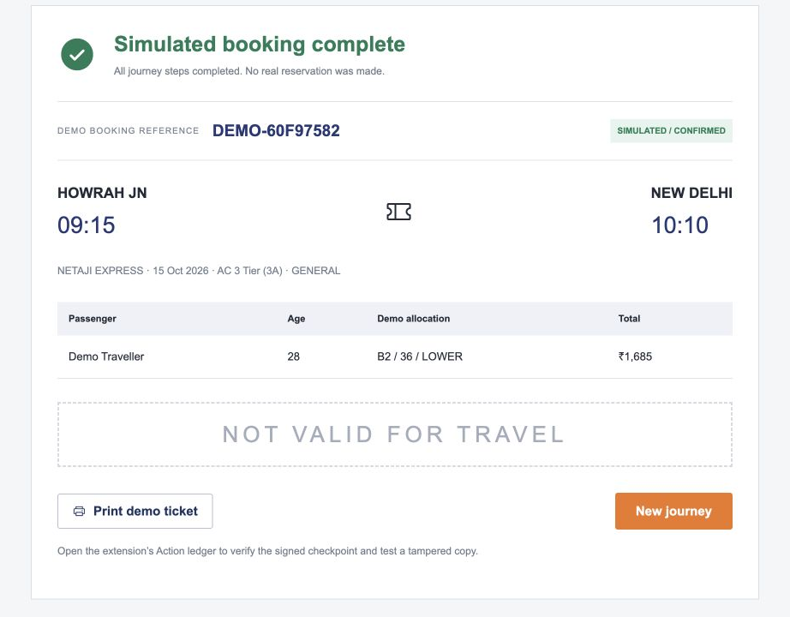
IMPACTS & BENEFITS
Controlled evidence from the v1.5 railway demonstration
01 BOOKING COMPLETED
END-TO-END SANDBOX JOURNEY
The packaged extension reached a simulated ticket in assisted and rehearsal tests.
02 HOSTILE PRIVATE FILL BLOCKED
A malicious server action targeted an unrelated field. The field stayed empty and the gate recorded BLOCKED.
03 MODIFIED LOG REJECTED
An edited ledger copy failed integrity verification. A separately retained checkpoint anchors the check.
Actual sandbox UI. Synthetic data and payment.
No IRCTC affiliation or live reservation.
18 Sep 2026 validation: 96 unit tests, 19 backend tests, 8 Chrome scenarios. Controlled fixtures with automated consent.
Unseen-site accuracy, memory and latency remain unmeasured. These tests do not establish universal injection resistance.
@chr0m1um
5
Notes:
Reported outcomes come from the local ContextShield 1.5.0 validation dated 18 September 2026, not from a fresh test run during this presentation revision. Ninety-six unit tests (4 shared, 92 extension), 19 backend tests and eight Chrome scenarios were recorded as passing. The eight comprise six core browser cases plus two railway mode runs. They are software checks, not product accuracy estimates.
Railway assisted test: packaged MV3 extension, real local Qwen service, correct cheapest morning fare, at least four approvals, final ticket heading, signed ledger verification and rejection of a modified copy. Qwen selects the fare; the declared local adapter handles other prepared screens. Rehearsal test: deterministic DOM-only controller, zero planner context requests, same authorization and evidence checks. Tests automatically answered consent prompts using synthetic values; execution durations are not human task-latency benchmarks. Failed exploratory Qwen trials were not counted as successful tasks.
The hostile action regression injects a schema-valid TYPE_HANDLE proposing a password handle for an unrelated textarea. It fails with PRIVACY_ASSERTION_FAILED, offers no approval for the mismatched field, leaves the field empty, omits the synthetic password from captured planner bodies, and records BLOCKED. This demonstrates the tested boundary case, not resistance to all possible prompt injections. The ledger test modifies a copy and verifies that it cannot match the trusted original checkpoint. Credentials are excluded from event fields. The exported key is not independently trusted merely because it is in the same file.
The ticket screenshot is an actual manually traversed local interface captured on 19 September 2026, using fictional details, and serves as a product illustration. It is not itself proof of the automated test. The sandbox is not affiliated with IRCTC and makes no real booking or payment. Independent egress audit, model quality, runtime memory and held-out task/attack evaluation remain open.
Demonstration sequence: complete an assisted sandbox journey with explicit approvals, explain the tested hostile-action rejection separately, then verify a ledger and edit a copy. Do not present the model-free rehearsal as live Qwen performance.
Implementation evidence: https://github.com/Arindam636-prog/chr0m1um/blob/main/docs/RAILWAY-VALIDATION.md
Demo scope: https://github.com/Arindam636-prog/chr0m1um/blob/main/docs/RAILWAY-DEMO.md
Validation date: 18 September 2026.
[4] Jing Yu Koh et al. VisualWebArena: Evaluating Multimodal Agents on Realistic Visual Web Tasks. ACL 2024, pp. 881–905. DOI:10.18653/v1/2024.acl-long.50.
https://aclanthology.org/2024.acl-long.50/
Scope: Provides motivation for multimodal observation and a future external evaluation framework. ContextShield has not run this benchmark.
[5] Edoardo Debenedetti, Jie Zhang, Mislav Balunović, Luca Beurer-Kellner, Marc Fischer and Florian Tramèr. AgentDojo: A Dynamic Environment to Evaluate Prompt Injection Attacks and Defenses for LLM Agents. NeurIPS 2024, Datasets and Benchmarks Track. DOI:10.52202/079017-2636.
https://proceedings.neurips.cc/paper_files/paper/2024/hash/97091a5177d8dc64b1da8bf3e1f6fb54-Abstract-Datasets_and_Benchmarks_Track.html
Scope: Published evidence that untrusted tool output can redirect tool-using agents and that utility and security need joint evaluation. ContextShield has not run AgentDojo.
[6] Qiusi Zhan, Zhixiang Liang, Zifan Ying and Daniel Kang. InjecAgent: Benchmarking Indirect Prompt Injections in Tool-Integrated Large Language Model Agents. Findings of ACL 2024, pp. 10471–10506. DOI:10.18653/v1/2024.findings-acl.624.
https://aclanthology.org/2024.findings-acl.624/
Scope: Supports the indirect-injection and exfiltration threat model. Its published attack results must not be represented as ContextShield results. ContextShield has not run InjecAgent.

Slide 6
RESEARCH AND REFERENCES
PERCEPTION & BROWSER AGENTS
PROMPT INJECTION, AUTHORIZATION & AUDIT
[1] Ge et al., 2021. Technical report (arXiv)
[5] Debenedetti et al., 2024. NeurIPS
YOLOX: Exceeding YOLO Series in 2021
AgentDojo: A Dynamic Environment to Evaluate Prompt Injection Attacks and Defenses for LLM Agents
Detector design. The face checkpoint needs separate validation.
Evaluate task success alongside resistance to attacks.
[2] Du et al., 2020. Technical report (arXiv)
[6] Zhan et al., 2024. Findings of ACL
PP-OCR: A Practical Ultra Lightweight OCR System
InjecAgent: Benchmarking Indirect Prompt Injections in Tool-Integrated Large Language Model Agents
Lightweight OCR family. Deployed v6 files are cited in notes.
Malicious external content and private-data exfiltration.
[3] Bai et al., 2025. Technical report (arXiv)
[7] Saltzer & Schroeder, 1975. Proceedings of the IEEE
Qwen3-VL Technical Report
The Protection of Information in Computer Systems
Multimodal reasoning background. No privacy guarantee.
Least privilege and authorization checks on every release.
[4] Koh et al., 2024. ACL
[8] Schneier & Kelsey, 1999. ACM TISSEC
VisualWebArena: Evaluating Multimodal Agents on Realistic Visual Web Tasks
Secure Audit Logs to Support Computer Forensics
Evaluation of web tasks that need visual information.
Audit-log integrity. Our local ledger has narrower guarantees.
Research informs the design. ContextShield has not yet run benchmarks [4–6].
SOURCE CODE
VALIDATION REPORT
RAILWAY DEMO GUIDE
Source, demo guide and validation report are linked above. The running demo remains local.
@chr0m1um
6
Notes:
RESEARCH PAPERS AND TECHNICAL REPORTS
[1] Zheng Ge, Songtao Liu, Feng Wang, Zeming Li and Jian Sun. YOLOX: Exceeding YOLO Series in 2021. arXiv:2107.08430, 2021.
https://arxiv.org/abs/2107.08430
Scope: Architecture-family reference. The paper reports general object detection, not privacy protection or our face-checkpoint accuracy.
[2] Yuning Du et al. PP-OCR: A Practical Ultra Lightweight OCR System. arXiv:2009.09941, 2020.
https://arxiv.org/abs/2009.09941
Scope: Historical OCR-family reference, not the source of the shipped PP-OCRv6 benchmark or model weights. The current pinned v6 assets and hashes are documented separately in the local model README.
[3] Shuai Bai et al. Qwen3-VL Technical Report. arXiv:2511.21631, 2025.
https://arxiv.org/abs/2511.21631
Scope: Background on the model family, not evidence that Qwen enforces our privacy policy or completes our railway task autonomously.
[4] Jing Yu Koh et al. VisualWebArena: Evaluating Multimodal Agents on Realistic Visual Web Tasks. ACL 2024, pp. 881–905. DOI:10.18653/v1/2024.acl-long.50.
https://aclanthology.org/2024.acl-long.50/
Scope: Provides motivation for multimodal observation and a future external evaluation framework. ContextShield has not run this benchmark.
[5] Edoardo Debenedetti, Jie Zhang, Mislav Balunović, Luca Beurer-Kellner, Marc Fischer and Florian Tramèr. AgentDojo: A Dynamic Environment to Evaluate Prompt Injection Attacks and Defenses for LLM Agents. NeurIPS 2024, Datasets and Benchmarks Track. DOI:10.52202/079017-2636.
https://proceedings.neurips.cc/paper_files/paper/2024/hash/97091a5177d8dc64b1da8bf3e1f6fb54-Abstract-Datasets_and_Benchmarks_Track.html
Scope: Published evidence that untrusted tool output can redirect tool-using agents and that utility and security need joint evaluation. ContextShield has not run AgentDojo.
[6] Qiusi Zhan, Zhixiang Liang, Zifan Ying and Daniel Kang. InjecAgent: Benchmarking Indirect Prompt Injections in Tool-Integrated Large Language Model Agents. Findings of ACL 2024, pp. 10471–10506. DOI:10.18653/v1/2024.findings-acl.624.
https://aclanthology.org/2024.findings-acl.624/
Scope: Supports the indirect-injection and exfiltration threat model. Its published attack results must not be represented as ContextShield results. ContextShield has not run InjecAgent.
[7] Jerome H. Saltzer and Michael D. Schroeder. The Protection of Information in Computer Systems. Proceedings of the IEEE 63(9), pp. 1278–1308, 1975. DOI:10.1109/PROC.1975.9939.
https://www.mit.edu/~Saltzer/publications/protection/index.html
Scope: Foundational principles include fail-safe defaults, complete mediation and least privilege. The mapping to our one-use private-fill gate is our engineering interpretation, not a formal security proof from this paper.
[8] Bruce Schneier and John Kelsey. Secure Audit Logs to Support Computer Forensics. ACM Transactions on Information and System Security, 1999. Author-hosted paper: https://www.schneier.com/wp-content/uploads/2016/02/paper-auditlogs.pdf.
https://www.schneier.com/academic/archives/1999/05/secure_audit_logs_to.html
Scope: Related work on detecting log modification and the importance of trust assumptions. Our SHA-256 chain and ephemeral ECDSA checkpoint do not implement this paper’s full forward-secure protocol, remote trust or compromise guarantees.
Research informs the architecture and future evaluation. No published benchmark score has been adopted as a ContextShield result. References [1–3] are model technical reports; [4–8] are peer-reviewed conference/journal publications. The deployed PP-OCRv6 files and the face-only YOLOX checkpoint are documented in extension/public/models/README.md and require their own evaluation.
Publication: the current v1.5 source, railway runbook and validation report accompany this deck in https://github.com/Arindam636-prog/chr0m1um. The application and model services run locally. Public source availability does not mean the demo is hosted online. No demo video has been published as part of this update.
Implementation evidence: https://github.com/Arindam636-prog/chr0m1um/blob/main/docs/RAILWAY-VALIDATION.md
Demo scope: https://github.com/Arindam636-prog/chr0m1um/blob/main/docs/RAILWAY-DEMO.md
Validation date: 18 September 2026.

