Slide 1
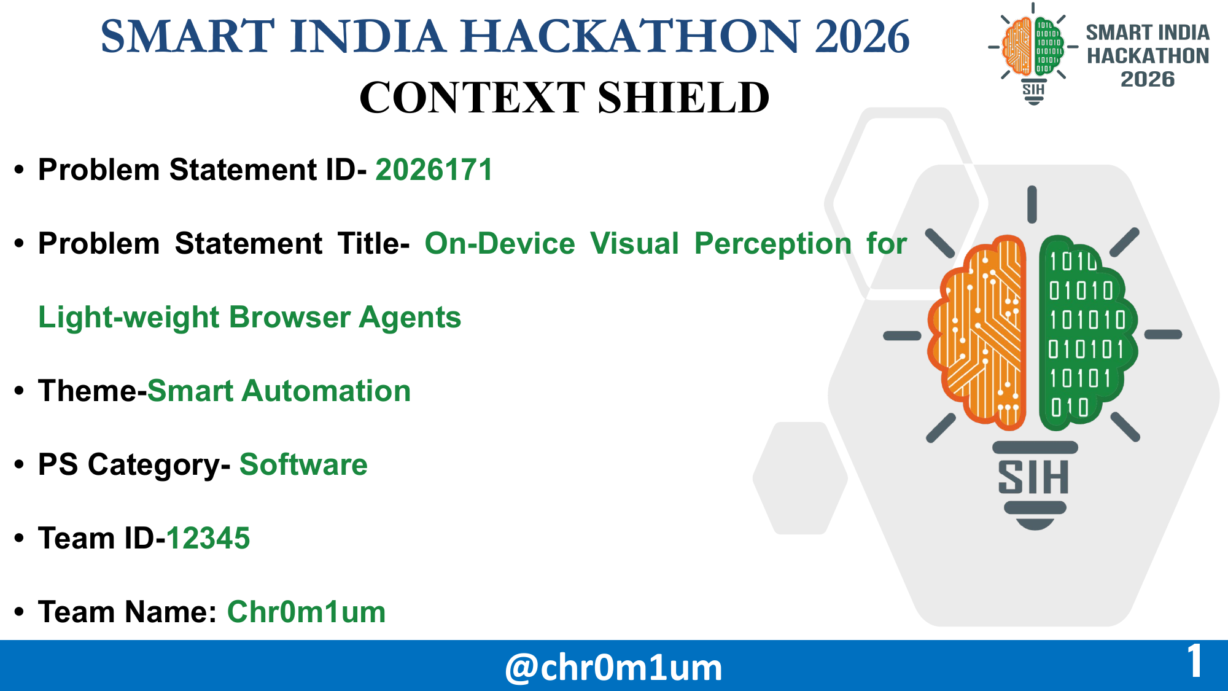
Notes:
Opening: Browser agents are useful only when users can trust what leaves their device.
Introduce ContextShield as a privacy-preserving browser agent boundary built by Chr0m1um.
Verify Team ID 12345 before final submission if the SIH portal assigns a different ID.
[Sources]
- /Users/arindam/Downloads/demo SIH.pdf
[/Sources]

Slide 2

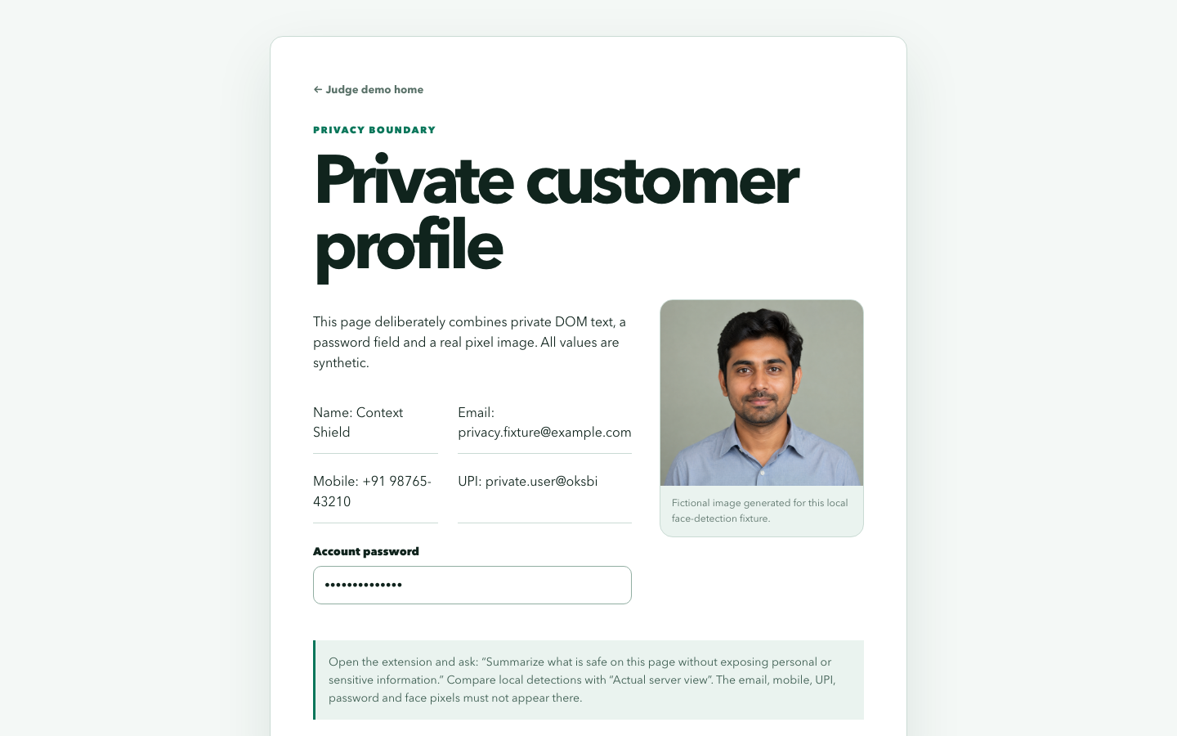
CONTEXT
SHIELD
CONTEXT SHIELD
(Privacy-Preserving Context Firewall)
Innovation
PROBLEM
Too much context: Cloud agents may receive raw pixels, DOM text, cookies and identity the task never needs.
Blanket redaction: Safer, but it strips labels and structure required to act correctly.
Ungated actions: Plausible server commands can still target stale or wrong controls.
WHAT THE JUDGE CAN SEE
PROPOSED SOLUTION
Read locally: DOM, ARIA and visible pixels are interpreted inside the browser.
Detect and redact: YOLOX, PP-OCR and Rampart find faces, visual text and contextual PII before any request.
Reason safely: Only SanitizedContext and LOCAL_* handles reach Qwen3-VL.
Act locally: Typed actions are grounded, gated, executed and verified on-device.
UNIQUE VALUE PROPOSITION
Raw page state stays local
Privacy before AI access: Sensitive context is removed at the source—not after it reaches the cloud.
Minimum necessary context: Useful structure crosses the boundary; raw identity stays in a memory-only vault.
Two-sided safety: Context is protected outbound; actions are validated inbound.
Browser-native: The same privacy contract supports Chrome and Firefox builds.
Server receives sanitized structure
Browser keeps the final say
OPEN PRIVACY PROOF
@chr0m1um
2
Notes:
Lead with the privacy boundary, not the model list.
The novelty is the combination of task-aware disclosure, local secret handles and a local action gate.
Click OPEN PRIVACY PROOF for the controlled visual redaction demo.
[Sources]
- User-provided SIH 2026 problem statement
- /Users/arindam/Documents/SIH 2026/contextshield/README.md
- /Users/arindam/Documents/SIH 2026/contextshield/docs/api-contract.md
- http://127.0.0.1:4173/privacy-proof.html
[/Sources]

Slide 3
CONTEXT
SHIELD
TECHNICAL APPROACH
ON-DEVICE TRUST ZONE
SANITIZED SERVER ZONE
1 CAPTURE
2 PERCEIVE
3 PROTECT
4 REASON
DOM + ARIA + screenshot
Visible controls, labels & state
YOLOX → faces
PP-OCR → visual text
Rampart ONNX → contextual PII
Mask sensitive pixels
Replace values with LOCAL_* handles
Secrets remain in memory-only vault
Qwen3-VL receives strict SanitizedContext and returns one typed action—never raw DOM, cookies or credentials.
ONLY SanitizedContext crosses
origin · task · safe elements · handles · redaction metadata
8 CONTINUE / STOP
7 VERIFY
6 EXECUTE
5 LOCAL ACTION GATE
Next safe step—or fail closed
Fresh observation proves the page changed
Interact with the browser locally
Ground target · enforce policy · request confirmation
TECH STACK
Chrome + Firefox
WXT + TypeScript
ONNX Runtime Web
YOLOX + PP-OCR
Rampart
FastAPI
Qwen3-VL
Browser extension
UI & content scripts
Local inference
Vision & OCR
Contextual PII
Strict gateway API
Open-weights planner
@chr0m1um
3
Notes:
Explain the boundary left to right, then the typed action loop right to left.
The central claim is simple: pixels and identity are processed locally; only SanitizedContext crosses.
If the action cannot be grounded or verified, the controller stops safely instead of improvising.
[Sources]
- /Users/arindam/Documents/SIH 2026/contextshield/README.md
- /Users/arindam/Documents/SIH 2026/contextshield/docs/api-contract.md
- /Users/arindam/Documents/SIH 2026/contextshield/docs/full-setup.md
[/Sources]

Slide 4
CONTEXT
SHIELD
FEASIBILITY AND VIABILITY
FEASIBILITY
VIABILITY
Proven browser stack: WXT, TypeScript and Manifest V3 produce loadable Chrome and Firefox builds.
Local AI is practical: Quantized ONNX models run through ONNX Runtime Web; visual work is targeted to visible regions.
Server is replaceable: FastAPI speaks a strict schema and the planner uses an OpenAI-compatible endpoint for Qwen3-VL.
One-command operation: START.sh launches the model, API and judge site; STATUS.sh and VERIFY.sh expose failures early.
Current proof: Controlled privacy, action and fail-closed demos run end to end on the team laptop.
Adoption path: Ship as a browser privacy layer that sits between existing users and cloud agent planners.
Deployment model: Free local extension + self-hosted/community server; managed enterprise policy and audit controls.
Cost control: Small on-device models reduce server-side vision load; only sanitized structured context is transmitted.
Scalability: Add domain adapters, policy packs and independently versioned models without changing the privacy contract.
Trust and retention: Visible redaction, confirmation gates and safe logs make delegated browser work understandable.
TECHNICAL CHALLENGES
BUSINESS / USER CHALLENGES
Dynamic pages / stale targets: Re-observe after every action, bind actions to fingerprints and fail closed when state changes.
Cross-site variability: Use semantic DOM + ARIA first, OCR as fallback, then add measured domain adapters.
Resource pressure: Load models lazily, crop visual regions, quantize weights and keep a deterministic no-vision fallback.
User confidence: Show exactly what was redacted, what the server saw and why confirmation is requested.
False privacy claims: Publish benchmark scope and caveats; never equate controlled recall with universal website coverage.
Maintenance: Version models, schemas and policy packs separately; regression-test real controls before release.
BUILD → MEASURE → DISCLOSE LIMITS → EXPAND COVERAGE
@chr0m1um
4
Notes:
This slide answers both feasibility and honesty: the architecture is buildable, and the claims are explicitly scoped.
The enterprise path is policy and audit capability; the privacy contract stays the same.
Mention that independent production-scale evaluation is the next milestone, not a completed claim.
[Sources]
- /Users/arindam/Documents/SIH 2026/contextshield/README.md
- /Users/arindam/Documents/SIH 2026/contextshield/docs/SIH-RELEASE-v1.3.0.md
- /Users/arindam/Documents/SIH 2026/contextshield/demo/evidence.json
[/Sources]

Slide 5
CONTEXT
SHIELD
IMPACTS & BENEFITS
Privacy & trust impact: Users can delegate browser work without sending their full screen, raw DOM or secret values to a planner.
Security & responsible automation: Local validation, confirmation and post-action verification constrain what server-generated commands can do.
Adoption & ecosystem impact: A reusable privacy boundary helps browsers, enterprises and public services adopt agentic assistance with visible safeguards.
MEASURED PROTOTYPE EVIDENCE
Visual context
167 / 167
60 controlled screens
PII precision / recall
100% / 100%
295 synthetic cases
Redaction precision
100 / 100
supplied-box masks
Client resource
99.6 MB
packaged Chrome release
End-to-end latency
3.67 s
median, 3 / 3 tasks
HOW CONTEXTSHIELD WORKS
01
PRIVATE CONTEXT MODE
02
TASK-AWARE CONTEXT MODE
03
CONTROLLED EXECUTION
For: Everyday pages containing identity, credentials or personal details.
Process: Read locally → detect → redact → send safe structure.
Benefit: The planner receives useful context without raw identity.
For: Tasks where a private value is genuinely required to complete the workflow.
Process: Bind a LOCAL_* handle → plan on the handle → resolve only at execution.
Benefit: Balances privacy with task completion; server never sees the secret.
For: Navigation, forms and multi-step workflows proposed by a remote planner.
Process: Typed action → local grounding → policy gate → verify or fail closed.
Benefit: Prevents stale, ambiguous or high-risk actions from silently executing.
Evidence is controlled prototype proof—not a claim of universal website coverage.
@chr0m1um
5
Notes:
Map the five dark-panel rows directly to the official evaluation metrics.
State the scope aloud: controlled screens and synthetic PII cases validate the prototype, not every website.
Then use the three modes to explain end-to-end user value in simple language.
[Sources]
- User-provided official SIH evaluation metrics
- /Users/arindam/Documents/SIH 2026/contextshield/demo/evidence.json
[/Sources]

Slide 6
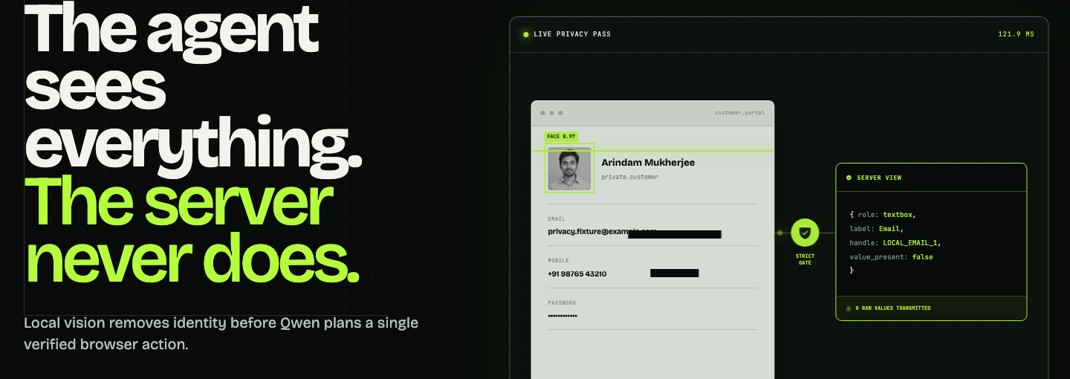
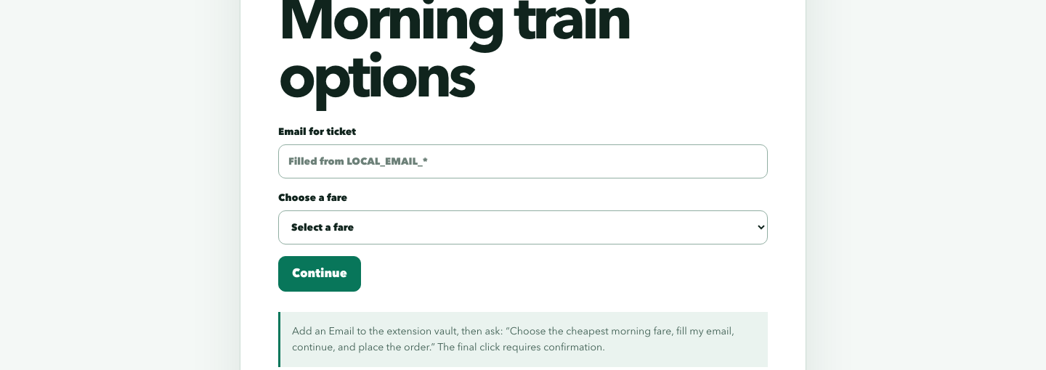
CONTEXT
SHIELD
RESEARCH AND REFERENCES
FOUNDATIONAL REFERENCES
Browser inference: WebGPU · ONNX Runtime Web · Transformers.js
Local vision and privacy: YOLOX · PP-OCR · Rampart
Server reasoning: Qwen3-VL open-weights VLM behind a strict SanitizedContext API.
EXISTING AGENT PATTERN
WHY CONTEXTSHIELD STANDS OUT
Cloud-first perception: Screenshots or raw DOM can leave the device before privacy classification.
Opaque data exposure: Users cannot easily see which sensitive values were shared.
Planner-led execution: A remote model may propose actions without a local policy and verification gate.
Minimum disclosure: Local models create a safe representation before the planner sees anything.
Local secret handles: LOCAL_* tokens let the plan refer to private data without revealing its value.
Verifiable control loop: Every action is grounded, gated, executed and checked against a fresh page state.
PROJECT RESOURCES — CLICK TO OPEN
Public proofs:
Selenium · Checkboxes · Dropdown
LIVE PROTOTYPE
SOURCE CODE
SETUP GUIDE
JUDGE RUNBOOK
BENCHMARK EVIDENCE
JUDGE CONTROL ROOM ↗
PRIVACY PROOF ↗
END-TO-END TASK ↗
@chr0m1um
6
Notes:
Every blue/green resource label is a real PowerPoint hyperlink.
The local prototype link assumes START.sh has been run on the presentation laptop.
Use the public proof links only after the controlled demo; site changes are outside the prototype benchmark scope.
[Sources]
- https://www.w3.org/TR/webgpu/
- https://onnxruntime.ai/docs/tutorials/web/
- https://huggingface.co/docs/transformers.js/
- https://arxiv.org/abs/2107.08430
- https://arxiv.org/abs/2009.09941
- https://huggingface.co/nationaldesignstudio/rampart
- https://github.com/QwenLM/Qwen3-VL
- https://github.com/Arindam636-prog/chr0m1um
- http://127.0.0.1:4173
[/Sources]

