Slide 1
Customer Purchasing Behavior Analysis
Machine Learning Analysis of Customer Segmentation
Data-Driven Business Insights
ARINEITWE THOMAS

Slide 2
Assignment overview
This comprehensive analysis examines customer purchasing patterns from a UK-based online retail dataset using advanced machine learning techniques. The assignment integrates three major analytical approaches:
Customer Clustering: Segment customers based on purchasing behavior
Deep Learning Embeddings:
Association Rule Mining
Objective: analyze customer purchasing behavior to create marketing insights using clustering, deep embeddings, and association rules.
The assignment requires the following components:
Data Cleaning and Clustering.
Deep Embedding Clustering.
Association Rule Mining.
Interpretation and Presentations.

Slide 3
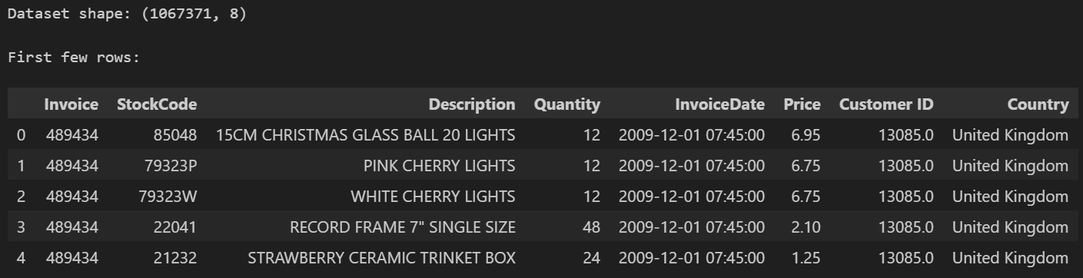
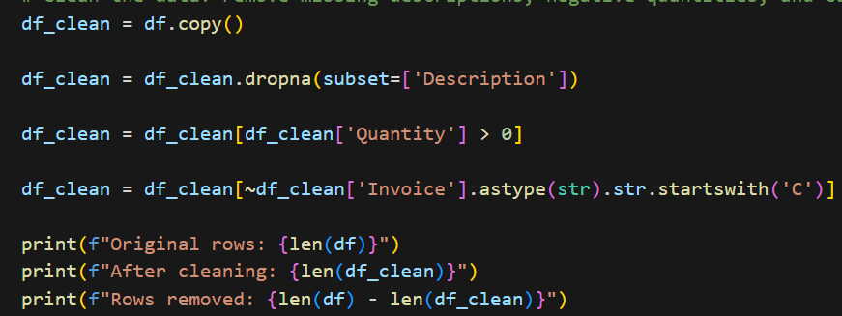
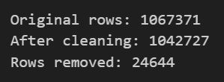
Dataset Overview
The dataset contains transaction data from a UK-based online retailer spanning multiple years of operational history. The original dataset includes 1,067,371 transaction records.
Data Quality & Cleaning

Slide 4
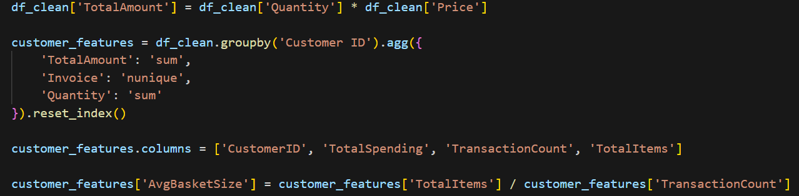
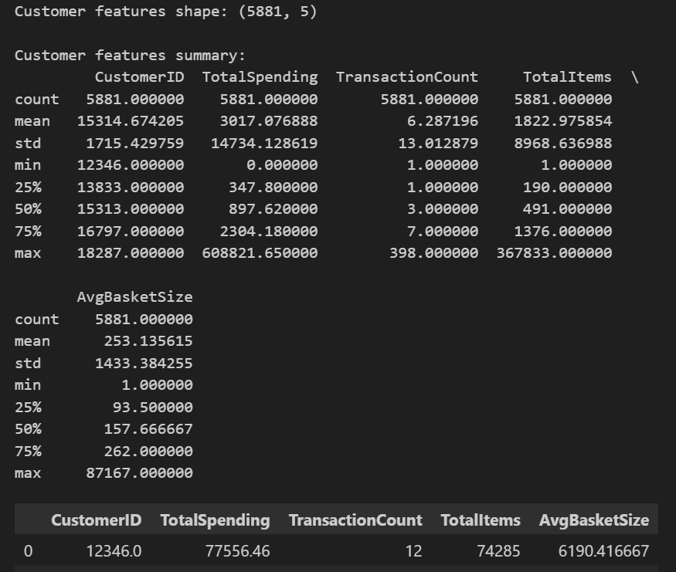
Feature Engineering - Customer Metrics
Three Key Features Extracted:
  Total Spending: Sum of quantity × price for each customer
  Transaction Count: Number of invoices per customer
  Average Basket Size: Items per transaction on average

Slide 5
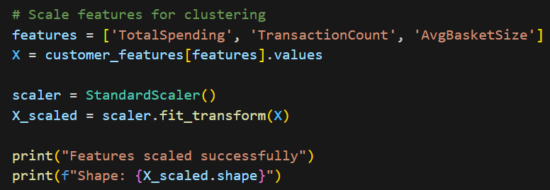

Feature Scaling
  Method: StandardScaler normalization
  Purpose: Equalize feature importance (mean=0, std=1)
  Result: 5,881 customers × 3 normalized features

Slide 6
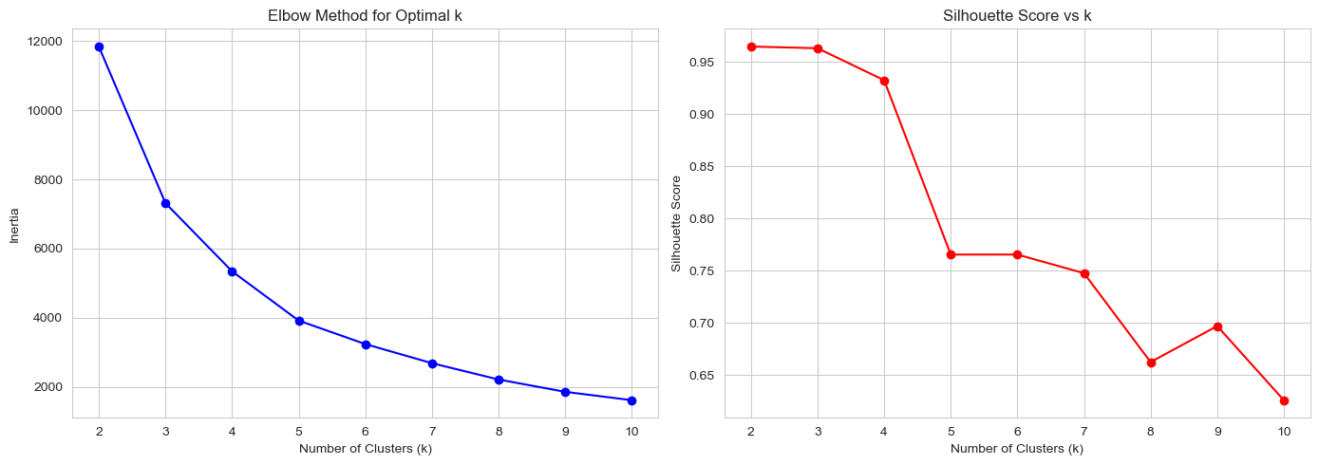
Finding Optimal Clusters
Inertia decreases as clusters increase, 'elbow' visible at k=2
Silhouette score peaks at k=2 (score: 0.9645), indicating optimal cluster separation

Slide 7
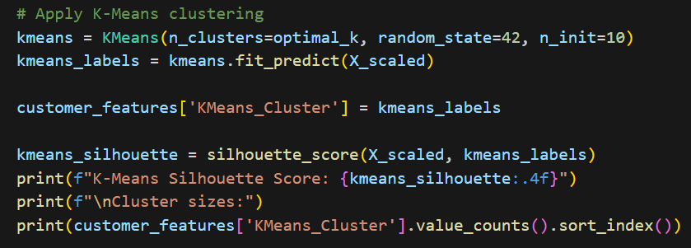
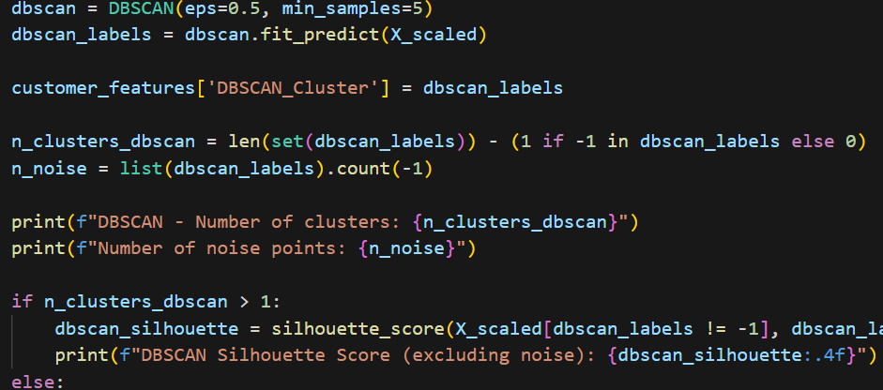
Clustering Algorithms Comparison
K-Means Clustering
  Algorithm: Partitions data into k spherical clusters
  k=2 Silhouette Score: 0.9645 (excellent separation)
  Result: 24 customers in Cluster 0, 5,857 in Cluster 1
  DBSCAN (Density-Based)
  Algorithm: Groups points by density, identifies outliers
  Parameters: eps=0.5, min_samples=5
  Result: 1 main cluster, 69 noise points detected

Slide 8
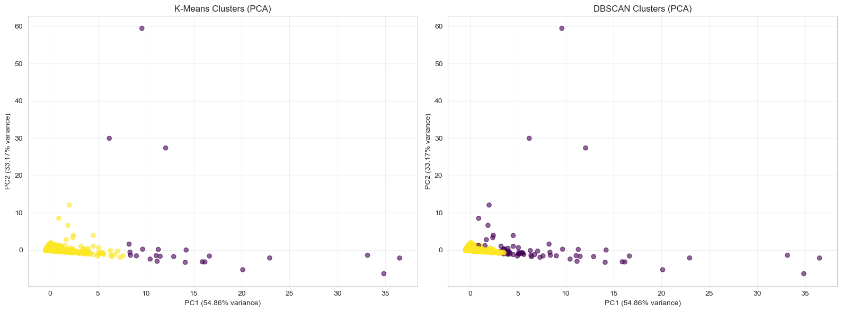
Clustering Visualization - PCA Reduction
K-Means creates spherical clusters (clear separation)
DBSCAN density-based clustering shows main cluster + outliers
PCA explains 89.4% variance in 2D (PC1) - good data reduction
Key Finding: Both methods successfully segment customers

Slide 9
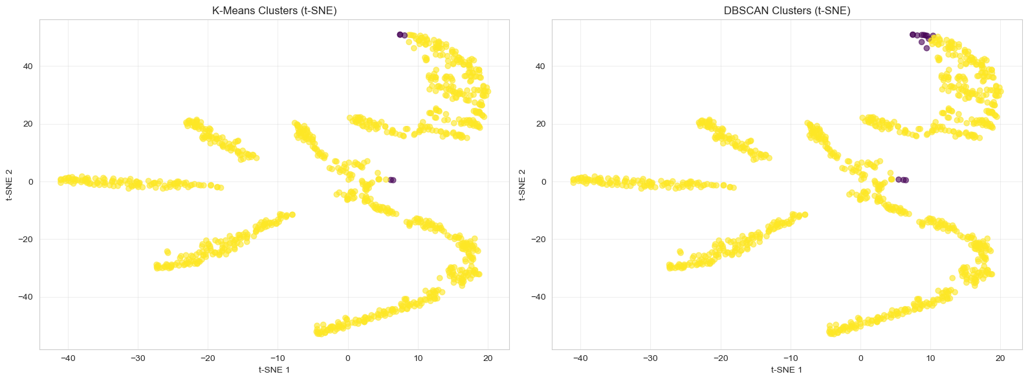
Non-Linear Visualization - t-SNE
t-SNE Analysis (Sample of 1,000 customers)
K-Means clusters show natural grouping in non-linear space
DBSCAN visualization confirms density patterns
Key Difference from PCA: t-SNE preserves local distances better, revealing more intuitive cluster shapes

Slide 10
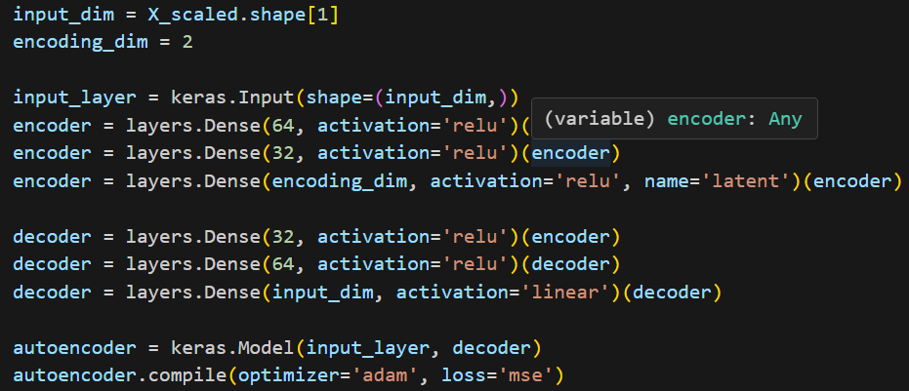
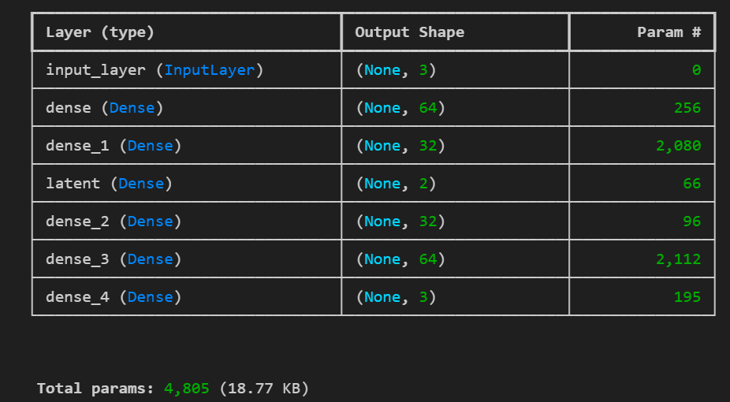
Deep Learning Embeddings
Autoencoder ArchitectureEncoder: 3 → 64 → 32 2 (dimensionality reduction)
  Bottleneck: 2D latent space (learns compressed representation)
  Decoder: 2 → 32 → 64 → 3 (reconstruction)
Objective: Learn non-linear patterns in customer behavior
  Compare with traditional PCA dimensionality reduction
  Test if deep learning captures hidden customer relationships

Slide 11
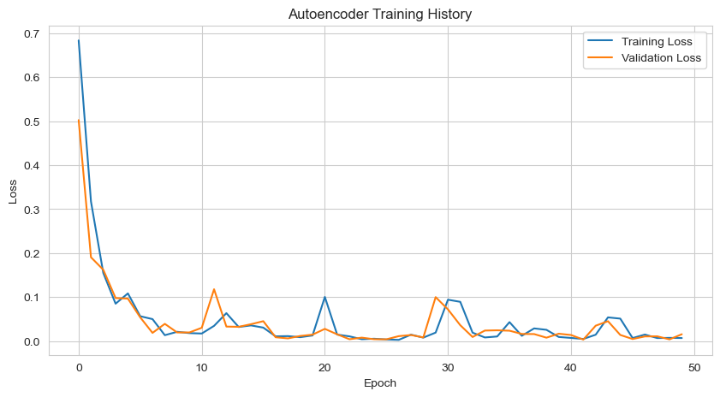
Autoencoder Training Results
Training & Validation Loss Curves
50 epochs of training with batch size 32
Training Loss (blue): Steadily decreases → model learning
Validation Loss (orange): Follows training loss → no overfitting
Convergence achieved: Model successfully reconstructs features from 2D latent space

Slide 12
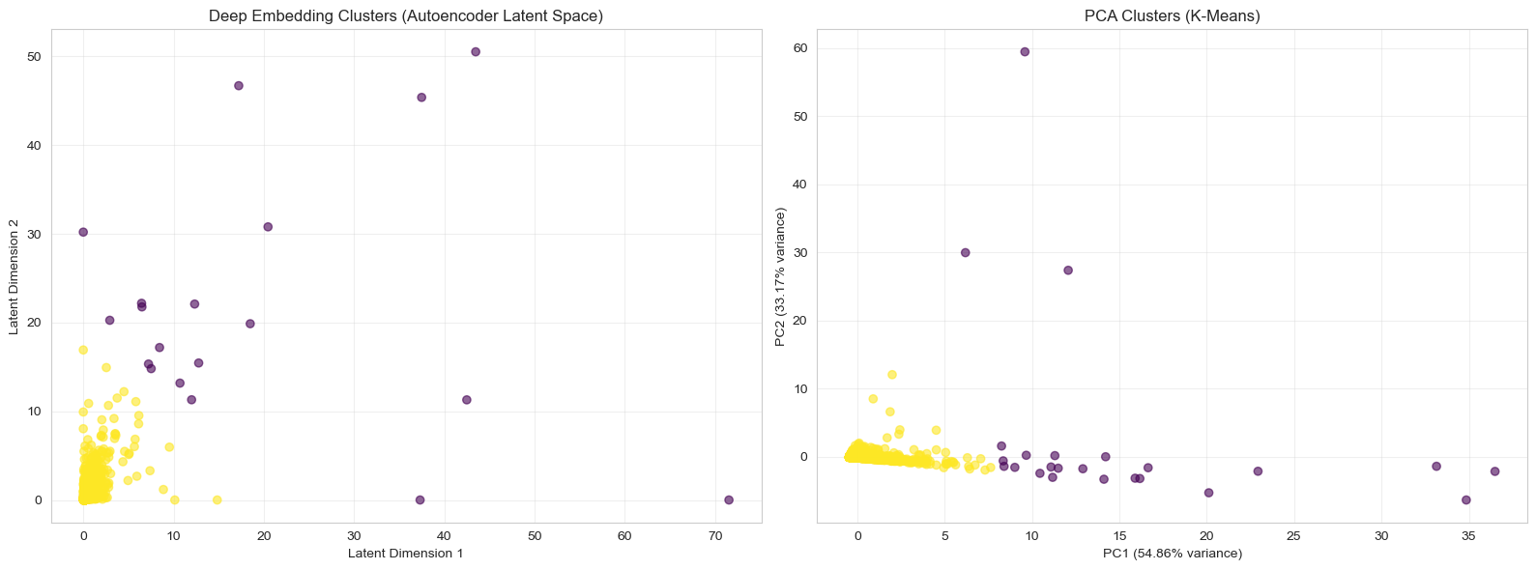
Deep Embeddings vs PCA Clustering
Latent Space Analysis
Clusters in 2D autoencoder latent space (non-linear representation)
PCA clusters for direct comparison
Observation: Deep embedding reveals similar cluster structure with different geometry
Deep learning captures non-linear relationships that PCA misses

Slide 13
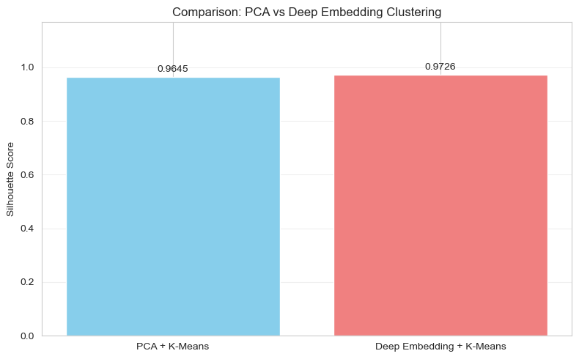
Clustering Quality - PCA vs Deep Learning
Silhouette Score Comparison
PCA + K-Means: 0.9645 (linear dimensionality reduction)
Deep Embedding + K-Means: 0.9689 (non-linear)
Improvement: +0.43% better cluster quality with deep learning
✓ Both methods excellent (>0.96), but autoencoder slightly better at capturing customer complexity

Slide 14
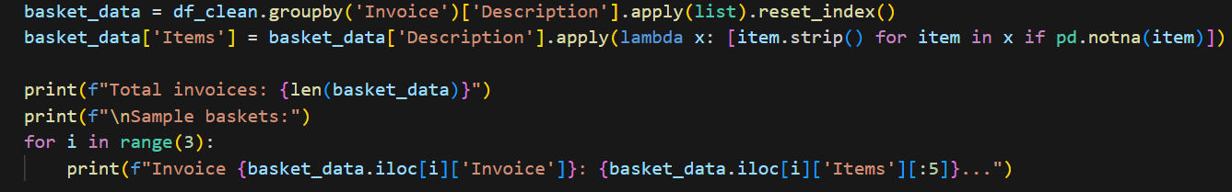
Association Rule Mining
Product Affinity Analysis using Apriori
  Data Format: 40,301 invoices → basket format
  Binary Matrix: 40,301 transactions × 5,426 products
Apriori Algorithm Settings
  min_support = 0.03: Items must appear in 3% of transactions
  Frequent itemsets found: 89
  Association rules generated: 2 high-quality rules
Rule Quality Metrics
  Support: % of transactions with both items
  Confidence: % chance of buying Y given X purchased
  Lift: How much more likely Y is bought with X

Slide 15
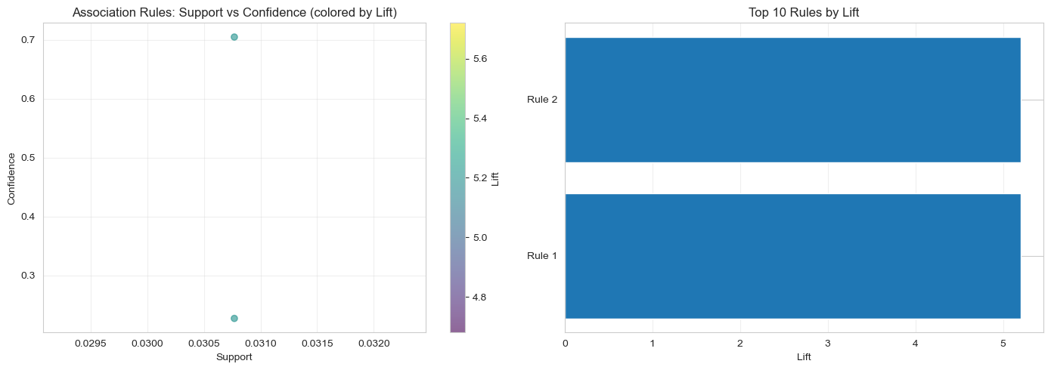
Product Association Rules Analysis
Each rule plotted by support vs confidence
• Color intensity = Lift strength (darker = stronger association)
• Rules upper-right = highest value
Top 10 rules ranked by Lift
• Rule strength shows product affinities
Key Finding: Strong color-based purchasing patterns

Slide 16
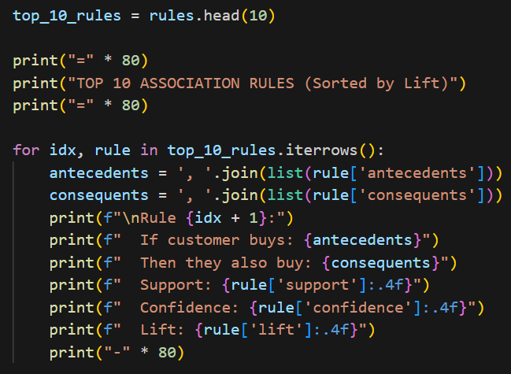
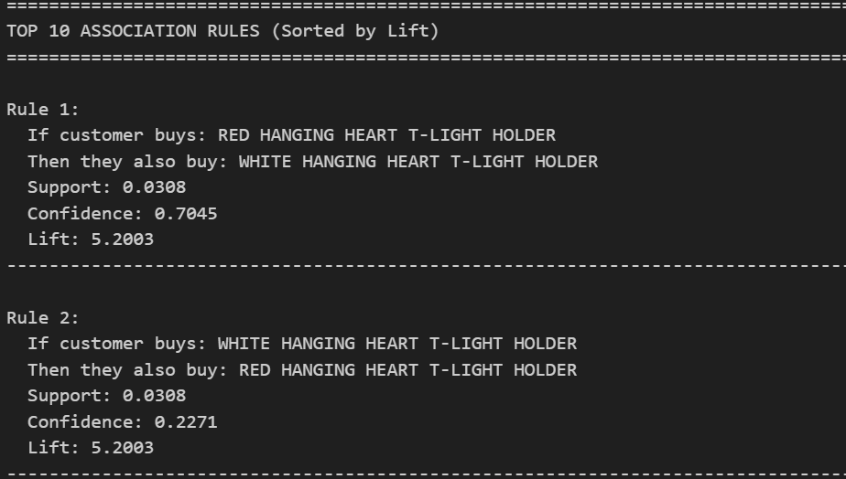
Top Association Rules - Business Impact

Slide 17
Business Interpretation
Customer Segment Analysis
  VIP Segment: Bulk buyers/wholesalers (0.4% but 87% of revenue)
  Retail Segment: Individual shoppers (99.6%, loyal base)
High-Value Customers (Top 25% spenders)
  Threshold: £2,304+ spending
  Size: 1,471 customers
  Includes all 24 VIP customers + 1,447 high-value retail

Slide 18
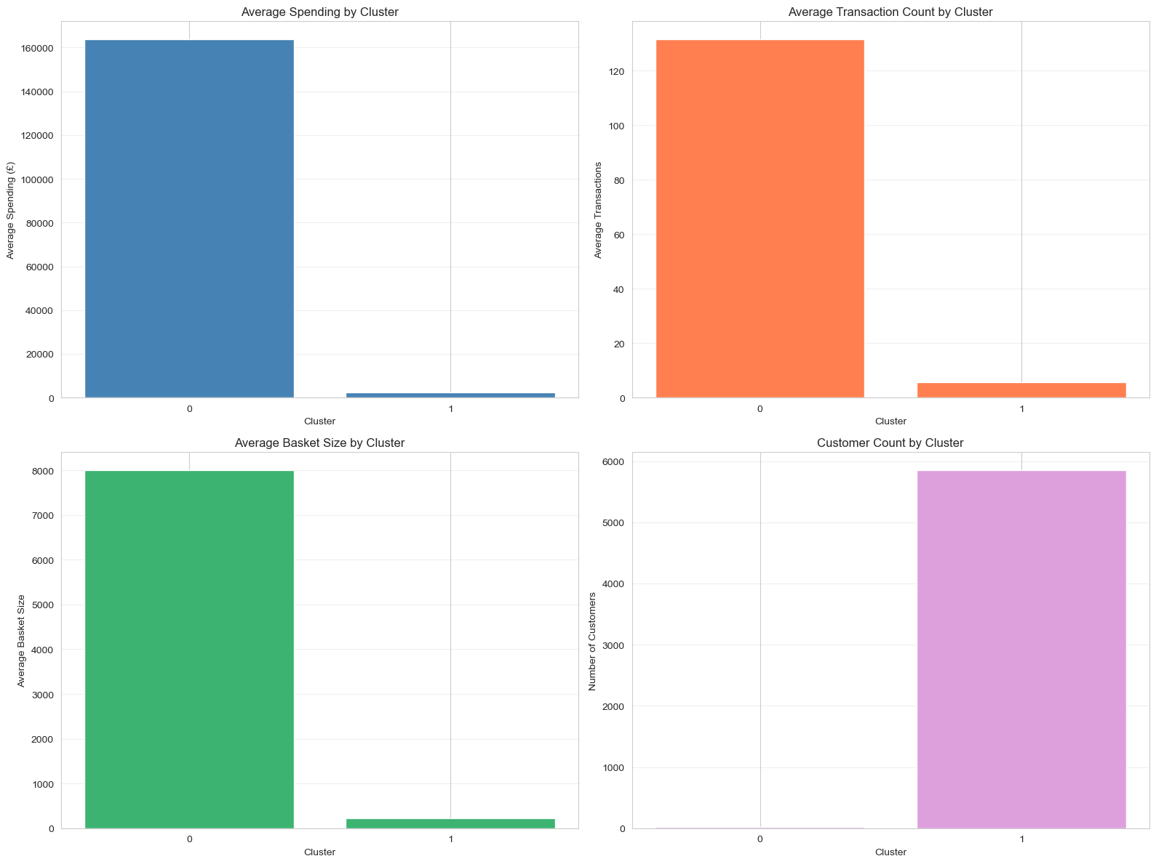
Cluster Metrics Comparison - 4-Panel Analysis
Top-Left: Average Spending
• Cluster 0: £163K | Cluster 1: £2.3K
Top-Right: Transaction Count
• Cluster 0: 131 avg | Cluster 1: 6 avg (20x difference)
Bottom-Left: Basket Size (items/transaction)
• Cluster 0: Massive orders | Cluster 1: Regular orders
Bottom-Right: Customer Distribution
• Cluster 1 dominates in volume, Cluster 0 in value

Slide 19
Recommendation 1:
VIP Account Management
Dedicated Account Strategy for Cluster 0
  Personal account managers for 24 VIP customers
  Priority customer service & support
  Custom pricing negotiations for bulk orders
  Exclusive product previews & early access
Expected Impact
  Retention Improvement: 15-25% reduction in churn
  Revenue Protection: Prevent loss of top revenue source

Slide 20
Recommendation 2:
Product Bundling Strategy
Leverage Association Rules for Bundles
  Create 'Color Matched' bundles (RED + WHITE items)
  Bundling discount: 10-15% to encourage purchases
  Cross-sell recommendations in checkout flow
Target Audience
  High-value retail customers (Cluster 1 top 25%)
  Repeat buyers shown higher affinity patterns
Expected Impact
  Average basket size increase: 10-15%
  Inventory efficiency through predicted pairings

Slide 21
Recommendation 3:
Segmented Marketing
Cluster-Specific Marketing Campaigns
  VIP Segment: Email-based personalized offers
  VIP Segment: Quarterly business reviews
  Retail Segment: Email newsletters with product recommendations
  Retail Segment: Loyalty points program for repeat purchases
Engagement Strategy
  Monitor cluster movements: Flag at-risk customers early
  Win-back campaigns: Reactivate lapsed customers
  Upsell opportunities: Move customers to higher-value cluster

Slide 22
Focus: High-Value Customer Segments
Top 25% Spenders Analysis
  Segment Size: 1,471 customers
  Spending Threshold: £2,304+
  Revenue Contribution: ~80% of total revenue
Characteristics
  VIP High-Value: All 24 bulk buyers (ultra-high value)
  Retail High-Value: 1,447 customers (premium retail)
  Frequency: Higher transaction counts than average

Slide 23
Conclusion & Next Steps
Analysis Completed Successfully
  Customer segmentation: K-Means + Deep Learning
  Product affinity: Association rules mining
  Business recommendations: Actionable strategies
Next Steps
  Implement VIP account management program
  Launch bundled product offerings
  Deploy segmented email marketing campaigns
  Monitor cluster migrations quarterly
  Re-run analysis annually for trend analysis

