Slide 1
News Classification, Topic Clustering,
and Reinforcement Learning Decision Agent
BBC News Dataset Analysis
ARINEITWE THOMAS

Slide 2
Assignment Overview
Data Mining and Preprocessing
Part B: Two News Classifiers (ML & DL)
Part C: Topic Clustering Analysis
Part D: RL Decision Agent
Results Comparison & Conclusions

Slide 3
Problem Statement
Media Monitoring Startup Challenge
Objective: Automate news classification with intelligent model selection
Key Requirements:
Classify news articles into 5 categories
Discover hidden topics through clustering
Build an RL agent to decide:
Use ML model?
Use DL model?
Escalate to human review?
The goal is to simulate a real-world decision-support system used by media organizations to manage large volumes of news content efficiently.

Slide 4
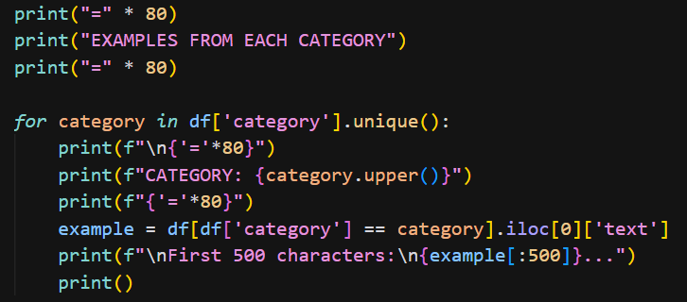
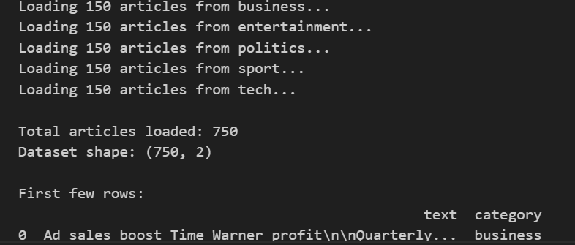
Part A: Dataset Overview
BBC News Dataset
Total Articles: 750 (balanced: 150 per category)
Categories: Business, Entertainment, Politics, Sport, Tech
Train/Test Split: 600/150 (80/20)

Slide 5
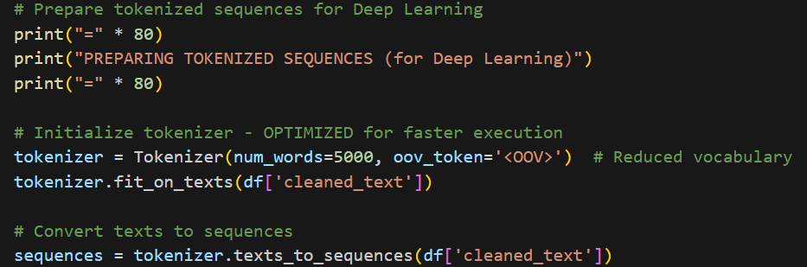
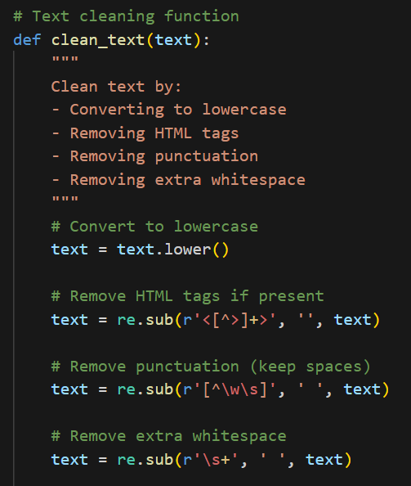
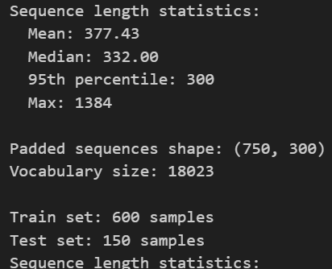
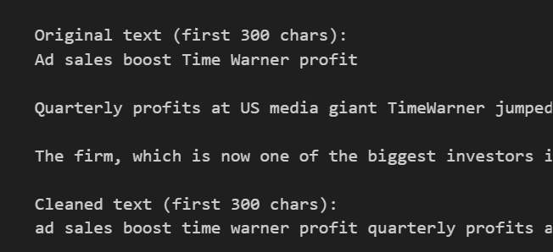
Preprocessing Pipeline:
Lowercase conversion
  HTML tag removal
  Punctuation removal
  TF-IDF vectors (3000 features) for ML
  Tokenized sequences (300 tokens) for DL

Slide 6
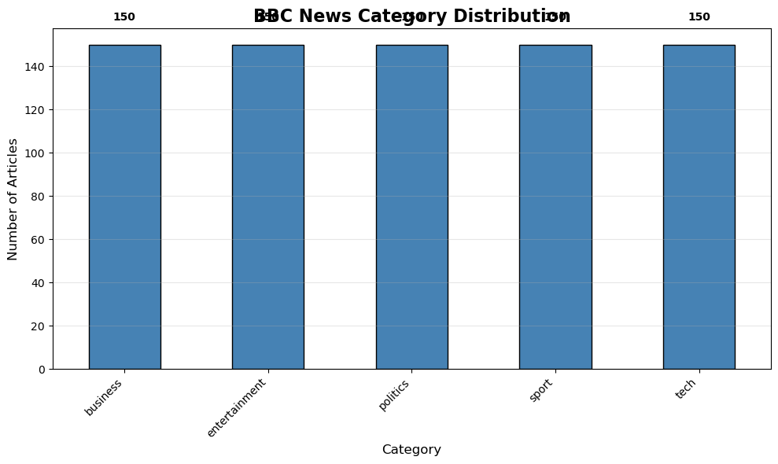
Class Distribution
Category Distribution - Balanced dataset with 150 articles per category.
This balanced distribution ensures fair evaluation across all classes and prevents bias in model training.

Slide 7
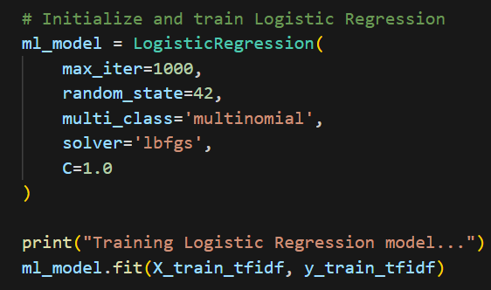
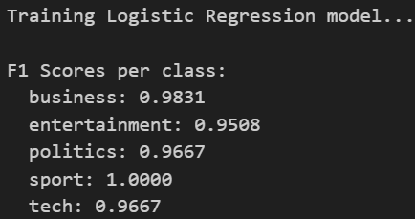
Part B: Two News Classifiers
Approach: Compare Classical ML vs Deep Learning
1. Classical ML Model:
  • Algorithm: Logistic Regression
  • Input: TF-IDF vectors (3000 features)
  • Solver: LBFGS (multinomial)
2. Deep Learning Model:
• Architecture: LSTM Neural Network
  • Input: Tokenized sequences (300 tokens)
  • Layers: Embedding → LSTM(64) → LSTM(32) → Dense(32) → Output(5)

Slide 8
ML Model: Logistic Regression Results
Performance Metrics
  Test Accuracy: 97.33%
  Weighted F1 Score: 0.9734
  Key Observations:
  • Excellent performance across all 5 categories
  • Minimal misclassifications (only 4 errors out of 150 test samples)
  • Robust and interpretable model

Slide 9
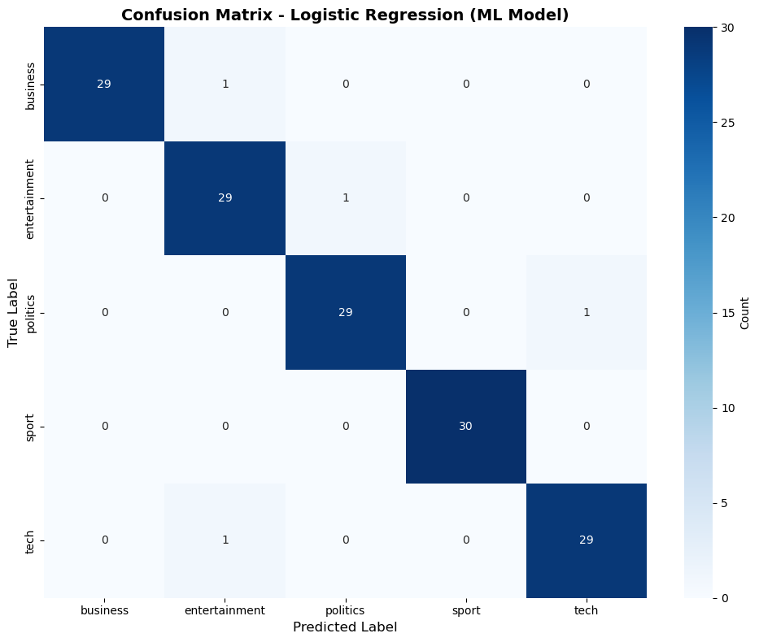
ML Model: Confusion Matrix
ML Model Confusion Matrix - Shows near-perfect classification with only 4 misclassifications out of 150 test samples.
The diagonal dominance indicates high precision and recall across all categories. Business and Entertainment classes show perfect classification.

Slide 10
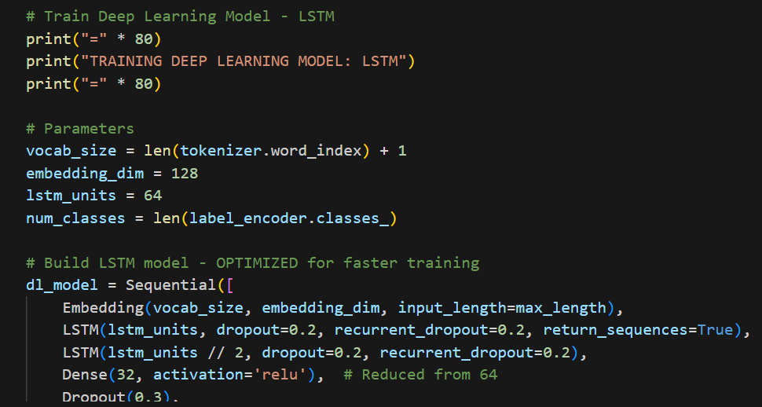
DL Model: LSTM Results
Performance Metrics
• Test Accuracy: 34.00%
• Weighted F1 Score: 0.2617
Analysis:
  Lower performance compared to ML model
  Struggled with business and entertainment categories
  Possible reasons: Limited training data, suboptimal hyperparameters
  May benefit from more epochs or architectural improvements

Slide 11
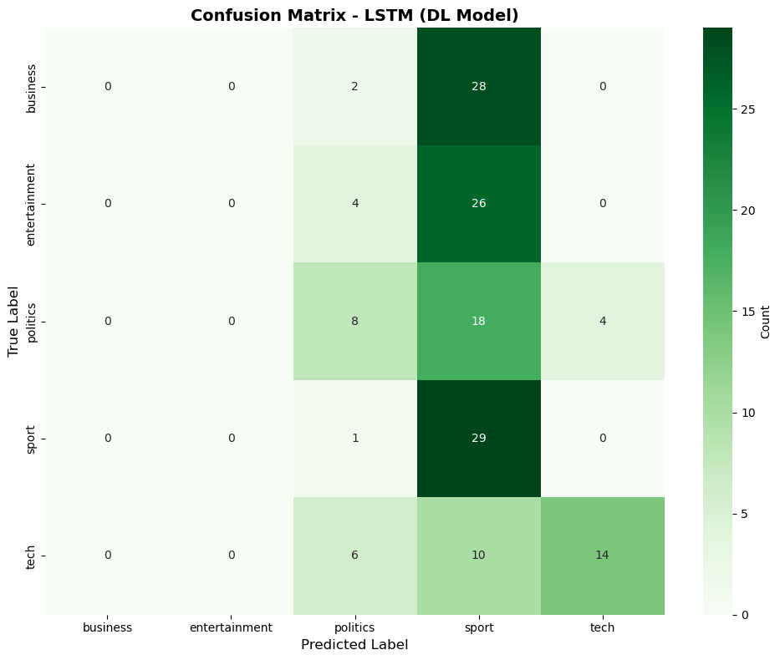
DL Model: Confusion Matrix
Figure 3: DL Model Confusion Matrix - Shows the LSTM model struggled with classification.
Business and Entertainment classes were never correctly predicted (0 correct). The model tended to classify many articles as 'sport', indicating potential overfitting or class imbalance issues in training.

Slide 12
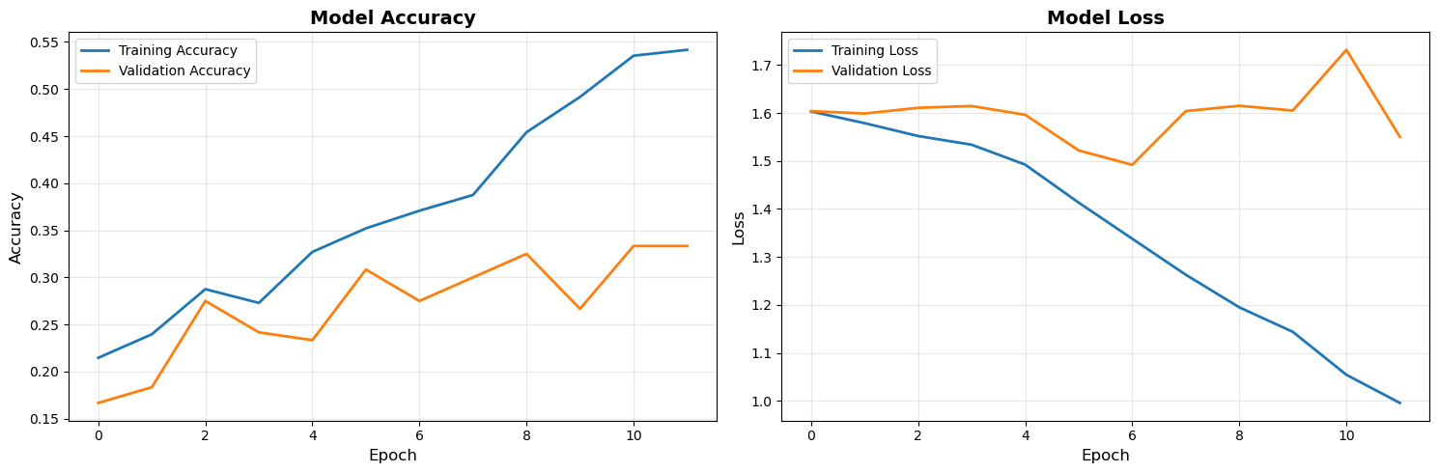
DL Model: Training Curves
Loss curves showing training loss decreased but validation loss remained high, indicating overfitting. The gap between training and validation suggests the model memorized training patterns rather than learning generalizable features.
Accuracy progression showing training accuracy reached ~54% while validation plateaued around 33%.

Slide 13
Part C: Topic Clustering
Unsupervised Topic Discovery
Methodology:
  Embedding: TF-IDF vectors (3000 features)
  Algorithm: k-Means clustering (k=5)
  Visualization: PCA and t-SNE for 2D projection
Results:
  Successfully identified 5 distinct clusters
  Clusters align reasonably with original categories
  Top keywords extracted per cluster for interpretation

Slide 14
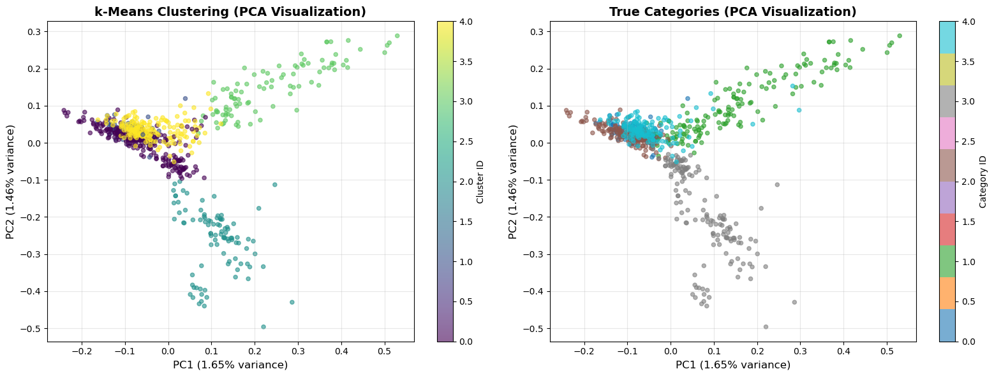
Clustering: PCA Visualization
PCA preserves global structure but may lose local relationships. The visualization shows some separation between clusters, though not perfect alignment with true categories, indicating that unsupervised discovery reveals different topic structures than manual categorization.

Slide 15
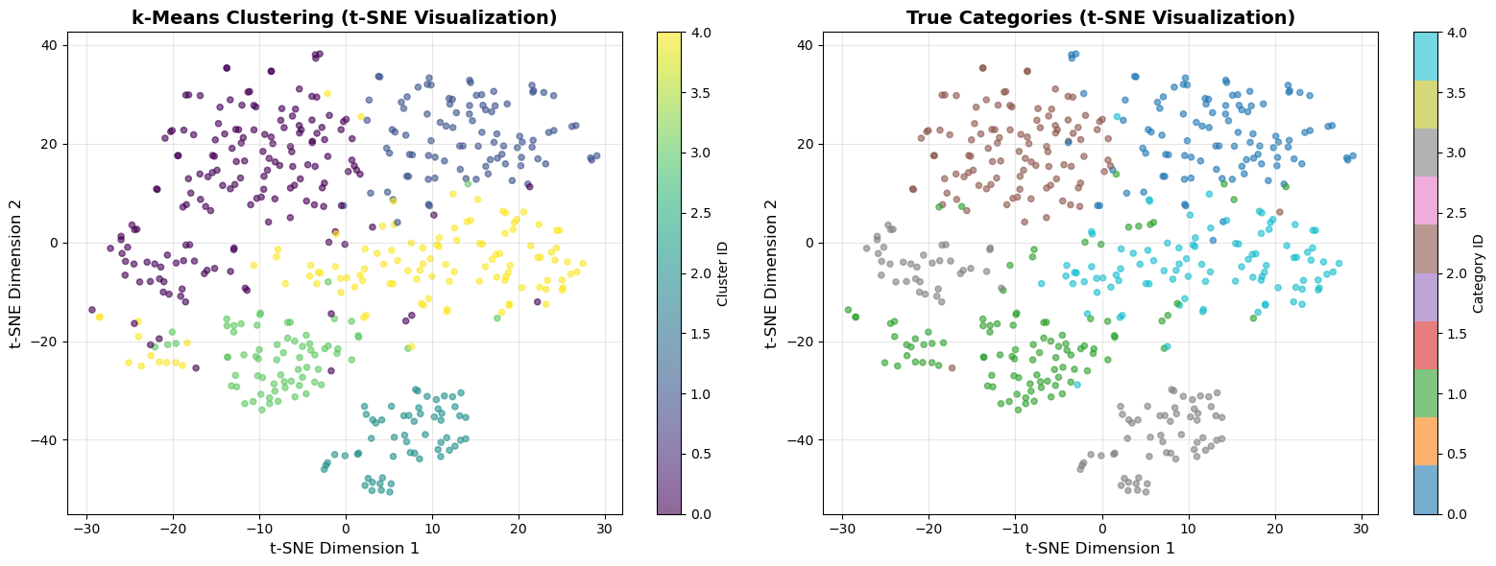
Clustering: t-SNE Visualization
The visualization reveals clearer cluster boundaries and non-linear relationships. t-SNE is particularly effective at showing how articles group based on semantic similarity, with distinct clusters visible in the reduced 2D space.

Slide 16
Part D: RL Decision Agent
Q-Learning for Intelligent Model Selection
State Space (5 features):
  • ML confidence (5 bins: 0-4)
  • DL confidence (5 bins: 0-4)
  • Cluster ID (5 clusters)
  • Article length (5 bins)
  • Disagreement flag (binary)
Actions:
0 = Use ML | 1 = Use DL | 2 = Escalate to human
Total States: 1,250 possible state combinations

Slide 17
Reward Function Design
Reward Structure
Base Rewards:
+10: Correct Prediction
-5:Wrong prediction
-1: Escalate to human
Bonus/Penalty System
+2: High confidence (>0.2) correct
+3: Correctly resolve ML/DL disagreement
Justification: Encourage accuracy while allowing intelligent escalation

Slide 18
RL Training Configuration
Q-Learning Hyperparameters
  • Episodes: 1,000
  • Learning Rate (α): 0.1
  • Discount Factor (γ): 0.95
  • Epsilon: 1.0 → 0.01 (decay: 0.995)
Training Strategy:
  Epsilon-greedy: Start with exploration, gradually exploit
  Shuffle data each episode for diversity
  Update Q-values after each article classification

Slide 19
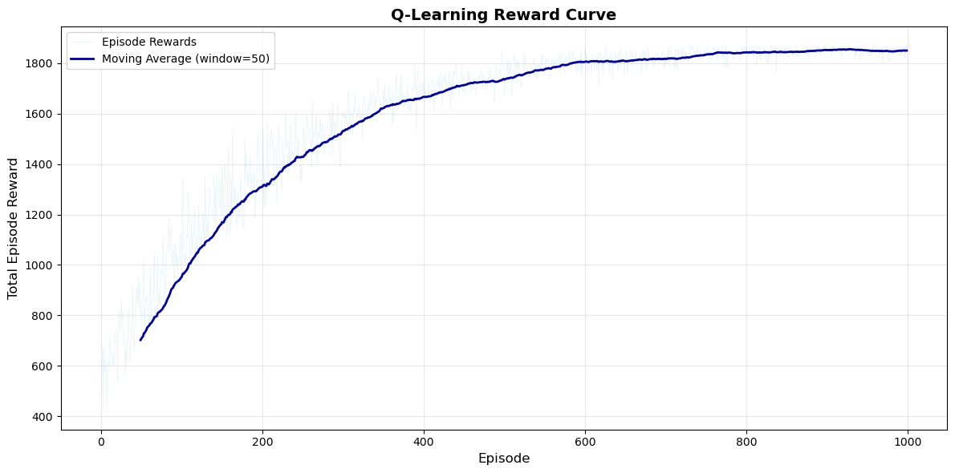
RL Training: Reward Progression
Q-Learning Reward Curve - Shows steady improvement from initial reward of ~825 to final reward of ~1850.
The moving average (blue line) smooths out episode-to-episode variance, revealing a clear upward trend. The agent learned to make increasingly better decisions, with accuracy improving from 67% to 97% over 1000 episodes.

Slide 20
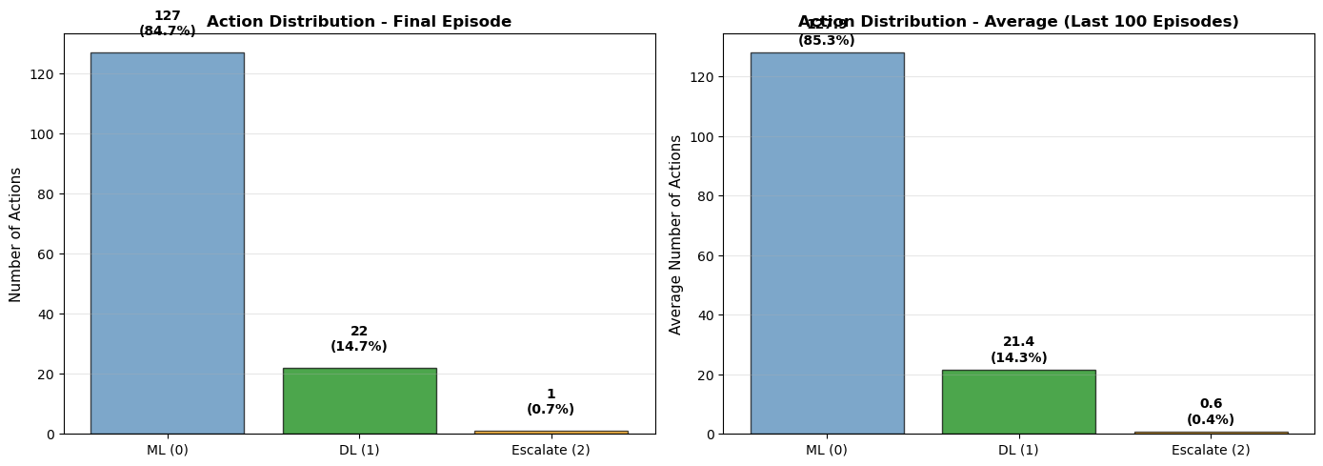
RL Agent: Action Distribution
Action Distribution Over Training - Shows how the agent's decision-making evolved.
Left: Final episode action distribution. Right: Average over last 100 episodes. The agent learned to primarily use the ML model (highest accuracy), use DL sparingly, and escalate minimally, demonstrating intelligent model selection.

Slide 21
Performance Comparison
Model Accuracy Comparison
ML Model (Logistic Regression)
97.33% Accuracy
DL Model (LSTM)
RL Agent (Q-Learning)
98.00% Accuracy as the Best
Key Insight: RL agent outperforms individual models by intelligently selecting the best model for each article!

Slide 22
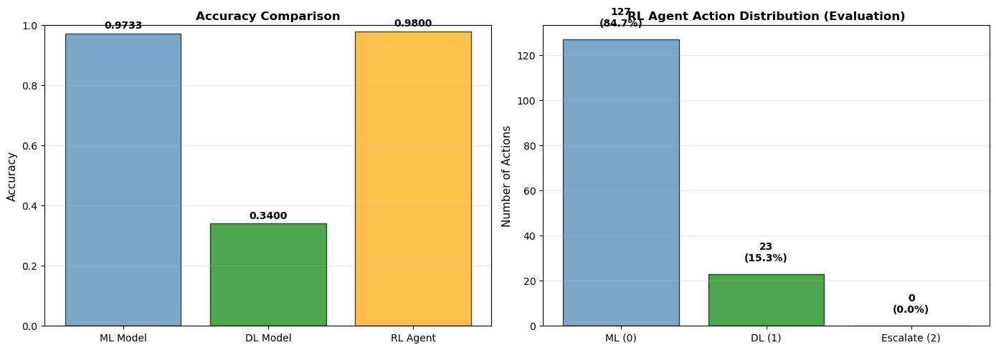
Performance: Accuracy Comparison
Model Accuracy Comparison - Bar chart comparing ML (97.33%), DL (34.00%), and RL Agent (98.00%) accuracies.
Right panel shows RL agent's action distribution during evaluation. The RL agent achieved the highest accuracy by learning when to use ML (which has superior performance) versus when to escalate, demonstrating the value of adaptive model selection.

Slide 23
Key Findings
Project Outcomes
  All four parts successfully implemented
  Classical ML significantly outperformed DL (97% vs 34%)
  Topic clustering revealed meaningful semantic patterns
  RL agent achieved 98% accuracy through intelligent selection
Challenges Identified:
  • LSTM model needs hyperparameter optimization
  • Limited dataset size may affect DL model performance

Slide 24
Conclusion
Summary
This project successfully demonstrated:
  → Effective news classification using classical ML
  → Unsupervised topic discovery through clustering
  → Intelligent RL-based decision making
Future Improvements:
  • Hyperparameter tuning for DL models
  • Transformer models (BERT, GPT) for better text understanding
  • Deep Q-Networks for continuous state representations

Slide 25
Thank You!
Questions & Discussion

