Slide 1
Atrial Fibrillation Dataset
Abbott Cardiac Rhythm Management Applied Research team

Slide 2
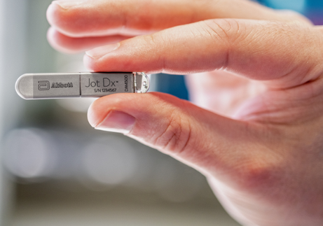
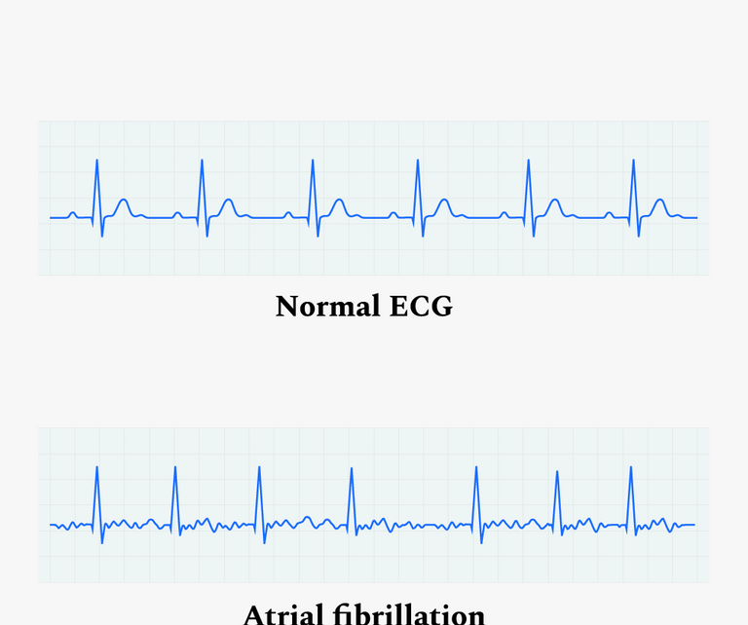
Hackathon 4
Problem: Develop a model to identify Stored Electrograms (SEGM) containing Atrial Fibrillation (AF)
Value: Current industry benchmarks have a specificity of ~75% and sensitivity of ~99%. Improved model performance (increased specificity with no reduction in sensitivity) will reduce AF false positives allowing clinicians to better serve CRM patients
Background: An implantable cardiac monitor (ICM) is a small device that gets implanted in a patient with a suspected heart condition. The ICM monitors the heart’s electrical signal for abnormalities. If one is detected, it saves the SEGM and transmits it to a clinician for review
Accurately diagnosing AF from an electrical recording is difficult, and the device often captures false positive recordings that purport to show AF, but in fact are something different
Dataset: 27,418 SEGMs from 345 Abbott ICMs - 9,030 true positives and 18,388 false positives. Each SEGM is 2-3 minutes long at 128 Hz sample rate

Slide 3


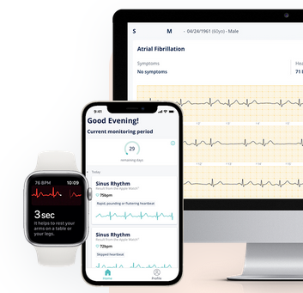

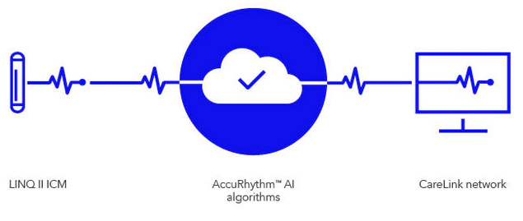
Competitors’ Solutions
www.cardiologs.com
www.implicity.com
www.medtronic.com
Notes:
Paul: Graphically show MDT Implicity and Cardiolog, and AccuRhythm solutions to demonstrate their interest in AI.
Replace slide w/ Jinesh’s version.

Slide 4
hackathon_dataset.csv overview
640MB CSV file, one example per row.
Contains 27,418 human-adjudicated atrial fibrillation (AF) stored electrograms (SEGMs) from 344 Abbott implantable cardiac monitors.
9,030 are true positives, meaning the device correctly detected AF.
18,388 are false positives, meaning the device incorrectly detected some other condition as AF.

Slide 5
Dataset Description

Slide 6
hackathon_dataset.csv fields
Column 1: Episode
Unique episode identifier in the form “DeviceXXXXX__EpisodeYYYYY”.
Episodes from the same device will have the same “DeviceXXXXXX” prefix.
Column 2: Label
1: True positive: Signal exhibits Atrial Fibrillation (AF)
0: False positive: Signal does not exhibit AF.
Column 3 SEGM signal
Base64-encoded byte array of stored electrogram measurements.
Each byte corresponds to a single analog-to-digital converter (ADC) sample. 128Hz sampling rate.
Signal lengths vary: Typically 1-3 minutes.

Slide 7
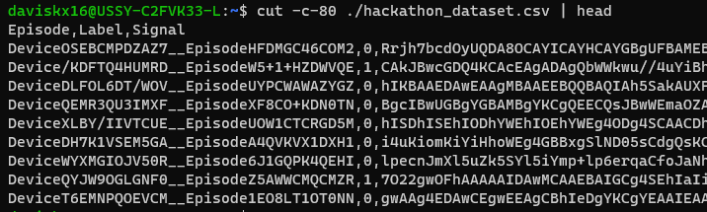
hackathon_dataset.csv sample

Slide 8
Signal Decoding
Each byte in the array corresponds to a signal amplitude measurement.
The most significant bit (msb) is set if the amplitude is negative.
The remaining 7 bits represent the amplitude.
bit #
7
6
5
4
3
2
1
0
Sign bit
Magnitude bits

Slide 9
Signal Decoding Example
7
6
5
4
3
2
1
0
bit #
Sign bit
Magnitude bits
Original byte[]
0x01
0x02
0x03
0x81
0x82
0x83
0x7F
Signal converted to int[]
1
2
3
-1
-2
-3
127

Slide 10
Signal Decoding Hints
Example: Python code to decode base64 string then convert byte values to signed integers using numpy:
import base64
import numpy as np
def parse_signal(signal: string):
"""Parses a Base64-encoded sequence of ADC values into a numpy array."""
raw_adc_values = base64.b64decode(signal)
raw_adc_values = np.array(list(raw_adc_values))
# The most significant bit of each ADC value is the sign bit. The 7 least significant bits are the value bits.
# Convert from raw ADC values to signed integers.
magnitudes = np.bitwise_and(raw_adc_values, 0x7F)
signs = np.where(raw_adc_values & 0x80 == 0x80, -1, 1)
signal = magnitudes * signs
signal = signal.astype(np.float32)
return signal

Slide 11
Other Hints
SEGMs from the same device tend to be similar.
The dataset isn’t balanced. Some devices contribute a lot more data than others.
Some possible data augmentation techniques:
Random rotation of signal on time axis.
Random stretch of signal by up to +/- 20%. (Any more could change the classification.)
Add Gaussian noise.
Random combination of above.

Slide 12
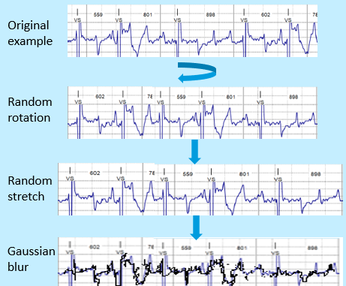
Data Augmentation Visualization

Slide 13
Some Data Augmentation Code Examples
def random_rotate(signal, original_signal_length):
"""Randomly shifts an array of signal values on the time axis: ex [1, 2, 3, 4] might shift right by 1 to become [4, 1, 2, 3]."""
shift_amount = random.randint(0, constants.SIGNAL_SIZE - 1)
signal[0][:original_signal_length] = np.roll(signal[0][:original_signal_length], shift_amount)
return signal
def random_stretch(signal, original_signal_length):
"""Randomly stretches/compresses the time axis of the signal. Adapted from this StackOverflow answer:
https://stackoverflow.com/a/38820560/353308."""
scale_factor = random.uniform(1 - constants.TIME_SCALE_FACTOR, 1 + constants.TIME_SCALE_FACTOR)
new_length = int(scale_factor*original_signal_length+1)
scaled_signal = np.interp(np.linspace(0, original_signal_length, new_length), np.arange(original_signal_length), signal[0][:original_signal_length])
signal[0] = np.zeros(constants.SIGNAL_SIZE, dtype=np.float32)
length = min(len(scaled_signal), constants.SIGNAL_SIZE)
signal[0][:length] += scaled_signal[:length]
return signal, length
def gaussian_blur(signal, original_signal_length):
"""Adds a small amount of random low amplitude noise to the signal."""
random_vals = np.random.normal(loc=0, scale=constants.GAUSSIAN_BLUR_STDEV, size=original_signal_length)
signal[0][:original_signal_length] += random_vals
return signal

Slide 14
hackathon_dataset.evaluation.csv overview
1,625 SEGMs from 80 devices.
525 true positives, 1100 false positives.
No device/SEGM overlap with training dataset.
F1 score as evaluation metric.
Notes:
Number of devices: awk -F '[\t_]' '{print $1 "\t" $2 "\t" $6 "\t" $8}' ./Episodes.csv | uniq | sort -u | cut -f3,4 | sort | uniq -c
Number of episodes: cut -f 2,4 ./Episodes.csv | sort | uniq –c

