Slide 1
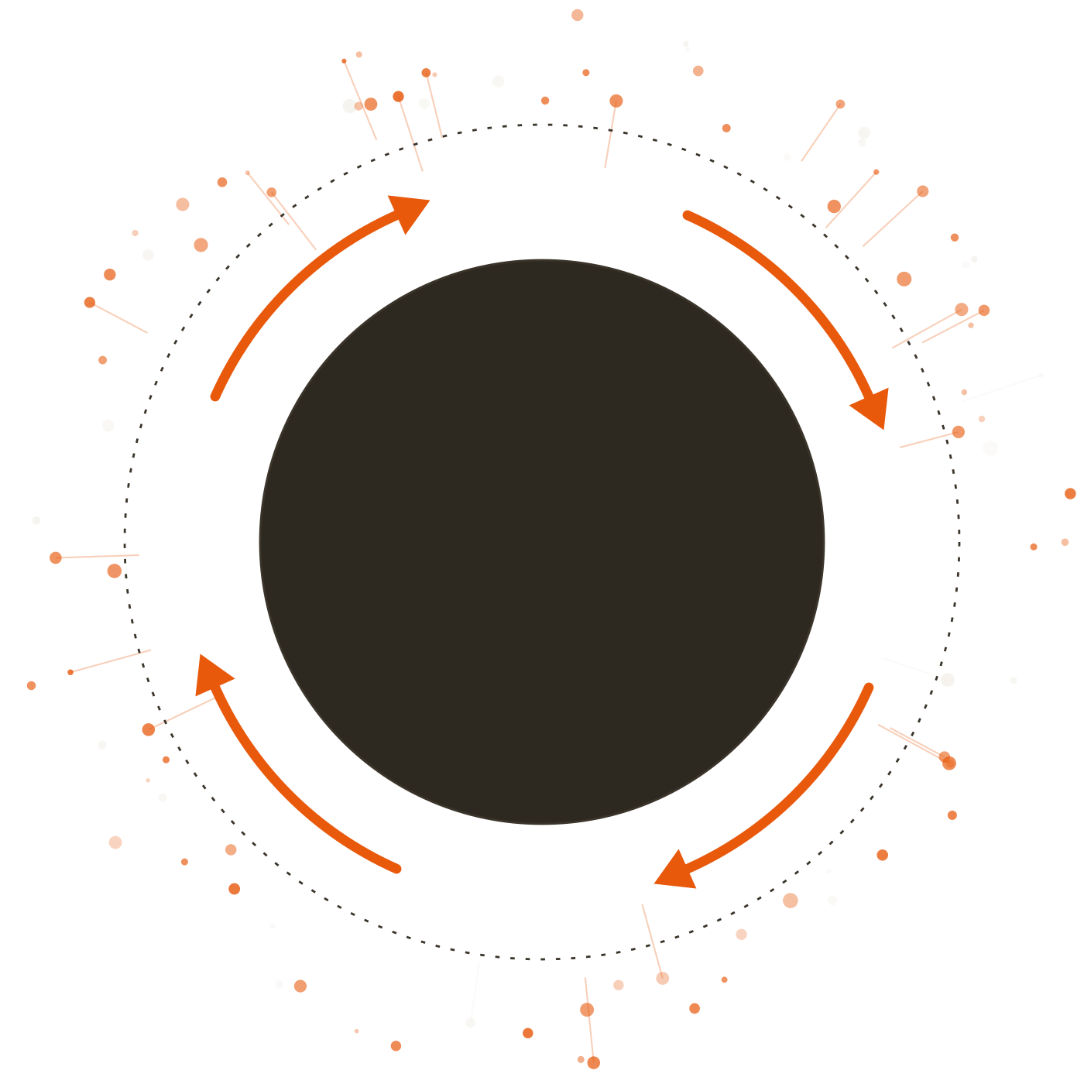
The AI way to market.
1 Capture
MARKETING OS
Marketing
4 Deploy
OS
2 Learn
One AI-native control plane for your marketing. Run by you and your agents.
THE LOOP
Signals in. Decisions out. In a loop.
3 Create
Arinox AI · October 2026
Notes:
Open with the one-line promise: Marketing OS (KOGO Workspace for Marketing) is one AI-native control plane for marketing. Signals in, decisions out, in a loop. The ring is the whole product: Capture, Learn, Create, Deploy. Everything after this slide zooms into one part of it.

Slide 2





Marketing has always been the same job
THE JOB
01
02
03
04
Deploy
Read the signals
Iterate
Steer the purchase
Launch the campaign
Check early how it is doing
Improve what ran
Guide the buyer towards buying
WHAT IS A SIGNAL?
Same job.
Any sign of how your marketing is doing: a click, a sale, a review, a store visit.
The difference now is the volume.
Notes:
Keep this simple. Every marketer does the same four things: launch, read how it is doing, improve, guide the buyer to purchase. Define "signal" out loud, because the rest of the deck leans on it: any sign of how marketing is doing. Land the closing line: the job is the same, the volume is not.

Slide 3






AI made output infinite. So the things to watch multiplied too
WHAT CHANGED
WHAT AI CAN NOW MAKE
WHAT YOU NOW HAVE TO WATCH
Creative
BEFORE: ONE AD
NOW: ENDLESS VERSIONS
Campaigns
Platforms
...
Generate anything, endlessly.
Every version has its own views, clicks and sales to check.
Every ad, post or email AI makes also throws off signals: views, clicks, sales. The more you generate, the more there is to watch.
Notes:
This is the shift. Generative AI makes creative, campaigns and platforms effectively unlimited. Every piece of output also produces signals (views, clicks, sales, reviews), so the amount to read grows with it. We are deliberately not quoting numbers here: the point is the direction, not a benchmark.

Slide 4




Infinite output. No cockpit
THE GAP
Teams need one place to go from signals to decisions: a cockpit to monitor, analyse and decide on all of it. We call it a control plane.
SIGNALS
DECISIONS
Clicks
Spend
Reviews
Footfall
Pause an ad
Move budget
NO CONTROL PLANE
Sales
Email opens
WhatsApp replies
Saves
Reach
A few decisions, made late.
WHAT SLIPS THROUGH
Tired ads keep running
Budget leaks
Buyers slip away
Winners scale too late
People have seen them too many times and stop clicking.
Money keeps flowing to what is not working.
Customers about to leave go unnoticed.
Ads that work do not get more budget in time.
Notes:
The gap: output has become infinite, but nobody has a cockpit for the signals that come back. Signals pile up on the left, very few decisions come out on the right. The four cards are the plain-language cost: tired ads keep running, budget leaks, buyers about to leave go unnoticed, and winning ads do not get more money in time. A control plane is simply the one place where signals turn into decisions.

Slide 5












So we built the cockpit: every signal in, every decision out
THE CONTROL PLANE
SIGNALS IN
THE AGENTS
DECISIONS OUT
Ads
Monitor
Pause
every platform
what is dying
always on, across every signal
Website
Scale
funnel and analytics
Analyse
what is winning
in the moment, as signals land
Stores
YOU APPROVE
Create
footfall and reviews
the next creative
Decide
Buyers
within the rules you set
Send
CRM and support
to the right person
Notes:
This is the product on one slide. Signals from ads, website, stores and buyers flow in on the left. Agents monitor (always on), analyse (in the moment) and decide (within the rules the customer sets). A human approves, then decisions go out: pause what is dying, scale what is winning, create the next creative, send to the right person. Control and memory are covered in detail later.

Slide 6


One loop: Capture, Learn, Create, Deploy
HOW IT RUNS
01
02
03
04
Capture
Learn
Create
Deploy
What is happening, everywhere?
What does it mean, right now?
What should we make next?
What do we do about it?
Every signal, from every platform, in one field.
Agents read the signals as they land, not next week.
The signal becomes the brief.
The decision goes back out as a new signal.
Every action becomes the next signal
Notes:
Each stage answers one plain question: what is happening, what does it mean, what should we make, what do we do about it. The return path along the bottom is what makes this a loop and not a pipeline: whatever the system does becomes the next signal.

Slide 7





Every signal. Every platform. One field
CAPTURE
Everything your marketing touches lands in one place, so the agents can read it together.
Ads
Sites
Messaging
Customers
Physical
Meta
Your website
WhatsApp
CRM
Store cameras
Google
Web analytics
SMS
Contact centre
POS
Amazon
Search Console
Email
Support
Footfall
Shopify
Landing pages
Reviews
Retail media
Google Business
Marketplaces
CAPTURED BY
Commerce OS
Matomo
Hyperlocal
CRM & Support
Notes:
The breadth slide: five families of signal, from paid ads to store footfall, all landing in one field. The tools along the bottom are what captures them today: Commerce OS, Matomo, Hyperlocal, and CRM & Support. The product team has not mapped each tool to a single family, so do not promise a one-to-one mapping.

Slide 8

The signal becomes the brief
LEARN · CREATE
Performance, behaviour and customer signals become one read, in the moment, not in a Monday report.
LEARN
CREATE
Agents read signals, not next week
Three products take it from there
What is fatiguing
COMMERCE OS
Flags the winning ad
Ads people have seen too many times
This creative is scaling. Make more like it.
What is scaling
Ads that are winning
ARTIST
Makes the next creative
Generated from the signal, on brand.
Where the budget leaks
Spend going to what is not working
ADAPT ENGINE
Sizes it for every platform
Who is about to churn
One master visual, every size and format.
Buyers likely to leave
Notes:
Learn: agents turn performance, behaviour and customer signals into one read, in the moment. Four things they look for: what is fatiguing (ads people have seen too often), what is scaling, where the budget leaks, and who is about to churn. Create: Commerce OS flags the winning ad, Artist makes the next creative from that signal, Adapt Engine sizes it for every platform and format.

Slide 9





The decision goes back out
DEPLOY
What the agents found becomes action.
Pause
Scale
Reallocate
Send
What is dying
What is winning
Move the budget
The email, to the right person
AND THE LOOP CLOSES
Back to Capture
Every action becomes a new signal, captured all over again.
You approve each decision, or pre-approve small moves within the rules you set.
Notes:
Deploy is where the decision goes back out: pause what is dying, scale what is winning, move the budget, send the email. Then the loop closes: every action becomes a new signal and is captured again. The agents do not act unseen: the customer approves each decision, or pre-approves narrow moves within rules they set.

Slide 10
An ad tires out at 2 a.m. By 7, the fix is waiting for you
ONE NIGHT IN THE LOOP · EXAMPLE
2:00 a.m.
NEEDS YOUR APPROVAL
Raised 2:05 a.m.
An ad starts to tire. The same people keep seeing it, and they click less and less.
Tired ad on Meta
2:05 a.m.
FLAG
Clicks falling while repeat views rise, over several days.
The agent flags it. This is a multi-day trend, not a one-night dip.
PROPOSED
Pause the tired ad. Replace it with a new one drafted from the winner.
Then
Replacement sized for every platform and format.
READY
Artist drafts a replacement from the winning ad. Adapt Engine sizes it for every platform.
BUDGET
Move the saved spend to the better performer.
7:00 a.m.
You wake up to one decision. You approve it, and the budget moves.
Approve
Edit
Decline
Notes:
This is the story to tell. It is an illustration, so say so; if you have a real example from the customer account, swap it in. Two a.m.: an ad has been shown to the same people too often and clicks are falling over several days. The agent flags it, Artist drafts a replacement from the winner, Adapt Engine sizes it for every platform. At seven the marketer sees one decision, approves it, and the budget moves. The agents detect, draft and size; the human decides.

Slide 11

You stay in command. And every decision makes it sharper
CONTROL AND MEMORY
YOU STAY IN CONTROL
AND IT REMEMBERS
1
Agents watch and draft
Every decision is logged
Every suggestion comes with its reason.
With the reason behind it.
2
You approve, edit or decline
Nothing goes out without your say.
The system learns what worked
Which ads tire fast, which angles win.
3
The action runs
Pause, scale, move budget, send.
The next suggestion is sharper
WITHIN YOUR RULES
The loop compounds.
Set small moves agents may make on their own, like shifting budget under a cap you choose.
Notes:
Two ideas, one slide. Control: agents draft, you decide. Every suggestion shows its reason, you approve, edit or decline, and only then does the action run. Customers can pre-approve narrow moves within rules they set, such as budget shifts under a cap. Memory: every decision is logged with its reason and learned from, so each lap of the loop is sharper than the last. Confirm the exact configurability of pre-approved rules with the product team before promising it.

Slide 12

One loop. Two teams. Yours
ONE LOOP, TWO TEAMS
The same loop, tuned to how your business sells. One customer can run both.
B2B loop
B2C loop
Teams selling to businesses
Brands selling to consumers
WHAT IT WATCHES
Accounts, intent and pipeline
Creative, audiences and storefronts
WHAT IT DECIDES
Who to pursue, and when
What to run next, and where
POWERED BY
CRM · Marketing skills · Campaign Manager
Commerce OS · Artist · Adapt Engine
Configured in days
Private: your cloud, your rules
Agents draft, you decide
Notes:
The loop is the same; what it watches and what it decides differs. B2B watches accounts, intent and pipeline and decides who to pursue and when. B2C watches creative, audiences and storefronts and decides what to run next and where. The bottom row is what both get: configured in days, private, and agents draft while you decide.

Slide 13




Private by design: three ways to run it
HOW YOU GET IT
MANAGED BY ARINOX AI
IN YOUR CLOUD
ON-PREM
We run it for you
It runs in your cloud
It runs in-house
YOU GET
YOU GET
YOU GET
Ready to use, on a subscription
Marketing OS inside your private cloud (VPC)
Deployed on your own infrastructure
WHO RUNS IT
WHO RUNS IT
WHO RUNS IT
Arinox AI runs the loop and the platform
Your IT team, with Arinox AI support
Your team runs it
BEST WHEN
BEST WHEN
BEST WHEN
You want results with little IT effort
You have data residency and control needs
Your data has to stay inside
In every option: the same loop, the same agents and the same controls.
Notes:
Privacy is a buying criterion, so it gets its own slide. Three ways to run one product: managed by Arinox AI, inside the customer cloud, or on-prem. The product page commits to "private: your cloud, your rules"; the three delivery options are Arinox-side framing, so confirm the wording of the on-prem column with the deployment team before sending externally.

Slide 14

Infinite output. Finite decisions, decided early
NEXT STEP
TAKE THE NEXT STEP
1. Marketing signal audit
Map your ad platforms, site, stores, leads and support channels.
2. Pick your loop
Choose B2B or B2C, and the first products to switch on.
Signals in. Decisions out. In a loop.
3. Go live in days
Your first loop running, with your first decision waiting for approval.
Notes:
Close on the three-step path. The signal audit is the low-commitment first move: it maps what the customer already has and shows where the loop would start. Leave the headline on screen for the discussion.

