Slide 1

The impact of post type on user engagement intentions:
The mediating role of perceived control
HKBU AIDM

Slide 2
The impact of post type on user engagement intentions:
The mediating role of perceived control
YIN Hanyu 25417665 YANG Yuna 25405527
LIU Jiayu 25421212 CHEN Jinqi 25439413
AIDM 7480

Slide 3
Catalogue
Introduction
Literature reviews
Method
Results
Discussion
AIDM 7480

Slide 4
1
Introduction
AIDM 7480

Slide 5


Introduction
Xiaohongshu (XHS) has established a unique dual-content ecosystem dominated by image-text posts, with short videos as a supplementary format. As a leading social commerce platform in China, its core user base consists of Gen Z females (born 1995–2010) in first-tier and new first-tier cities, who rely on the platform for in-depth consumption decision-making information. While prior research has explored the impact of content format on user engagement, few studies have systematically examined the psychological mechanism underlying the difference between image-text and short video posts on Xiaohongshu. This study focuses on the relationship between post type (image-text vs. short video) and user engagement intentions, and investigates the mediating role of perceived control in this process. Understanding this mechanism is of great theoretical and practical significance: it not only enriches the research on social media content psychology, but also provides actionable guidance for content creators and platform operators to optimize content strategies and improve user experience.
A I D M 7 4 8 0

Slide 6
2
Literature reviews
2.1 User Engagement on Social Media
2.2 Media Affordances and Content Formats
2.3 The Need for Autonomy and Perceived Control
2.4 The Mediating Role of Perceived Control
AIDM 7480

Slide 7
2.1 User Engagement on Social Media
Definition & Dimensions
User engagement is defined as proactive psychological tendencies to interact with online content.
Operationalized into 5 core dimensions: liking, sharing, commenting, watching/reading, and saving.
Dual Classification
Social-oriented Behaviors
Liking, Sharing, Commenting. Reflects the need for social connection.
Utilitarian Behaviors
Watching/Reading, Saving. Represents goal-driven information processing.
Research Context
This study focuses specifically on information-seeking scenarios where engagement supports decision-making.
Example Platform: Xiaohongshu (RED) Excludes pure e-commerce transactions.

Slide 8
2.2 Media Affordances and Content Formats
Graphic-textual Mode
CORE MECHANISM Presents information via static images + text for a structured, visually anchored delivery.
USER CONTROL User-paced: Allows independent regulation of processing speed and free navigation.
PRIMARY VALUE Goal-driven: Better supports focused information-seeking tasks.
Short Video Mode
CORE MECHANISM Delivers content via dynamic visuals + audio for a multisensory, continuous flow.
USER CONTROL System-paced: Linear nature prevents users from controlling the pace of intake.
PRIMARY VALUE Immersive: High media richness creates a vivid, emotionally engaging experience.
Key Insight: Even with the same content quality, the choice of format fundamentally reshapes user experience and interaction dynamics.

Slide 9
2.3 The Need for Autonomy and Perceived Control
Perceived Control
Hypothesis H1
The user’s subjective sense of agency over their information processing experience (e.g., adjusting reading pace, navigating content freely).
Content formats directly shape perceived control: User-paced formats (graphic-text) satisfy autonomy needs, while system-paced formats (short videos) restrict them.
Rooted in the Theory of Planned Behavior (TPB) and intrinsically linked to the psychological need for autonomy (Self-Determination Theory, SDT).
H1: Compared with short video posts, graphic posts tend to significantly increase users’ perceived control over the information processing experience.

Slide 10
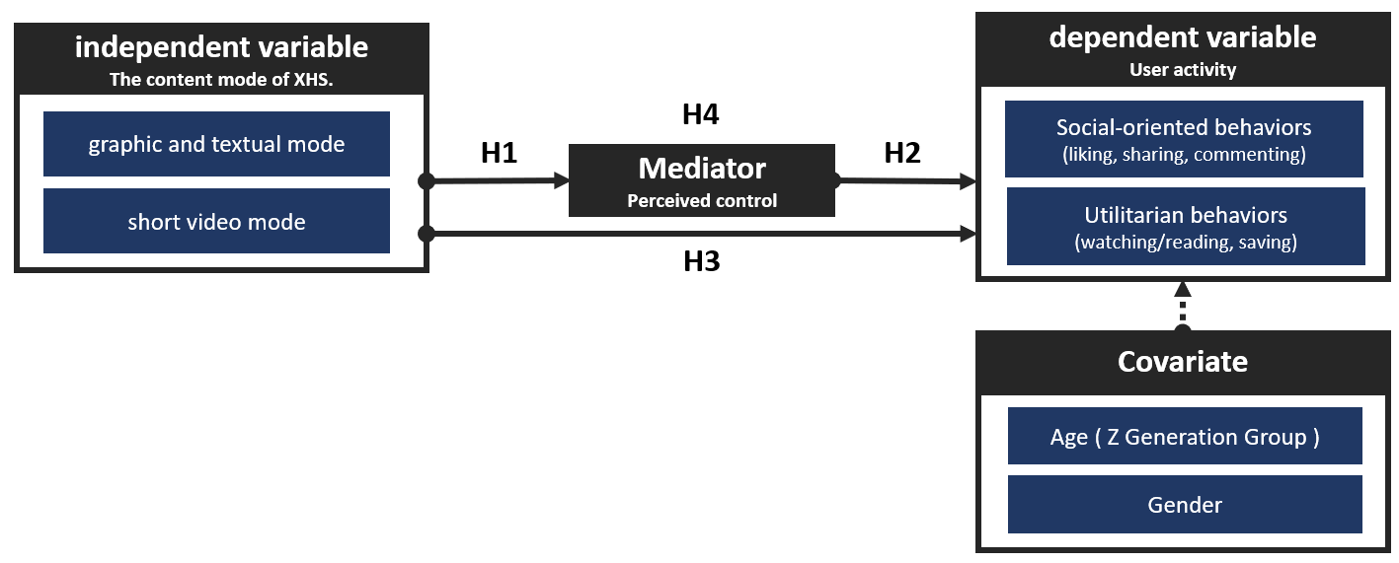
2.4 The Mediating Role of Perceived Control
H2: Direct Effect of Control
Perceived control is positively associated with intentions to (H2a) like, (H2b) share, (H2c) comment, (H2d) watch/read, and (H2e) save.
H3: Effect of Post Format
Users have higher behavioral intentions to (H3a) like, (H3b) share, (H3c) comment, (H3d) watch/read, and (H3e) save graphic posts compared with short video posts.
H4: Mediation Effect
H4: Perceived control mediates the effect of post type on the intention to (H4a) like, (H4b) share, (H4c) comment, (H4d) watch/read, and (H4e) save.

Slide 11
3
Method
AIDM 7480

Slide 12

Questionnaire
1. Participants & Sampling
Target sample: Gen Z users (born 1995–2010)
Randomized controlled design: Participants were randomly assigned to either the image-text group or the short video group
Stimulus materials: 3 common content topics (outfit matching, home cooking, product recommendation) with consistent core information across formats
2. Measures
Independent Variable: Post type (image-text / short video)
Mediator: Perceived control (information processing control)
Dependent Variable: User engagement intentions (like, share, comment, watch, save)
Scales: 7-point Likert scale for perceived control; 5-point likelihood scale for engagement intentions
Covariates: Gender, age, daily Xiaohongshu usage duration
Reliability: All scales demonstrated good internal consistency (Cronbach’s α > 0.7)
3. Procedures
Informed consent
Random exposure to stimulus materials
Completion of perceived control and engagement intention scales
Collection of demographic and covariate information
A I D M 7 4 8 0

Slide 13
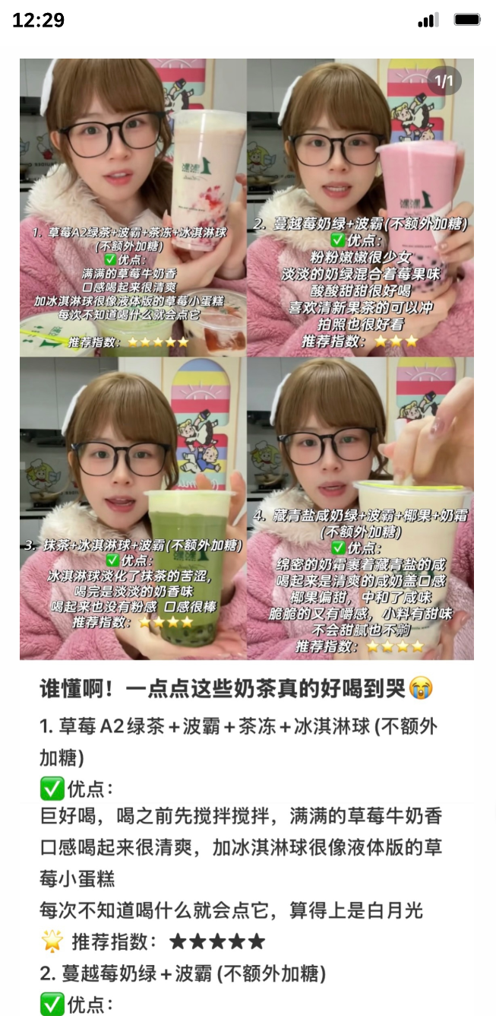
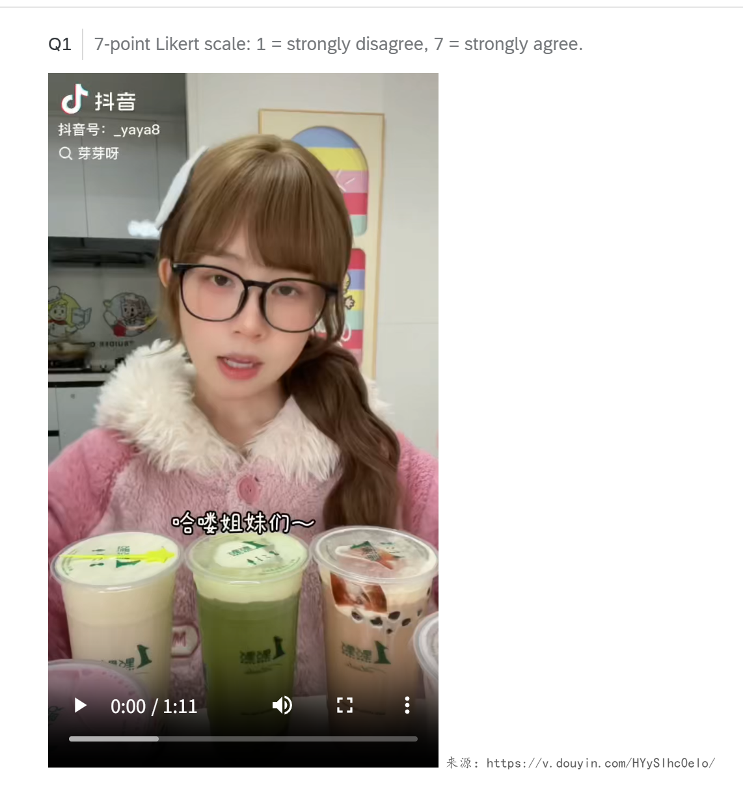
AIDM 7480
picture example
video exmaple

Slide 14
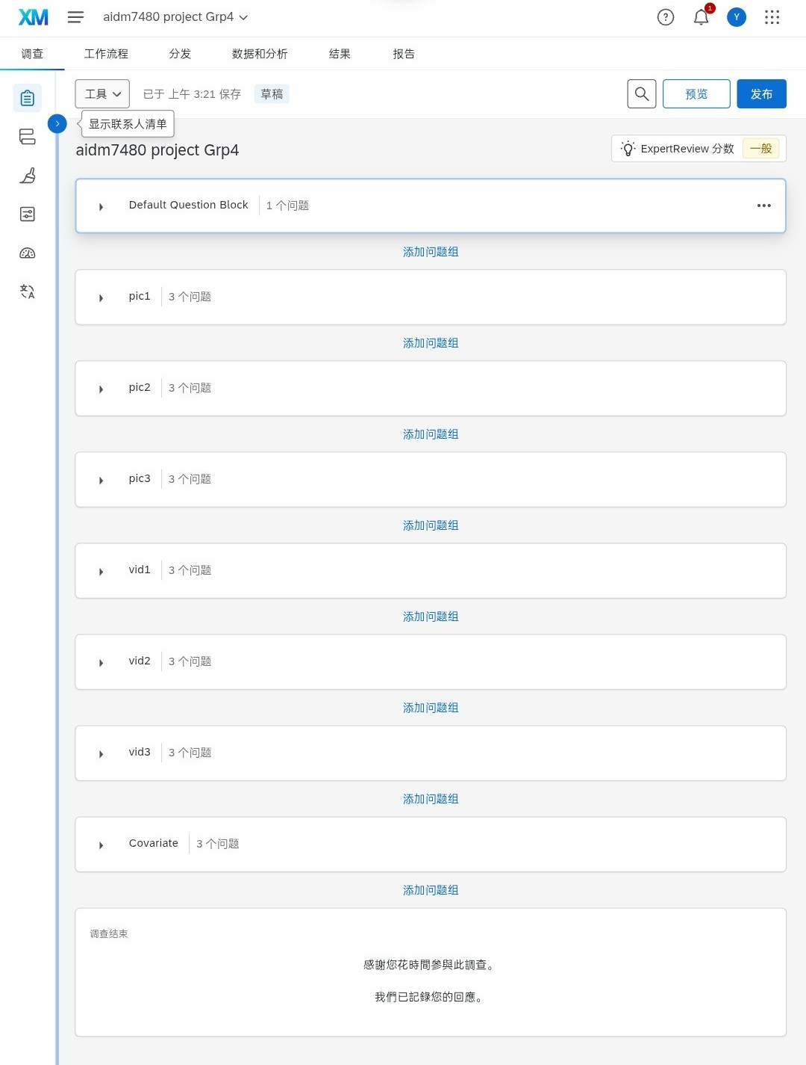
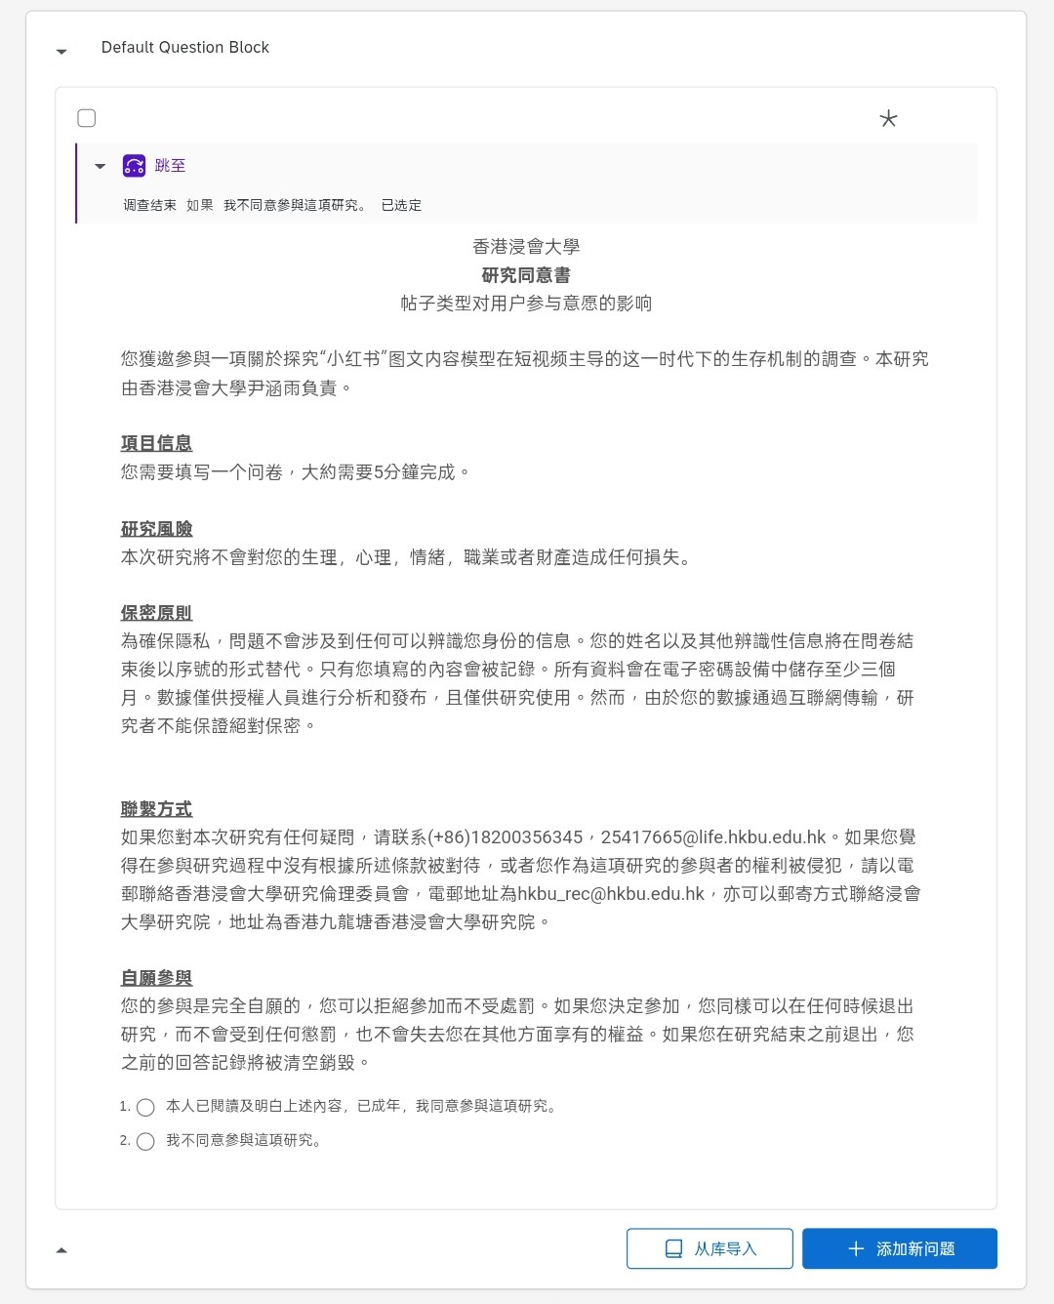
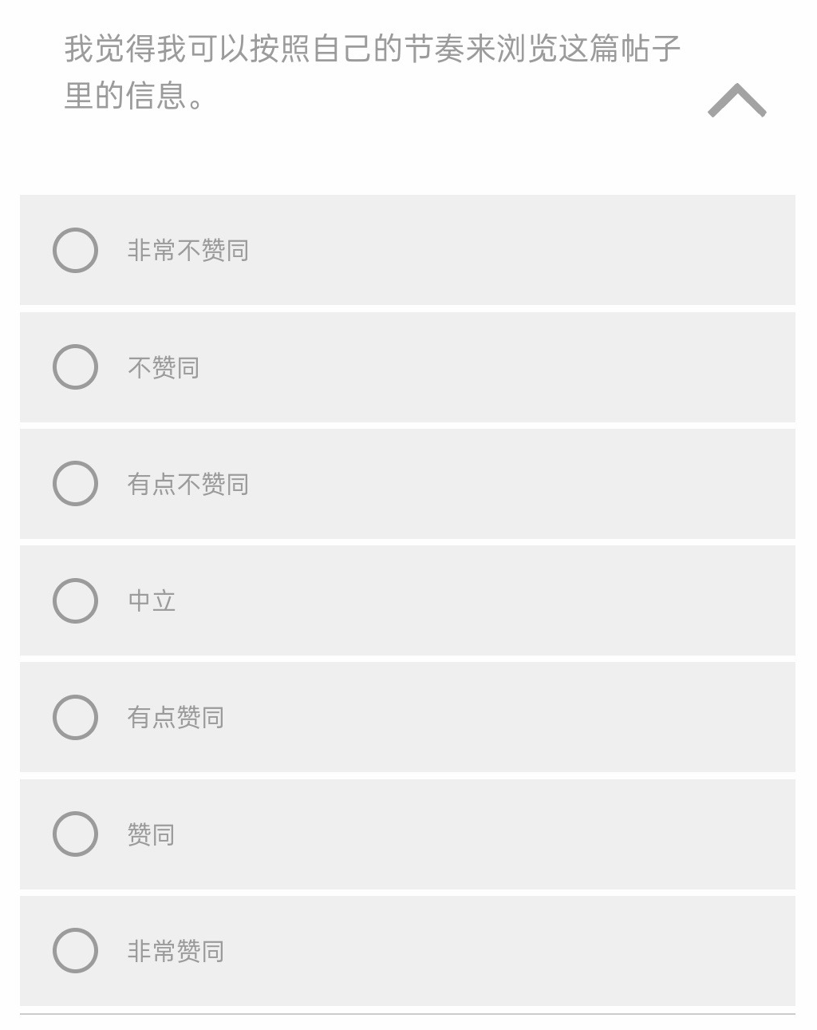
AIDM 7480
Fig.1: Questionnaire Structure Diagram
Fig.2: Informed Consent
Fig.3 Questionnaire Item Example

Slide 15
4
Results
4.1 Data Analysis & Questionnaire Results
4.2 Hypothesis testing and comparison
AIDM 7480

Slide 16

4.1 Data Analysis &
Questionnaire Results
A I D M 7 4 8 0

Slide 17
Sample distribution
Filter forms with reasonable filling time, reasonable answers, and complete filling;
Calculate basic statistical information in the original table:
The original 224 pieces of data (including 15 previews), now 209 pieces of data, 170 usable data, with a loss of 18.66%;
The average daily usage time of XHS is 3.5 hours, with the majority being 4 hours (mode);
The average age of users participating in the questionnaire is 25 (mean & mode);
Among them, more ♀ participated in the questionnaire (80%).
Image and Text Post Group
(Group A)
Number of people: 88
Short Video Post Group
(Group B)
Number of people: 82
AIDM 7480
Notes:
1.7.2013
本次汇报将分为五个部分：首先介绍研究主题与假设，然后展示描述性统计与信度检验结果，接着是核心的假设检验结果，之后对结果进行讨论并阐述启示，最后分析研究的局限并提出未来展望。
‹#›

Slide 18
Reliability Test (Cronbach’s α)
Group | Perceptual Control （PC）α | Willingness to participate （Intent）α | Content Quality Perception （PCQ）α
A group | 0.831 | 0.873 | 0.670
B group | 0.898 | 0.764 | 0.671
α > 0.7 is considered acceptable reliability, and α > 0.8 is considered good reliability. The data show that the PC and Intent scales have good reliability, while the PCQ scale is close to the acceptable range.
AIDM 7480
Notes:
1.7.2013
本次汇报将分为五个部分：首先介绍研究主题与假设，然后展示描述性统计与信度检验结果，接着是核心的假设检验结果，之后对结果进行讨论并阐述启示，最后分析研究的局限并提出未来展望。
‹#›

Slide 19
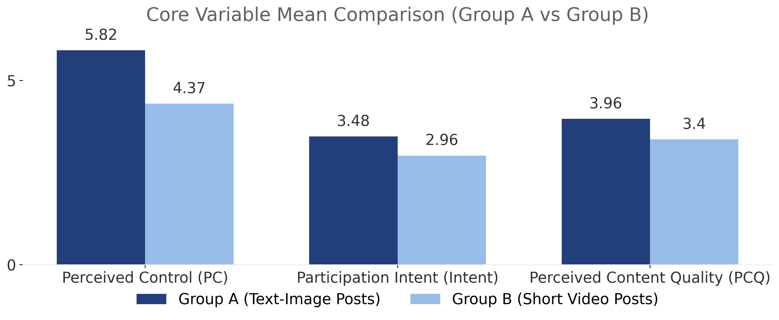
Mean and standard deviation of core variables (M±SD)
Core variable | Group A (Image and Text Post) M±SD | Group B (Short Video Post) M±SD
PC | 5.82 ± 0.56 | 4.37 ± 0.95
Intent | 3.48 ± 0.64 | 2.96 ± 0.48
PCQ | 3.96 ± 0.46 | 3.40 ± 0.49
AIDM 7480
Conclusion: Group A (text and image posts) scored significantly higher than Group B (short video posts) on all core variables, with the largest difference observed in perceived control.
Notes:
1.7.2013
本次汇报将分为五个部分：首先介绍研究主题与假设，然后展示描述性统计与信度检验结果，接着是核心的假设检验结果，之后对结果进行讨论并阐述启示，最后分析研究的局限并提出未来展望。
‹#›

Slide 20
Pearson Correlation Analysis (1)
Range of correlation coefficient(r)
Analysis of Five Major Participatory Behavior Associations
0.396 - 0.649
Research shows that there is a moderate positive correlation between users' five behaviors: liking, sharing, commenting, reading/watching, and saving.
This result indicates that although there are inherent connections between the behaviors, they are relatively independent of each other; therefore, in subsequent model building, they can be analyzed as independent dependent variables to more accurately capture user behavior motivations.
Moderate positive correlation
AIDM 7480
Notes:
1.7.2013
本次汇报将分为五个部分：首先介绍研究主题与假设，然后展示描述性统计与信度检验结果，接着是核心的假设检验结果，之后对结果进行讨论并阐述启示，最后分析研究的局限并提出未来展望。
‹#›

Slide 21
Pearson Correlation Analysis (2)
The Relationship Between Post Types and Perceived Control
Data show that post type is strongly positively correlated with perceived control (r=0.682, p<0.01). This means that image and text posts can significantly enhance users' sense of perceived control.
The Correlation Between Post Types and Willingness to Participate
The type of post is significantly positively correlated with all five participation intentions, with correlation coefficients r ranging from 0.296 to 0.437 (p<0.01). Among them, the highest correlation is with the bookmarking behavior (r=0.437).
AIDM 7480
Notes:
1.7.2013
本次汇报将分为五个部分：首先介绍研究主题与假设，然后展示描述性统计与信度检验结果，接着是核心的假设检验结果，之后对结果进行讨论并阐述启示，最后分析研究的局限并提出未来展望。
‹#›

Slide 22
Pearson Correlation Analysis (3)
The Correlation Between Perceptual Control and Participatory Behavior
Perceived control is significantly positively correlated with the willingness to engage in the five major participatory behaviors (p<0.01), with correlation coefficients r ranging from 0.287 to 0.549.
Among them, it has the highest correlation with collecting behavior, with a correlation coefficient of:
r = 0.549
Conclusion:
The H2 hypothesis was preliminarily verified: the stronger the user's perceived control, the higher the willingness to participate, with the willingness to favorite being the most obvious.
AIDM 7480
Notes:
1.7.2013
本次汇报将分为五个部分：首先介绍研究主题与假设，然后展示描述性统计与信度检验结果，接着是核心的假设检验结果，之后对结果进行讨论并阐述启示，最后分析研究的局限并提出未来展望。
‹#›

Slide 23

4.2 Hypothesis testing and comparison
A I D M 7 4 8 0

Slide 24
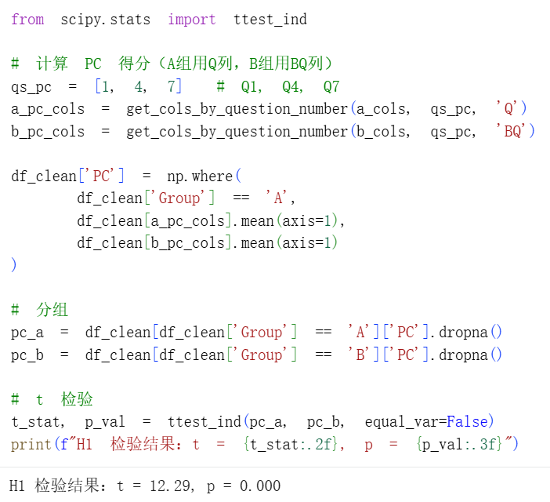
Hypothesis testing H1
Compared to short video posts, image and text posts can enhance users' perceived control over information processing.
Testing methods
Conclusion:
The perceptual control of the graphic group (A) is significantly higher than that of the video group (B) → Graphics and text make users more "controllable" rather than videos.
Why interpret it this way
Use pc_a=the average PC value of group A, pc-b=the average PC value of group B, and then do ttest_ind (pc_a, pc-b, equalinvar=False).
T is positive and large, indicating that mean (A)>mean (B).
P ≈ 0 indicates a highly significant difference.
Perceived control (PC) is not a literal understanding of "easier to read", but rather a sense of control over the pace and manner of information processing. Therefore, it can be expressed as' graphics and text bring stronger perceptual control than short videos'. This is consistent with the direction of H1 (H1 expects higher graphics and text).
AIDM 7480
Statistical results
Conclusion Determination
t = 12.29, p = 0.000 (p < 0.001)
The hypothesis is supported.
Notes:
1.7.2013
本次汇报将分为五个部分：首先介绍研究主题与假设，然后展示描述性统计与信度检验结果，接着是核心的假设检验结果，之后对结果进行讨论并阐述启示，最后分析研究的局限并提出未来展望。
‹#›

Slide 25
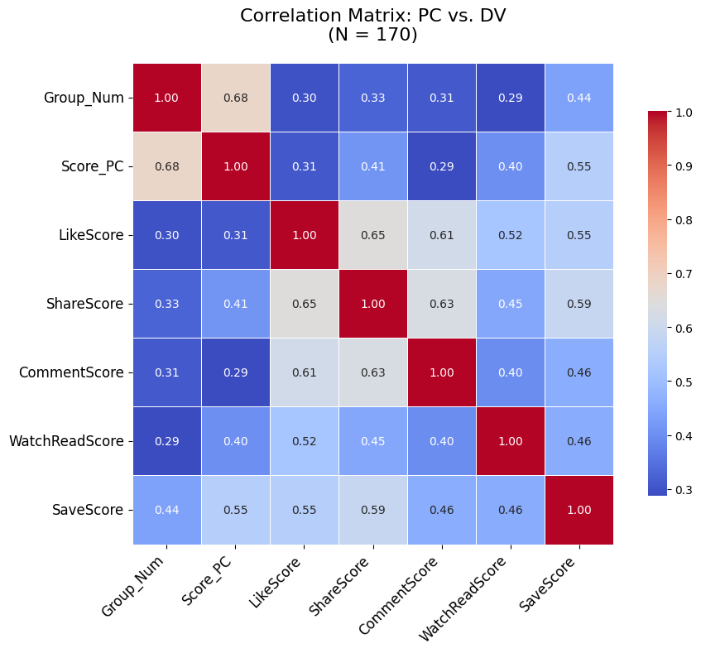
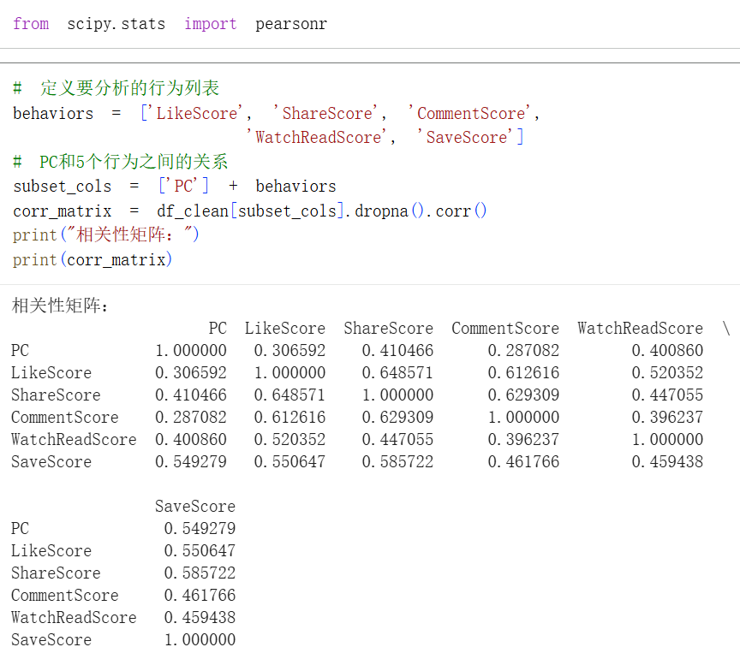
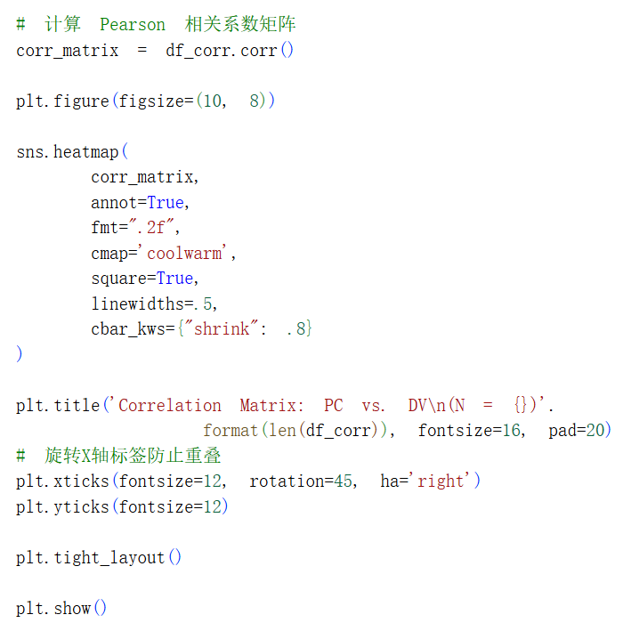
Hypothesis testing H2
Perceived control is positively associated with intentions to (H2a) like, (H2b) share, (H2c) comment, (H2d) watch/read, and (H2e) save.
Testing methods
AIDM 7480
The heatmap shows
Independent variable → mediating variable: Grouping changed users' sense of control
(0.68).Mediating variable → dependent variable: Sense of control enhances user behavior
(0.40+).Independent variable → dependent variable: Grouping improved user behavior (0.30+).
Notes:
1.7.2013
本次汇报将分为五个部分：首先介绍研究主题与假设，然后展示描述性统计与信度检验结果，接着是核心的假设检验结果，之后对结果进行讨论并阐述启示，最后分析研究的局限并提出未来展望。
‹#›

Slide 26
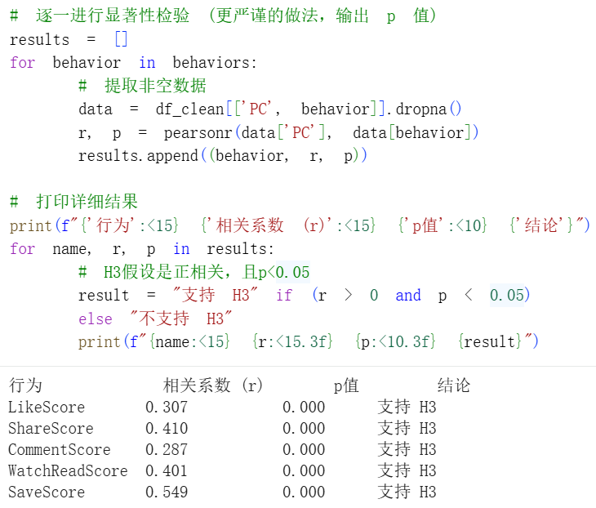
Hypothesis testing H2
Perceived control is positively associated with intentions to (H2a) like, (H2b) share, (H2c) comment, (H2d) watch/read, and (H2e) save.
Testing methods
Conclusion:
All correlation coefficients (r) are positive;
p-value less than 0.05 indicates that the higher the perceived control (PC), the higher the user's willingness to participate (DV) (like, share, comment, watch/read, save),
Perceived control (PC) and behavioral intention (DV) are significantly positively correlated, which supports the H3 hypothesis.
AIDM 7480
Statistical results
Conclusion Determination
r > 0， p = 0.000 (p < 0.001)
The hypothesis is supported.
Notes:
1.7.2013
本次汇报将分为五个部分：首先介绍研究主题与假设，然后展示描述性统计与信度检验结果，接着是核心的假设检验结果，之后对结果进行讨论并阐述启示，最后分析研究的局限并提出未来展望。
‹#›

Slide 27
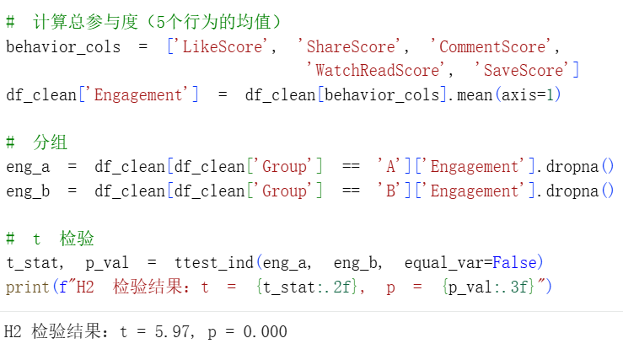
Hypothesis testing H3
Compared to short video posts, users have higher willingness to engage in all five major interaction behaviors with image and text posts.
Testing methods
Conclusion:
Users' intentions to like, share, comment, read, and save graphic and textual posts are significantly higher than those of short video posts, with strong statistical significance (t=5.97, p=0.000), verifying that graphic and textual content can better stimulate users' willingness to participate in various aspects.
AIDM 7480
Statistical results
Conclusion Determination
t = 5.97, p = 0.000 (p < 0.001)
The hypothesis is supported.
Notes:
1.7.2013
本次汇报将分为五个部分：首先介绍研究主题与假设，然后展示描述性统计与信度检验结果，接着是核心的假设检验结果，之后对结果进行讨论并阐述启示，最后分析研究的局限并提出未来展望。
‹#›

Slide 28
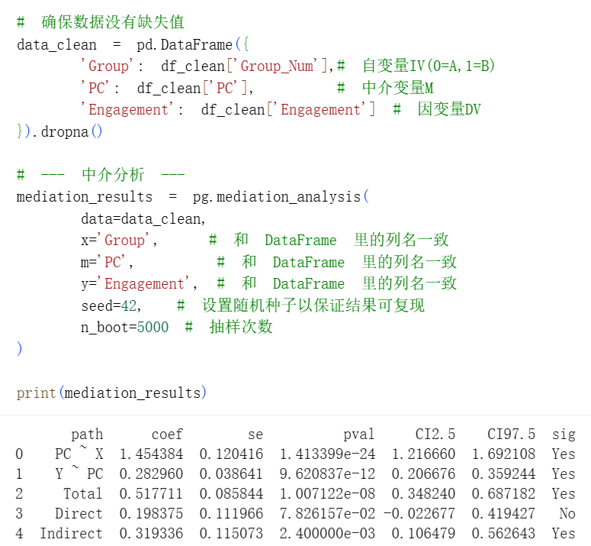
Hypothesis testing H4
PC mediates the effect of post type on the intention to (H4a) like, (H4b) share, (H4c) comment, (H4d) watch/read, and (H4e) save.
Testing methods
Conclusion:
Experimental grouping has a significant positive impact on perceived control, and perceived control also has a significant positive impact on user engagement.
The most critical mediation effect value is 0.319 and highly significant.
After introducing the mediator variable, the direct effect of experimental grouping on user engagement is no longer significant.
This indicates that the influence of experimental grouping on user engagement is entirely achieved by enhancing users' perceived sense of control, which verifies H4.
AIDM 7480
Statistical results
Conclusion Determination
The hypothesis is supported.
Notes:
1.7.2013
本次汇报将分为五个部分：首先介绍研究主题与假设，然后展示描述性统计与信度检验结果，接着是核心的假设检验结果，之后对结果进行讨论并阐述启示，最后分析研究的局限并提出未来展望。
‹#›

Slide 29
Summary of main findings
The data analysis results provide robust support for all four hypotheses.
H1 (Perceived Control): The Image and Text Post Group (Group A) demonstrated significantly higher levels of perceived control over information processing compared to the Short Video Post Group (Group B) (t=12.29, p<0.001).
H2 (Correlation): Pearson correlation analysis confirmed a significant positive relationship between perceived control and behavioral intentions, validating the proposed associations.
H3 (Willingness to Participate): Consistent with H1, Group A also exhibited significantly higher willingness to engage in all five major interactive behaviors (t=5.97, p<0.001).
H4 (Mediation): The mediation analysis revealed a full mediation effect. While the experimental grouping had a significant impact on perceived control, its direct effect on user engagement became non-significant after introducing perceived control as the mediator. The indirect effect (ab = 0.319) was highly significant, indicating that the influence of post type on user engagement is entirely achieved through enhancing users' perceived sense of control.
Conclusion
The findings collectively suggest that Image and Text posts outperform Short Videos by fostering a greater sense of user control, which in turn drives higher user engagement.
AIDM 7480
Notes:
1.7.2013
本次汇报将分为五个部分：首先介绍研究主题与假设，然后展示描述性统计与信度检验结果，接着是核心的假设检验结果，之后对结果进行讨论并阐述启示，最后分析研究的局限并提出未来展望。
‹#›

Slide 30
5
Discussion
AIDM 7480

Slide 31

Theoretical & Practical Implications
Theoretical Implications
First to reveal the full mediating role of perceived control
Post type → perceived control → engagement intention (full mediation, indirect effect = 0.319, p < 0.001)
Image-text posts enhance engagement entirely through enhancing perceived control
Redefines media forms by “control provision”
Image-text = high-control provision type
Short video = low-control provision type
Fills the theoretical gap in defining the essence of media forms
Extends Self-Determination Theory & UGT to new media contexts
Perceived control = manifestation of “autonomy need” in information processing
Shifts research from “shallow association of forms” to “deep psychological mechanism-driven”
AIDM 7480

Slide 32
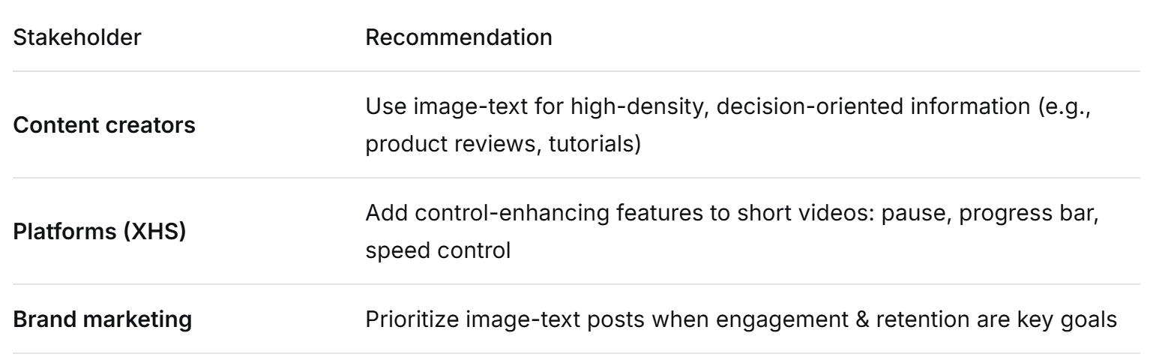
Practical Implications
AIDM 7480

Slide 33
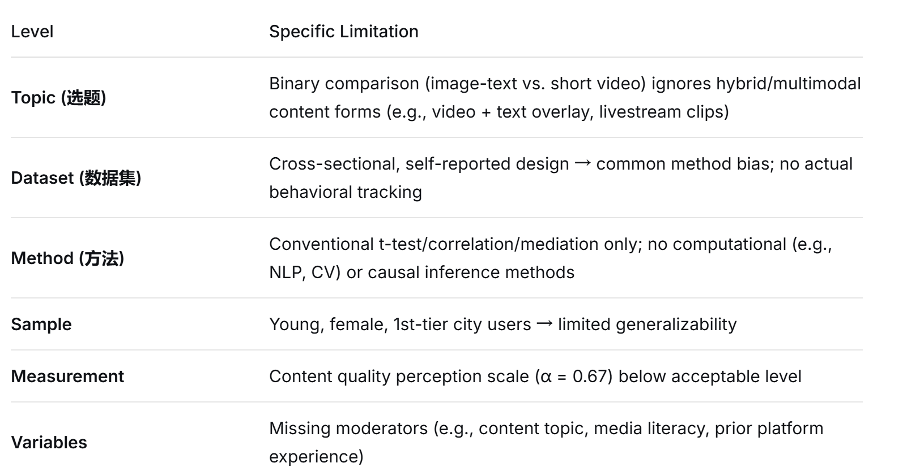
Limitations
AIDM 7480

Slide 34
Future Directions
Use multimodal content sampling (e.g., hybrid posts) to test boundary conditions of binary findings
Collect longitudinal or repeated-measures data to reduce common method bias
Apply computational methods (NLP for information density, CV for visual complexity)
Stratify sampling by age, city tier, usage intensity, and platform behavior patterns
Combine self-reported intentions with actual behavioral logs (e.g., dwell time, clicks)
Test moderators such as topic type (hedonic vs. utilitarian) or user media literacy
AIDM 7480

Slide 35
Thanks for watching!
YIN Hanyu 25417665 YANG Yuna 25405527
LIU Jiayu 25421212 CHEN Jinqi 25439413
AIDM 7480

