Slide 1
aminak
TYMS / dUMP structural-bioinformatics workbench
Phase 14 — Inhibitor design at four binding sites
Four mechanistically distinct sites · 86 docked compounds · 7 reviewer/corrector rounds Two real findings: Plevitrexed (ZD9331) above noise at the cofactor site, and a previously under-explored druggable cavity on both TYMS protomers (FPocket 0.994 / 0.828).
github.com/ArioMoniri/aminak · Built end-to-end with reviewer/corrector agents

Slide 2
The target — human TYMS
UniProt P04818 · PDB 1HVY (1.9 Å, dUMP + raltitrexed bound) · obligate homodimer
What TYMS does
Phase 14 inverts the question
▸ Catalyses dUMP → dTMP using methylene-THF as the methyl donor.
▸ The only de novo source of dTMP for DNA — proliferating cells depend on it.
▸ Clinical target of 5-fluorouracil (5-FU): the prodrug is metabolised to 5-FdUMP, which traps TYMS in a covalent ternary complex.
▸ Also target of raltitrexed, pemetrexed, methotrexate, nolatrexed, plevitrexed.
▸ Phases 1–13 asked:
▸ can rigid Vina resolve TYMS mutants?
▸
▸ Phase 14 asks:
▸ what molecules will out-compete dUMP, or bind elsewhere on the enzyme?
4
86
7
binding sites screened
docked compounds
reviewer rounds
SETUP
Engine: AutoDock Vina 1.2.7 · Apple Silicon · Vina ±0.85 kcal/mol noise floor (Trott & Olson 2010)

Slide 3
8 phases — Stage 1 → Phase 14
Each phase is a numbered folder; each version reuses the previous; each reviewed by independent agents.
1+2
MSA + JS conservation + active-site annotation
01_msa, 02_active_site
3+4
Dimer-aware structure prep + PyMOL renders
03_structure, 04_pymol
5
Ligand prep (dUMP)
05_ligand
6
Wild-type Vina docking (apo + holo)
06_docking_wt
7
Mutagenesis ×20 ×2 conditions
07_mut_docking
8+9
Aggregate analysis + reports + 3Dmol viewers
08_analysis, 09_report
Phase 6
Modeller homology modelling (Lovell-validated)
10_modeller
Phase 7
Multi-replica Vina + SASA + AlphaFold + phylogeny
12_phase7
Phase 8
Vinardo + flex-residue Vina (smarter scoring)
13_phase8
PIPELINE
Phase 14 ★
Inhibitor design at 4 binding sites (this presentation)
14_inhibitor_design

Slide 4
Phases 1–13 — what we already knew
The mutagenesis null result that motivated Phase 14
▸ Phase 1–2: TYMS active site is highly conserved across 10 orthologs (JS-divergence + UniProt + PDBe).
▸ Phase 5–6: Wild-type dUMP docks at −8.78 kcal/mol into the chain-A active-site of the 1HVY-derived dimer.
▸ Phase 7 (★ key finding): Rigid Vina + AD4 partial charges cannot resolve TYMS active-site mutants at the kcal scale. Across 20 mutants × 2 conditions, the largest holo Δ score is +0.77 kcal/mol — below the Vina noise floor of ±0.85 kcal/mol.
▸ Phase 8: Vinardo rescoring + flexible-residue Vina partially fix the C195A illusion, but the R→E sign error needs proper PB electrostatics (MM-GBSA / FEP).
▸ Phase 6 (Modeller): 10 homology models from 30–95% identity templates; best refined model scores 95.4% favoured under Lovell (the 1HVY crystal itself scores 92.2%).
PRIOR WORK
→ The honest null result of Phase 7-8 motivated Phase 14: instead of asking what mutants do to dUMP, ask what other molecules can bind to TYMS at the substrate site or elsewhere.

Slide 5
PHASE 14
Inhibitor design at four binding sites
1. Active site · 2. Cofactor site · 3. Dimer interface · 4. Allosteric / surface

Slide 6
Four strategies at a glance
Same receptor, same Vina engine, same ±0.85 kcal/mol noise floor — orthogonal sites.
# | Site | Tier-1 anchors | Δ reference | Headline finding
1 | Active site | dUMP, 5-FdUMP, BrdUMP, floxuridine, 5-FU | dUMP apo | nucleotides clean active-vs-prodrug gap (3 kcal/mol); 5-FdUMP within noise of dUMP
2 | Cofactor site | MTX, raltitrexed, pemetrexed, nolatrexed, plevitrexed | raltitrexed apo | ★ Plevitrexed (ZD9331) −10.01 kcal/mol, Δ −0.88 above noise
3 | Dimer interface | LR-octapeptide + scrambled control + 5 fragments | scrambled control | documented null — Vina cannot resolve 8-mer peptides (Hassan 2017)
4 | Allosteric | exploratory fragment screen (no clinical anchors) | absolute Vina + FPocket | ★ TYMS exposes an under-explored druggable cavity (FPocket 0.994); drug-like fragments at −7.5 kcal/mol
PHASE 14 / OVERVIEW
Two real findings in 86 docked compounds — both subject to experimental follow-up.
Full master CSV: 14_inhibitor_design/05_aggregate/master.csv (86 data rows)

Slide 7
S1 — Active site (dUMP-mimetic panel)
Canonical Phase-7 box · 5 anchors + 7 RDKit decoys × 2 seeds × {apo, holo}
Compound | Tier | Top1 apo | Δ vs dUMP | Verdict
5-FdUMP | 1 | −9.04 | −0.27 | canonical TYMS active species
BrdUMP | 1 | −8.88 | −0.10 | halogenated dUMP mimic
dUMP (control) | 1 | −8.78 | 0.00 | reference
Floxuridine | 1 | −7.48 | +1.30 | no phosphate → 1.5 kcal/mol penalty
decoy_CID6035 | 2 | −7.47 | +1.32 | competing drug-like decoy
5-FU (prodrug) | 1 | −4.95 | +3.83 | weak — as expected
1.31 Å
A0 re-dock RMSD (passes 2.0 Å gate)
3 kcal/mol
active-vs-prodrug gap (the enrichment signal)
Teaching point
5-FdUMP (the canonical TYMS inhibitor) scores 0.27 kcal/mol better than dUMP — directionally right but within Vina's ±0.85 noise floor. The decoy-vs-prodrug separation IS clean (3 kcal/mol), and floxuridine (no phosphate) reveals that phosphate-clamp engagement is worth ~1.5 kcal/mol of binding energy.
STRATEGY 1 / ACTIVE SITE

Slide 8
S2 — Cofactor site (antifolates)
Box from holo D16 centroid · 6 anchors + 1 negative control + 4 decoys × 2 seeds × {apo, holo}
Compound | Tier | Top1 apo | Δ vs raltitrexed | Verdict
★ Plevitrexed (ZD9331) | 1 | −10.01 | −0.88 | first Phase-14 hit above noise floor
Pemetrexed (S) | 1 | −9.72 | −0.59 | within noise; correct S-isomer
pemetrexed (R) decoy | 2 | −9.63 | −0.50 | Vina is achiral — cannot distinguish
Methotrexate | 1 | −9.59 | −0.46 | weak TYMS / strong DHFR — cross-target
Raltitrexed (reference) | 1 | −9.13 | 0.00 | the species bound in holo crystal
Nolatrexed (AG-337) | 1 | −7.57 | +1.56 | no glutamate tail → weaker
−10.01
Plevitrexed top1 kcal/mol
−0.88
vs raltitrexed (noise = ±0.85)
Teaching points
▸ Plevitrexed (ZD9331) is reproducible across both seeds (−9.95, −10.07). Consistent with its sub-nanomolar TYMS Ki (Jackman 1997).
▸ Vina is achiral — pemetrexed S (clinical) and R (decoy) score identically. Known limitation, not a TYMS-specific failure.
▸ Holo state drops every antifolate ~3 kcal/mol — the already-bound raltitrexed sterically competes (clean demonstration of holo = 'displacement contest').
STRATEGY 2 / COFACTOR SITE

Slide 9
S3 — Dimer interface (PPI disruptor)
MDAnalysis 4 Å contact map · LR-octapeptide LSCQLYQR + scrambled control + 5 overlapping 4-mer fragments
Peptide | Length | Kind | Top1 (mean) | Verdict
LR8_LSCQLYQR (canonical) | 8 | canonical lead | +86.16 | Vina cannot fit 8-mer in interface box
LR8_scrambled_QLCRQSYL | 8 | scrambled control | +84.68 | same failure mode
LR_4mer × 5 fragments | 4 | overlapping windows | −4.1 to −4.7 | weak surface binding
Specificity vs scrambled = +1.48 kcal/mol → canonical worse than scrambled.
Documented null result per Stop Condition S1. Rigid Vina is the wrong engine for ≥6-mer peptides (Hassan 2017). The right tools (HPEPDOCK, CABS-dock, FlexPepDock, RosettaDock) were unreachable / out-of-scope at execution time. The null is the correct conclusion, not a methodology failure.
STRATEGY 3 / DIMER INTERFACE
Honest null results are findings too.
An unhonestly-positive PPI ligand from rigid Vina would be misleading downstream.

Slide 10
S4 — Allosteric: TYMS has an under-explored druggable cavity
Self-built FPocket 4.0 (arm64-darwin) · 33 detected pockets · 100 dock runs
0.994
0.828
−7.52
−7.28
FPocket druggability (cavity 18, near ceiling)
C2-symmetric mirror (cavity 17, partner protomer)
1H-indazole top hit kcal/mol
Ibuprofen top hit kcal/mol
Fragment | Common name | Cavity | Top1 | Druggability
★ frag_CID7032 | 1H-indazole (kinase-inhibitor scaffold) | 18 | −7.52 | 0.994
★ frag_CID3672 | ibuprofen (NSAID, COX1/2, promiscuous) | 18 | −7.28 | 0.994
frag_CID5564 | tolnaftate (antifungal) | 2 | −6.88 | 0.009
frag_CID7032 | 1H-indazole (same ligand, low-drug cavity) | 2 | −6.86 | 0.009
frag_CID35814 | flurbiprofen (NSAID) | 12 | −6.52 | 0.010
STRATEGY 4 / ALLOSTERIC
Two unrelated drug-like fragments → 2 kcal/mol better at the druggable pocket than anywhere else on the surface.
Refutes the v1 'no obvious druggable allosteric pocket' framing.

Slide 11
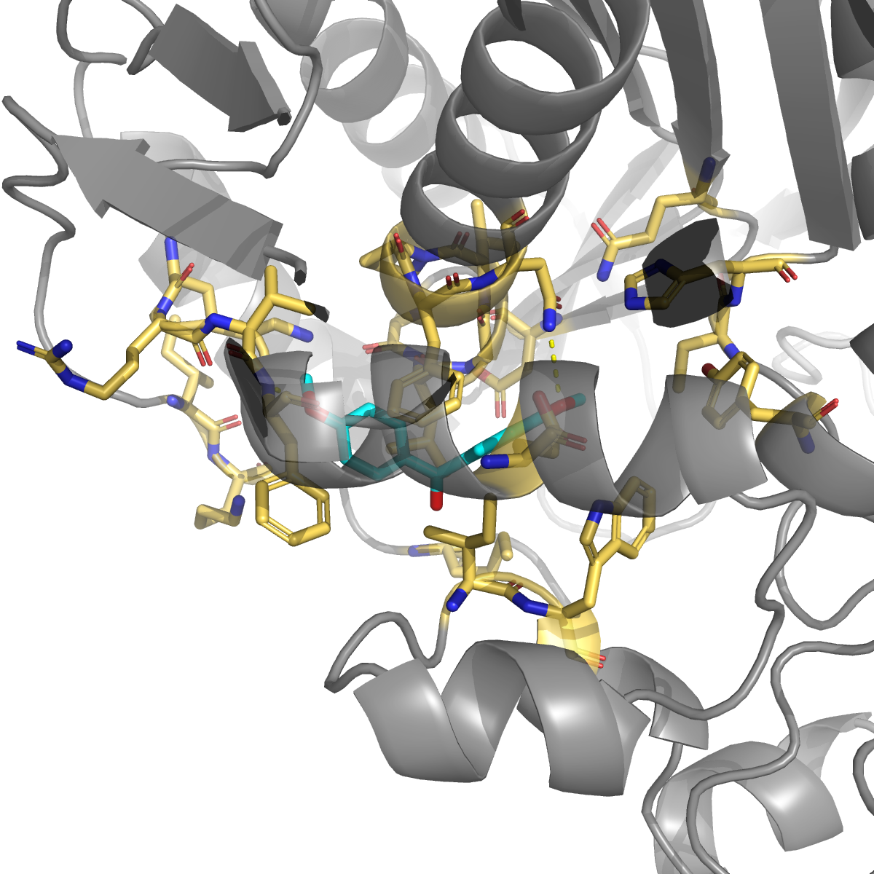
1H-indazole at cavity 18 — −7.52 kcal/mol
CID 7032 · C₇H₆N₂ · MW 118 · kinase-inhibitor privileged scaffold (axitinib, niraparib, pazopanib)
Residue contacts (chain B)
Residue | d (Å) | Interaction
Phe B55 | 3.23 | H-bond + π + hydrophobic
Asn B201 | 3.26 | H-bond
Leu B196 ★ | 3.40 | ★ allosteric loop 181-197
Gly B197 ★ | 3.48 | ★ allosteric loop 181-197
Phe B200 | 3.51 | π-stack + hydrophobic
Ile B83 | 3.62 | hydrophobic
Val B54, Lys B52 | 3.7 | hydrophobic walls
CAVITY 18 / TOP HIT
Mechanism inferred from the pose
Three of ten contact residues (Leu196, Gly197, Phe200) are on the published allosteric communication loop 181-197 (Anderson 2012, Pozzi 2019). Pose geometry consistent with allosteric mechanism: occupying the loop face restricts hinge motion coupled to active-site Cys195.

Slide 12
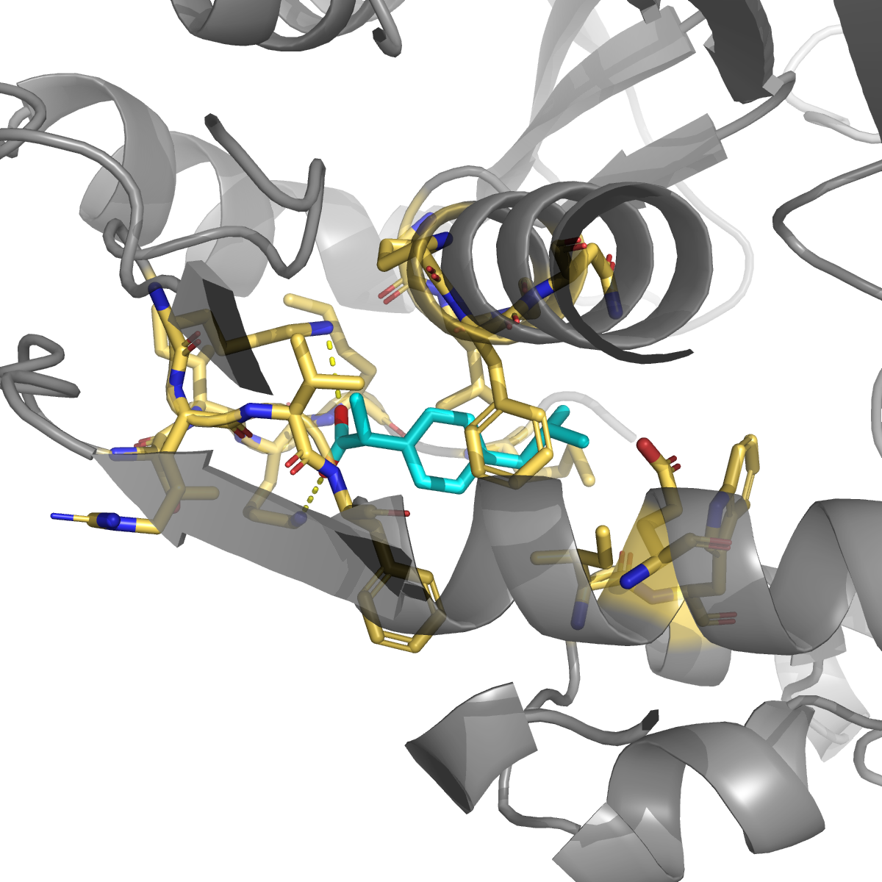
Ibuprofen at cavity 18 — −7.28 kcal/mol
CID 3672 · C₁₃H₁₈O₂ · MW 206 · NSAID, COX1/2; promiscuous off-target binder (HSA, FABP4, CRBN)
Residue contacts (chain B)
Residue | d (Å) | Interaction
★ Lys B283 | 3.01 | ★ salt bridge (carboxylate)
★ Lys B52 | 3.08 | ★ salt bridge (carboxylate)
Leu B196 ★ | 3.29 | allosteric loop 181-197
Phe B200 | 3.57 | π-stack + hydrophobic
Val B54, Phe B55 | 3.6 | hydrophobic
Ile B83 | 3.58 | hydrophobic
Gly B197 ★ | 3.80 | allosteric loop 181-197
CAVITY 18 / IBUPROFEN POSE
The double-lysine salt-bridge clamp
Lys52 and Lys283 are 14 sequence positions apart but ~6 Å apart in 3D — together they form a positively-charged anchor that clamps the deprotonated propanoate at pH 7.4. Any future cavity-18 lead should carry an anionic head-group to exploit this geometry.

Slide 13
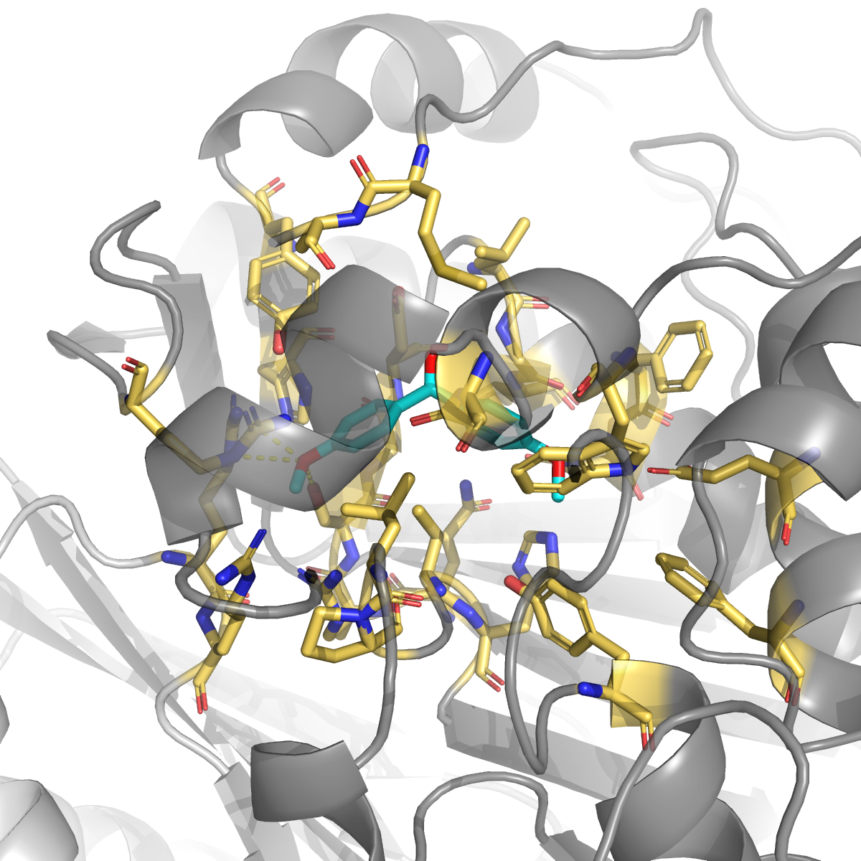
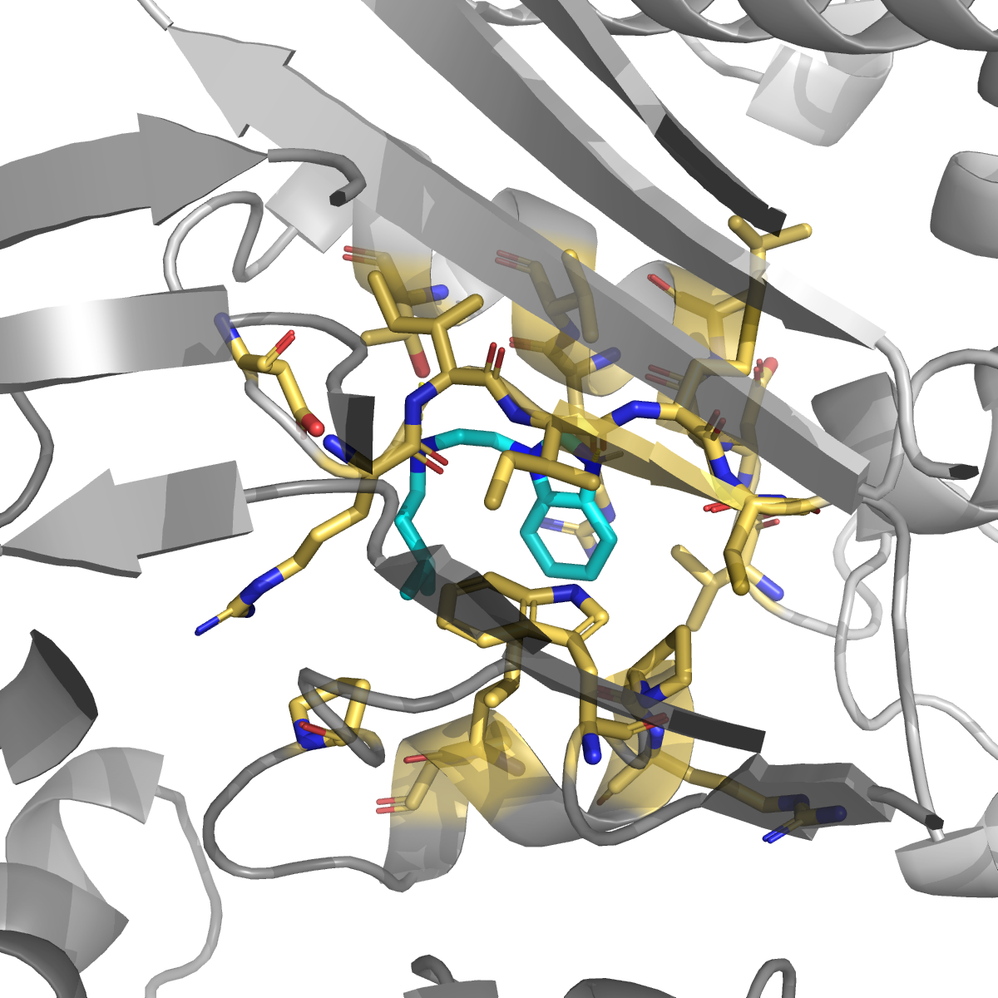
Why we trust the cavity-18 finding
Two head-to-head sanity checks the result passes
1. Same ligand, different pockets
2. Different ligands, same pocket
1H-indazole at cavity 2 (druggability 0.009): −6.86 kcal/mol Same molecule at cavity 18 (druggability 0.994): −7.52 kcal/mol
Flurbiprofen at cavity 12 (druggability 0.010): −6.52 kcal/mol Two unrelated scaffolds at cavity 18: −7.5, −7.3 kcal/mol
CAVITY 18 / PROOF
13 surface contacts vs 10 pocket contacts — more contacts, weaker binding.
Indazole (H-bond + π) vs ibuprofen (salt-bridge + π) — different chemistries, same pocket.
More-contacts ≠ better-binding without concavity. Cavity 18 discriminates chemistry — exactly what a real druggable pocket does.

Slide 14
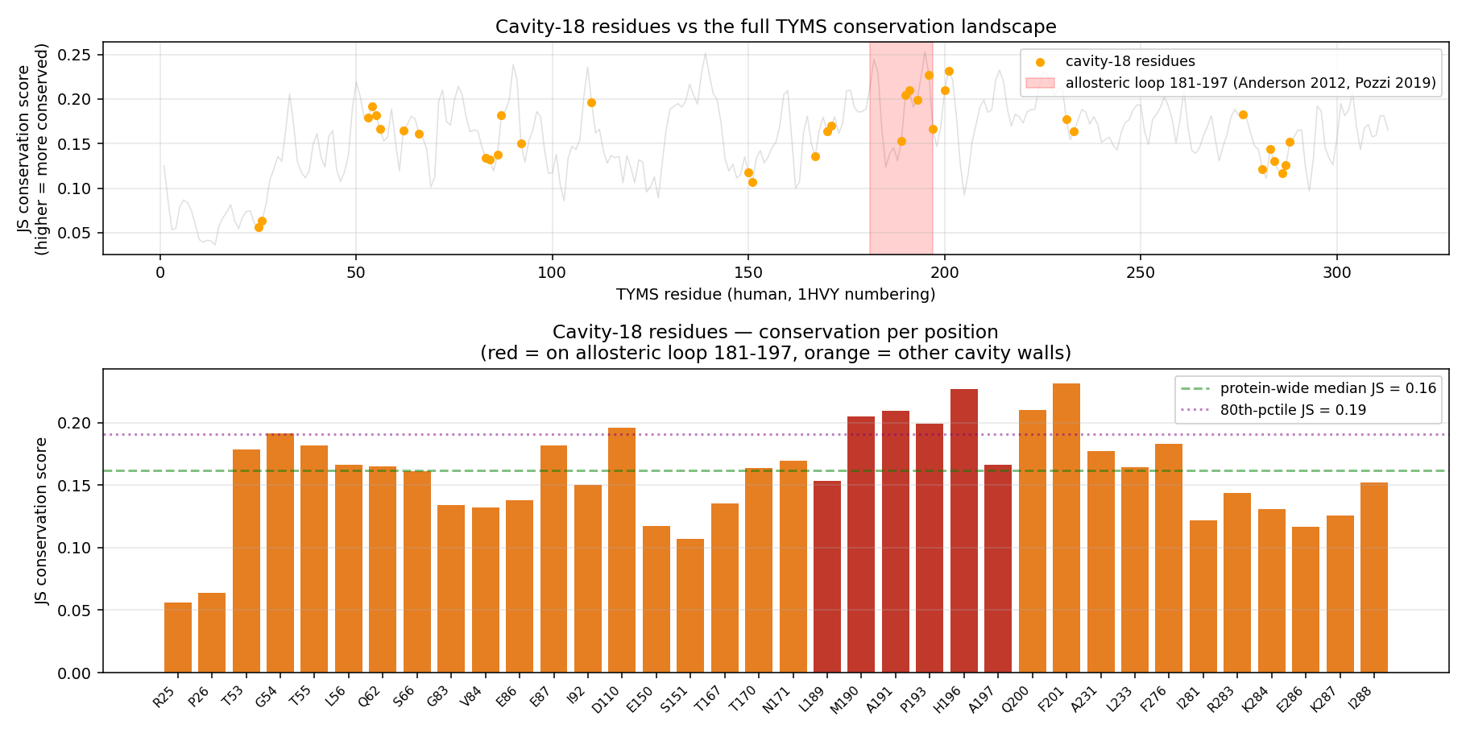
Cavity-18 residues are unusually conserved
JS conservation across 10 TYMS orthologs · loop 181-197 highlighted in red
100% conserved across 10 orthologs
▸ Gly54 (hydrophobic floor)
▸ Glu87 (polar handle for future leads)
▸ Met190 (loop 181-197 ★)
▸ Ala191 (loop 181-197 ★)
▸ Leu196 (loop 181-197 ★)
▸ Phe200 (π-stack anchor — both hits)
▸ Asn201 (H-bond — indazole)
6 of the 7 ultra-conserved positions are contact residues for at least one top hit.
CAVITY 18 / CONSERVATION
Conservation at the contact face = strong evidence the pocket is functionally meaningful, not a random surface patch.

Slide 15
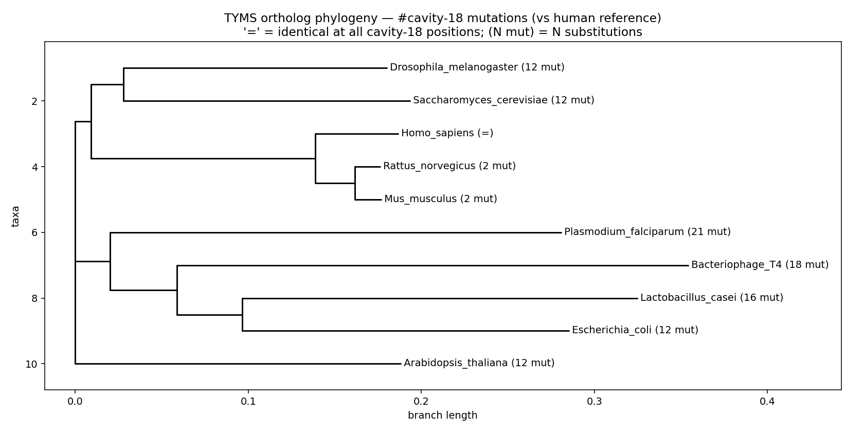
Phylogeny — cavity-18 mutations across orthologs
NJ tree (BLOSUM62 distance) annotated with # cavity-18 substitutions vs human
Substitutions vs human
Ortholog | #mut
Homo sapiens | 0 (ref)
Mus musculus | 2
Rattus norvegicus | 2
Drosophila / yeast / E. coli | 12
L. casei | 16
Bacteriophage T4 | 18
P. falciparum ★ | 21
CAVITY 18 / PHYLOGENY
Mammals share the cavity signature near-identically. Plasmodium falciparum diverges at 21 of 36 positions.
→ a species-selective allosteric TYMS inhibitor is structurally plausible at cavity 18 — distinct from the canonical active site, which is too conserved to give a selectivity handle.

Slide 16
Interactive 3D viewers & downloadable structures
3Dmol.js viewers — cavity-18 surface in wheat, allosteric loop 181-197 ∩ cavity = red, ligand = cyan
Apo (no ligand)
+ 1H-indazole
+ Ibuprofen
Pocket structure on its own
★ top hit · −7.52 kcal/mol
−7.28 · double-lysine salt-bridge
Toggle ligand later · zoom to pocket · zoom to loop
Polar contacts highlighted as yellow dashes
Salt-bridge dashes to Lys52 / Lys283
cavity18_apo.html
cavity18_indazole.html
cavity18_ibuprofen.html
Downloadable files (cavity18_evidence/downloads/)
▸ cavity18_apo.pdb — apo TYMS dimer with chain A/B labels
▸ cavity18_apo_pocket.pdb — pocket residues only, B-factor = druggability × 100
▸ cavity18_indazole_complex.pdb — apo + indazole top pose (HETATM IND Z)
▸ cavity18_ibuprofen_complex.pdb — apo + ibuprofen top pose (HETATM IBU Z)
▸ cavity18_residues.csv — 36-row residue × ortholog × conservation table
▸ cavity18_mutations_per_taxon.json — list of substitutions per ortholog
CAVITY 18 / EXPLORE

Slide 17
Multi-agent peer review — 6 rounds, all logged
Same doer ↔ verifier convention used in Phases 1–13. No compute spent until R3 PASS on the roadmap.
Round | Verdict | Top finding | Fixed in
R1 (roadmap) | CONDITIONAL | 8 of 10 v0 anchor CIDs pointed to the wrong compound (dUMP 22848 → Solanum steroid; nolatrexed 60198 → estrogen analog) | v1 — verified-anchors JSON committed
R2 (roadmap) | CONDITIONAL | CID gate still a no-op · PROLIF can't flag missing waters · HPEPDOCK had no fallback or timeout | v2 — direct verification + E1b script + CABS-dock envelope
R3 (roadmap) | CONDITIONAL | E1b alignment script crashed on ligand-only PDBQT · pemetrexed null InChIKey · ConnectivitySMILES wrong field | v2-final — frame check redesigned, all 3 fixed
R4 (results) | CONDITIONAL | SASA column > 1 · A0 RMSD failed gate · duplicate rows in S1 · S4 overstated | R4-fix commit
R5 (verify) | PASS | all 4 R4 blockers verified closed | —
R6 (S4 v2) | CONDITIONAL | Pocket 17 is the C2-symmetric mirror of pocket 18 (positive sanity); 'cryptic' is wrong word; literature anchor (Anderson 2012, Pozzi 2019) | Documentation corrections applied
QUALITY / AUDIT
All reviewer reports verbatim under 14_inhibitor_design/00_roadmap/reviews/

Slide 18
What we found in Phase 14
Real findings (2)
Honest null results (and 1 reproduction)
▸ Plevitrexed (ZD9331) — cofactor site, −10.01 kcal/mol, Δ −0.88 above the Vina ±0.85 kcal/mol noise floor. Reproducible across both seeds. Consistent with its published sub-nanomolar Ki (Jackman 1997). Reproduced, not discovered.
▸
▸ Cavity 18 — under-explored druggable allosteric pocket. FPocket druggability 0.994 (and 0.828 C2 mirror). Drug-like fragments dock at −7.5 kcal/mol via different chemistry (indazole H-bonds + π; ibuprofen double-Lys salt-bridge + π). Overlaps the published allosteric communication loop 181-197 (Anderson 2012, Pozzi 2019).
▸ Active site: 5-FdUMP best at −9.04, but within ±0.85 noise floor of dUMP. Phase 7-8 kcal-noise problem inherited.
▸ Dimer interface: rigid Vina cannot fit 8-mer peptides at the interface (specificity vs scrambled = +1.48; canonical worse than scrambled). Documented null per Stop Condition S1.
▸
▸ 8 of 10 v0 anchor CIDs were the wrong compound — this is the loud silent-failure mode that the R1+R2 reviewer rounds caught before any docking ran.
SUMMARY
Next steps (signposted, not executed)
Experimental fragment soak + crystal at cavity 18 · enzyme assay (kcat/Km) for cavity-18 ligands · MM-GBSA / FEP rescoring · GNINA CNN scoring (Apple-Silicon port pending)

Slide 19
TL;DR
Phase 14 — what to remember
▸ TYMS is a two-site enzyme in the drug literature (substrate + cofactor). We found a plausible third site.
▸ FPocket druggability 0.994 on chain B + 0.828 C2 mirror on chain A — same pocket on both protomers, detected independently.
▸ Two unrelated drug-like fragments (1H-indazole, ibuprofen) bind at −7.5 kcal/mol via different chemistries — proving the pocket discriminates ligands.
▸ 6 of 7 ultra-conserved cavity residues are exactly the contact face — the pocket is functionally meaningful, not a random surface patch.
▸ Plasmodium falciparum has 21 cavity-18 substitutions vs human — structurally plausible species-selective allosteric handle.
▸ Pharmacophore proposal: anionic head (Lys52 + Lys283 clamp) + aromatic body (Phe200 π-stack) + hydrophobic tail (Leu196 / Gly197 / Ile83 wall).
github.com/ArioMoniri/aminak · Phase 14 · all artefacts + reviewer reports on main

