Slide 1
Trying to speed up homology computation algorithm with cupy
PhD-1 student Anton Dmitriev

Slide 2
Introduction
Homology is a tool from topology proposed for description of manifold invariants (holes).
Homology is a central definition in TDA (topological data analysis) which can be applied to cosmic web [1], image [2] and protein [3] analysis.
However, the main problem of homology is its computational complexity and memory consumption. Every combination of k+1 points is k-dimensional complex. Computing homologies of dimensions greater than 1 is still impossible in practical applications.
In this work I will try to speed up the algorithm using Cupy. Spoiler, I will have no success but I hope that an example when speedup is unreachable by only parallelization will be useful.
1) Van de Weygaert R, Vegter G, Edelsbrunner H, Jones BJ, Pranav P, et al. 2011. Alpha, betti and the megaparsec universe: on the topology of the cosmic web
2) Bonis T, Ovsjanikov M, Oudot S, Chazal F. 2016. Persistence-based pooling for shape pose recognition, In International Workshop on Computational Topology in Image Context.
3) Kovacev-Nikolic V, Bubenik P, Nikoli´c D, Heo G. 2016. Using persistent homology and dynamical distances to analyze protein binding. Statistical applications in genetics and molecular biology

Slide 3
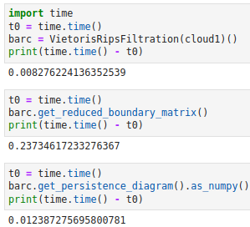
Bottleneck
First of all, I managed to do a code profiling to see the time consumed by each function in the computation.
There are 3 stages
Building filtration
Reduction of boundary matrix
Building a persistence diagram
Now it’s clear what is a bottleneck

Slide 4
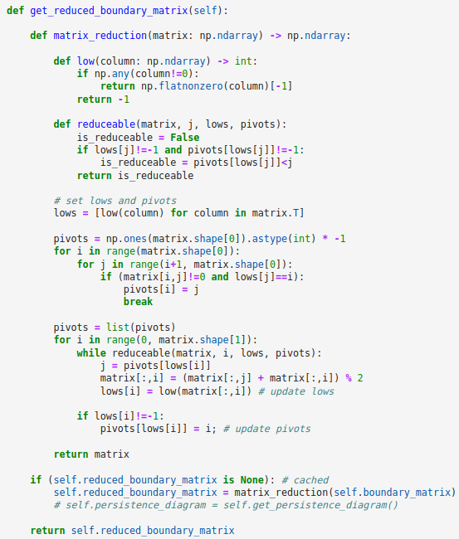
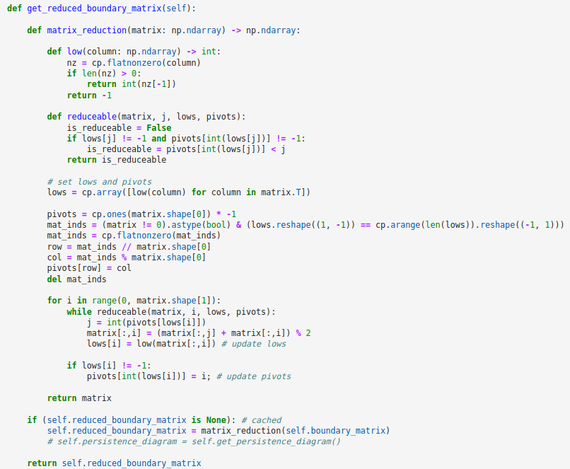
Looking at the code
The first cycle is a nested cycle which can be rewritten in cupy

Slide 5
Looking at the code
The second cycle actively changes the matrix inside itself and I didn’t find a way to optimize it.
Moreover, using CuPy made the second cycle slower.
Before CuPy | 0.216
After CuPy | 3.150

Slide 6
Analysis of results
I see the following reasons of the problem
We operate with small datasets (because I don’t have enough memory to run the algorithm even with 100 points of dimension 10) and it’s much cheaper to operate with them on CPU than on GPU
Only a small amount of work in this algorithm can be done in parallel

Slide 7
Conclusion
Unfortunately I couldn’t speedup my code with CuPy and, moreover, I made it worse.
However, there are faster algorithms (see Ripser) and even an algorithm appropriate for GPU (see Ripser++).
The conclusion I can make is that parallelism is not a magic wand and if you use it in bad conditions the code may become worse that in one thread.

Slide 8
Thank you for attention

