Slide 1
// DATA · TECH · FLOW
Data Analytics Capstone 1
This project consists of a data storytelling analysis using a sample_sales database, MySQL and Excel tools focusing on Florida sales.
Arionsae McCutcheon| D_A Group 13 | November 2026

Slide 2




// AGENDA
Four stages from raw data to decisions
01
02
03
04
Collect
Transform
Analyze
Act
Describe where data originates and how it is captured.
Explain cleaning, modeling, and enrichment steps.
Surface the patterns, metrics, and signals that matter.
Translate insight into decisions and next actions.
DATA / TECH / FLOW
02

Slide 3
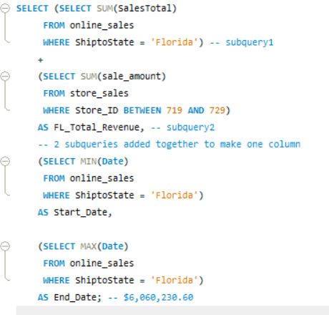
// Query 1
What is total revenue overall for sales in the assigned territory, plus the start date and end datethat tell you what period the data covers?
Replace labels with your own systems. Duplicate a tile to add more sources or outputs.
DATA / TECH / FLOW
03

Slide 4
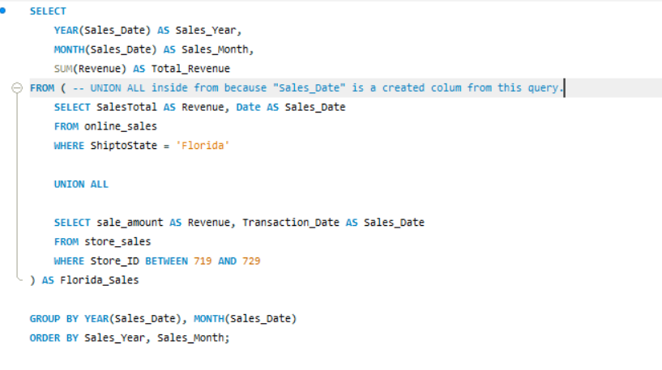
// Query 2
2 What is the revenue breakdown by year and month for the sales territory?
DATA / TECH / FLOW
04

Slide 5
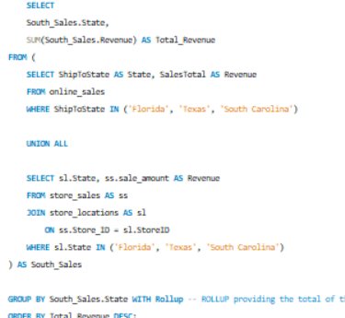
// Query 3
Provide a comparison of total revenue for the specific sales territory and the region it belongs to. -- Calculate the revunue of entire south region , then each individual state in the region (FL, TX, SC)
DATA / TECH / FLOW
05

Slide 6
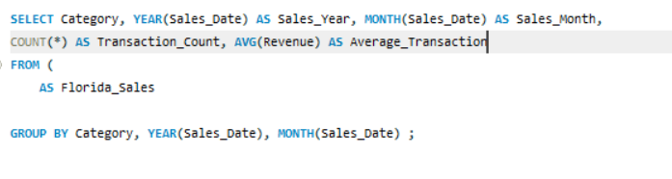
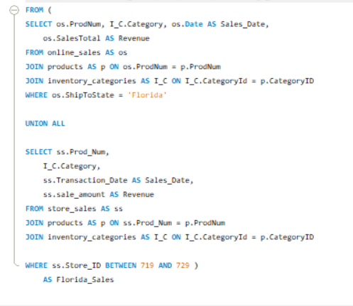
// Query 4
What is the number of transactions per month and average transaction amount by product category for the sales territory?
DATA / TECH / FLOW
05

Slide 7
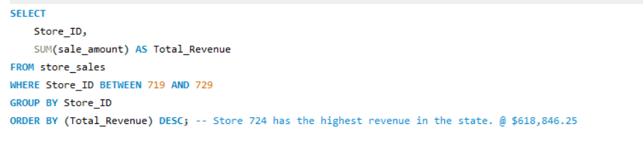
// Query 5
5 Can you provide a ranking of in-store sales performance by each store in the sales territory, or aranking of online sales performance by state within an online sales territory?
DATA / TECH / FLOW
05

Slide 8
// RECCOMENDATIONS
A phased path to full rollout
Q1
Q2
Q3
Q4
Foundation
Integration
Intelligence
Scale
Stand up core pipelines and governance.
Connect priority systems and teams.
Launch models and automated alerts.
Expand coverage and optimize cost.
Milestone detail or dependency note goes here.
DATA / TECH / FLOW
06

Slide 9
// DATA CHARTS / PIVOT TABLES
Bringing the data together
DATA / TECH / FLOW
07

Slide 10


// NEXT STEPS
Thank You
Questions, feedback, and follow-ups welcome.
name@company.com
company.com/data

