Slide 1


Explainable Sentiment Analysis on TripAdvisor Reviews

Slide 2
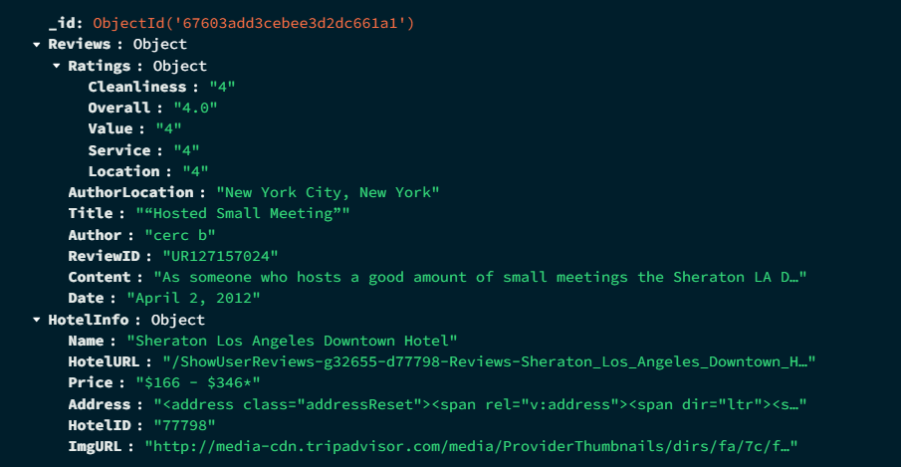
DATASET DESCRIPTION
Collection of 87.5k documents
Each document is a single review

Slide 3
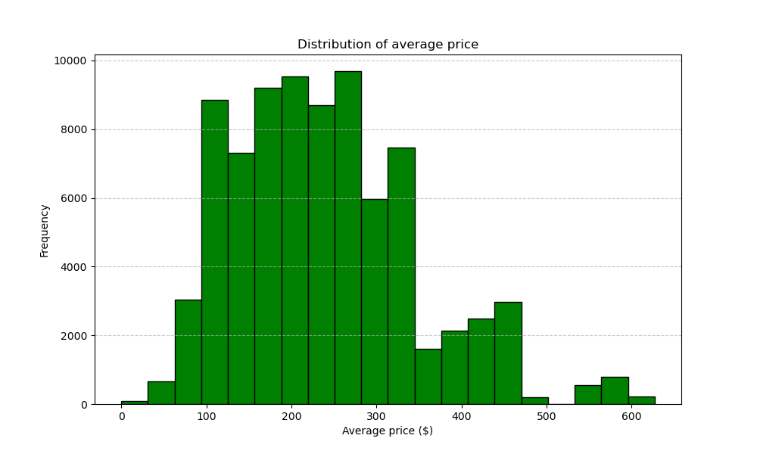
QUERY with PyMongo
from
to
7 Aug 2001
11 Sep 2012

Slide 4

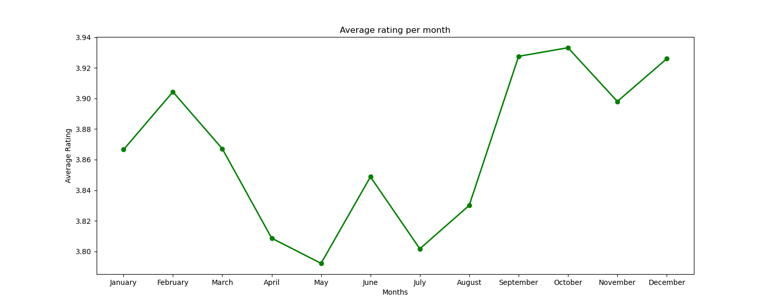
QUERY with PyMongo
Which are the best and worst rated hotels?
What is the average rating per month?
Inn New York (4,85)
Civic Center Miami (1,13)

Slide 5
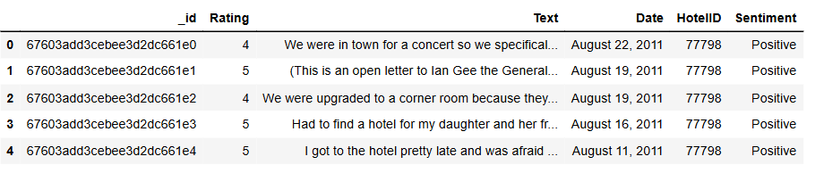
Filtering and Label Creation
Selection of Reviews based off months: May, June, July, August
Creation of the Sentiment variable
Deletion of neutral reviews
Final DataFrame

Slide 6
Pre-Processing & Vectorization
Remove punctuation
Remove stop words
Remove multiple letters
Remove numbers
Lemmatization
Lowering
We were upgraded to a corner room because they did not have a room ready after 4:00pm. The service was great BTW, Location was close to good restaurants, and there is a Ralph's 2 blocks away I like beiing able to walk to restaurants and shopping. Only negative, was the hall carpeting need replaced on the 16th floor..
upgraded corner room room ready pm service great BTW Location close good restaurant Ralphs block away like beiing able walk restaurant shopping negative hall carpeting need replaced th floor
Tf-Idf Vectorizer ( max features = 500 , random state = 42 )

Slide 7
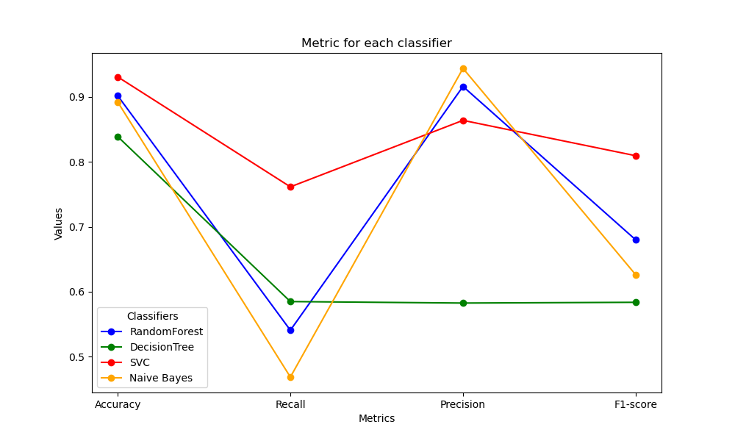
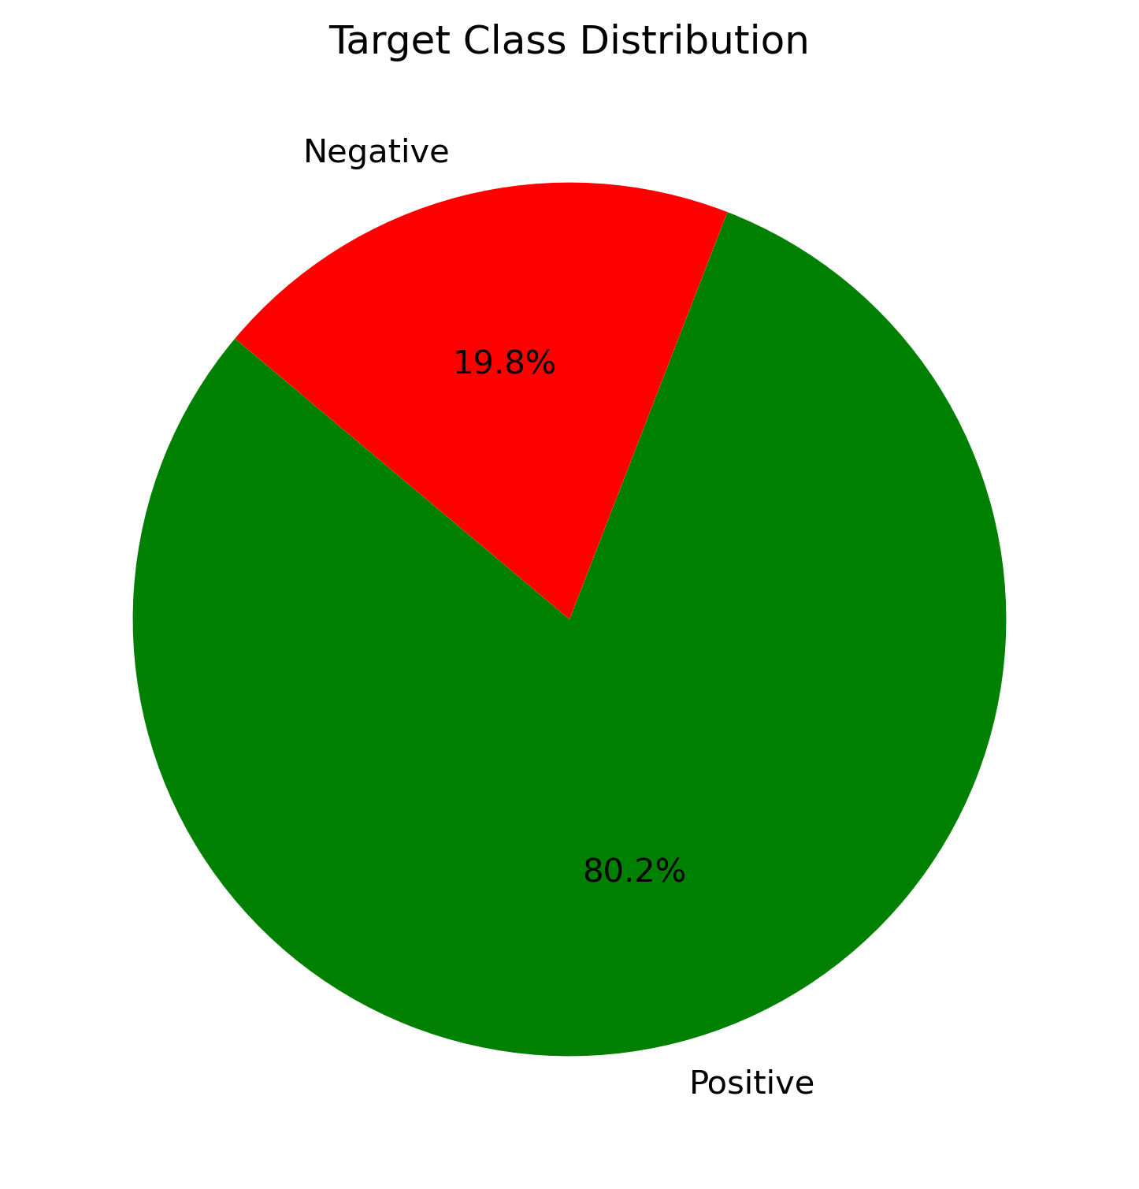
CLASSIFIERS
Random Forest
Decision Tree
Support Vector Machine
Naive Bayes
Training and Evaluation

Slide 8

Model Selected: Support Vector Machine
 | Precision | Recall | F1-Score | Support
Negative | 0.86 | 0.76 | 0.81 | 1291
Positive | 0.94 | 0.97 | 0.96 | 5387
Accuracy |  |  | 0.93 | 6678
Macro avg | 0.90 | 0.87 | 0.88 | 6678
Weighted avg | 0.93 | 0.93 | 0.93 | 6678

Slide 9
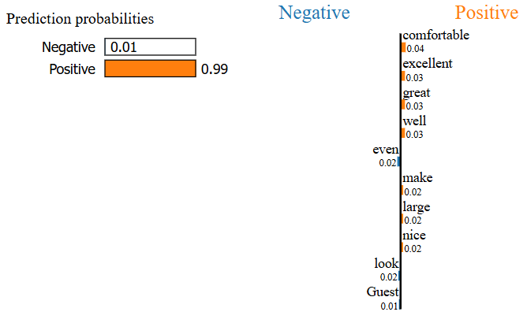
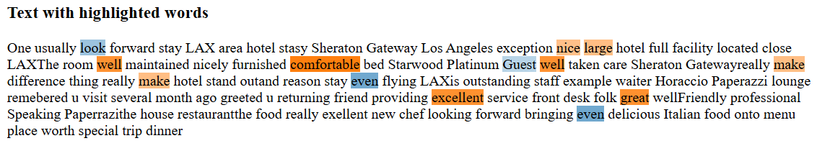
EXPLAINABILITY: Lime

Slide 10
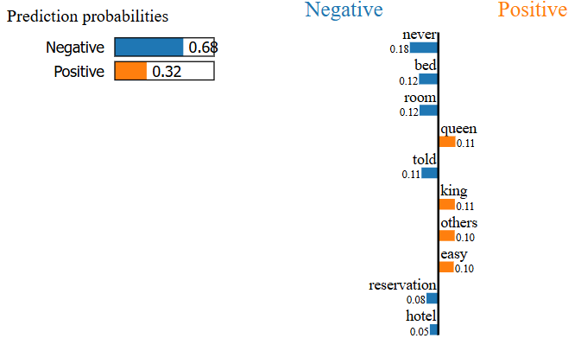
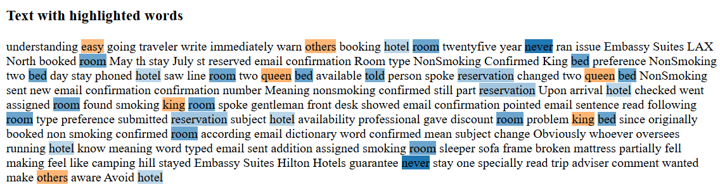
EXPLAINABILITY: Lime

Slide 11
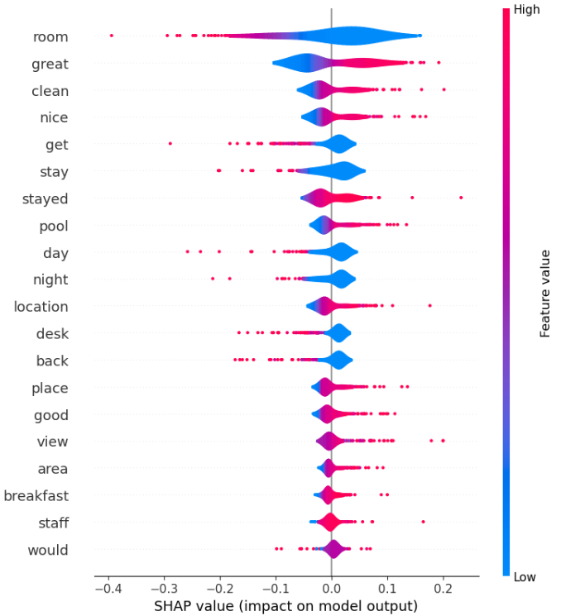
SHAP

Slide 12
Thank you
for the attention
Alberto Arienti
Sofia Turroni

