Slide 1
Text Analysis
of
Scientific Papers

Slide 2

Dataset Description
DataFrame Columns
Target Classes
DataFrame Shape
Abstract id
Line id
Line number
Total lines
Abstract text
Target
OBJECTIVE,
BACKGROUND,
METHODS,
CONCLUSIONS,
RESULTS
Rows: 180040
Number of different papers: 15000

Slide 3
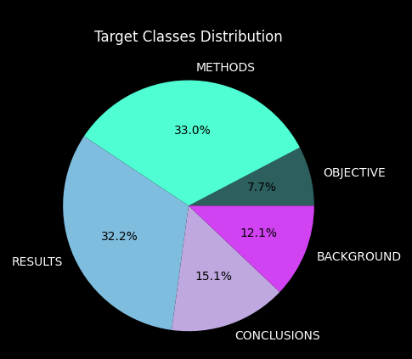
About the target variable…
Target Class
Avg text length
Avg number of words
OBJECTIVE | 172.295831 | 27.331382
RESULTS | 158.710559 | 30.530326
CONCLUSIONS | 147.521017 | 22.975155
METHODS | 147.464324 | 25.209728
BACKGROUND | 139.216367 | 21.813734

Slide 4
Pre-Processing
Punctuation remove
Numbers remove
Stop words remove
Lemmatization
Tokenization
Machine-readable text
Raw text
To investigate the efficacy of 6 weeks of daily low-dose oral prednisolone in improving pain , mobility , and systemic low-grade inflammation in the short term and whether the effect would be sustained at 12 weeks in older adults with moderate to severe knee osteoarthritis ( OA ) .
['investigate', 'efficacy', 'week', 'daily', 'low', 'dose', 'oral', 'prednisolone', 'improve', 'pain', 'mobility', 'systemic', 'low', 'grade', 'inflammation', 'short', 'term', 'whether', 'effect', 'would', 'sustain', 'week', 'old', 'adult', 'moderate', 'severe', 'knee', 'osteoarthritis', 'OA']

Slide 5
Vectorization
Pros:
Low computational capacity
Balance frequency
Tf – Idf Vectorizer
Cons:
No semantic meaning
Sparse matrix

Slide 6
Text Classification
Decision Tree
Random Forest
Support Vector Machine
Multinomial Naive Bayes
Logistic Regression

Slide 7
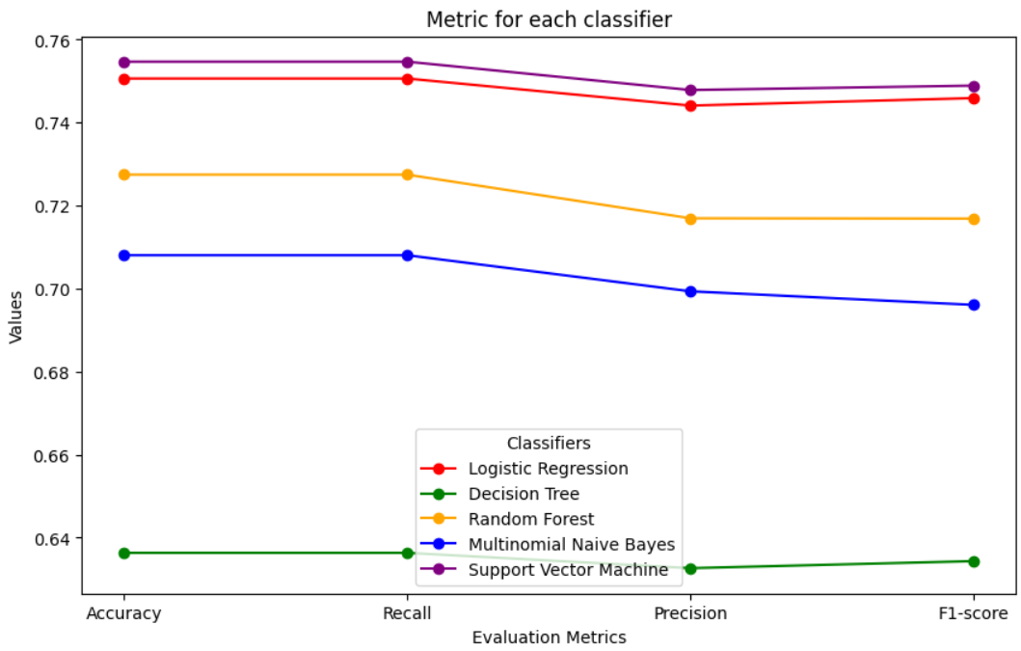
Classifiers Evaluation
Used metrics:
Accuracy
Recall
Precision
F1-Score
Best Performance:
Support Vector Machine
Logistic Regression

Slide 8
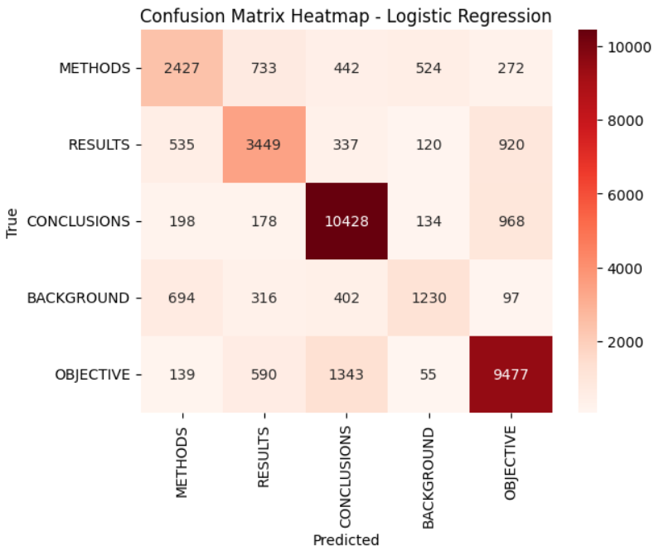
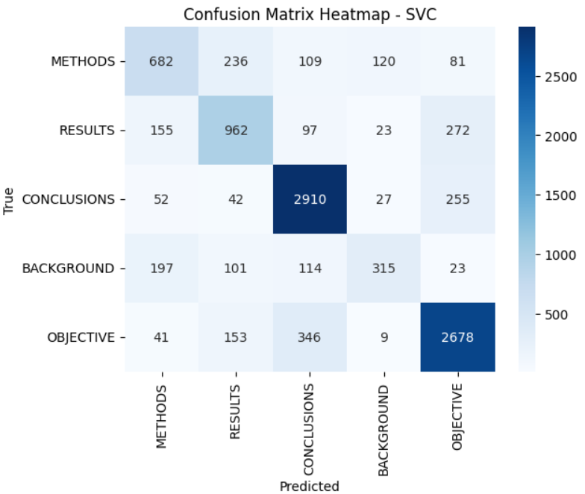
Logistic Regression
Support Vector Machine
Pros:
Low computational capacity
Interpretability
Cons:
Sensitive to class imbalance
Pros:
Effective with sparse matrix
Avoid overfitting
Cons:
Computational costly

Slide 9
Topic Modeling
Abstract’s line 1
Abstract’s line 2
Full Abstract
Abstract’s line 3
Abstract’s line 4
Abstract’s line 5

Slide 10
Latent Dirichlet Allocation:
5 Passes as parameter to better convergence
Models
Tokens from the preprocessing steps
Dictionary composed of tokens and filtered: minimum 5 docuemtns and maximum 75%
Latent Sematic Analysis
Hierarchical Dirichlet Process

Slide 11
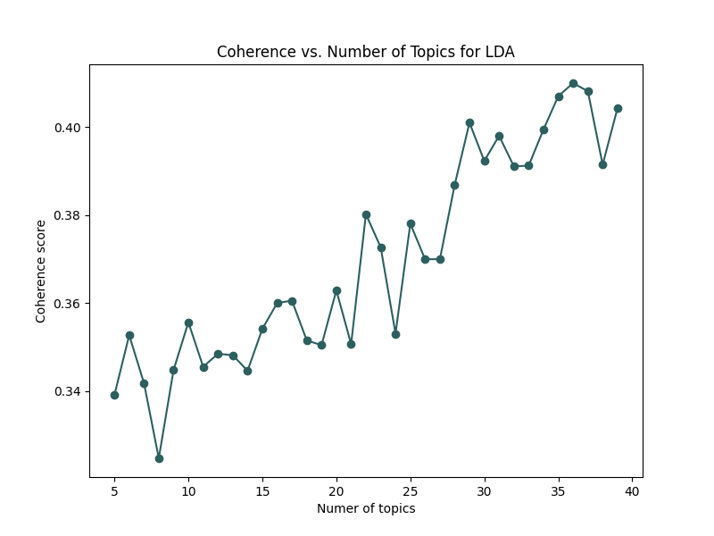
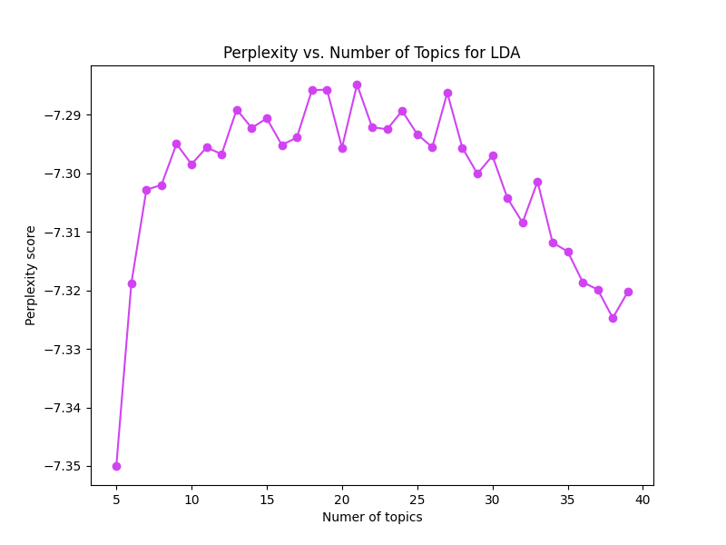
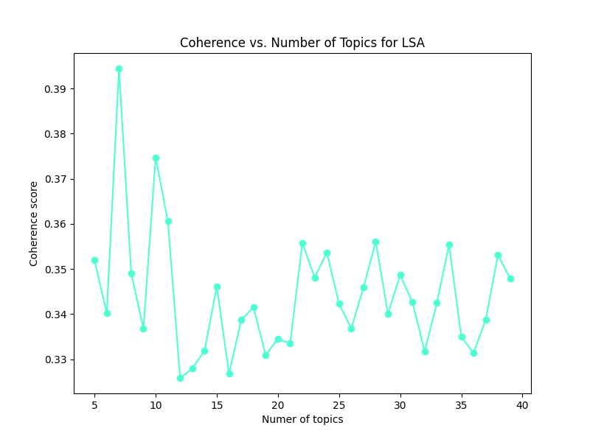
Number of Topics Optimization
LDA:
The decisional point could be 29
LSA:
The decisional point could be 7

Slide 12
Evaluation of Models
Topic 0: group, patient, treatment, P, study, control, use, compare, week, month
Topic 1: group, patient , study , trial, placebo, year, P, outcome, CI, risk
Topic 2: patient, intervention, control, use, group, study, participant, effect, child, trial
Topic 3: P, treatment, intervention, patient, placebo, week, group, mg, care, p
Topic 4: P, treatment, week, p, v, risk, placebo, high, mg, patient
Topic 5: treatment, p, P, placebo, mg, study, dose, intervention, month, care
Topic 6: CI, month, pain, year, v, patient, study, risk, use, p
Latent Semantic Analysis

Slide 13
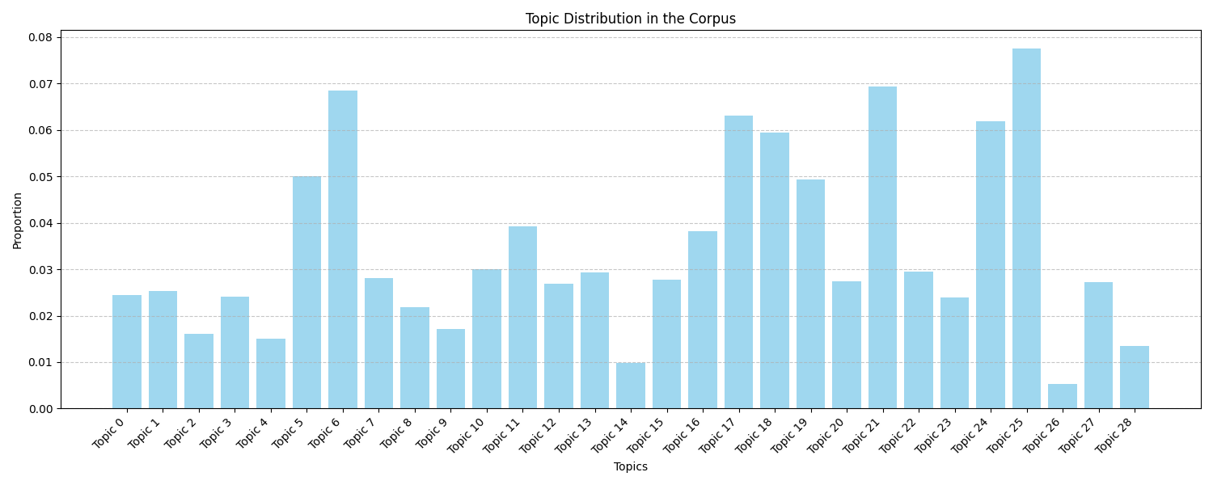
Evaluation of Models:
Latent Dirichlet Allocation

Slide 14
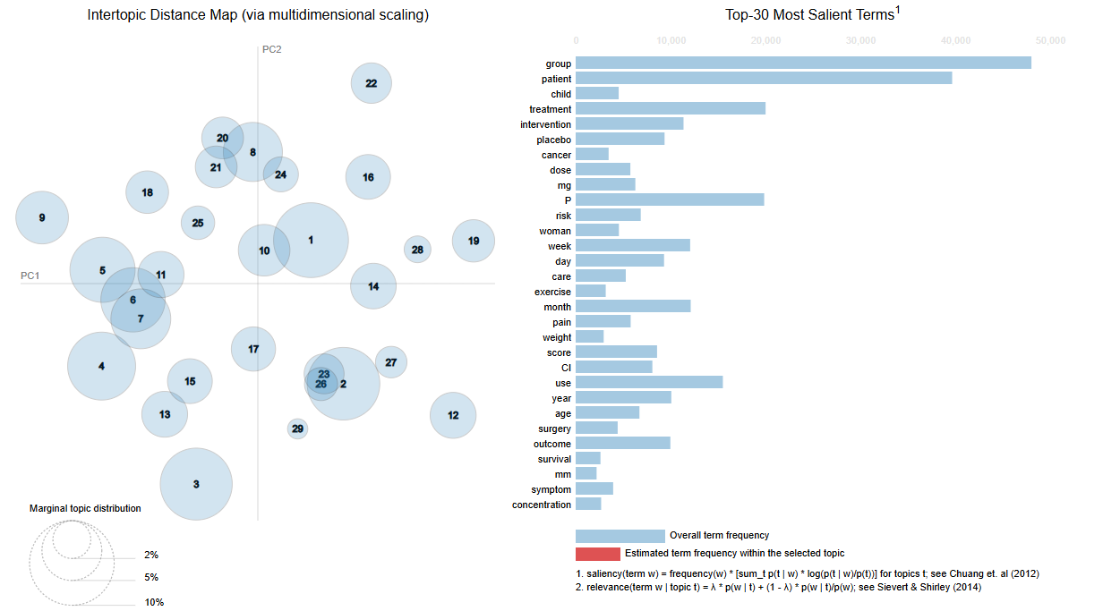

Slide 15
Patient Care and Interventions
Physical and Medical Conditions
Testing and Outcomes
Topics 5, 6, 7, 11, 16, 17, 18, 21, 24, 27, 25.
Topics 0, 3, 4, 8, 12, 14, 20, 28.
Topics 1, 2, 9, 10, 13, 15, 19, 22, 23, 26
Treatment, score
Patient CI
Survival, Month
Control, trial
Surgery, postoperative
Pain, study
Intervention, Care
Group, Control
Week, placebo
Exercise, group
Glucose, insuline
Infection, antibiotic
Child, age
Patient, heart
Sleep, alcohol
Weight, body
Cancer, cell
Eye, mm
Smoking, use
Acid, mg
Dose, day
Risk, associate
Woman, outcome
Level, group
Image, sudy
Effect, stimulation
HF, CRT

Slide 16
Thank you
for the attention
Alberto Arienti
Sofia Turroni

