Slide 1
6.033, Spring 2013
Congestion Control: The Role of the Routers
Dina Katabi
nms.csail.mit.edu/~dina

Slide 2
Outline
No help from routers
  DropTail
  Problems with DropTail
What can routers do?
Examples
  RED
  ECN

Slide 3
TCP + DropTail
Most routers use DropTail
Problems:
  Large average queues
  Bursty losses
  Synchronized losses
Notes:
What is a persistent queue? Queues are meant to absorb bursts or oscillations but not to persist
Why do we get persistent queues? Is that bad?

Slide 4
Large Average Queues
Queues are needed to absorb transient bursts
  Yet avg. queue should stay low
TCP fills the queue until a drop
  Keeps avg. queue length high ☹

Slide 5
Bursty Losses
Queue
Dropped packets
Traffic from a single source comes in a burst
  Packets are dropped in bursts
  Too many packets dropped from same cwnd
  Source can’t use 3 dupacks to recover and has to wait for timeout ⇒ less efficient

Slide 6
Synchronized Losses
All losses happen together when the queue overflows
Sources decrease together ⇒ potential underutilization
Sources increase together until overflowing queue
Cycle repeats…
Mainly caused by drops concentration at time of overflow

Slide 7
How can routers help?
Send an early and more explicit congestion feedback
  Drops occur when queue overflows, but routers can send feedback earlier when queue starts forming
  Spread the drops in time ➔ desynchronize the senders and prevents too many drops from bursty flows

Slide 8
Pors & Cons of Routers’ Participation in Cong. Cont.
Pros
  Routers observe congestion first hand and have better information with less delay
    Better efficiency and fairness
Cons
  Increase the complexity of the routers
  Deployment is harder
    It is hard to change the routers (convince ISPs)
    Many schemes need to change a large number of routers together for the scheme to be effective

Slide 9
1. Random Early Detection (RED)

Slide 10
RED’s objectives
Operates at congestion avoidance
  Keeps avg. queue low (low delay)
  Safer
Attempts to solve the synchronization and bursty drops problems
Congestion Avoidance
Congestion
Control
cliff
Throughput
Latency
Input traffic

Slide 11
RED Algorithm
Define 2 vars: min_thresh and max_thresh
  Try to keep the queue between these two vars
How? when a packet arrives:
  Compute Qavg = w ×Q + (1-w) ×Qavg; 0 < w <1
  Drop packet with probability p=f(Qavg)
Drop Prob.
1.0
max_{P}
Qavg
min_{th}
max_{th}

Slide 12
What Does RED Achieve?
Less bias against bursty flows
    Why?
Smaller average queue size
    Why?
Reduces likelyhood of bursty drops
    Why?
Reduces likelihood of synchronized flows
    Why?

Slide 13
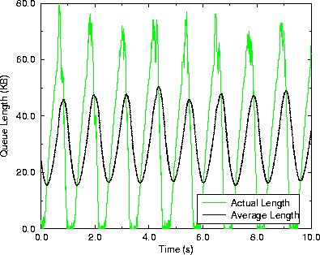
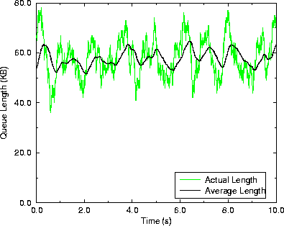
What Doesn’t RED Achieve?
RED introduces its own problems
  Hard to set parameters
8 Sources
32 Sources

Slide 14
ECN: Explicit Congestion Notification
Mark packet instead of dropping it. Receiver has to relay this mark to the sender
  Explicit feedback
Advantages
  Enable the sender to react before the queue is full and the delay is already too large
  In wireless environments drops are mainly caused by errors rather than congestion (ECN may help if widely deployed)

