Slide 1
Machine Learning In Computational Biology
A comprehensive single cell transcriptional landscape of human hematopoietic progenitors.
Final Project Presentation
Presented by
Aris Podotas
Rafail Adam
Georgios Leventis
DSIT
2024 =2025

Slide 2
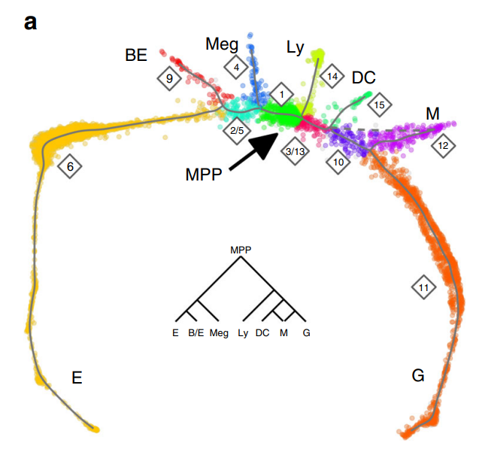
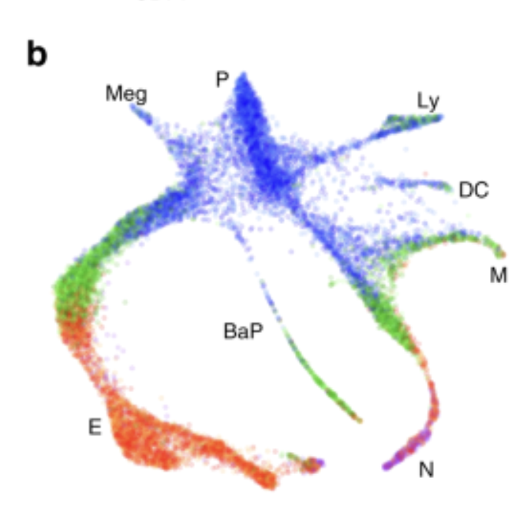
Biological problem:
Paper Overview
Define a comprehensive differentiation trajectory for progenitor cells of of the hematopoietic lineage
Many different progenitors
Focus on CD34 is not enough
Importance:
Increase resolution regarding early differentiation by analysing whole bone marrow fraction
DSIT
2024 =2025

Slide 3

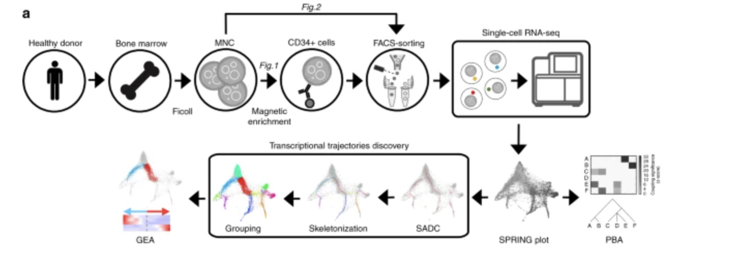
Method used
Single-cell RNA-Seq on cells from the entire Bone Marrow + fractionation based on CD164
Filtering out cells based on mitochondrial gene expression threshold and normalizing expression values
KNN graph (k=4), branching reconstruction and ordering of cells based on the structure
DSIT
2024 =2025

Slide 4
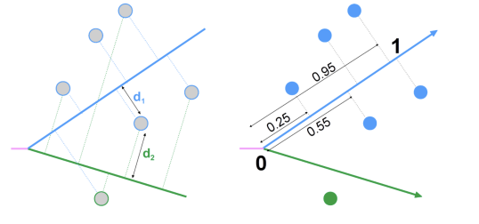
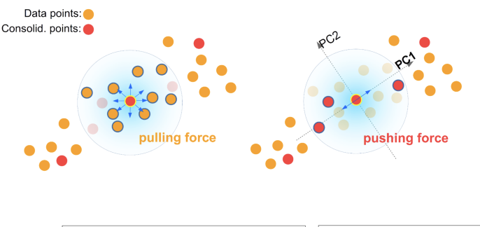
Structure-
Aware filtering
Branch association
Measure distances between branches for ordering
Branch reconstruction:
Minimum spanning tree
DSIT
2024-2025

Slide 5
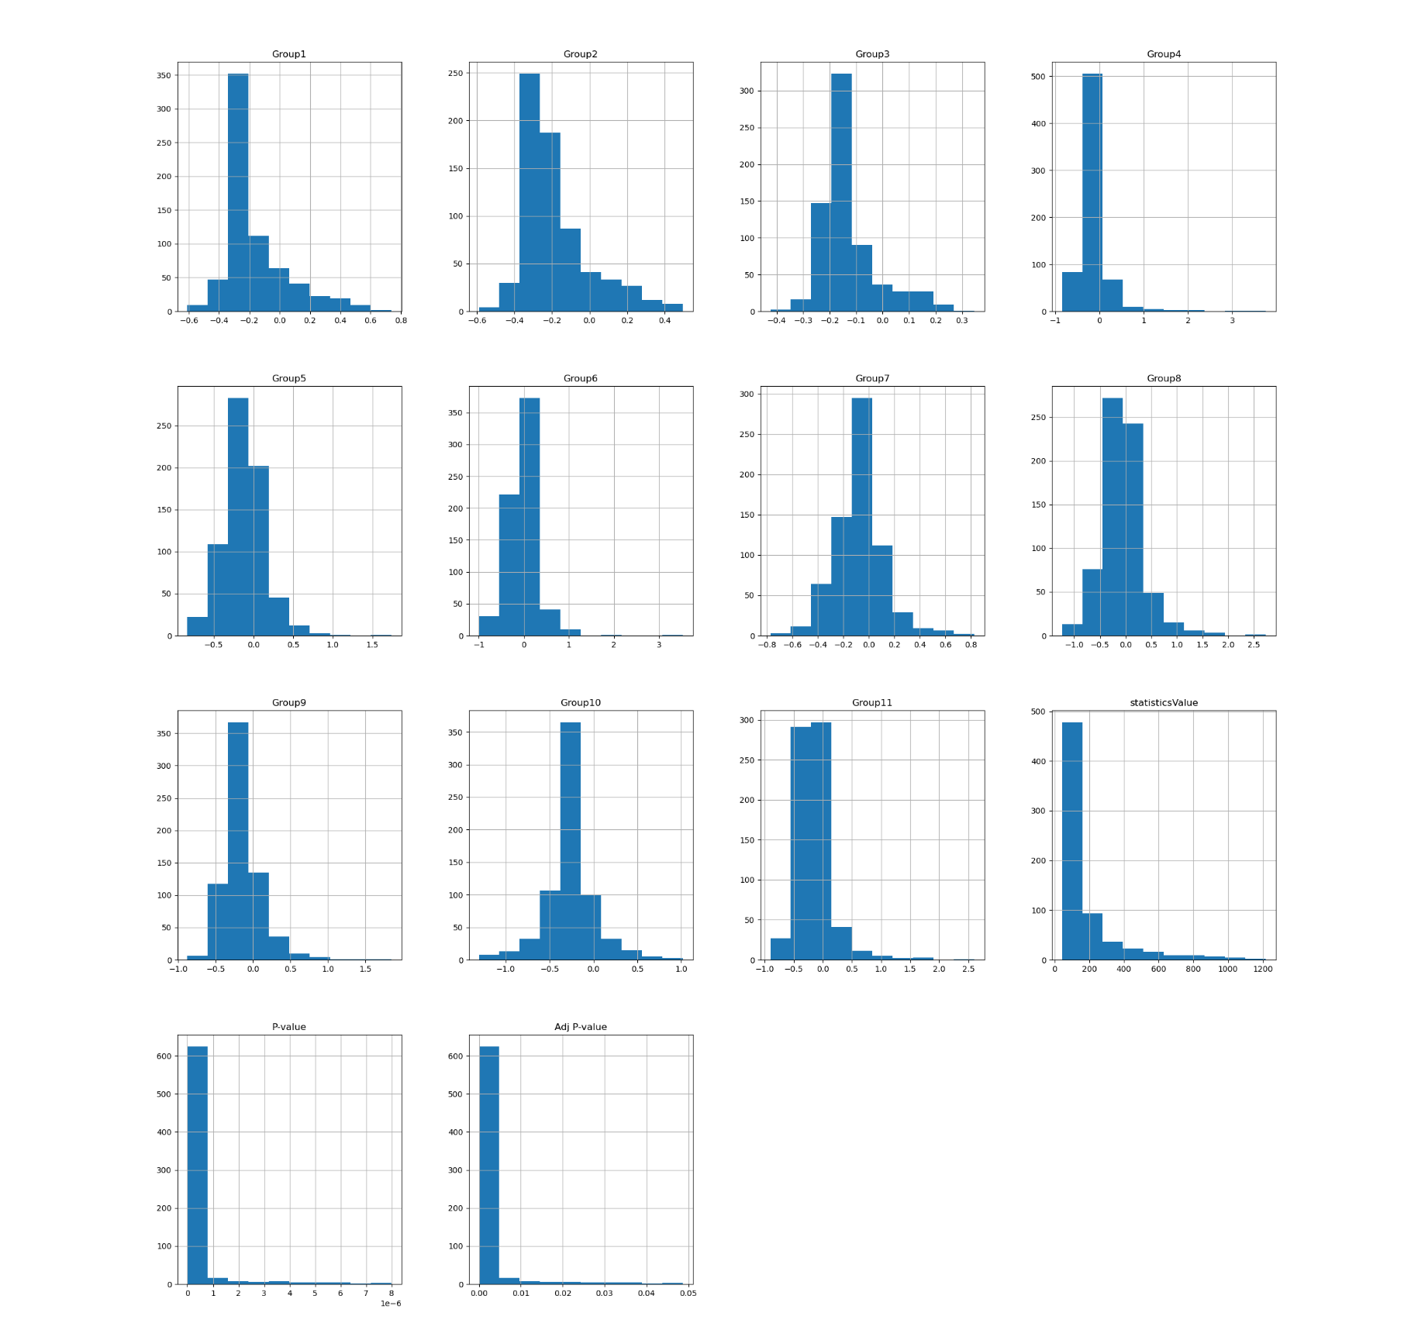
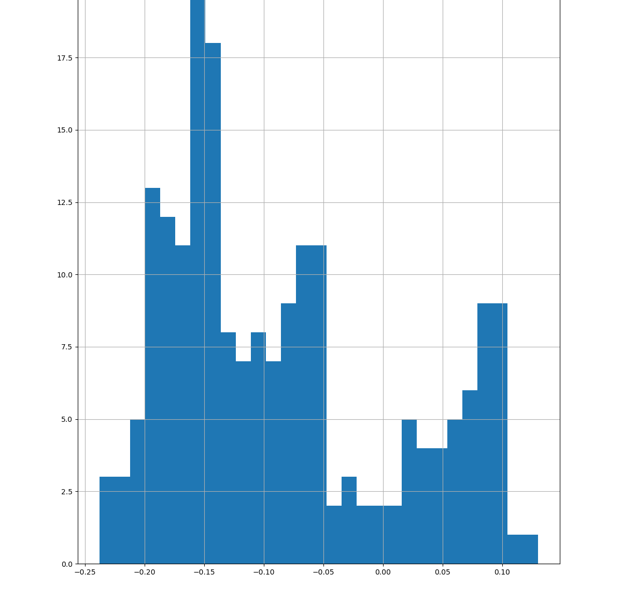
Representing expression domains
Fitting a generator
DSIT
2024 =2025

Slide 6
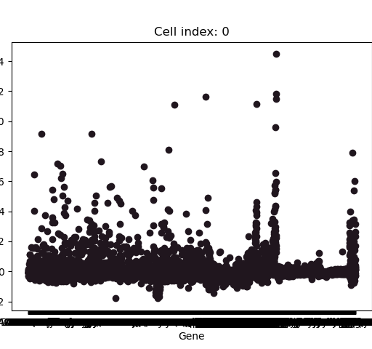
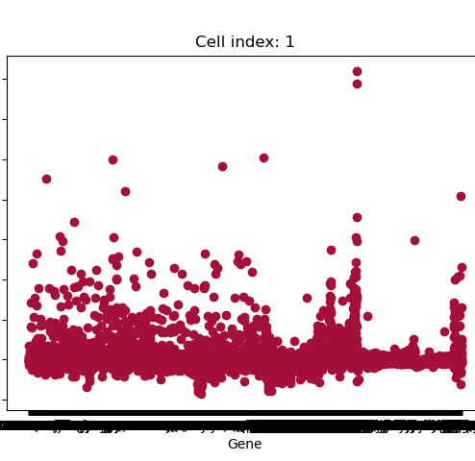
What the new cells look like
Making cells
DSIT
2024 =2025

Slide 7
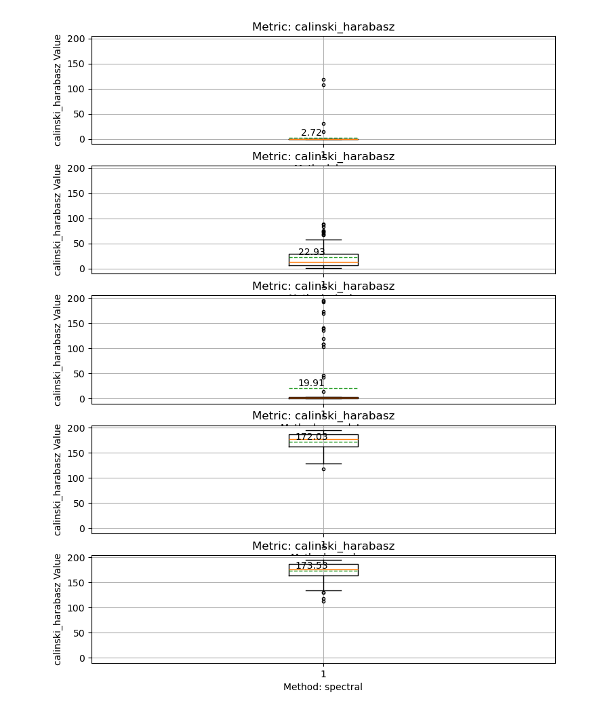
Significance
Results
KNN
Single Link
Complete Link
Ward Algorithm
Spectral
DSIT
2024 =2025
Notes:
This is where the metrics go

Slide 8
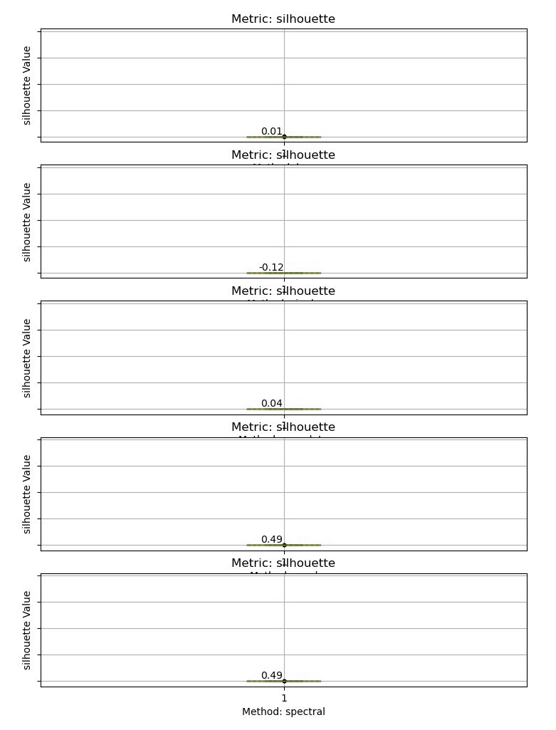
Significance
Results
KNN
Single Link
Complete Link
Ward Algorithm
Spectral
DSIT
2024 =2025
Notes:
This is where the metrics go

Slide 9
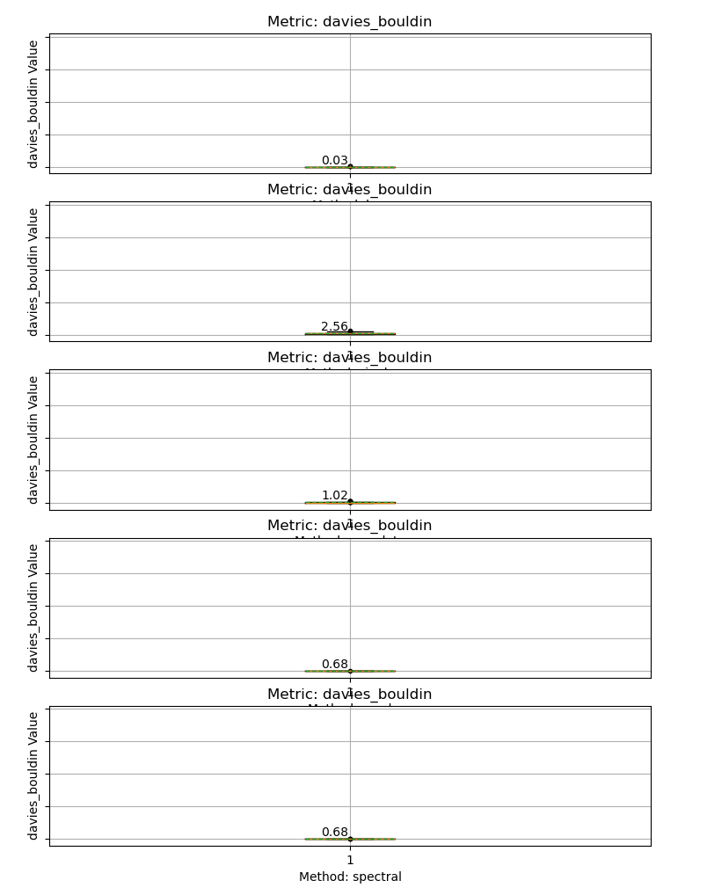
Significance
Results
KNN
Single Link
Complete Link
Ward Algorithm
Spectral
DSIT
2024 =2025
Notes:
This is where the metrics go

Slide 10
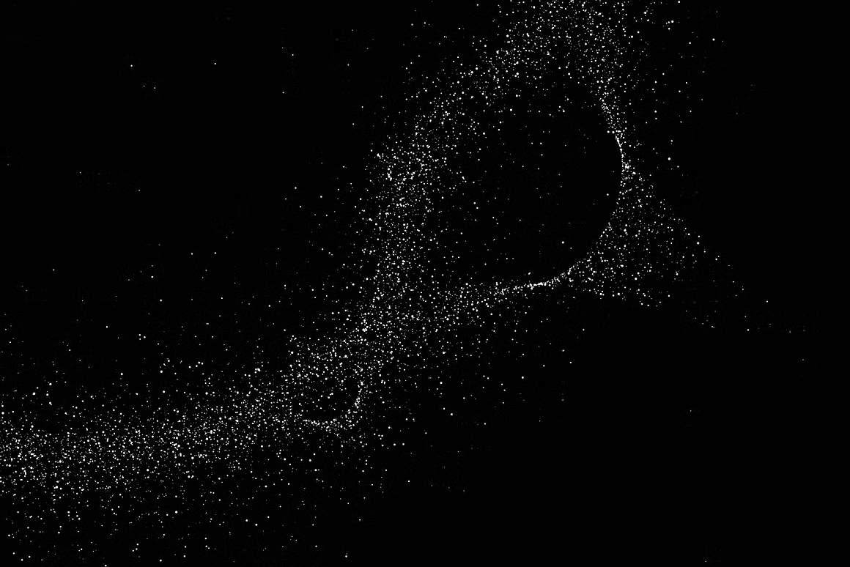
Still pending
Emulating PCA
Gene Hierarchy
Altering the KNN
The original citation used PCA with 40 components in the final data. This is a significant modifications since the original data has more than 5800 genes and reducing this matrix would yield large benefits in runtime
Using LDA to get the feature significance to know what genes contributed to formation of clusters the most
Testing more values of K for the KNN (especially odd values)
Pending 2
Pending 1
Pending 3
DSIT
2024 =2025

Slide 11
Citations
[1] D. Pellin et al., “A comprehensive single cell transcriptional landscape of human hematopoietic progenitors,” Nat. Commun., vol. 10, no. 1, p. 2395, Jun. 2019, doi: 10.1038/s41467-019-10291-0.
[2] S. Wu, P. Bertholet, H. Huang, D. Cohen-Or, M. Gong, and M. Zwicker, “Structure-Aware Data Consolidation,” IEEE Trans. Pattern Anal. Mach. Intell., vol. 40, no. 10, pp. 2529–2537, Oct. 2018, doi: 10.1109/TPAMI.2017.2754254.
[3] F. Pedregosa et al., “Scikit-learn: Machine Learning in Python,” J. Mach. Learn. Res., vol. 12, no. 85, pp. 2825–2830, 2011.
[4] A. P. Chatzigeorgiou and E. S. Manolakos, “MLscAN A flexible tool for single-cell data analysis pipelines and model selection using unsupervised machine learning methods”.
DSIT
2024 =2025

