Slide 1
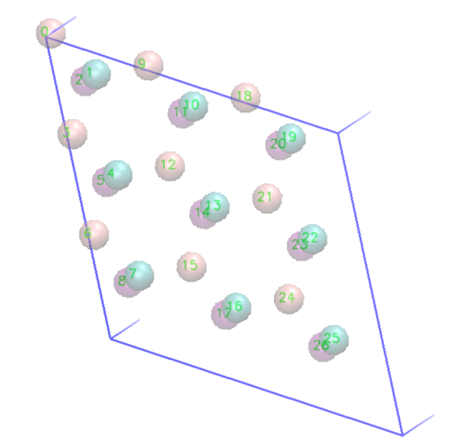
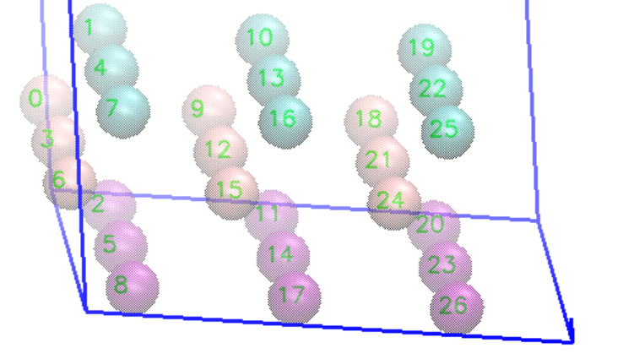
Check bond connectivity
# vmd id
i | j
0 | 1
0 | 2
0 | 7
0 | 8
0 | 19
0 | 20
1 | 3
1 | 9
2 | 3
2 | 9
3 | 4
3 | 5
3 | 22
3 | 23
4 | 6
4 | 12
5 | 6
5 | 12
6 | 7
6 | 8
6 | 25
6 | 26
7 | 15
8 | 15
9 | 10
9 | 11
9 | 16
9 | 17
10 | 12
10 | 18
11 | 12
11 | 18
12 | 13
12 | 14
13 | 15
13 | 21
14 | 15
14 | 21
15 | 16
15 | 17
16 | 24
17 | 24
18 | 19
18 | 20
18 | 25
18 | 26
19 | 21
20 | 21
21 | 22
21 | 23
22 | 24
23 | 24
24 | 25
24 | 26
type 1 2
Ds M X⁺ M X⁻
bond/cell: 3 3

Slide 2


Check angle connectivity
8
8
7
20
20
0
23
22
1
6
18
type 1 2 3 4 5 6
Sym T N T O T T
Ds M X⁺ M X⁺ M X⁻ X⁺ M X⁺ X⁺ M X⁻ M X⁻ M X⁻ M X⁻ angle/cell: 3 3 3 6 3 3
(drew indicative angles from excel file check_connectivity.xlsx)
n_cell | 9
type | ang/cell | predict | count | type
1 | 3 | 27 | 27 | M X⁺ M [T]
2 | 3 | 27 | 27 | X⁺ M X⁻ [N]
3 | 3 | 27 | 27 | X⁺ M X⁺ [T]
4 | 6 | 54 | 54 | X⁺ M X⁻ [O]
5 | 3 | 27 | 27 | M X⁻ M [T]
6 | 3 | 27 | 27 | X⁻ M X⁻ [T]
sum | 21 | 189 | 189

