Slide 1


A hands-on introduction to molecular dynamics with LAMMPS
Place : Internal
Date : 2026, 8 July
Dr. Aristotelis P. Sgouros
MPRIME LAB @
Theoretical and Physical Chemistry Institute (TPCI), National Hellenic Research Foundation (NHRF)

Slide 2
List of examples
08 — ++ ++

Slide 3
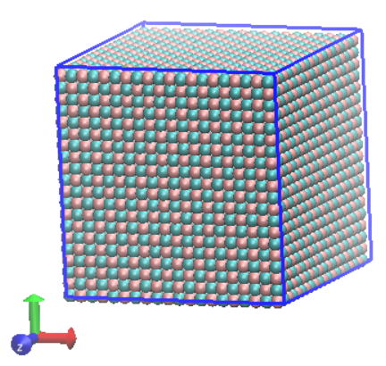
Example 08 – 3D Solid: Compute XRD
This example demonstrates how to calculate the XRD of a NaCl crystal.
System:
NaCl crystal with 10x10x10 cells
Learning goals:
Calculate XRD on-the-fly (simulated radiation method)
Calculate XRD through Fourier transforming the partial pair correlation function
NaCl crystal

Slide 4

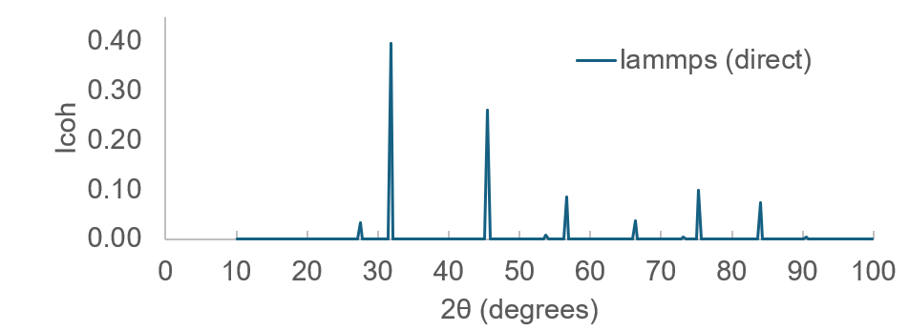

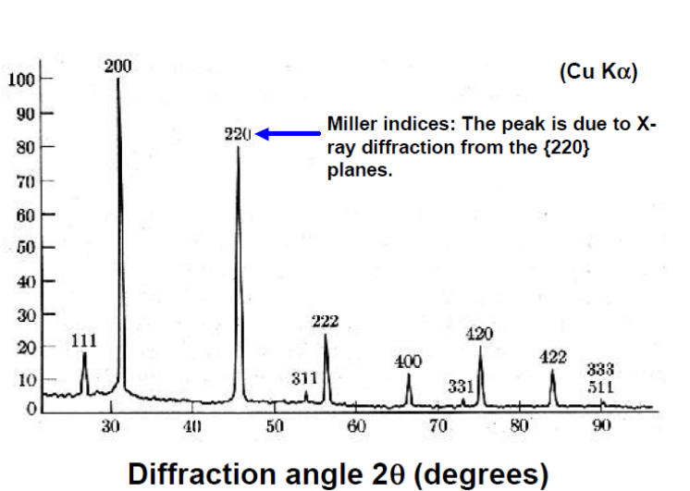

Example 08 – 3D Solid: Compute XRD: Simulated radiation
Coherent scattering intensity:
Structure factor:
where,
r : atomic coordinate
q : scattering wave vector
f_{i} : form factor of component i
Relation between q = |q| and incidence angle θ:
λ_{inc} : incidence beam wavelength; usually, λ_{inc} = 1.5406 Å (Cu Ka)

Slide 5
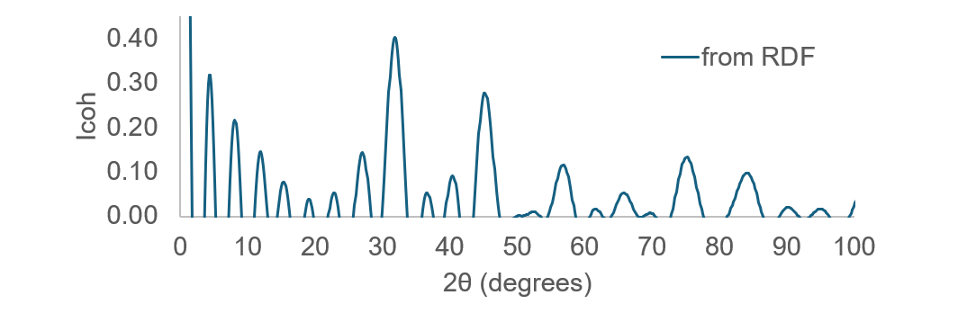

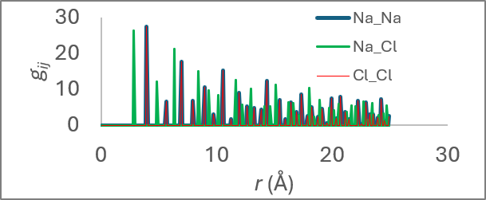
Example 08 – 3D Solid: Compute XRD: Fourier transform of RDF
Coherent scattering intensity:
where,
c_{i} : number density of component I
ρ₀ : total number density
q : scattering wave vector
f : form factor
g_{ij} : pair-correlation function

Slide 6
Example 08 – 3D Solid: Compute XRD
Actions:
Calculate the XRD on-the-fly
Calculate the XRD by Fourier transforming the partial RDF
How do they compare to the experimental XRD of NaCl?
Perceived differences? Could we improve the Fourier method? (improves with increasing system size)
A detailed description of the methods can be found in the following reference:
S. Kallivokas; A. P. Sgouros; D. N. Theodorou, Molecular dynamics simulations of epon-862 / detda epoxy networks: structure, topology, elastic constants, dynamics. Soft Matter 15, 721, 2019.

Slide 7
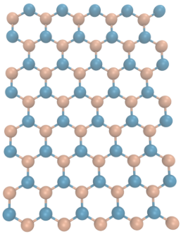
Example 09 – Uniaxial deformation of orthogonal hBN sheet
This example demonstrates how to perform uniaxial deformation with lammps
System:
2D hBN crystal with 30x15 4-atom cells
Learning goals:
Equilibrate reference dimensions
Calculate lattice constant
Export the stress-strain curves
Estimate the: - Lattice constants - Young’s modulus - Poisson ratio
0 atm
Uniaxial deformed
hBN crystal (5x4 repl)

Slide 8
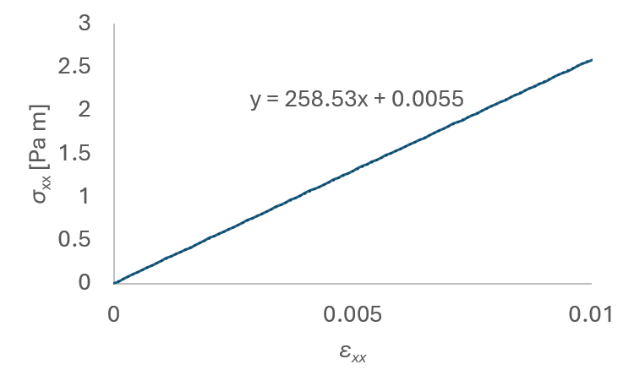
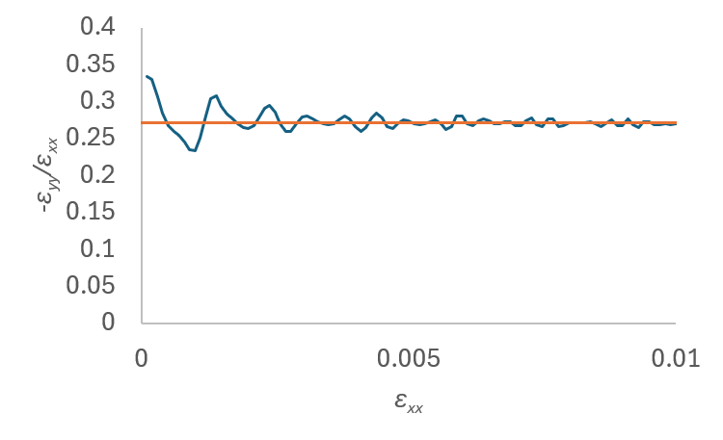
Example 09 – Uniaxial deformation of orthogonal hBN sheet
Actions:
Estimate lattice constant from reference dimensions; note that, L_{x} = n_{x}a_{lat} and L_{y} = 3^{0.5}n_{y}a_{lat}
Extract thermodynamic log from the deformation part
Convert the pressure [atm] to 2D stress [Pa m]; σ_{2D,ij} = P_{ij} L_{z}
Plot stress-strain curve → extract Young modulus; compare with analytic value 258.2 Pa m.¹
Plot the –ε_{yy}/ε_{xx} curve → extract Poisson ratio compare with analytic value 0.275.¹
1. A. P. Sgouros et al., First-principles derived force field for h-BN monolayer nanostructures: Applications to sheets, nanotubes, and nanotori. PRB 111, 155443, 2019.

Slide 9
Example 10 – Estimation of the stiffness matrix
This example demonstrates how to calculate the stiffness matrix components of hBN
System:
2D hBN crystal with 30x15 4-atom cells
Learning goals:
Introduction to material elasticity
Determine stiffness matrix components
1. A. P. Sgouros et al., First-principles derived force field for h-BN monolayer nanostructures: Applications to sheets, nanotubes, and nanotori. PRB 111, 155443, 2019.

Slide 10

Example 10 – Uniaxial deformation of orthogonal hBN sheet
The 2D linear elastic equation
where
ϵ : imposed strain tensor
σ : resulting stress tensor
C : stiffness matrix
Matrix form:
Derivative definition of C:
C_{αβγδ}​=∂ε_{γδ​}/∂σ_{αβ}|, ε→0​
1. A. P. Sgouros et al., First-principles derived force field for h-BN monolayer nanostructures: Applications to sheets, nanotubes, and nanotori. PRB 111, 155443, 2019.

Slide 11
Example 10 – Uniaxial deformation of orthogonal hBN sheet
Actions:
Conduct individual deformation experiments, each time perturbing a different component of the strain tensor.
Calculate the corresponding stress-strain curves
Calculate Cαβγδ, based on the derivative definition of C
How do the obtained values compare to the analytic values from ref 1?
Notes
Voigt notation in 2D: xx → 1, yy → 2, xy → 6
1. A. P. Sgouros et al., First-principles derived force field for h-BN monolayer nanostructures: Applications to sheets, nanotubes, and nanotori. PRB 111, 155443, 2019.

Slide 12
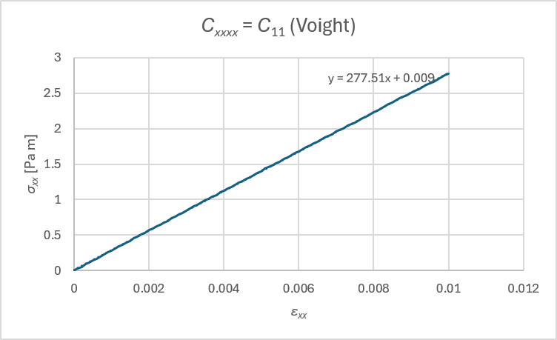
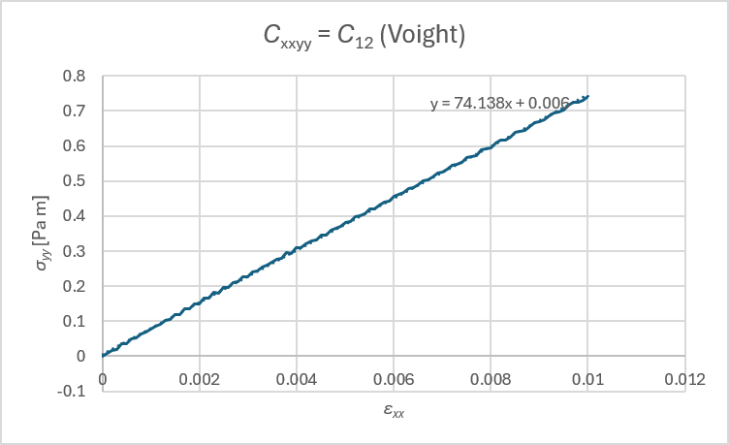
Example 10 – Deformation: x_const_y

Slide 13
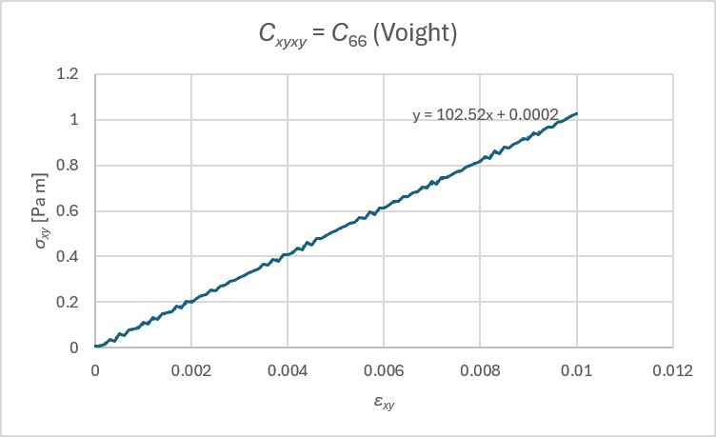
Example 10 – Deformation: xy_shear

