Slide 1

Small Project
Aplikasi Booking Room Hotel Prime
Arisa Hazriaty

Slide 2
Identification
Aplikasi Booking Room Hotel merupakan Situs yang menawarkan Pencarian hotel otomatis yang berbeda dengan pencarian konvensional.
Objective dari Aplikasi ini adalah memudahkan pelanggan dalam menyortir hotel sesuai kriteria yang diplih user.

Slide 3
Testing Process ( CTFL, 2018)
Test Planning
Test Analysis dan Design
Test Implementation
Test Execution
Test Completion

Slide 4
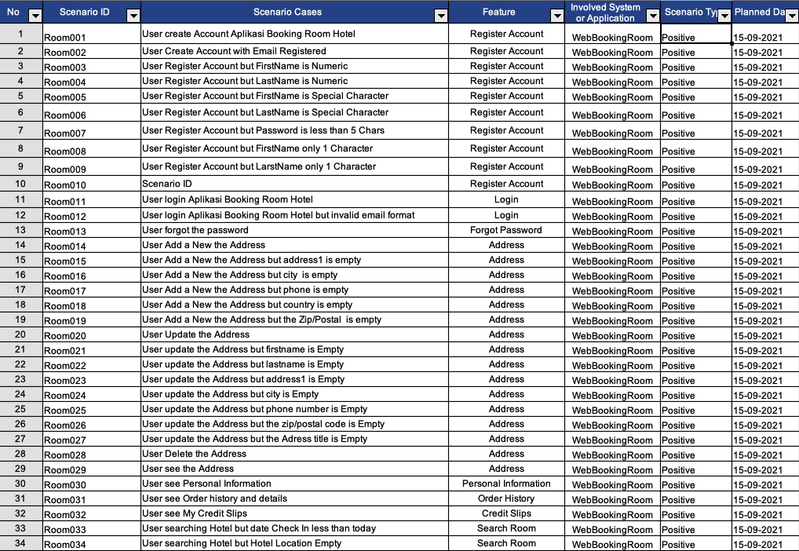
Test Plan

Slide 5
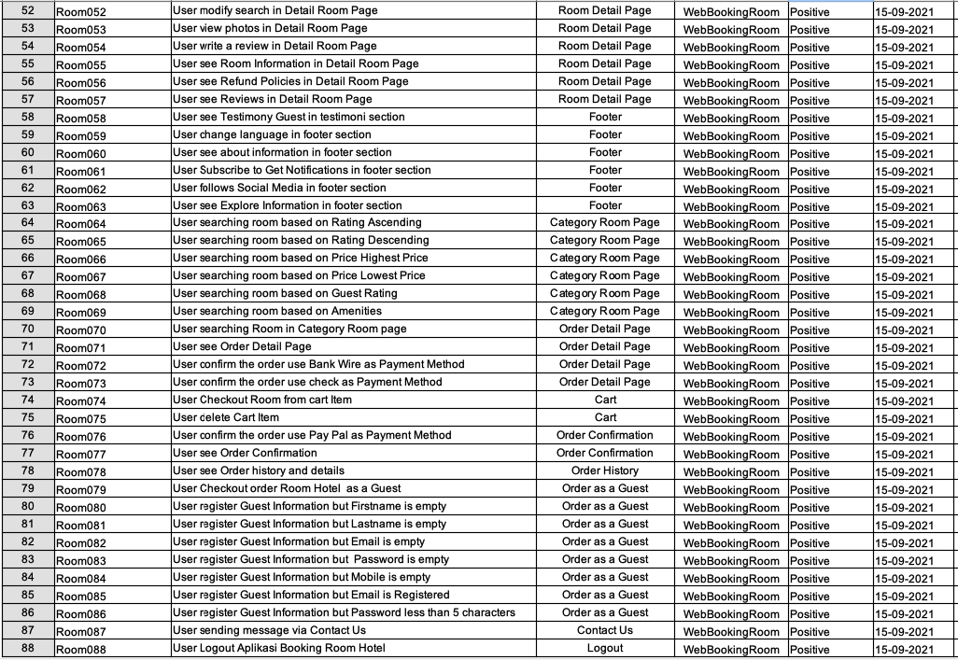
Test Plan Continue..

Slide 6
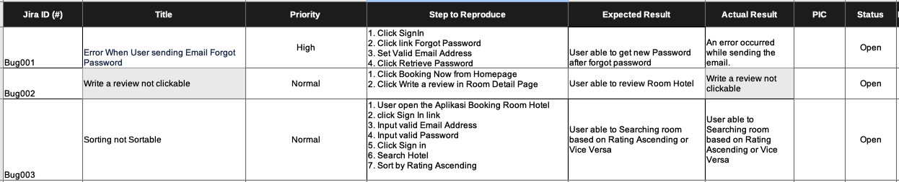
Test Result – Bug Report

Slide 7
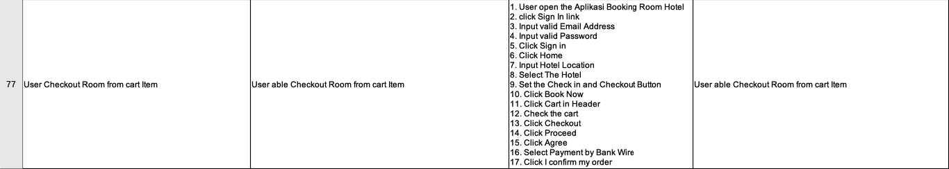
Test Execution

Slide 8
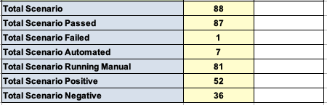
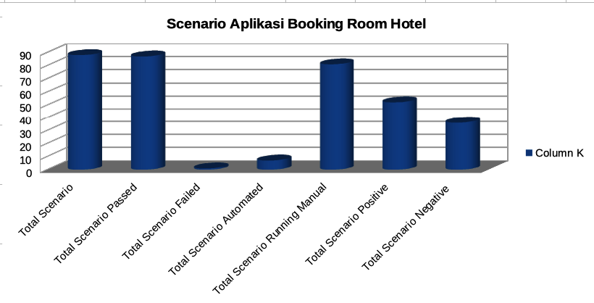
Test Result

Slide 9
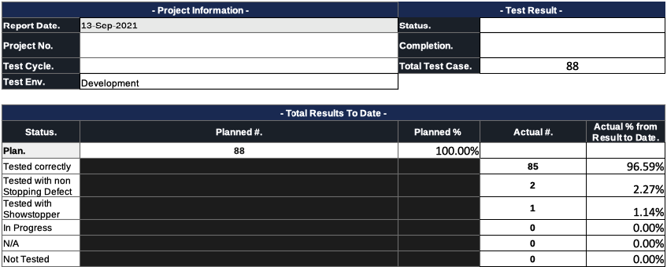
Test Completion UAT Report

Slide 10

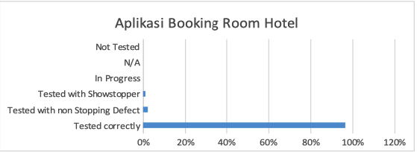
Test Completion Continue...

Slide 11
Implementasi Scenarion Table style to Gherkin Style
@InvalidRegister @development
Feature: Invalid Register Account
User register Invalid Account
@NegativeCase
Scenario Outline: User Register Account Application Booking Hotel Dominique Parks but Invalid Data Input
Given User Open the Homepage
When User create account "<email>" as Email Address on Login Authentication
And User input invalid data such as "<firstname>" as firstname, "<lastname>" as lastname, "<password>" as password
Then User failed to Register and see error notification
Examples:
| email | firstname | lastname | password |
| valid | | Testing | P@ssw0rd123 |
| valid | Tester | | P@aaw0rd123 |
| valid | 12345 | Testing | P@ssw0rd123 |
| valid | Tester | Testing | 1234 |
| valid | Tester | Testing | |
| valid | @ris@ | Testing | P@ssw0rd123 |
| valid | Tester | T35t1n9 | P@ssw0rd123 |

Slide 12
Demo Automation

Slide 13
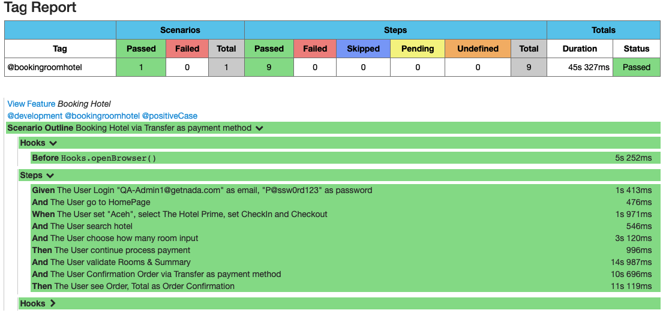
Report Automation

Slide 14

Terima Kasih

