Slide 1
SMALL PROJECT: CONTACT MANAGER

Slide 2
MEMBERS
John Balbuza
Fernando Bilbao
Arisa Kitagishi
Imahd Khan
Susan Long
Sarah Thompson
Jonathan White

Slide 3
EXPLANATION OF PROJECT
A contact manager website
Login, password hashing, add contacts, search contacts, and delete contacts
Extra features:
Sign up if user is not already present in the website
Batch delete
Logoff

Slide 4
HOW PROJECT WAS DEVELOPED
LAMP stack
Creation of database: phpMyAdmin
Server type: MySQL
Implementation of API: PHP
Front-end: JavaScript, HTML, and CSS.
Communication between frontend and backend: JSON

Slide 5
ISSUES ENCOUNTERED
Lack of Communication
Modelling should have occurred earlier in the development process
Unfamiliarity with the various software involved
Took time to learn the basics of php/databases/javascript
Version Control

Slide 6
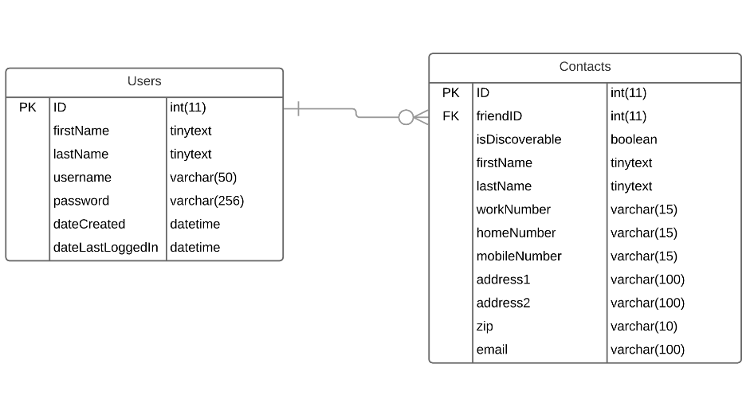
ER DIAGRAM

Slide 7
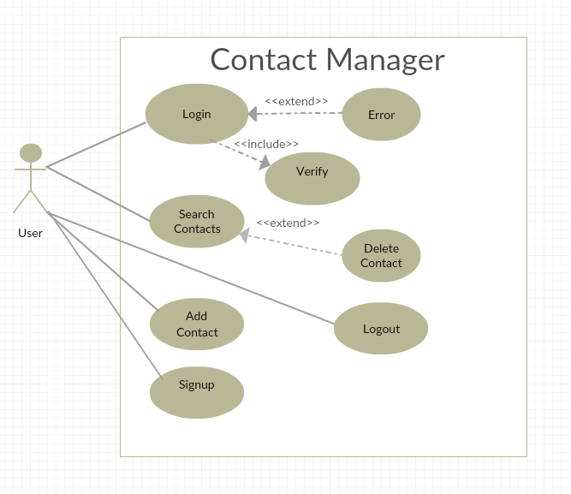
USE CASE DIAGRAM

Slide 8
Extra Features
Multi-user support
Sign up page
Implemented via user table in database
FriendID in contact table identifies which user that contact corresponds to

Slide 9
Extra Features
Deleting multiple contacts
Command broken up by row on front end
Executed one by one by API

Slide 10
Demo
Click here

Slide 11
QUESTIONS?

