Slide 1
AUTOSAR AI MDE Hackathon Project
AI-Augmented Model-Driven Engineering for Software-Defined Vehicles Natural language to YAML to Adaptive + Classic ARXML with safety checks and demo HMI
Demo focus Classic + Adaptive + Safety
BMW + Ford
Tenants
YAML + 2x ARXML
Outputs
Safety + Mapping
Checks
AUTOSAR AI MDE Hackathon Demo

Slide 2
Problem We Are Solving
AUTOSAR design is slow, artifact-heavy, and split across Classic CAN and Adaptive SOME/IP stacks.
Teams must turn informal requirements into models, mappings, and safety evidence under time pressure.
Early iterations often lack fast validation, traceability, and reusable demo artifacts.
We need a working pipeline that converts intent and ARXML references into usable outputs, not just documents.
Pain
Manual modeling, fragmented communication stacks, late safety feedback
Need
Fast, local, explainable AUTOSAR artifact generation
Ollama default
Local-first
Chroma + references
RAG
Audit + tenant scope
Governance
AUTOSAR AI MDE Hackathon Demo

Slide 3
What This Project Delivers
Natural language to AUTOSAR YAML using local grounded retrieval.
One-click compile to both Adaptive ARXML and Classic ARXML.
Safety validation for structure, ASIL coverage, mappings, and communication risk.
Reference ARXML upload, AI suggestions, HMI simulation, and tenant-scoped audit trails.
Artifacts
YAML, Adaptive ARXML, Classic ARXML, safety findings
UX
Streamlit app with guided demo buttons and downloads
Ollama default
Local-first
Chroma + references
RAG
Audit + tenant scope
Governance
AUTOSAR AI MDE Hackathon Demo

Slide 4
End-to-End Workflow
1. User provides a natural-language AUTOSAR request or loads an AEB / CAN-to-SOME-IP demo prompt.
2. Engine retrieves relevant local references from markdown and AUTOSAR example ARXML documents.
3. Local Ollama or Gemini generates normalized YAML for system, ECUs, services, signals, and safety.
4. Core compiler converts that YAML into normalized AUTOSAR-like XML outputs for both Adaptive and Classic variants.
5. Safety validator and mapping baseline score the result before users export artifacts or drive the HMI simulation.
Core pipeline
Prompt -> RAG -> YAML -> ARXML -> Safety/HMI
Ollama default
Local-first
Chroma + references
RAG
Audit + tenant scope
Governance
AUTOSAR AI MDE Hackathon Demo

Slide 5
How AI Is Helping
RAG grounds prompts in local AUTOSAR notes and example ARXML, reducing generic LLM drift.
The model converts broad intent into structured system, ECU, service, signal, and safety sections.
AI suggestions propose safety, mapping, and deployment improvements after generation.
A lightweight ML baseline flags risky signal-to-service mappings before compile time.
LLM
Ollama default, Gemini optional provider
ML
Mapping baseline test accuracy 0.80, F1 0.8571
Ollama default
Local-first
Chroma + references
RAG
Audit + tenant scope
Governance
AUTOSAR AI MDE Hackathon Demo

Slide 6
What Is In The Repo
core.py: ingestion, retrieval, YAML parsing, ARXML compilation, safety validation, AI suggestions, and mapping pre-check logic.
streamlit_app.py: authenticated multi-tenant UI, demo flows, model selection, upload validation, compile/download actions, and safety reporting.
AUTOSAR_WorkflowExample/ and data/: local AUTOSAR reference material used for grounding and example architectures.
scripts/ and models/: baseline ML training/inference utilities and saved mapping metrics.
audit/ and chroma_db/: tenant-scoped audit trails and retrieval persistence for BMW/Ford demo isolation.
Security
Login gate + tenant-scoped storage + audit JSONL
Demo assets
SVG visuals, HMI cluster HTML, ARXML simulator
Ollama default
Local-first
Chroma + references
RAG
Audit + tenant scope
Governance
AUTOSAR AI MDE Hackathon Demo

Slide 7
Safety, Governance, and Validation
Safety report checks system naming, ECU ASIL coverage, hardware bindings, service presence, signal mappings, and safety section completeness.
Mapping pre-check can block compile when the ML baseline sees a high-confidence invalid or unsafe mapping.
ARXML uploads are classified as Classic / Adaptive / Unknown / Invalid before being accepted as references.
Audit logs track generation, compile, reload, and fallback actions per tenant, supporting demo governance and traceability.
Validation
Structure + mapping + safety + upload sanity checks
Ollama default
Local-first
Chroma + references
RAG
Audit + tenant scope
Governance
AUTOSAR AI MDE Hackathon Demo

Slide 8
Current Evidence From The Project
Mapping baseline metrics: train accuracy 0.9474, validation accuracy 1.00, test accuracy 0.80, test F1 0.8571.
Current end-to-end batch result snapshot: 1 pass / 10 cases with most failures caused by local Ollama timeout, not by parser or compiler logic.
The app includes deterministic fallback YAML so the demo remains usable even when model inference is unreliable.
Recent enhancement: one compile action now emits both Adaptive and Classic ARXML outputs for the same generated architecture.
Strength
Architecture toolchain works end-to-end
Gap
LLM latency/reliability is the current bottleneck
0.80
Test accuracy
0.8571
Test F1
1 / 10
E2E pass count
AUTOSAR AI MDE Hackathon Demo

Slide 9
Live Demo Story
Log in as BMW or Ford demo admin to show tenant isolation and auditability.
Load the AEB or CAN-to-SOME-IP prompt, generate YAML, and explain how retrieval grounds the output.
Compile once and show both Adaptive and Classic ARXML outputs plus downloadable files.
Run the safety check and AI suggestion flow to show how the tool catches issues and proposes improvements.
Open the HMI cluster HTML to show ARXML-driven telltale authorization and human-facing validation behavior.
Best demo path
Prompt -> YAML -> dual ARXML -> safety -> HMI
AEB / CAN->SOME-IP
Prompt
Adaptive + Classic
Compile
Safety + HMI
Review
AUTOSAR AI MDE Hackathon Demo

Slide 10
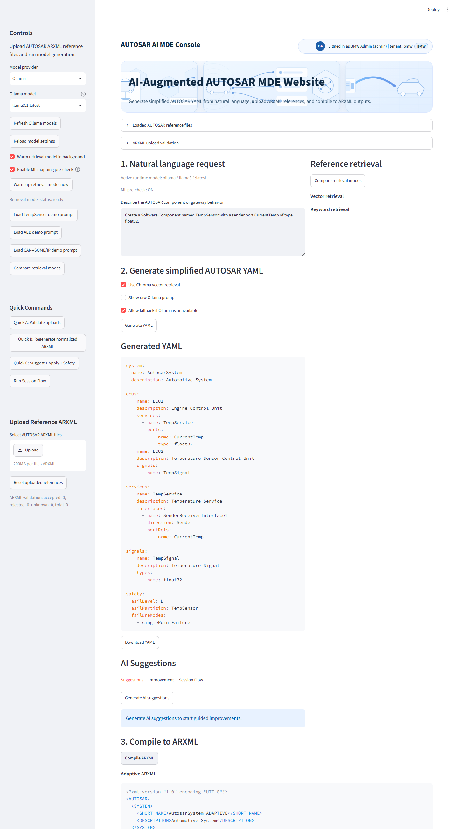
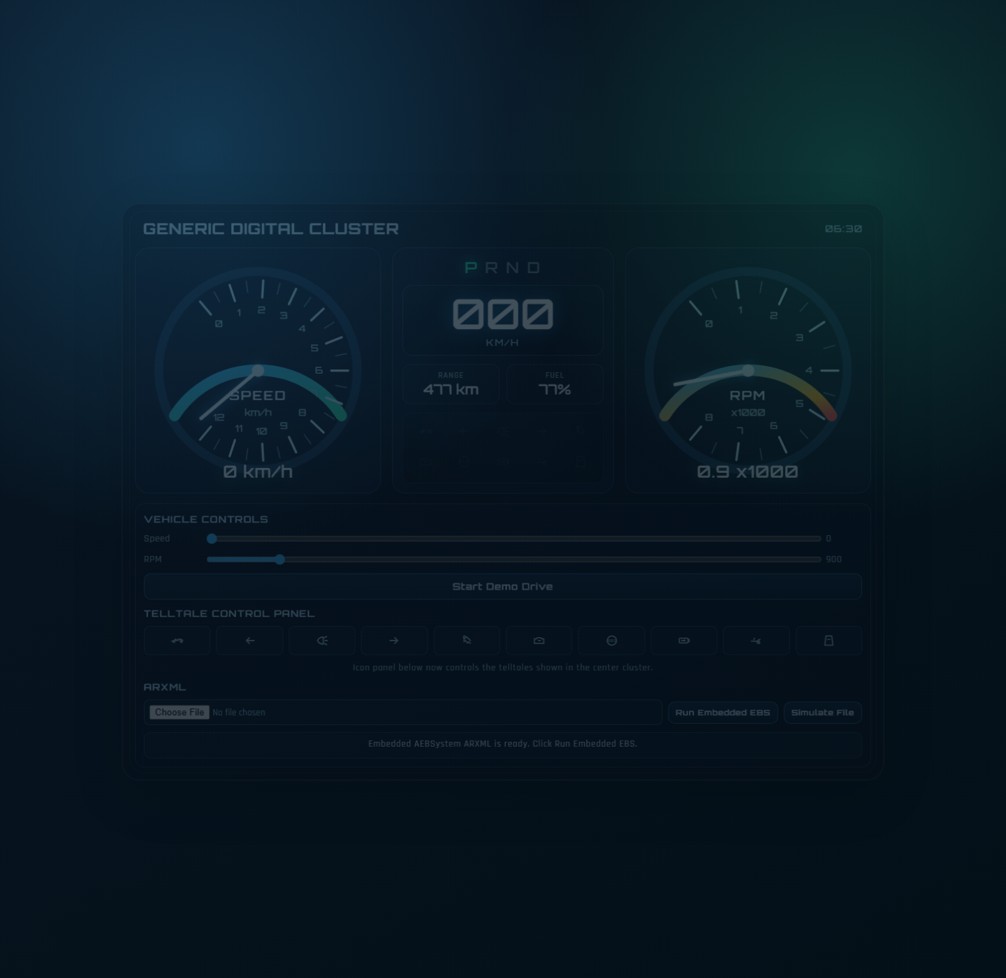
Demo Screenshots
Authenticated Streamlit console and ARXML-driven HMI cluster
1. Prompt to YAML
Natural-language request generates structured AUTOSAR YAML in-app.
2. HMI linkage
Loaded ARXML authorizes telltales before the cluster can be controlled.
Streamlit console: authenticated multi-tenant UI, YAML generation, compile, and safety workflow
ARXML-driven HMI cluster: telltale authorization, control panel, and validation feedback
AUTOSAR AI MDE Hackathon Demo

Slide 11
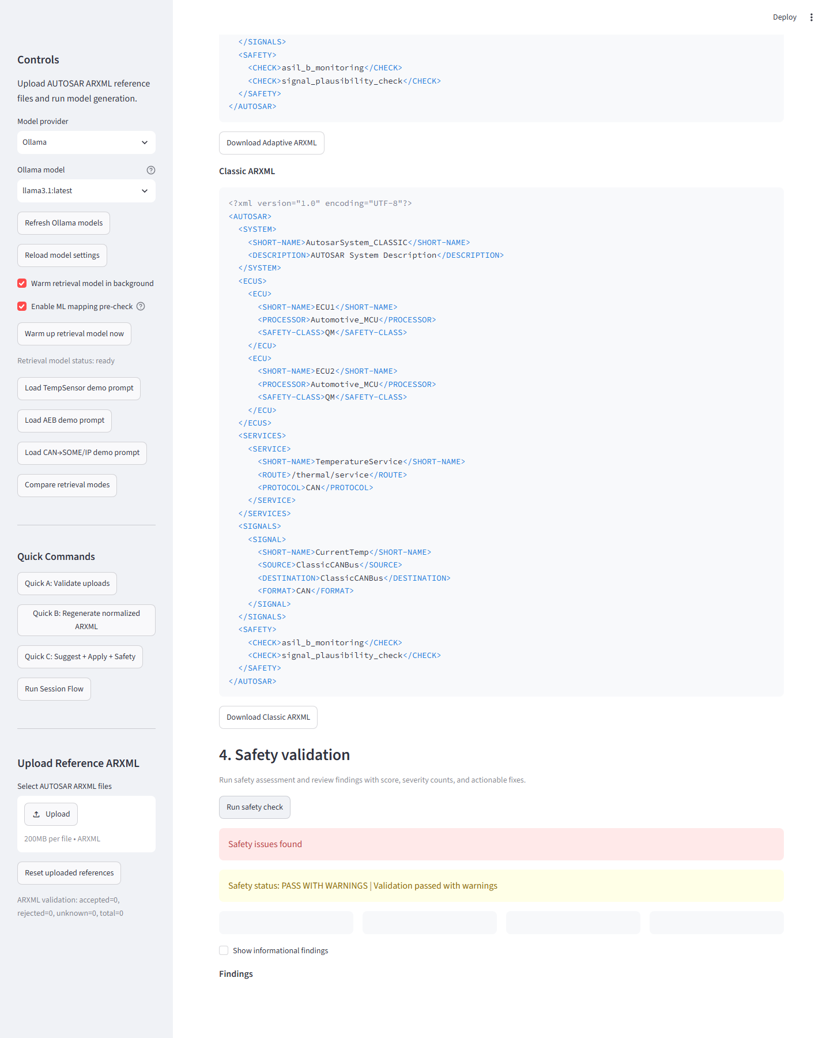
Compile and Safety Evidence
Dual ARXML output and safety validation results captured from the live app
Dual output
One compile flow now generates both Adaptive and Classic ARXML downloads.
Safety feedback
Warnings surface immediately so the demo shows engineering governance, not just generation.
Judge takeaway
This is a working pipeline: model output, compile artifact, and validation evidence in one UI.
Live app state showing Classic ARXML output and safety status after compile/check
AUTOSAR AI MDE Hackathon Demo

Slide 12
Why This Matters
Faster concept-to-architecture turnaround for SDV teams working across Classic and Adaptive AUTOSAR stacks.
Earlier safety feedback reduces rework and makes ASIL-oriented design tradeoffs visible sooner.
Local-first inference and tenant separation make the approach suitable for sensitive automotive design environments.
The same framework can evolve from hackathon scaffold into a stronger engineering assistant with richer schema validation and enterprise identity.
Benefit
Speed, consistency, safety visibility, and demo-grade explainability
Ollama default
Local-first
Chroma + references
RAG
Audit + tenant scope
Governance
AUTOSAR AI MDE Hackathon Demo

Slide 13
Judging Summary
Innovation: combines local LLM generation, RAG, safety checks, ML mapping pre-check, and HMI simulation in one AUTOSAR demo flow.
Technical depth: covers YAML generation, dual ARXML compilation, tenant isolation, validation, audit logging, and UI-driven review.
Practical impact: accelerates AUTOSAR architecture iteration while exposing safety and communication issues earlier.
Demo strength: judges can see prompt input, generated artifacts, compile evidence, safety results, and HMI behavior in one session.
One-line pitch
An AI-assisted AUTOSAR copilot that turns intent into dual-stack artifacts with safety-aware feedback.
Judge lens
Innovation + feasibility + impact + live proof
Ollama default
Local-first
Chroma + references
RAG
Audit + tenant scope
Governance
AUTOSAR AI MDE Hackathon Demo

Slide 14
Next Steps
Replace simplified XML with richer AUTOSAR package/schema support and stronger Classic vs Adaptive specialization.
Improve LLM robustness and latency through prompt slimming, model tuning, caching, or better local runtime setup.
Expand ML datasets and features for communication mapping, hazard patterns, and safety mechanism recommendations.
Add official AUTOSAR document ingestion, OAuth/OIDC, and richer reporting for production-ready engineering workflows.
Hackathon message
We already proved the flow; next step is industrial-grade depth
Ollama default
Local-first
Chroma + references
RAG
Audit + tenant scope
Governance
AUTOSAR AI MDE Hackathon Demo

