Slide 1
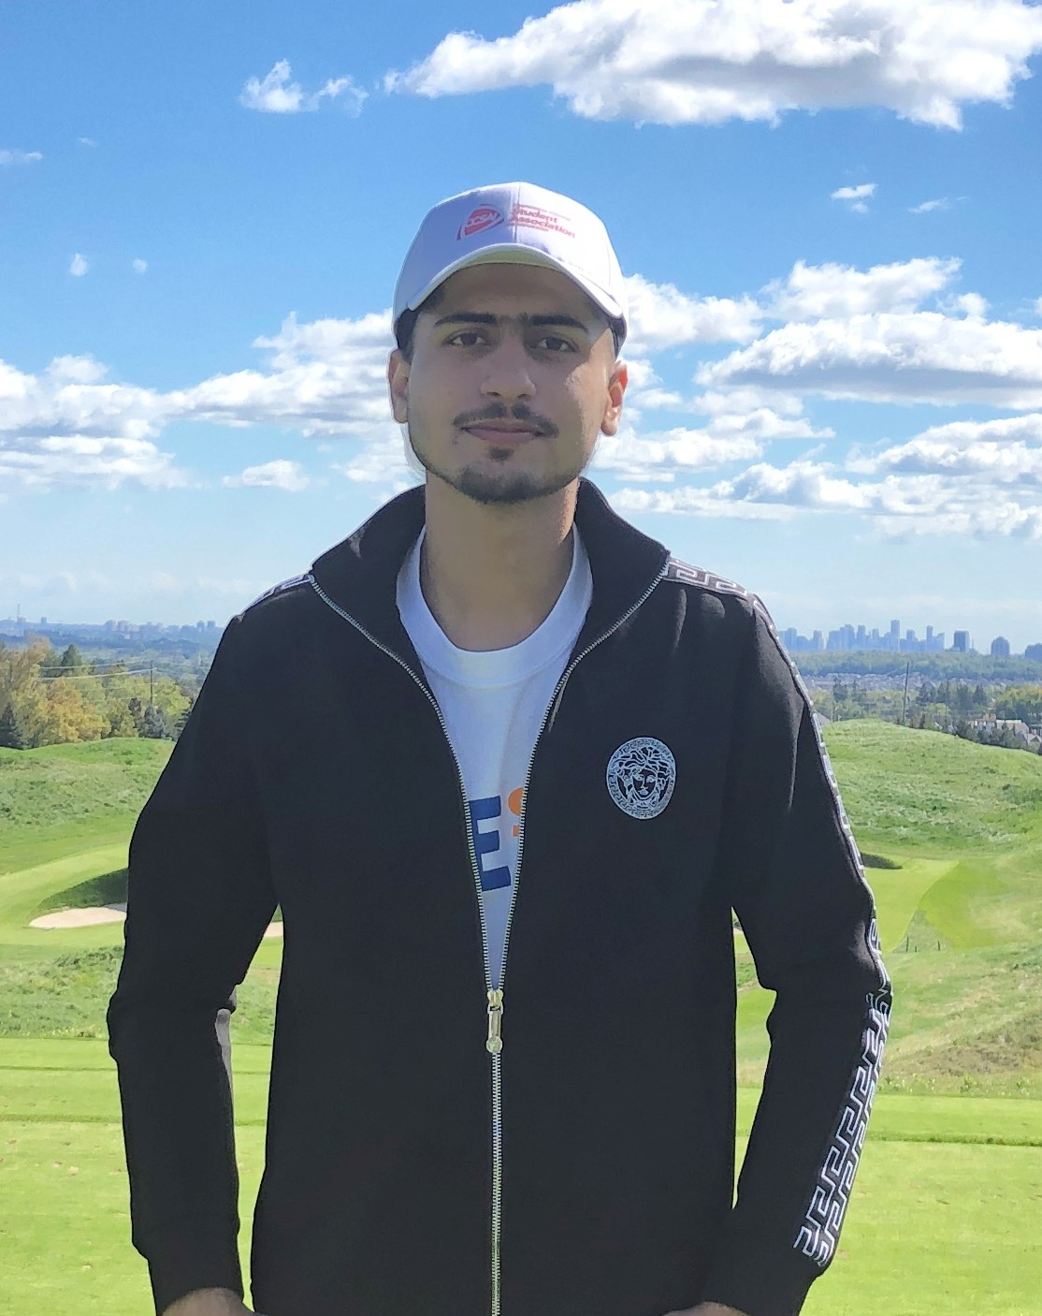
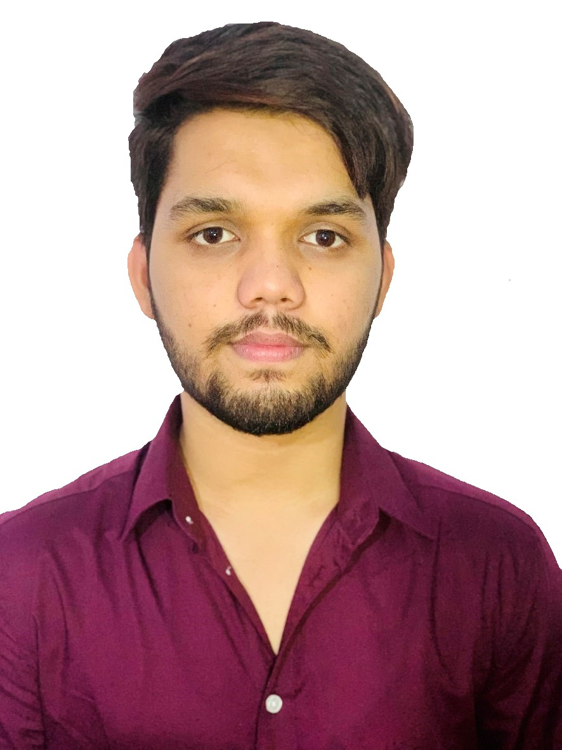
Name- Arish Qureshi Student Id-301176321 Course code- COMP229 Course name- Web Application Development Midterm Test Summer 2022

