Slide 1
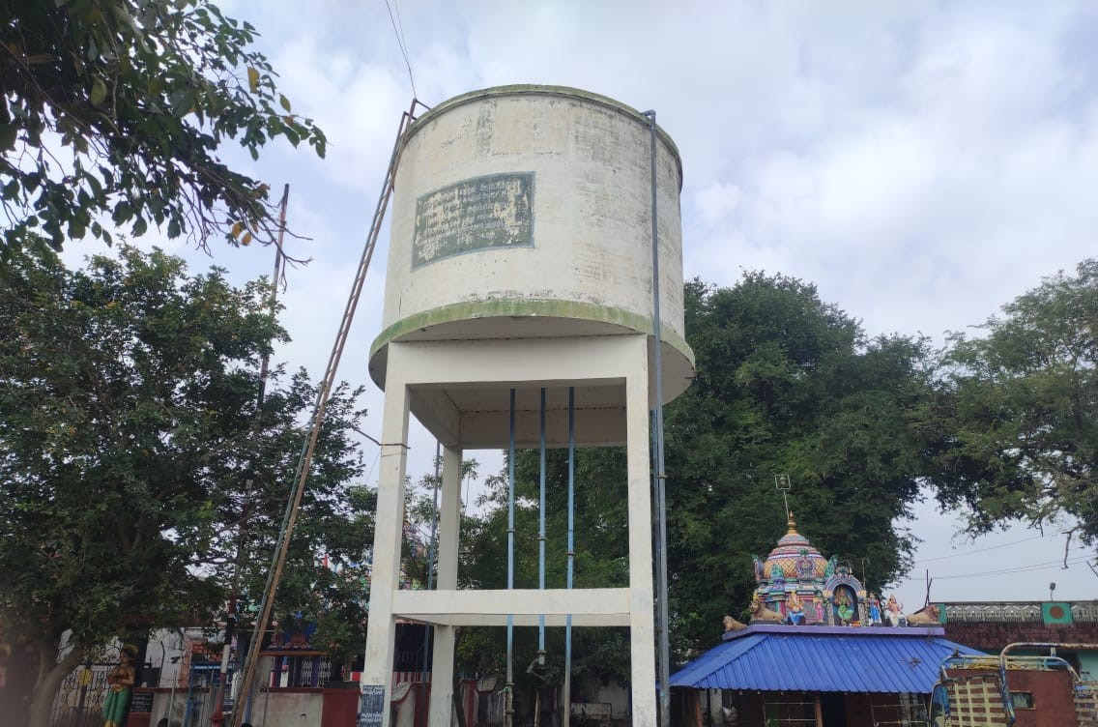
AquaNet: A Quality Monitoring Network for Rural Potable Water Distribution Scheme Using Smart Things
Presented By
Aris Kannan A , Divyan T & Javith Ahamed
Third Year,
Department of Information Technology,
E.G.S. Pillay Engineering College
Guided By
Ms V. Surya, AP/IT
Department of Information Technology,
E.G.S. Pillay Engineering College

Slide 2

INTRODUCTION
Water is the international solvent.
Safe water service is a safely distributed drinking water.
Quality monitoring is an important part of the potable water supply and management system.
In this process, parameters at designated places are measured at predefined intervals to provide data that may be used to reveal present conditions, create trends, etc.
Measuring and collecting water quality data is a challenging problem
Monitoring of water quality provides a pragmatic basis by measuring temporal and spatial physiochemical data.
It sets and drives thresholds for predicting water quality conditions, and water quality trends, and enabling obligatory statistics for the validation and standardization of models.
Climate variability worsens the issue further.

Slide 3
PROBLEM STATEMENT
To develop an efficient and real-time Internet of Things (IoT)-based system for monitoring and ensuring the quality of water in rural tanks.
The system aims to enhance water management and safety in rural areas by providing continuous insights into water quality parameters, thereby promoting safe water use for agriculture, drinking, and other needs.
Project Goals:
Continuous Monitoring: Implement IoT-enabled sensors to continuously monitor key water quality parameters such as pH levels, turbidity, dissolved oxygen, temperature, and chemical contaminants.
Data Analytics and Alerts: Use cloud-based systems to collect, analyze, and store data in real-time, providing alerts and insights when water quality deteriorates beyond safe thresholds.
Low-Cost Implementation: Design the system to be affordable and scalable for rural communities, considering budget constraints and the need for low-maintenance solutions.
Community Empowerment: Involve local communities and stakeholders in understanding water quality metrics and using the data to take corrective actions, such as tank cleaning, filtering, or water treatment.

Slide 4
SCOPE OF WORK
IoT Sensor Design: Develop and deploy sensors to monitor water quality parameters such as pH, turbidity, and temperature in rural water tanks.
Communication Protocol: Use wireless communication like LoRa to transmit data to a centralized cloud platform.
Data Processing: Implement a cloud system to collect, store, and analyze real-time water quality data.
Mobile Application: Develop an app to display data and send alerts when water quality falls below safety thresholds.
Pilot Testing: Conduct pilot trials in select rural tanks to assess performance and accuracy.
Community Training: Educate local authorities on interpreting data and responding to alerts.
Real-Time Monitoring: Continuously monitor and maintain sensors for long-term use.
Reporting: Provide periodic reports on water quality trends and their impact on agriculture and health.
Maintenance: Create a schedule for sensor calibration and cleaning.
Scalability: Ensure the system can expand to cover more tanks and larger water bodies

Slide 5
OBJECTIVE AND CONTRIBUTION
OBJECTIVE
To develop an IoT-based water quality monitoring system for a rural drinking water distribution system → sensors, a powerful controller, a seamless communication network, a fixed access point and a personalized anchored float (buoyage).
To measure critical quality parameters including temperature, conductivity, turbidity, and pH
CONTRIBUTION
A real-time WQM system is proposed for rural areas
A method is developed to direct a suitable warning message to the participants when the observed CQPs diverge from WHO standards.

Slide 6
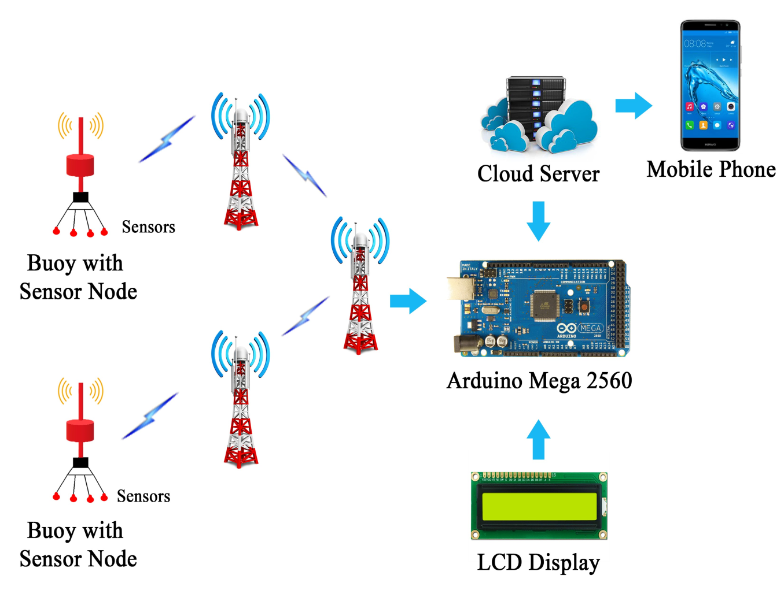
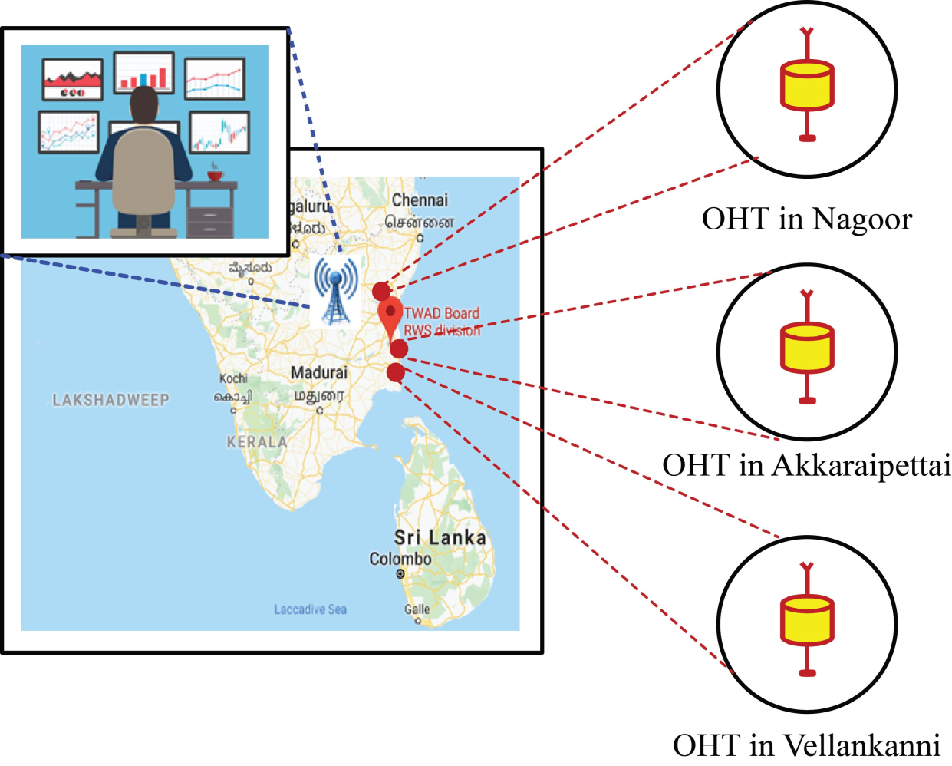
SOLUTION
Figure 1. Block diagram of AquaNet
Figure 2. Schematic of AquaNet

Slide 7
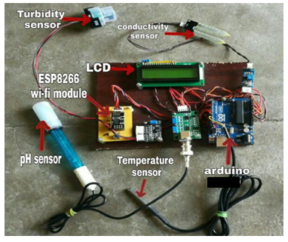
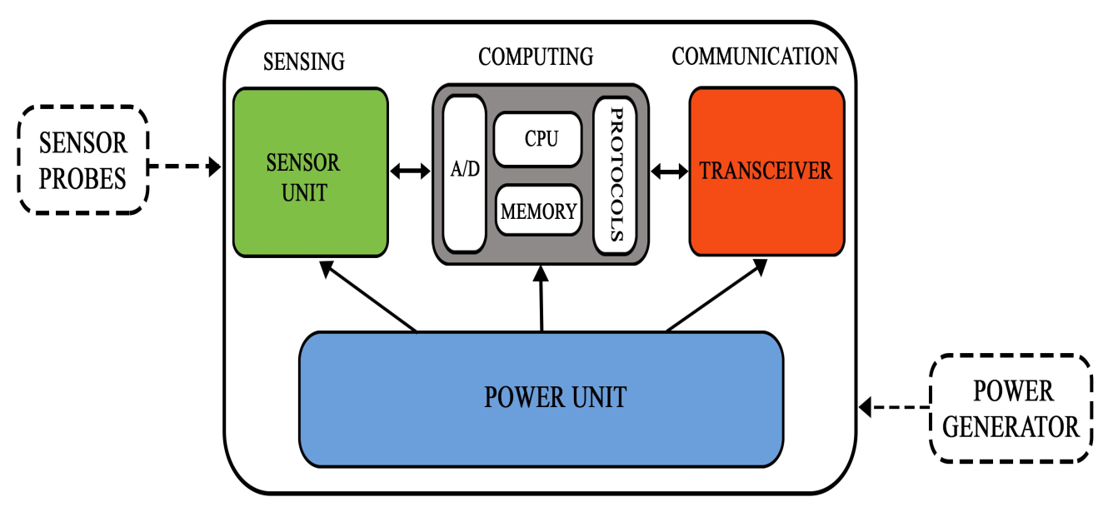
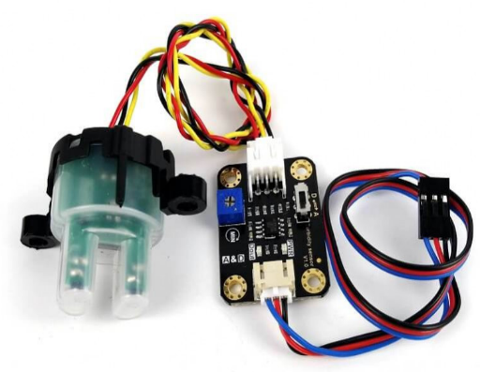
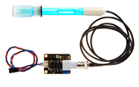
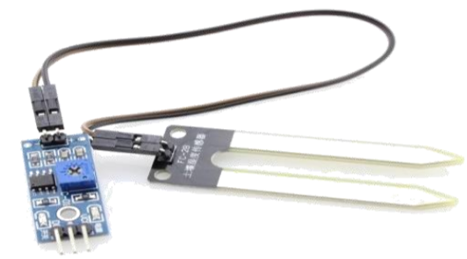
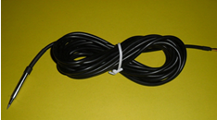
Selection of Sensing Probes
Figure 3. Basic hardware architecture of a sensing node
(a) DFRobot SEN0161- pH sensor
(b) DFRobot SEN0189 - Turbidity sensor
(c) SparkFun YL 69 -Conductivity sensor
(d) TI LM35 - Temperature sensor

Slide 8
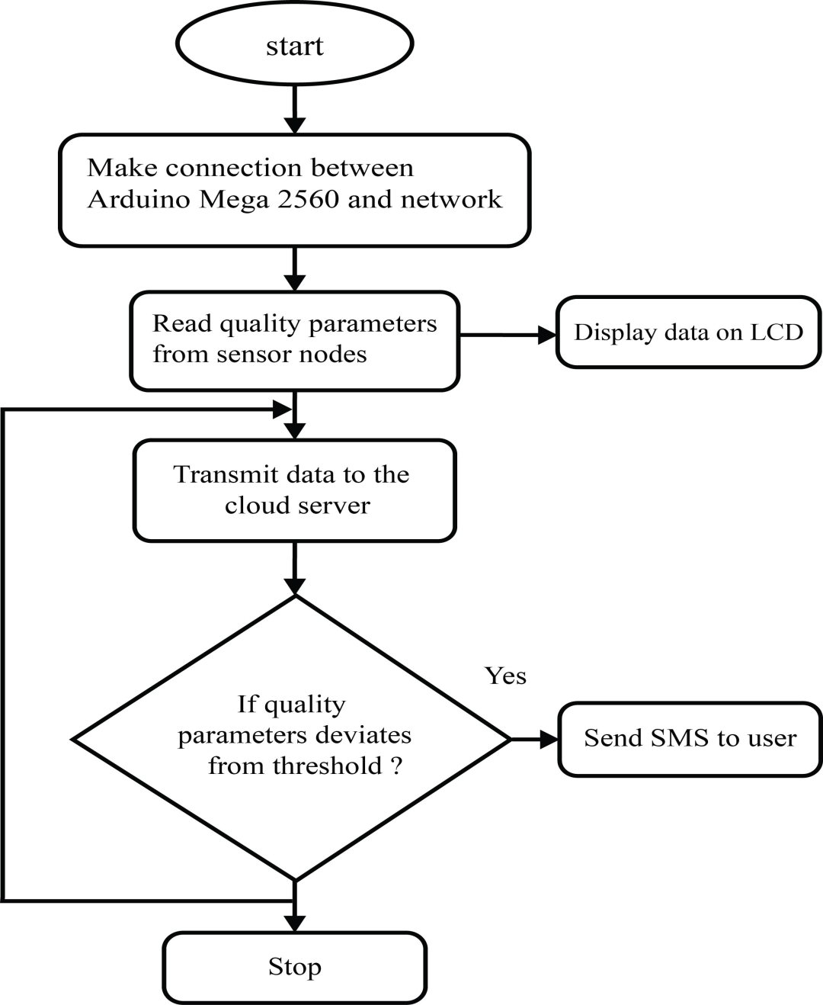
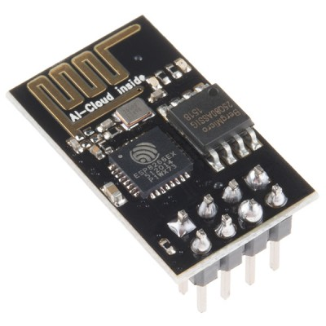
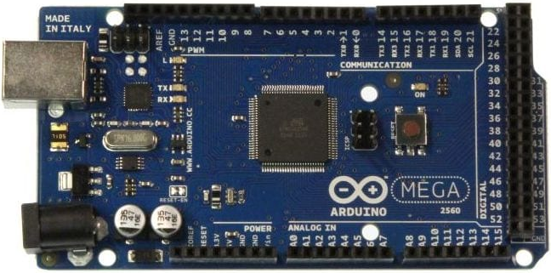
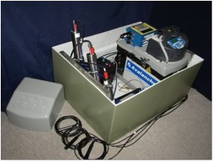
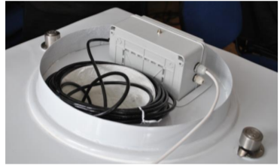
Control system in AquaNet
Figure 6. Mega2560 Controller
Figure 7. ESP8266 transceiver unit
Figure 5. Workflow of AquaNet
Figure 8. Buoyage in AquaNet

Slide 9
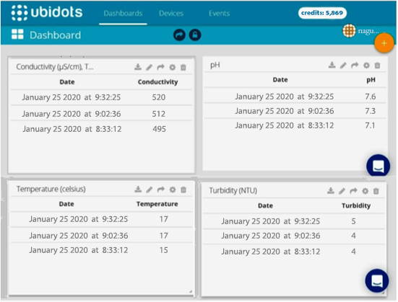
DEMO
OWT | pH |  |  | Turbidity
 | AquaNet | Horiba | Diff | AquaNet | Horiba | Diff
1 | 7.58 | 8.02 | -0.44 | 5.67 | 5.88 | -0.21
2 | 7.62 | 7.56 | 0.06 | 5.26 | 5.69 | -0.43
3 | 7.31 | 7.11 | 0.2 | 5.47 | 5.43 | 0.04
 | Average Difference |  | -0.06 | Average Difference |  | -0.20
OWT | Conductivity |  |  | Temperature
 | AquaNet | Horiba | Diff | AquaNet | Horiba | Diff
1 | 523 | 527 | -4 | 17.6 | 17.2 | 0.4
2 | 527 | 526 | 1 | 17.2 | 16.9 | 0.3
3 | 487 | 486 | 1 | 16.5 | 16.2 | 0.3
 | Average Difference |  | -0.67 | Average Difference |  | -0.34

Slide 10
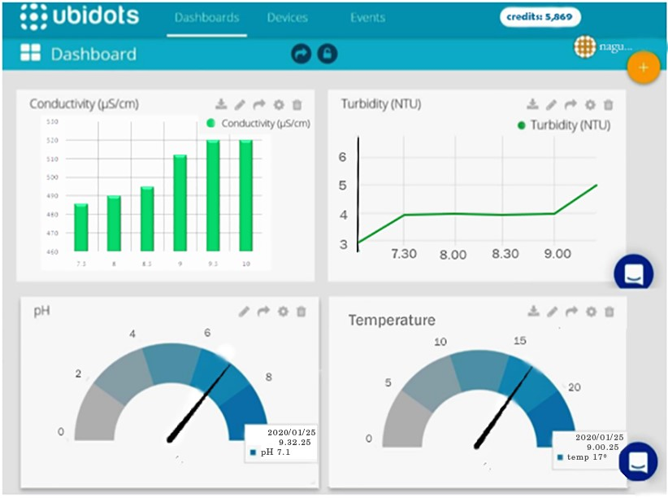
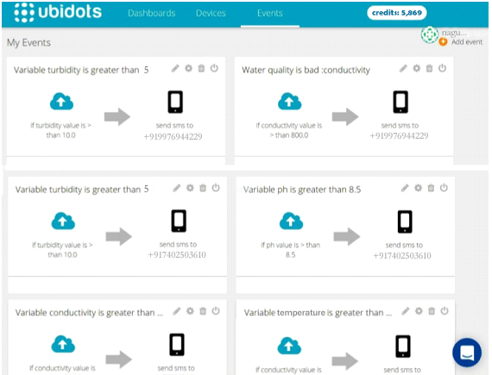
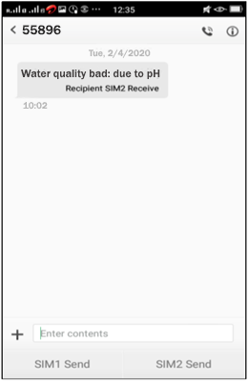
RESULT AND DISCUSSION
Figure 10. CQPs Values obtained from OWT in Velankanni
Figure 11. Graphs related to CQPs measured at Akkaraipettai
Figure 12. Events created for alert

Slide 11
REFERENCES
Al Hamedi, F.H., Kandhan, K., Liu, Y., Ren, M., Jaleel, A., and Alyafei, M.A.M. (2023). “Wastewater Irrigation: A Promising Way for Future Sustainable Agriculture and Food Security in the United Arab Emirates”, Water, 15(12):2284.
Alam, A.U., Clyne, D., and Deen, M.J. (2021). “A Low-Cost Multi-Parameter Water Quality Monitoring System”. Sensors, 21(11):3775.
Ashrafuzzaman, M., Gomes, C., and Guerra J. (2023). “The Changing Climate Is Changing Safe Drinking Water, Impacting Health: A Case in the Southwestern Coastal Region of Bangladesh (SWCRB)”. Climate, 11(7), 146-152.
Avila-Perez, H., Flores-Munguía, E.J., Rosas-Acevedo, J.L., Gallardo-Bernal, I., Ramirez-delReal, T.A. (2023). “Comparative Analysis of Water Quality Applying Statistic and Machine Learning Method: A Case Study in Coyuca Lagoon and Tecpan River, Mexico”, Water, 15(4):640.
Balcerzak, M. (2022). Biomonitoring of Human Exposure to Fluorine, Handbook of Bioanalytics, Springer, Cham.
Bayu, T., Kim, H., and Oki, T. (2020). “Water Governance Contribution to Water and Sanitation Access Equality in Developing Countries”. Water Resour. Res., 56(4), e2019WR025330.
Bertule, M., Glennie, P., Bjørnsen, K.P., Lloyd, J. G., Kjellen, M., and Dalton, J. (2018). “Monitoring Water Resources Governance Progress Globally: Experiences from Monitoring SDG Indicator 6.5.1 on Integrated Water Resources Management Implementation”. Water, 10(12):1744.

