Slide 1
Microsoft Azure
Name: Dom Arishi
TUID: 915604744

Slide 2
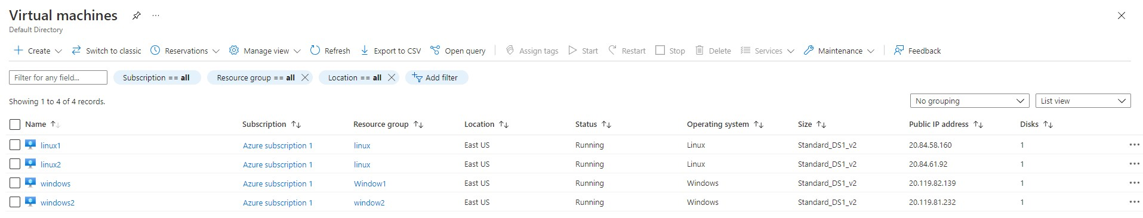
2 Windows VM’s &2 Linux VM’s

Slide 3
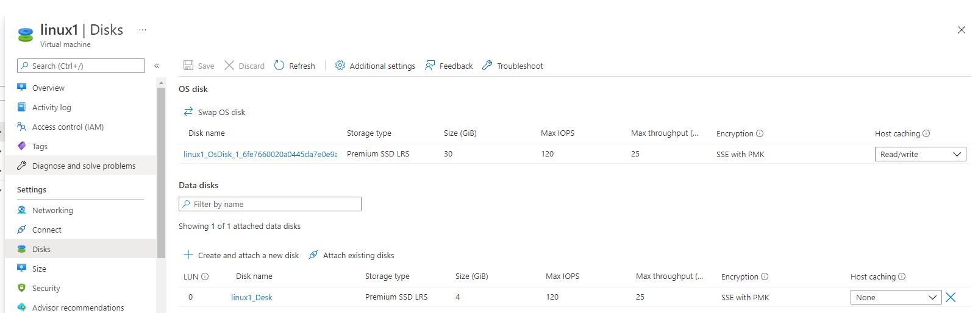
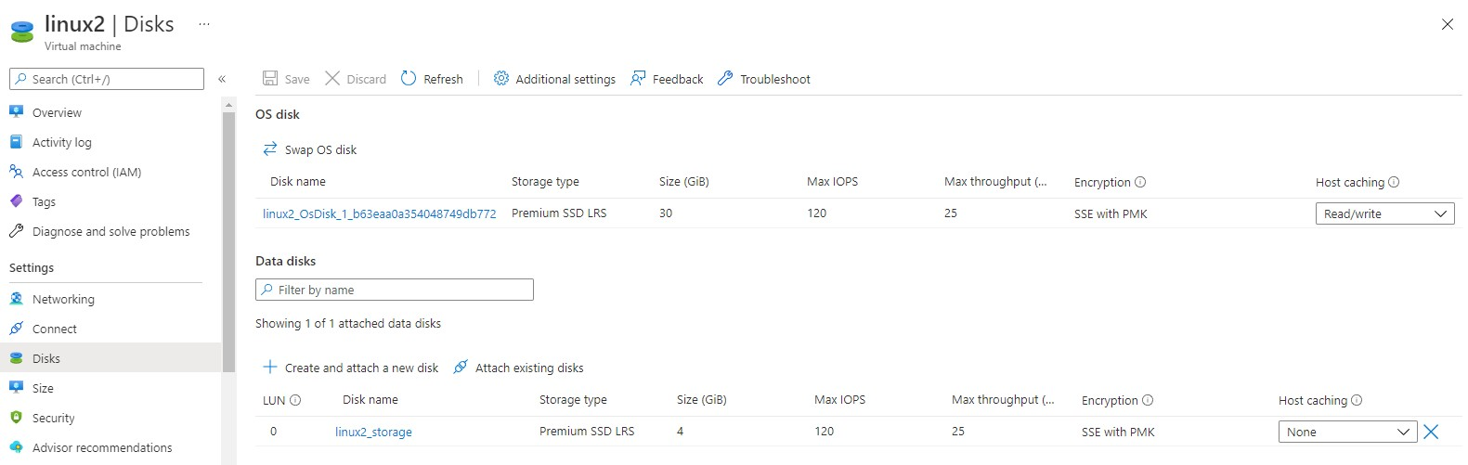
storage to Linux VM

Slide 4
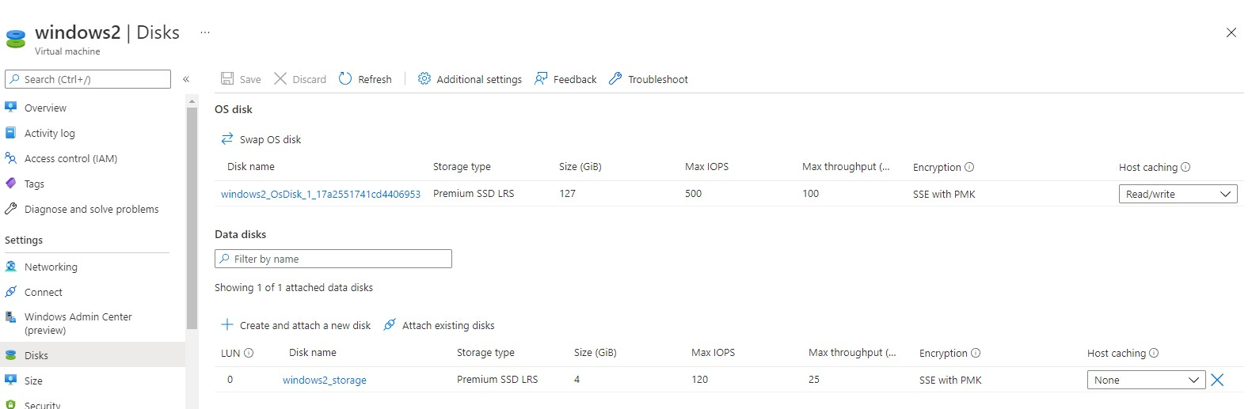
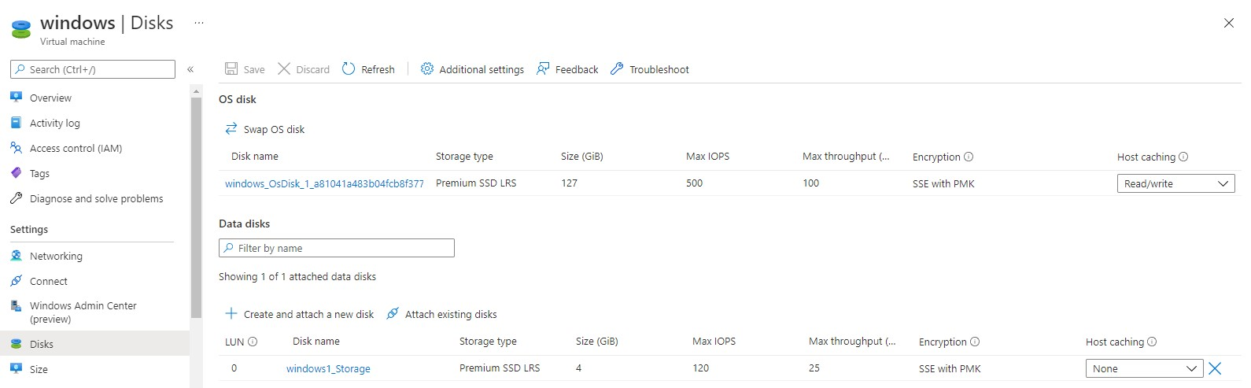
storage to Windows VM

Slide 5
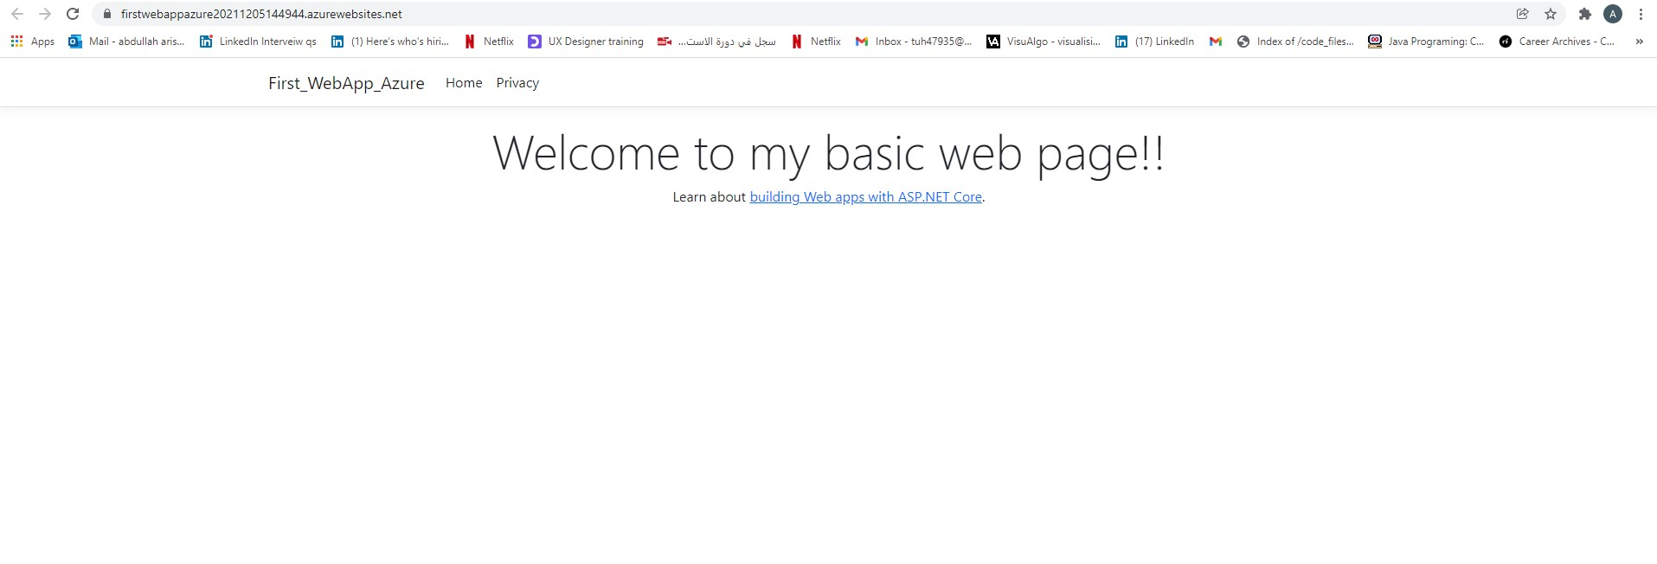
Basic web app using ASP.NET and Visual Studio

Slide 6
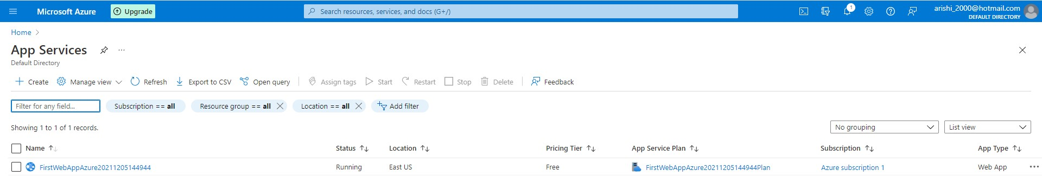
Basic web app using ASP.NET and Visual Studio

Slide 7
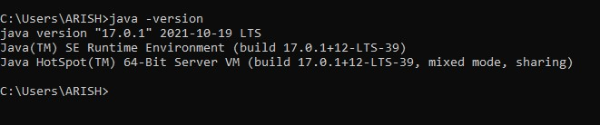
Install JDK on Windows VM

Slide 8
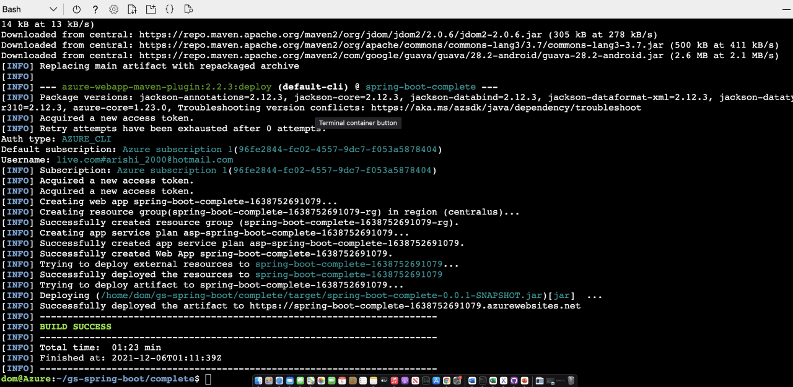
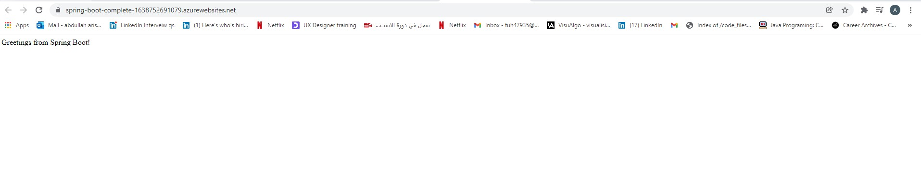
java website using Tomcat

Slide 9
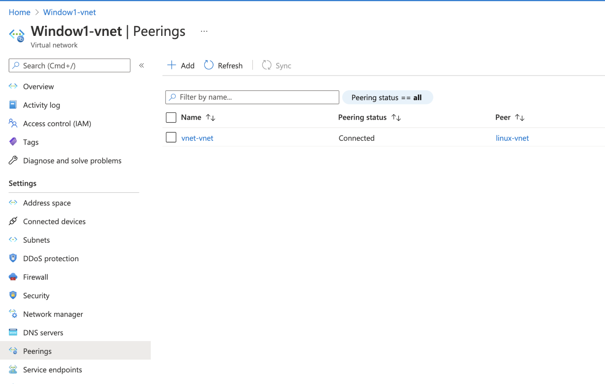
Peering between Windows VPC and Linux VPC

Slide 10
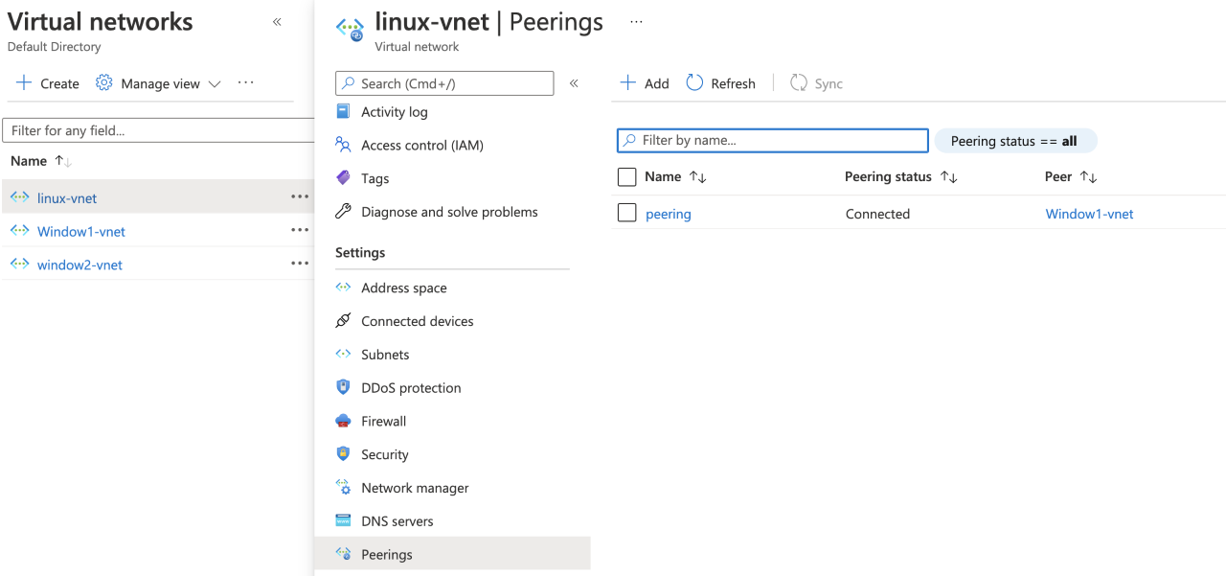
Peering between Linux VPC and Windows VPC

Slide 11
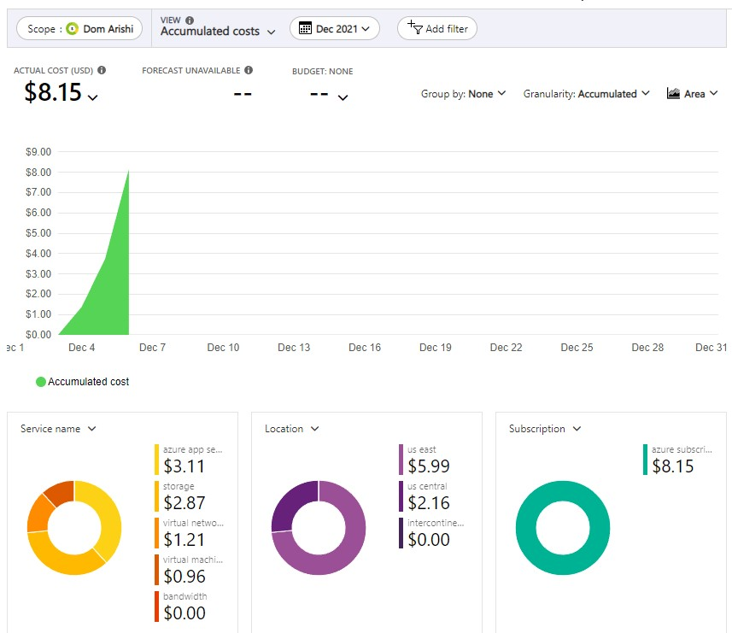
Project Cost

Slide 12
Time Spent on Project:
3-4 Days
Project Cost:
8.15$
Two Pro’s:
I like it because it gave me the opportunity to have exposure on Visual Studio and creating a web page.
it has more specific functionalities than the other cloud platforms.
Two Con’s:
the flexibility of the Implementation of some of the tasks were way harder and complicated than AWS and GCP plus the I thought it would have bigger community than AWS.
I didn’t like the documentation that was provided by Microsoft and YouTube videos were outdated, so I had to figure out some task by myself.

