Slide 1
CIS4345 Assignment 04
Name: Dom Arishi
School ID: 915604744

Slide 2
GCP Project & Tutorials

Slide 3

Project review
- Since I’m an international student, using GCP services I created a website that display a memorable moments in my life in the cities that I have visited during my stay in the United Stay since 2017.

Slide 4
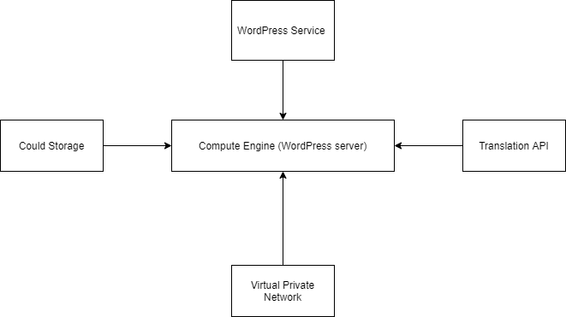
GCP SERVICES IMPLEMENTATION

Slide 5
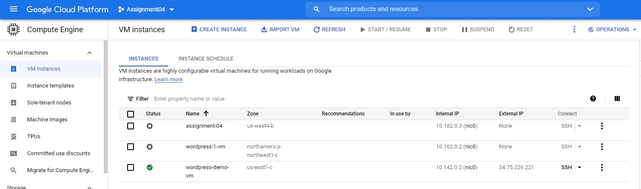
COMPUTE ENGINE

Slide 6
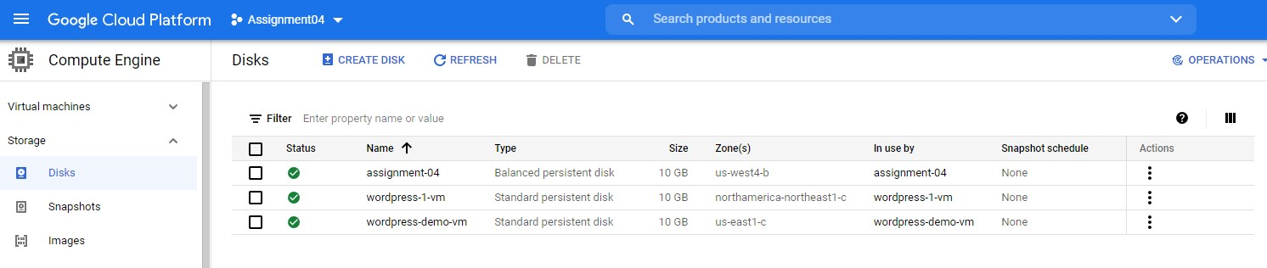
storage

Slide 7
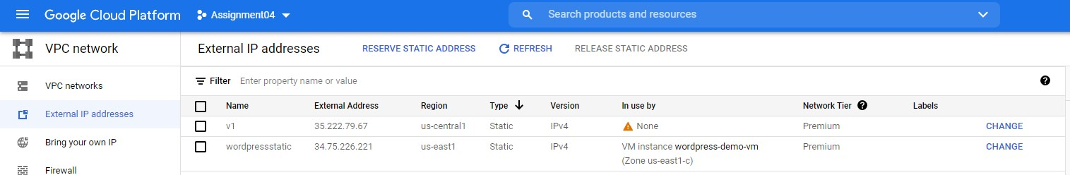
Network (vpc)

Slide 8
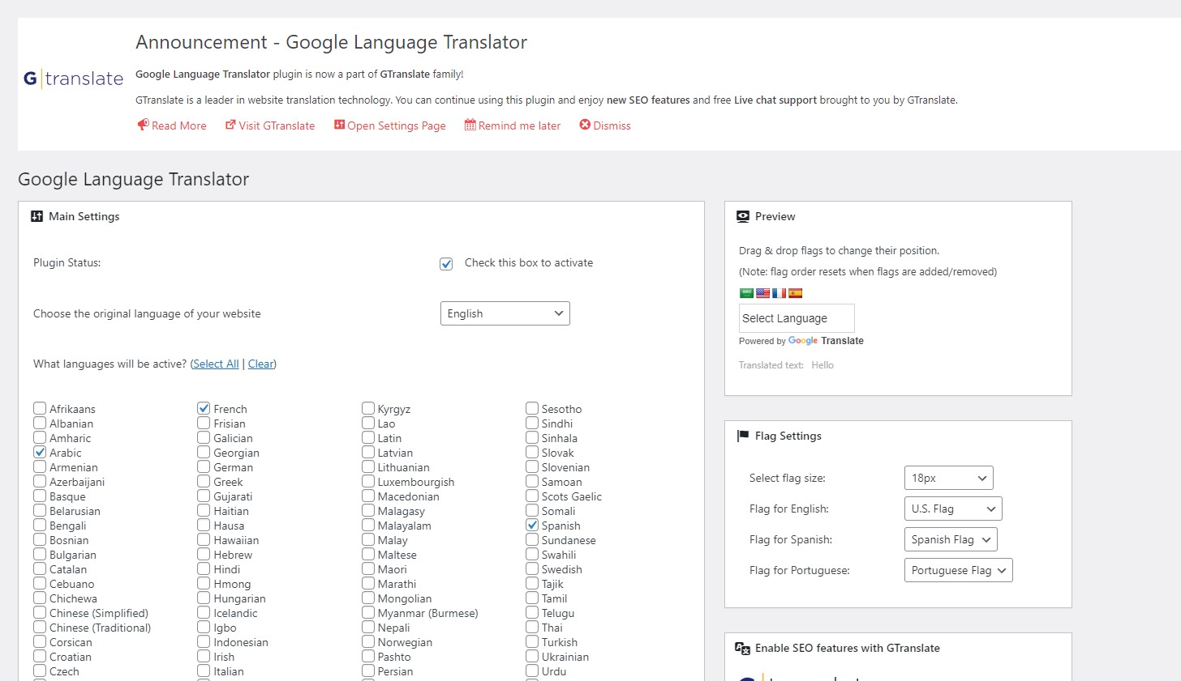
Translation (api)

Slide 9
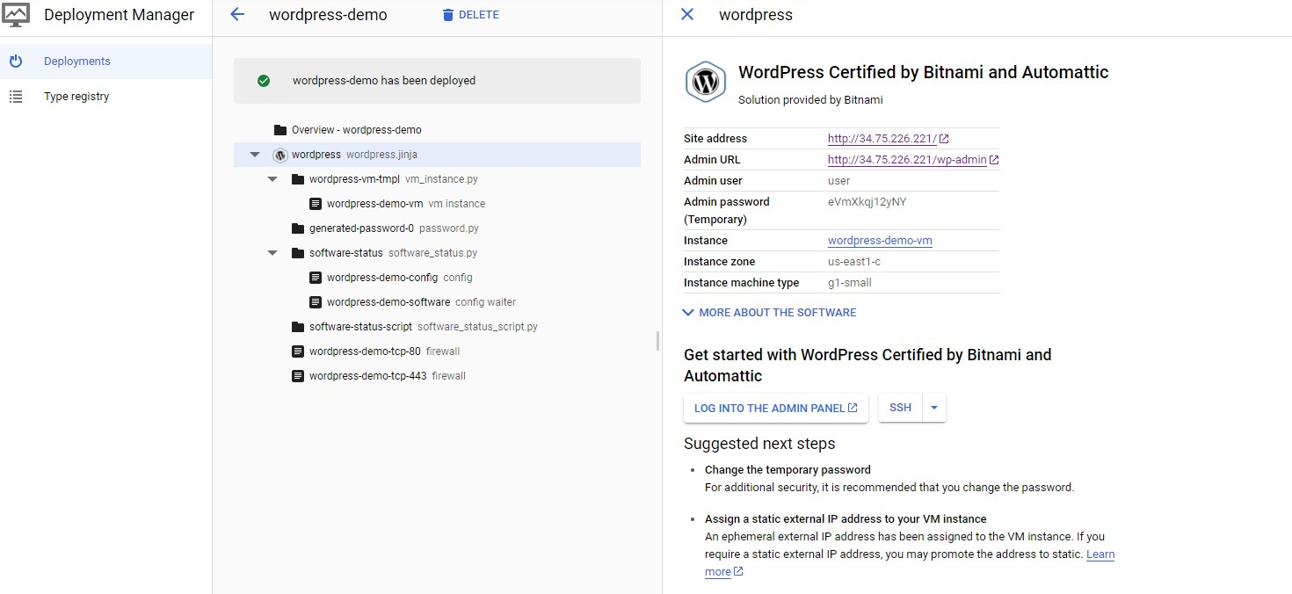
WordPress service

Slide 10
tutorials

Slide 11
Computer Engine

Slide 12
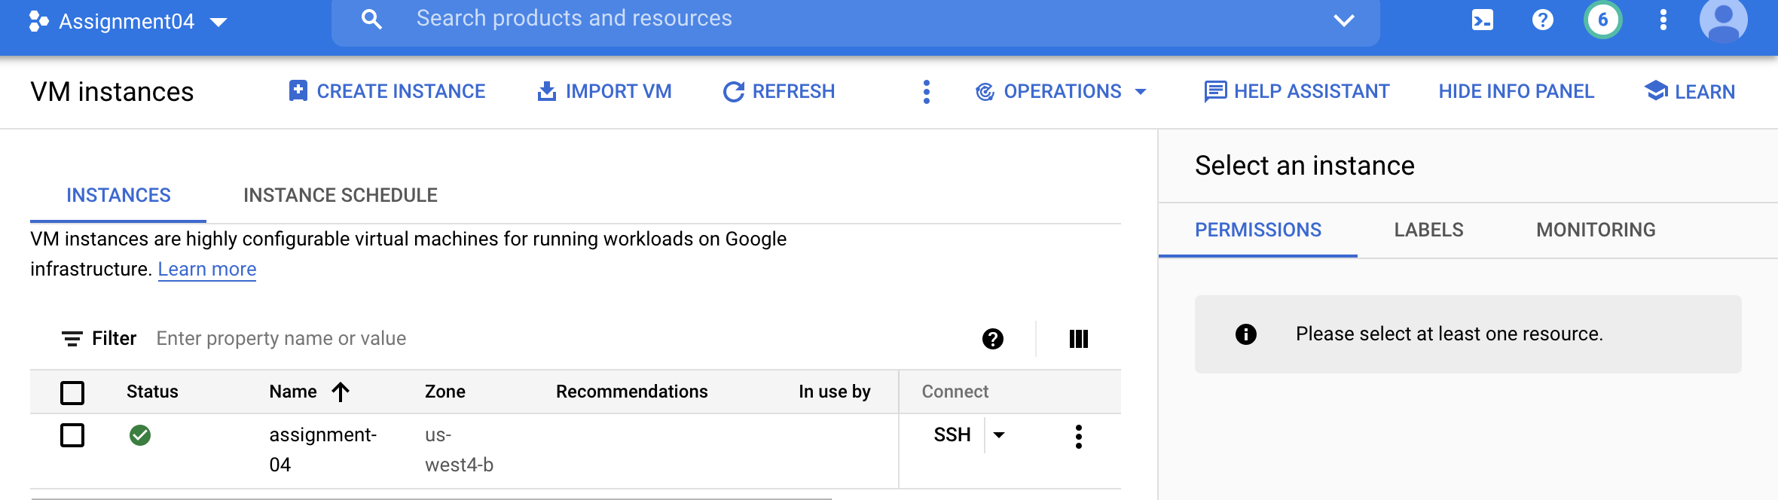
Setup a GCE Instance

Slide 13
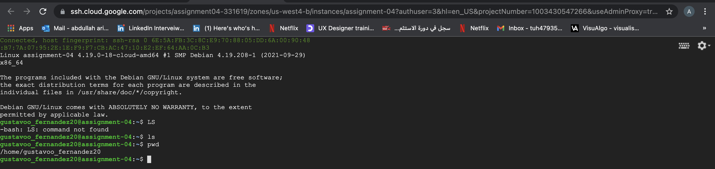
Connect via SSH and use your VM

Slide 14
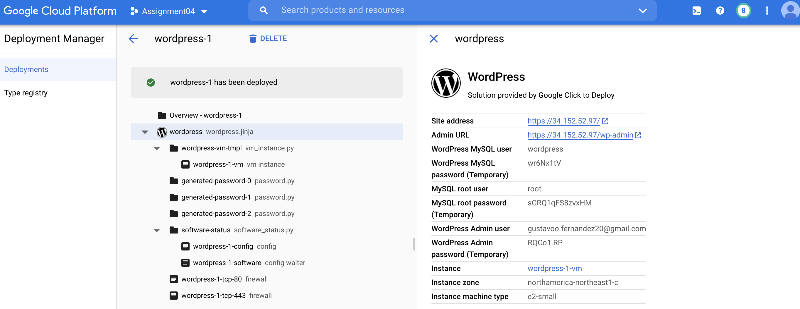
Setup a WordPress site through Cloud Launcher

Slide 15
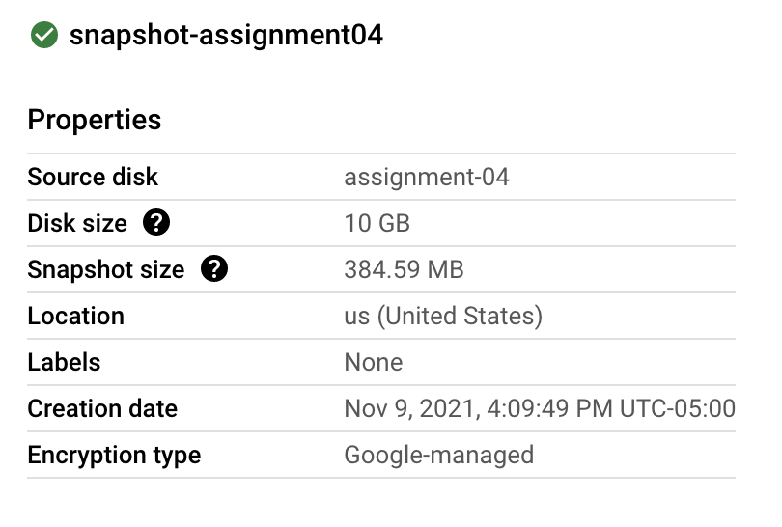
Set up a snapshot for the VM deployed

Slide 16
App Engine

Slide 17
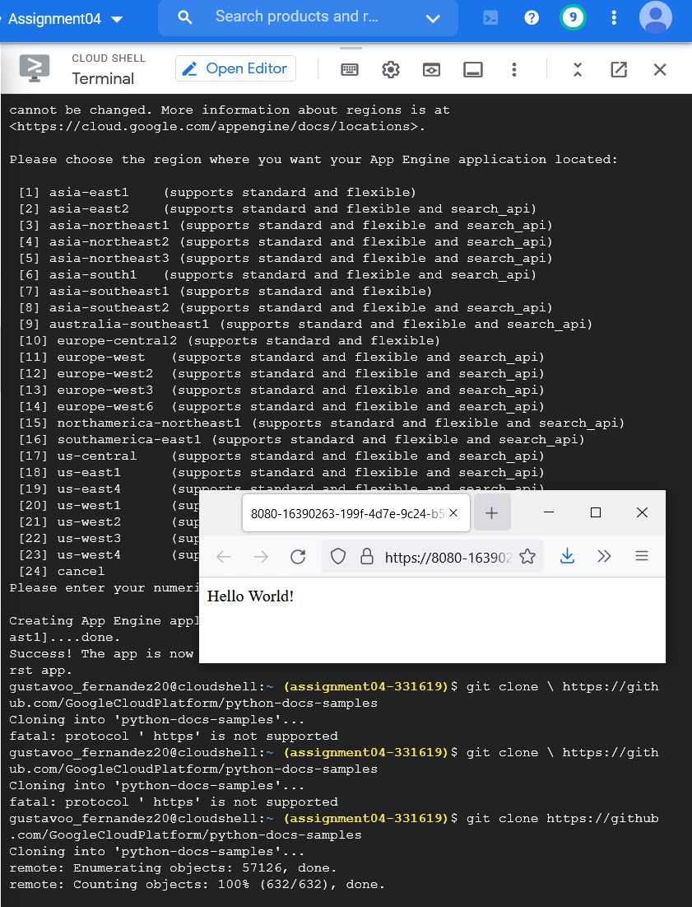
Setup a "Hello World" website in Python

Slide 18
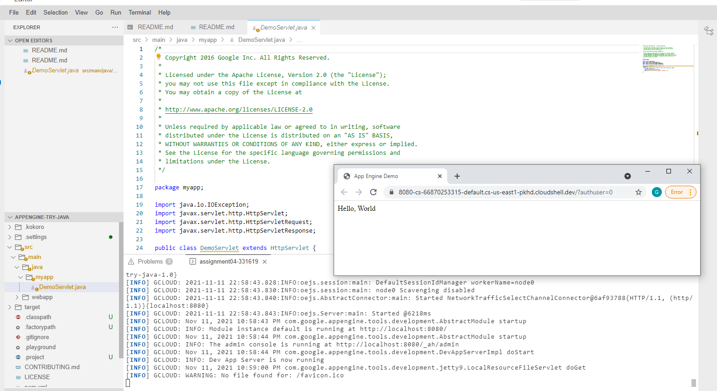
Setup a Java web application using the Eclipse plugin with Java

Slide 19
Setup a Java web application using Codeenvy IDE
No Luck unfortunately ☹

Slide 20
Cloud Storage

Slide 21
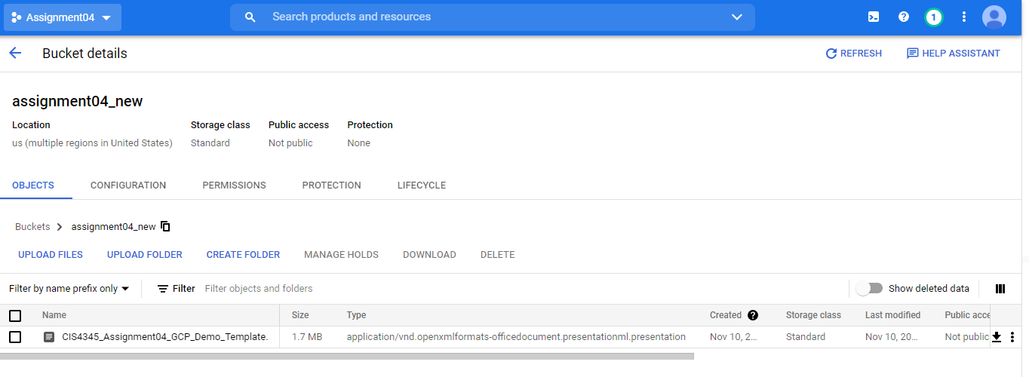
Setup a bucket and store some files

Slide 22
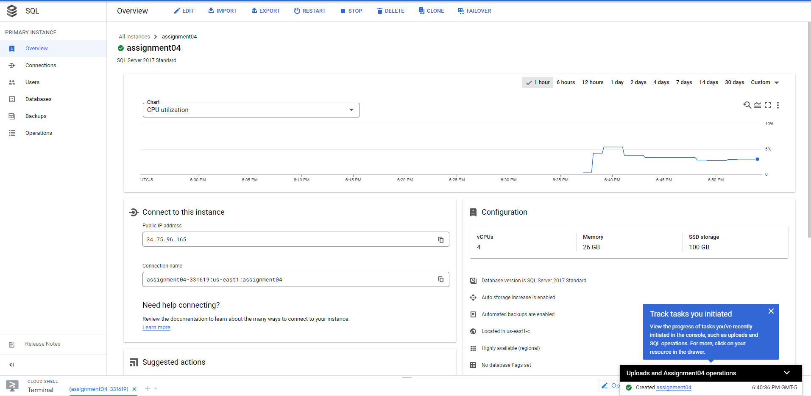
Setup a SQL cloud and Setup a new database inside

Slide 23
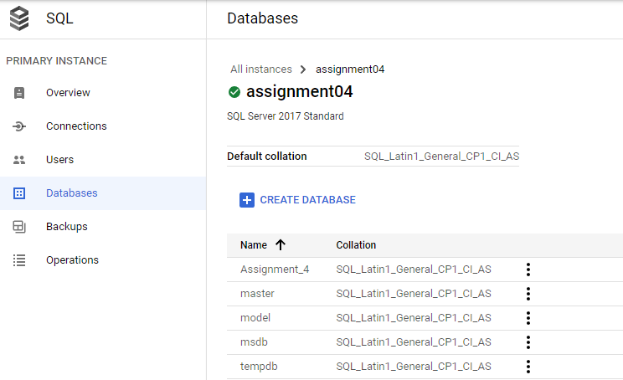
Setup a SQL cloud and Setup a new database inside

Slide 24
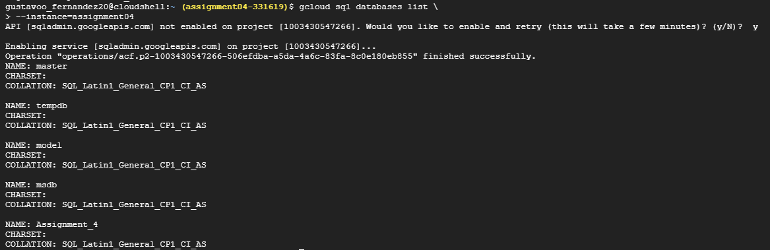
Setup a SQL cloud and Setup a new database inside

Slide 25
Translation API

Slide 26
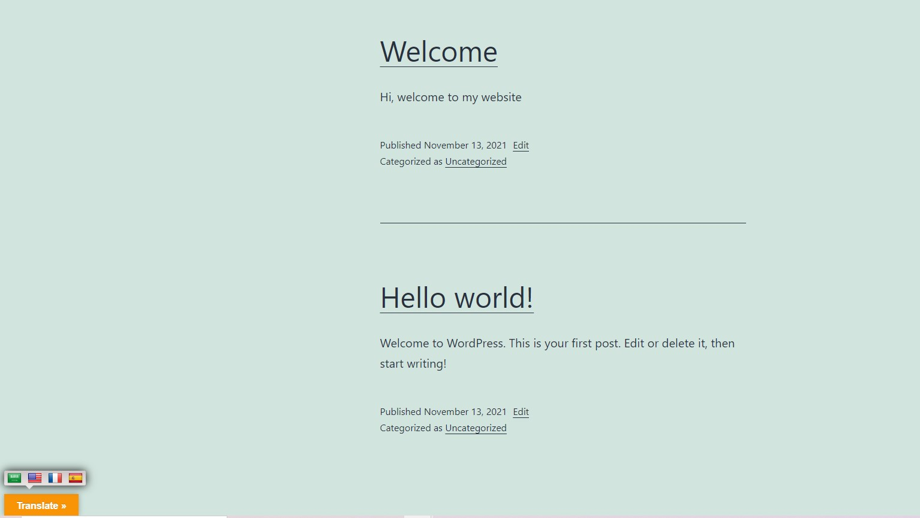
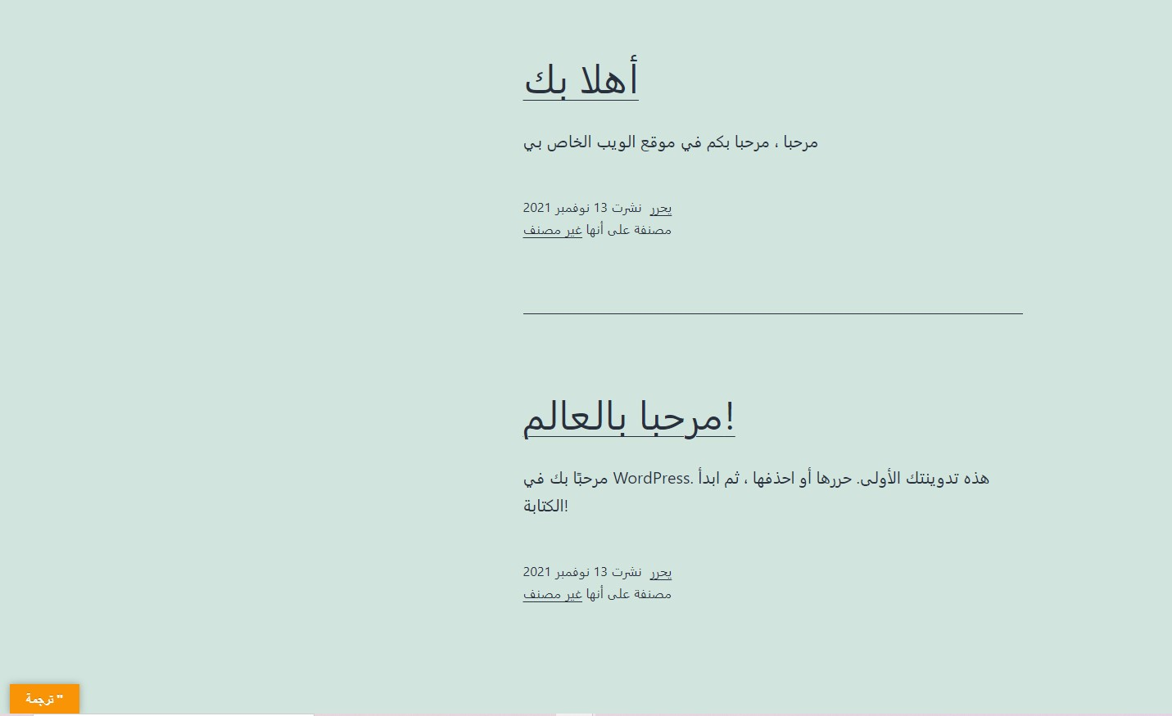
Setup a simple website that uses Google Translate API

Slide 27
Networking

Slide 28
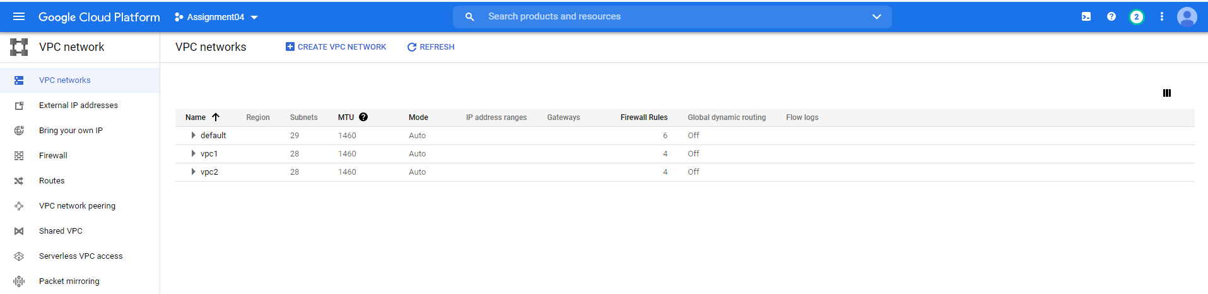
Setup a network vpc 1 and vpc 2

Slide 29
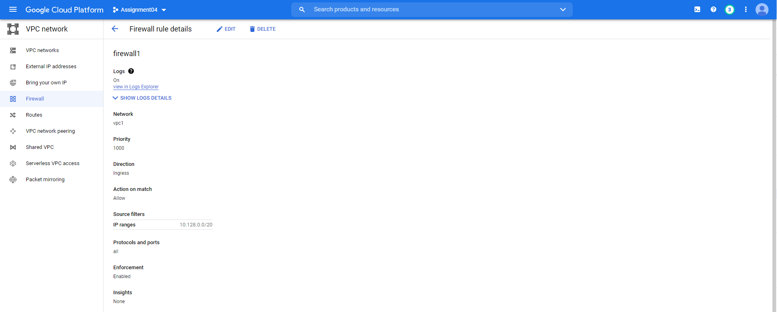
Setup a firewall for vpc1

Slide 30
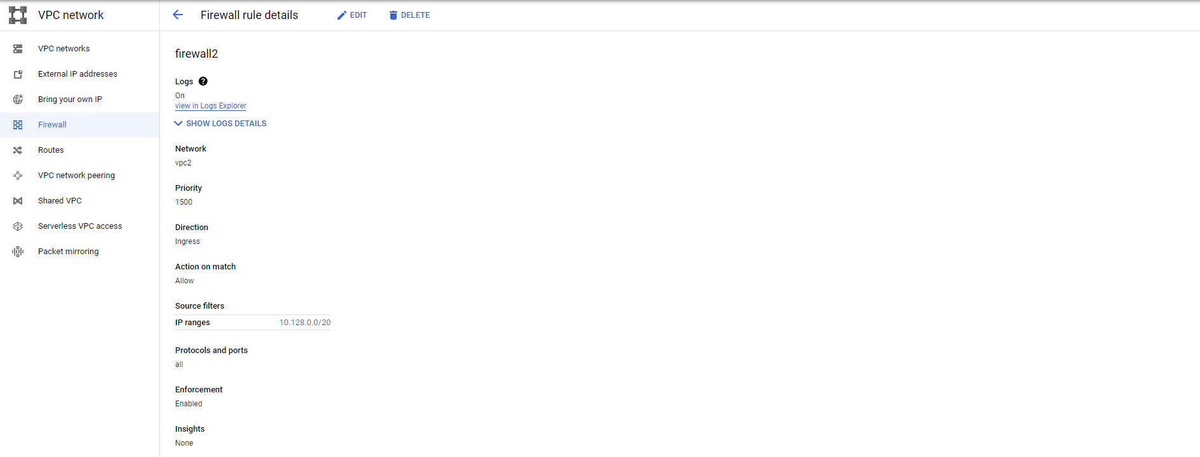
Setup a firewall for vpc2

Slide 31
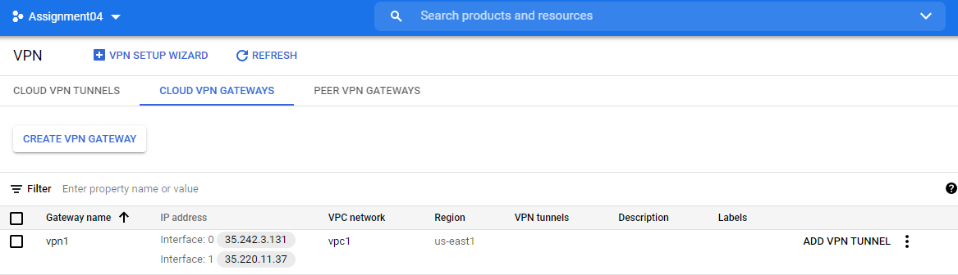
Setup a VPN network

Slide 32
Billing and Conclusion

Slide 33
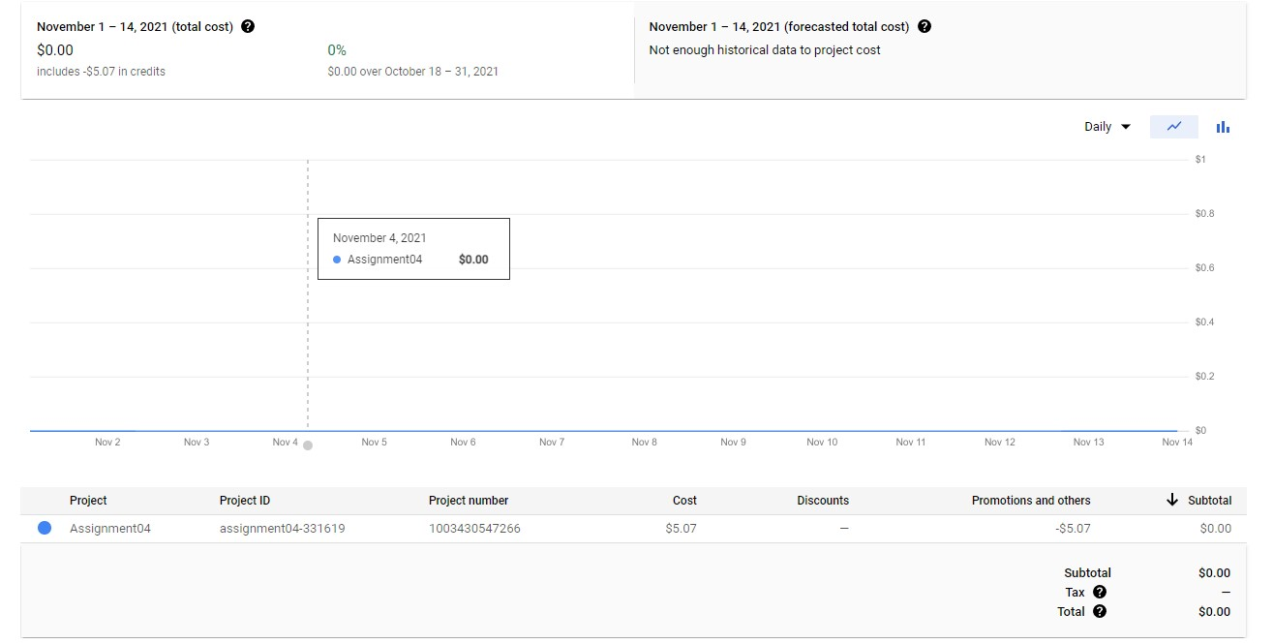
Cost & Billing

Slide 34
Conclusion
How many hours did it take you to finish the assignment?
- 2 DAYS
What was your project cost at the end?
- ZERO $
Name two pros of GCP (let’s say two things you like) and why?
- I like how they walked me through and highlighted the steps in the tutorials when using my console without assuming any knowledge that I have a cloud experience.
- I like the documentations of the services that they have and how well written they were to a point where it was easy for a beginner to understand.
Name two cons of GCP (let’s say two things you don’t like) and why?
- I couldn’t find that much of hands-on labs as like what we practiced in AWS. AWS had a lot of options for us to practice but GCP didn’t have any.
- It doesn’t have a huge community also comparing to Aws, so when I get stuck at one of the steps on the tutorial it would be hard to look for someone who has been in the same situation but overall, the console was way easier to use compared to the AWS one.

