Slide 1
Java Features & Architectures

Slide 2
Java
Java is a programming language and a platform.
Java is a high level, robust, object-oriented and secure programming language.
Java was developed by Sun Microsystems (which is now the subsidiary of Oracle) in the year 1995. James Gosling is known as the father of Java.
Before Java, its name was Oak. Since Oak was already a registered company, so James Gosling and his team changed the name from Oak to Java.
Java follows the principle of WORA (Write Once, Run Anywhere) and is platform-independent.

Slide 3
Java Features
The primary objective of Java programming language creation was to make it portable, simple and secure programming language.
Apart from this, there are also some excellent features which play an important role in the popularity of this language.
The features of Java are also known as Java buzzwords.

Slide 4
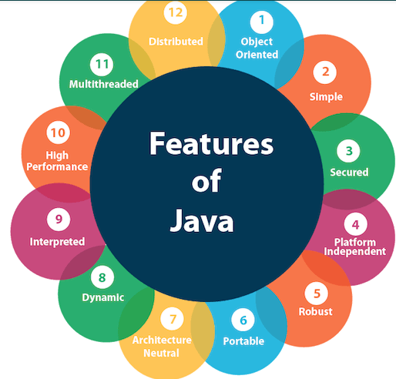
A list of the most important features of the Java language .

Slide 5
Java Architecture
There are three main components of Java architecture .
JVM
JDK
JRE

Slide 6
JVM
JVM stands for Java Virtual Machine, which is used to interpret an entire program line by line.
Architecture of the JVM, as it enables us to write code more efficiently.
Bytecode will be executed by JRE (Java Runtime Environment) but JRE is the implementation of Java Virtual Machine (JVM), which analyzes the bytecode, interprets the code, and executes it.

Slide 7
JRE
JRE stands for Java Runtime Environment.
It is a collection of tools that together allow the development of applications and provide a runtime environment.
The JVM is a part of JRE and it is platform dependent.

Slide 8
JDK
JDK stands for Java Development Kit.
In order to create, compile and run Java program we need JDK installed .
We need JDK to develop our Java programs and JRE to execute your java code.

Slide 9
Applications
Standalone Application.
Standalone applications are also known as desktop applications.
Web Application.
An application that runs on the server side and creates a dynamic page is called a web application.
Enterprise Application.
An application that is distributed in nature, such as banking applications, etc. is called enterprise application.
Mobile Application.
An application that is created for mobile devices is called a mobile application.

Slide 10
The End.

