Slide 1
VISIONCRAFT- the winter challenge
Name- Shambhavi singh
Roll no.- 240958
Branch- mse

Slide 2
Project introduction
The project is to reconstruct 3D models of objects or environments using video data. This involves extracting information from 2D video frames, processing it with computer vision techniques, and converting it into a detailed 3D representation with the help of tools like Python (for coding) and OpenCV (for video and image processing).

Slide 3
WEEK 1

Slide 4
Basics of python
Functions:
def function_name(parameters):
# Code block
return value # Optional
function_name(arguments) #Calling the function
Taking input:
a=int(input(“enter a number: ”))
Data Types:
Int
Float
String
Bool
None
a=2
print(type(a))
Loops:
For loop
for variable in sequence:
# Code to execute
OR
for i in range (5):
# Code to execute
2. While loop
while condition:
# Code to execute
Conditionals (if-elif-else):
if condition1:
# Code to execute if condition1 is True
elif condition2:
# Code to execute if condition2 is True
else:
# Code to execute if all conditions are False

Slide 5
Sequences in python
Lists- sequence of mutable objects
list=[‘India’, ‘Argentina’, ‘Japan’]
print(list[1])
print(list[2][1])
print(len(list))
list.append(“China”)
print(list)
Output:
Argentina
a
3
[‘India’, ‘Argentina’, ‘Japan’, ‘China’]
Set- sequence of unique values
s=set()
s.add(1)
s.add(2)
s.add(2)
print(s)
s.remove(2)
print(s)
Output:
{1,2}
{1}
Tuples- sequence of immutable objects
tuple=(1.0, 2.5)
print(tuple)
Output:
(1.0, 2.5)
Dictionary- collection of key-value pairs
dictionary_name = {
key1: value1,
key2: value2,
key3: value3
}

Slide 6
Numpy library
NumPy is a multi-dimensional array library [1D, 2D, 3D arrays, etc]
Why NumPy over list?
List slow, NumPy fast because NumPy uses fixed type
- In NumPy, a number like 5 is stored in binary using 4 bytes (e.g., Int32), whereas a list uses a lot more space.
- Faster due to less memory use and no need to check data type on each iteration.
Uses contiguous memory.
Applications of NumPy:
Mathematics (MATLAB replacement)
Plotting (Matplotlib)
Backend (Pandas, Connect 4, Digital Photography)
Machine Learning

Slide 7
Basic usage examples
import numpy as np
a = np.array([1, 2, 3])
print(a) -> Output: [1 2 3]
b = np.array([[9.0, 8.0, 7.0], [6.0, 5.0, 4.0]])
print(b) -> Output:
[[9. 8. 7.]
[6. 5. 4.]]

Slide 8
Array properties Accessing and Modifying Elements
# Get Dimension
a.ndim -> 1, b.ndim -> 2
# Get Shape
a.shape -> (3,)
b.shape -> (2,3)
# Get Type
a.dtype -> dtype('int32')
a = np.array([[1, 2, 3, 4], [5, 6, 7, 8]])
a[1, 2] -> Element at row 1, column 2 (7)
a[0, :] -> Row 0
a[:, 1] -> Column 1

Slide 9
Initializing Arrays Mathematics and Linear Algebra
Zeros: np.zeros((2,3))
Ones: np.ones((3,3))
Random Numbers: np.random.rand(4,2)
Identity Matrix: np.identity(3)
# Element-wise operations
a = np.array([1, 2, 3])
a + 2 -> [3, 4, 5], a * 2 -> [2, 4, 6]
# Matrix multiplication
a = np.ones((2,3))
b = np.full((3,2), 2)
np.matmul(a, b) -> Resulting matrix

Slide 10
Statistics Reshaping and Stacking
a = np.array([[1, 2], [3, 4]])
np.min(a), np.max(a) -> Min and max values
np.sum(a, axis=0) -> Sum along columns
before = np.array([[1, 2, 3, 4], [5, 6, 7, 8]])
after = before.reshape((4, 2))
np.vstack([v1, v2]), np.hstack([v1, v2])
Boolean masking
a = np.array([1, 2, 3, 4, 5])
a > 3 -> [False, False, False, True, True]
a[a > 3] -> [4, 5]

Slide 11
pandas
is an open source data analysis library written in python
- It leverages the power and speed of numpy to make data analysis and processing easy for data scientists
- It provides rich and highly robust data operations
Pandas has two types of data structures:
- Series- It's a one dimensional array with indexes, it stores a single column or row of data in a dataframe
- Dataframe- It's a tabular spreadsheet like structure representing rows each of which contains one or multiple columns
- A one dimensional array(labeled) capable of holding any type of data- Series
- A two dimensional data(labeled) structure with columns of potentially different types of data- DataFrame

Slide 12
Creating DataFrames
import pandas as pd
# From a dictionary
data = {'Name': ['Alice', 'Bob'], 'Age': [25, 30]}
df = pd.DataFrame(data)
# From a list of lists
data = [['Alice', 25], ['Bob', 30]]
df = pd.DataFrame(data, columns=['Name', 'Age'])

Slide 13
Reading and Writing Files
Viewing Data
# Top and bottom rows
df.head() # First 5 rows
df.tail(3) # Last 3 rows
# Basic info and statistics
df.info()
df.describe()
# Reading files
df = pd.read_csv('file.csv')
# Writing files
df.to_csv('file.csv', index=False)

Slide 14
Selecting and Filtering
Modifying Data
# Selecting columns
df['column_name']
df[['col1', 'col2']]
# Filtering rows
df[df['Age'] > 25]
# Using loc and iloc
df.loc[0] # Row by label
df.iloc[0] # Row by index
# Adding a new column
df['New_Column'] = df['Age'] * 2
# Renaming columns
df.rename(columns={'Name': 'Full Name'}, inplace=True)
# Dropping rows/columns
df.drop(columns=['Age'], inplace=True)
df.drop(index=0, inplace=True)

Slide 15
Handling Missing Data
Group By and Aggregations
Group by and aggregate
df.groupby('column_name').sum()
df.groupby('column_name').mean()
# Detect missing values
df.isnull()
# Fill missing values
df.fillna(0, inplace=True)
# Drop rows with missing values
df.dropna(inplace=True)

Slide 16
WEEK 2

Slide 17

opencv
What is OpenCV?
A library for real-time image and video processing.
Applications:
Image transformations
Edge and contour detection
Object detection and recognition

Slide 18
Reading, displaying and saving images
Importing OpenCV in Python:
import cv2 as cv
Reading, Displaying and Saving Images:
img=cv.imread(‘path’) #Reading the image
#Displaying the image
cv.imshow(‘Image’, img)
cv.waitKey(0)
cv.destroyAllWindows()
#Saving the image
cv.imwrite(‘saved_img.jpg’, img)

Slide 19
Reading and displaying videos
# For reading and displaying a video
vid=cv.VideoCapture(‘video_path’)
currentframe=0
while(True):
success,frame=cap.read()
cv.imshow(“Video”,frame)
currentframe+=1
if cv.waitKey(1)&0xFF==ord(‘q’):
break
cap.release()
cv.destroyAllWindows()
#For capturing through webcam
cam=cv.VideoCapture(0)
currentframe=0
while(True):
success, frame=cam.read()
cv.imshow("WebCam",frame)
currentframe+=1
if cv.waitKey(1)&0xFF==ord('q'):
break
cam.release()
cv.destroyAllWindows()

Slide 20
Image transformations
#Rescaling an Image:
def rescaleFrame(frame,scale=0.3):
#works for images, videos and live video
width=int(frame.shape[1]*scale)
height=int(frame.shape[0]*scale)
dimensions=(width,height)
return cv.resize(frame,dimensions,interpolation=cv.INTER_AREA)
resized_image=rescaleFrame(img)
cv.imshow('Image',resized_image)
cv.waitKey(0)
#Cropping an image
cropped=img[y_start:y_end,x_start:x_end]
cv.imshow('Cropped',cropped)
cv.waitKey(0)

Slide 21
Image transformations (continued)
#Rotation
def rotate(img,angle,rotPoint=None):
(height,width)=img.shape[:2]
if rotPoint is None:
rotPoint=(width//2,height//2)
rotMat=cv.getRotationMatrix2D(rotPoint,angle,1.0)
dimensions=(width,height)
return cv.warpAffine(img,rotMat,dimensions)
rotated_image=rotate(img,-90) #Rotates image by 90 degrees clockwise
cv.imshow('Rotated',rotated_image)

Slide 22
Image transformations (continued)
#Translation
def translate(img,x,y):
transMat=np.float32([[1,0,x],[0,1,y]])
dimensions=(img.shape[1],img.shape[0])
return cv.warpAffine(img,transMat,dimensions)
#-x --> Left
#-y --> Up
#x --> Right
#y --> Down
translated=translate(img,20,20)
cv.imshow('Translated',translated)

Slide 23
Image transformations (continued)
#Resizing an image
resized=cv.resize(img,(500,500),interpolation=cv.INTER_CUBIC)
cv.imshow('Resized',resized)
cv.waitKey(0)
#interpolation=cv.INTER_AREA for shrinking image
#interpolation=cv.INTER_LINEAR for enlarging
#interpolation=cv.INTER_CUBIC for enlarging (slow but best)
#Flipping
flip=cv.flip(img,0)
cv.imshow('flipped',flip)
# 0 means flip vertically (X axis)
# 1 means flip horizontally (Y axis)
# -1 means flipping both vertically and horzintally
cv.waitKey(0)

Slide 24
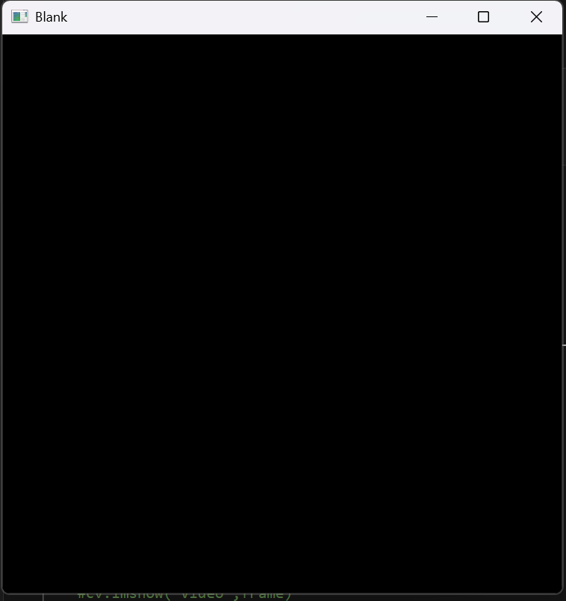
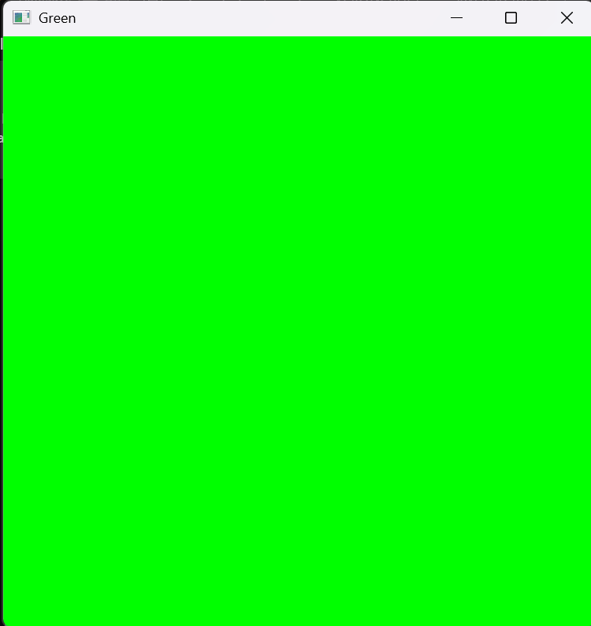
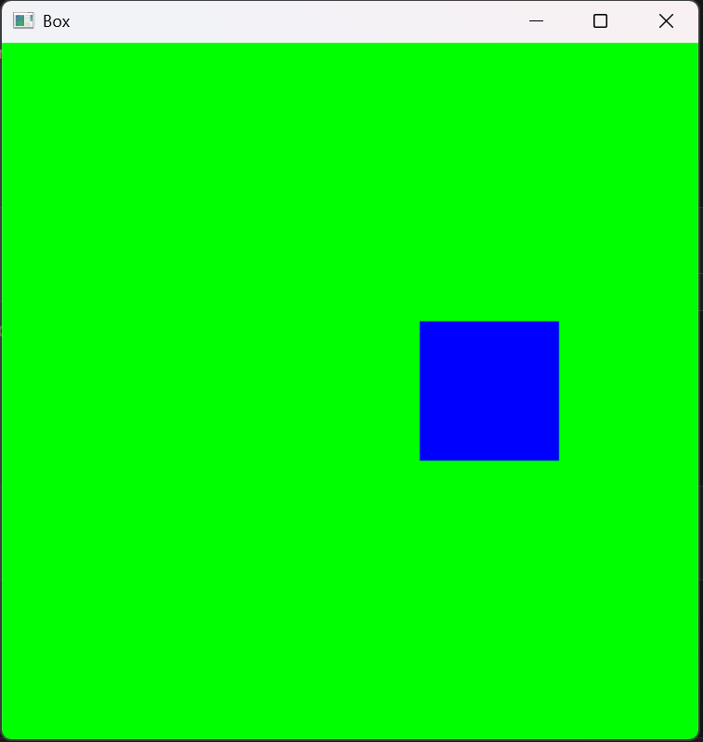
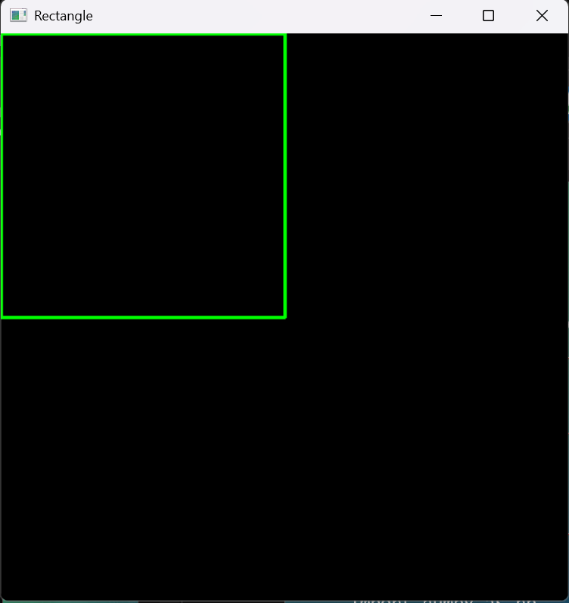
Drawing shapes and putting text
import cv2 as cv
import numpy as np
blank=np.zeros((500,500,3),dtype='uint8')
cv.imshow('Blank',blank)
#Paint the image a certain colour #BGR
blank[:]=0,255,0
cv.imshow('Green',blank)
cv.waitKey(0)
#Colour a portion of blank
blank[200:300,300:400]=255,0,0
cv.imshow('Box',blank)
cv.waitKey(0)
#Draw a rectangle
import numpy as np
blank=np.zeros((500,500,3),dtype='uint8')
cv.rectangle(blank,(0,0),(250,250),(0,255,0),thickness=2)
cv.imshow('Rectangle',blank)
cv.waitKey(0)

Slide 25
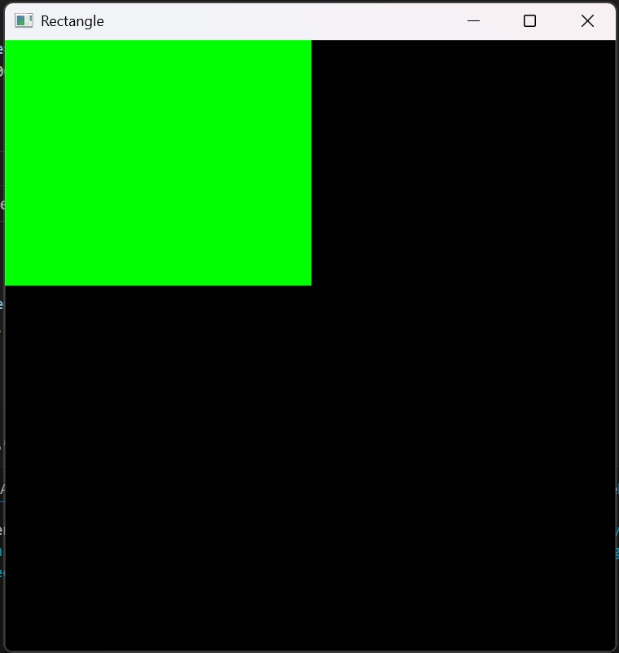
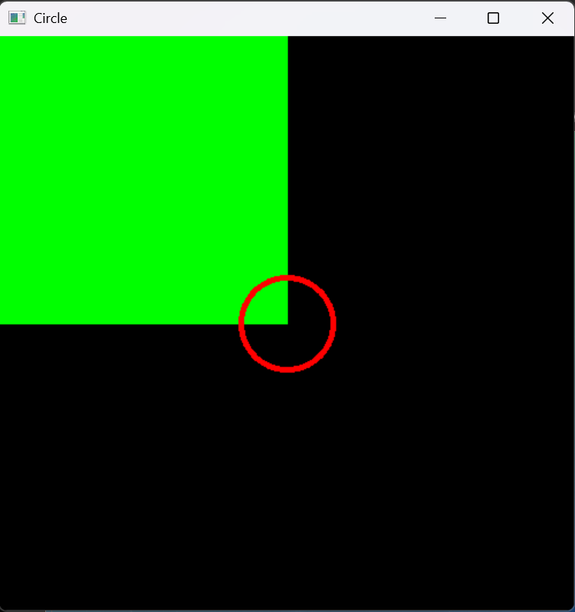
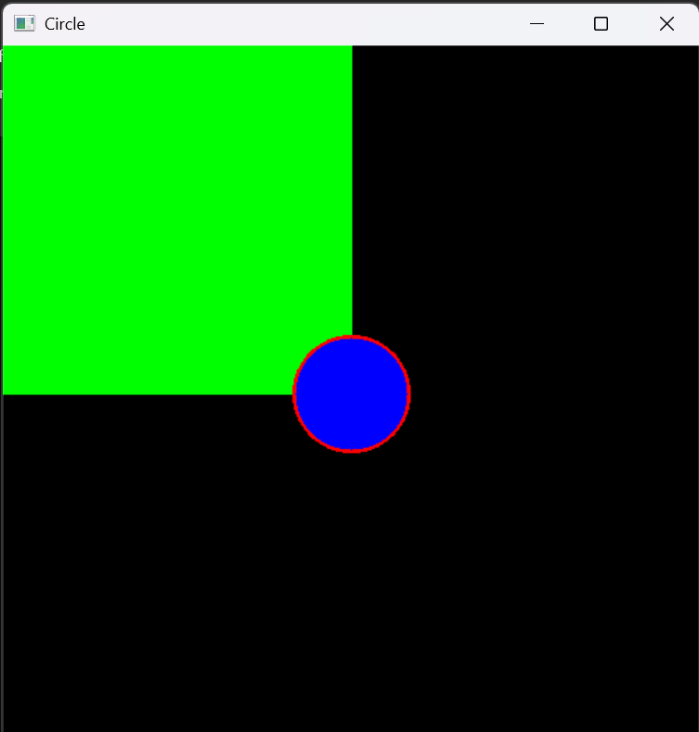
#Filling in colour to rectangle
blank=np.zeros((500,500,3),dtype='uint8')
cv.rectangle(blank,(0,0),(250,200),(0,255,0),thickness=cv.FILLED) #or thickness=-1
cv.imshow('Rectangle',blank)
cv.waitKey(0)
#Draw a circle
cv.circle(blank,(250,250),40,(0,0,255),thickness=3)
cv.imshow('Circle',blank)
cv.waitKey(0)
#To fill circle
cv.circle(blank,(250,250),40,(255,0,0),thickness=-1)
cv.imshow('Circle',blank)
cv.waitKey(0)

Slide 26
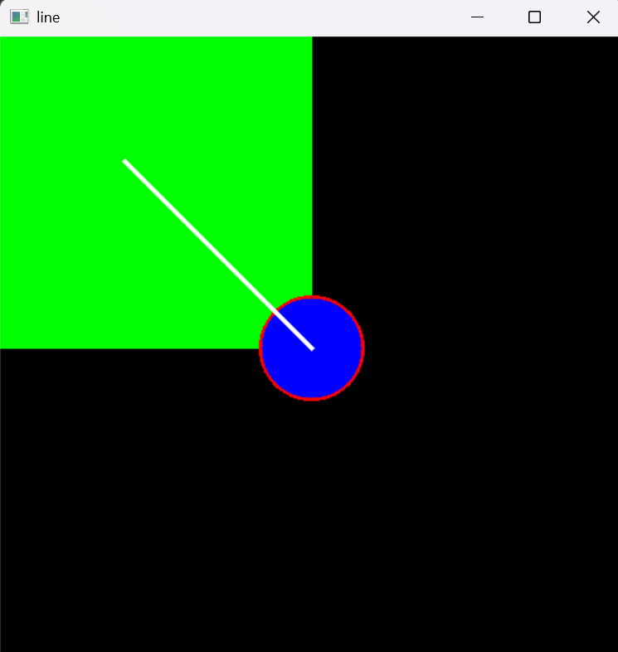
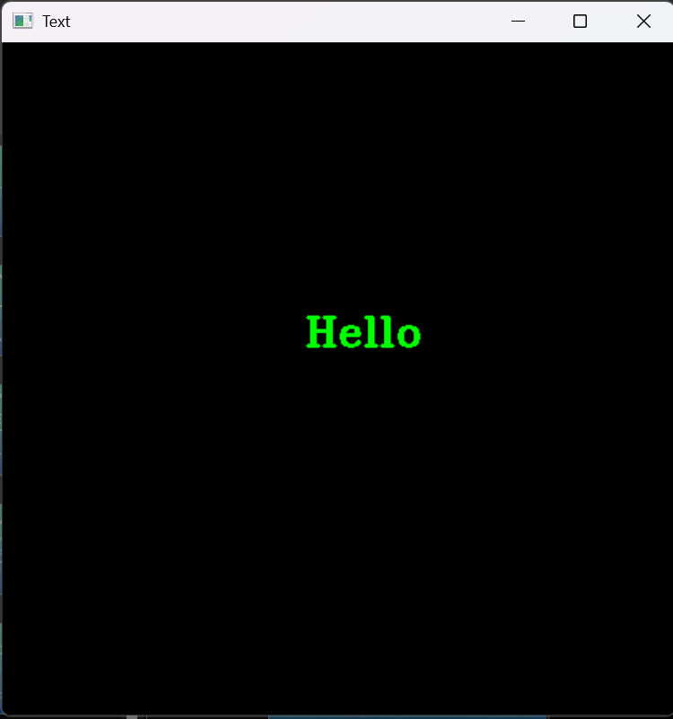
#To draw a line
cv.line(blank,(100,100),(250,250),(255,255,255),thickness=3)
cv.imshow('line',blank)
cv.waitKey(0)
#Write text
blank=np.zeros((500,500,3),dtype='uint8')
cv.putText(blank,'Hello',(225,225),cv.FONT_HERSHEY_TRIPLEX,1.0,(0,255,0),2)
cv.imshow('Text',blank)
cv.waitKey(0)

Slide 27
Converting an image to grayscale
gray=cv.cvtColor(img,cv.COLOR_BGR2GRAY)
cv.imshow('gray_img',gray)
Blurring an image (gaussian blur)
blur=cv.GaussianBlur(img,(5,5),cv.BORDER_DEFAULT)
#change (5,5) to higher number to get more blurred image
cv.imshow('Blurred',blur)

Slide 28
Canny edge detection
canny=cv.Canny(img,125,175)
cv.imshow('Canny Edges',canny)
Dilating the image
dilated=cv.dilate(canny,(3,3),iterations=3)
cv.imshow('Dilated',dilated)

Slide 29
eroding
eroded=cv.erode(dilated,(7,7),iterations=3)
cv.imshow('Eroded',eroded)
Contour detection
#Contour Detection
gray=cv.cvtColor(img,cv.COLOR_BGR2GRAY)
cv.imshow('Gray',gray)
canny=cv.Canny(img,125,175)
cv.imshow('Canny Edges',canny)
contours,hierarchies=cv.findContours(canny,cv.RETR_LIST,cv.CHAIN_APPROX_SIMPLE)
print(f'{len(contours)} contour(s) found!’) cv.waitKey(0)

Slide 30
WEEK 3

Slide 31
Contour detection in opencv
# Importing Libraries
import cv2
import numpy as np
import matplotlib.pyplot as plt
# Reading and Displaying Images
Images can be read using the cv2.imread() function in BGR format
Conversion to RGB is done using numpy for proper display with matplotlib
#Read the image
image1=cv2.imread('link')
#Reverse the image channels
rgb_image=image1[:,:,::-1]
#Display the image
plt.figure(figsize=[10,10])
plt.imshow(rgb_image);plt.title("Original Image");plt.axis("off")

Slide 32
Finding contours
Contours can be found using cv2.findContours()
The function requires grayscale images with white foreground and black background.
#Find all contours in the image
contours,hierarchy=cv2.findContours(Gray_Image,cv2.RETR_EXTERNAL,cv2.CHAIN_APPROX_SIMPLE)
#Display the total number of contours found (external)
print(“Number of contours found={}”,.format(len(contours)))

Slide 33
Visualizing the contours detected
Function Syntax:
cv2.drawContours(image, contours, contourIdx, color, thickness, lineType, hierarchy, maxLevel, offset)
image: The image on which contours are drawn.
contours: A list of detected contours.
contourIdx: Index of the contour to draw. -1 means all contours.
color: Color of the contours.
thickness: Thickness of the contour lines.
lineType: Type of the line.
hierarchy: Information about the contour hierarchy.
maxLevel: Maximal level for drawn contours.
offset: Optional parameter for contour shift.

Slide 34
Visualizing the contours detected (contd.)
# Read the image in colour mode for drawing purposes
image1_copy = cv2.imread('link')
# Draw all the contours
cv2.drawContours(image1_copy, contours, -1, (0, 255, 0), 3)
# Display the result
plt.figure(figsize=[10,10])
plt.imshow(image1_copy[:,:,::-1]); plt.axis("off");

Slide 35
Pre-processing images for contour detection
The cv2.findContours() function takes in as input a single channel binary image. However, in most cases the original image will not be a binary image. Detecting contours in coloured images require pre-processing to produce a single-channel binary image that can be then used for contour detection.
The two most commonly used techniques are:
Thresholding based Pre-processing
Edge based Pre-processing

Slide 36
Thresholding based pre-processing for contours
Function: cv2.threshold()
The function takes in as input the gray-scale image, applies fixed level thresholding, and returns a binary image. Pixel values below 100 are set to 0 (black) while the ones above are set to 255 (white)
#Invert the Colours
gray_inverted=cv2.bitwise_not(gray)
#Create a binary thresholded image
_, binary=cv2.threshold(gray_inverted,100,255,cv2.THRESH_BINARY)
#Display the result
plt.imshow(binary,cmap=”gray”);plt.title(“Binary Image”);plt.axis(“off”);
#Make a copy of the source image
image2_copy2=image2.copy()
#find the contours from the thresholded image
countours,hierarchy=cv2.findContours(binary,cv2.RETR_LIST,cv2.CHAIN_APPROX_SIMPLE)
#draw all the contours found
image2_copy2=cv2.drawContours(image2_copy2,contours,1,(0,0,255),2)
plt.figure(figsize=[15,15])
plt.subplot(121);plt.imshow(image2_copy2[:,:,::-1];plt.title(“With Thresholding”);plt.axis(“off)

Slide 37
Edge based pre-processing for contours
Thresholding works out well for simple images with fewer variations in colours, however, for complex images, it’s not always easy to do background-foreground segmentation. In these cases creating the binary image using edge detection yields better results
#Read the image
image3=cv2.imread(‘link’)
#Blur the image to remove noise
blurred_image=cv2.GaussianBlur(image3.copy(),(5,5),0)
#Apply canny edge detection
edges=cv2.Canny(blurred_image,100,160)
#Detect the contour using the edges
contours,hierarchy=cv2.findContours(edges,cv2.RETR_EXTERNAL,cv2.CHAIN_APPROX_SIMPLE)
#Draw the contours
image3_copy=image3.copy()
cv2.drawContours(image3_copy,contours, -1,(0,255,0),2)
#Display the drawn contours
plt.figure(figsize=[10,10])
plt.imshow(image3_copy[:,:,::-1]);plt.title(“Contours Detected”);plt.axis(“off”);

Slide 38
Retrieval modes
Using the retrieval modes, the cv2.findContours() function can determine how the contours are to be returned or arranged in a hierarchy.
Important retrieval modes:
cv2.RETR_EXTERNAL- retrieves only the extreme outer contours
cv2.RETR_LIST- retrieves all of the contours without establishing any hierarchical relationships
cv2.RETR_TREE- retrieved all of the contours and reconstructs a full hierarchy of nested contours
cv2.RETR_CCOMP- retrieves all of the contours and organizes them into a two level hierarchy. At the top level, there are external boundaries of the components. At the second level, there are boundaries of the holes. If there is another contour inside a hole of a connected component, it is still put at the top level.

Slide 39
Extracting the largest contour in the image
The contours detected are returned as a list of continuous coordinates that form the shape of the object.
import cv2
import matplotlib.pyplot as plt
# Copy the image
image1_copy = image1.copy()
# Convert to grayscale
gray_image = cv2.cvtColor(image1_copy, cv2.COLOR_BGR2GRAY)
# Find all contours in the image
contours, hierarchy = cv2.findContours(gray_image, cv2.RETR_LIST, cv2.CHAIN_APPROX_NONE)
# Retrieve the biggest contour
biggest_contour = max(contours, key=cv2.contourArea)
# Draw the biggest contour
cv2.drawContours(image1_copy, [biggest_contour], -1, (0, 255, 0), 4)
# Display the results
plt.figure(figsize=[10, 10])
plt.imshow(image1_copy[:, :, ::-1])
plt.axis("off")
plt.show()

Slide 40
Sorting contours in terms of size
# Convert to grayscale.
imageGray = cv2.cvtColor(image1_copy, cv2.COLOR_BGR2GRAY)
# Find all contours in the image.
contours, hierarchy = cv2.findContours(imageGray, cv2.RETR_CCOMP, cv2.CHAIN_APPROX_NONE)
# Sort the contours in decreasing order.
sorted_contours = sorted(contours, key=cv2.contourArea, reverse=True)
# Draw largest 3 contours.
for i, cont in enumerate(sorted_contours[:3], 1):
# Draw the contour.
cv2.drawContours(image1_copy, cont, -1, (0, 255, 0), 3)
# Display the position of contour in sorted list.
cv2.putText(image1_copy, str(i), (cont[0][0][0], cont[0][0][1]-10), cv2.FONT_HERSHEY_SIMPLEX, 1.4, (0, 255, 0), 4)
# Display the result.
plt.figure(figsize=[10, 10])
plt.imshow(image1_copy[:, :, ::-1])
plt.axis("off")
plt.show()

Slide 41
Drawing a rectangle around the contour
Types of Bounding Rectangles:
Straight Bounding Rectangle
Rotated Rectangle
Straight Bounding Rectangle
Description: Upright rectangle, ignoring object rotation.
Function: cv2.boundingRect()
x, y, w, h = cv2.boundingRect(array)
x, y: Coordinates of top-left corner
w, h: Width and height of rectangle
Rotated Rectangle
Description: Rotated rectangle with minimal area to enclose the contour.
Function: cv2.minAreaRect()
retval = cv2.minAreaRect(points)
retval:
Tuple containing:
x, y coordinates of top-left vertex
width, height of rectangle
angle of rotation

Slide 42
Contour area
# Import necessary library
import cv2
area = cv2.contourArea(contour)
# 'area' now contains the area of the contour
print("Contour area:", area)

Slide 43
Feature Detection and Description in OpenCV
• Feature detection identifies distinct patterns in images.
• Features are invariant to scale, rotation, or illumination.
• Crucial for tasks like object recognition, image stitching, and 3D reconstruction.

Slide 44
Feature Matching Techniques
Compares two images to find similar regions.
Steps:
Detect Keypoints: Identify unique points in each image using algorithms like SIFT, SURF, or ORB.
Extract Descriptors: Compute a detailed description for each keypoint.
Match Descriptors: Compare descriptors from both images and pair the closest matches.
Techniques:
Brute-Force Matcher: Compares descriptors using distance metrics.
FLANN (Fast Approximate Nearest Neighbor): Faster for large datasets.

Slide 45
Key Algorithms Overview
Harris Corner Detection: Identifies corners using gradients.
Shi-Tomasi Corner Detection: Improves Harris by selecting optimal corners.
SIFT (Scale-Invariant Feature Transform) : Detects scale and rotation-invariant features.
SURF (Speeded-Up Robust Features): Faster than SIFT but patented.
ORB (Oriented FAST and Rotated BRIEF): ORB combines FAST (corner detection) and BRIEF (descriptor extraction). It is an efficient, free alternative to SIFT and SURF.

Slide 46
Haris corner detection
Haris corner detection is a method in which we can detect the corners of the image by sliding a slider box all over the image by finding the corners and it will apply a threshold and the corners will be marked in the image. This algorithm is mainly used to detect the corners of the image.
# Importing the libraries
import cv2
import numpy as np
# Reading the image and converting the image to B/W
image = cv2.imread('book.png')
gray_image = cv2.cvtColor(image, cv2.COLOR_BGR2GRAY)
gray_image = np.float32(gray_image)
# Applying the function
dst = cv2.cornerHarris(gray_image, blockSize=2, ksize=3, k=0.04)
# dilate to mark the corners
dst = cv2.dilate(dst, None)
image[dst > 0.01 * dst.max()] = [0, 255, 0]
cv2.imshow('haris_corner', image)
cv2.waitKey()

Slide 47
Shi-tomasi corner detection
Shi and Tomasi came up with a different corner detection algorithm which is mostly similar to the Haris corner detection algorithm in which the only difference will be the kernel value in which we can find only the n strongest corners of the image. This can greatly help while we need only the limited and very important features of the image.
# Importing the libraries
import cv2
import numpy as np
# Reading the image and converting into B?W
image = cv2.imread("book.png")
gray_image = cv2.cvtColor(image, cv2.COLOR_BGR2GRAY)
# Applying the function
corners = cv2.goodFeaturesToTrack(
gray_image, maxCorners=50, qualityLevel=0.02, minDistance=20)
corners = np.float32(corners)
for item in corners:
x, y = item[0]
x = int(x)
y = int(y)
cv2.circle(image, (x, y), 6, (0, 255, 0), -1)
# Showing the image
cv2.imshow('good_features', image)
cv2.waitKey()

Slide 48
SIFT (Scale-Invariant Feature Transform)
SIFT is one of the important algorithms that detect objects irrelevant to the scale and rotation of the image and the reference. This helps a lot while we are comparing the real-world objects to an image though it is independent of the angle and scale of the image. This method will return the key points of the images which we need to mark in the image.
# Importing the libraries
import cv2
# Reading the image and converting into B/W
image = cv2.imread('book.jpg')
gray_image = cv2.cvtColor(image, cv2.COLOR_BGR2GRAY)
# Applying the function
sift = cv2.xfeatures2d.SIFT_create()
kp, des = sift.detectAndCompute(gray_image, None)
# Applying the function
kp_image = cv2.drawKeypoints(image, kp, None, color=(
0, 255, 0), flags=cv2.DRAW_MATCHES_FLAGS_DRAW_RICH_KEYPOINTS)
cv2.imshow('SIFT', kp_image)
cv2.waitKey()

Slide 49
FAST algorithm for corner detection
SURF is fast when compared to SIFT but not as fast to use with real-time devices like mobile phones and surveillance cameras. So FAST algorithm was introduced with a very fast computing time. However FAST gives us only the key points and we may need to compute descriptors with other algorithms like SIFT and SURF. With a Fast algorithm, we can detect corners and also blobs.
# Importing the libraries
import cv2
# Reading the image and converting into B/W
image = cv2.imread('book.png')
gray_image = cv2.cvtColor(image, cv2.COLOR_BGR2GRAY)
# Applying the function
fast = cv2.FastFeatureDetector_create()
fast.setNonmaxSuppression(False)
# Drawing the keypoints
kp = fast.detect(gray_image, None)
kp_image = cv2.drawKeypoints(image, kp, None, color=(0, 255, 0))
cv2.imshow('FAST', kp_image)
cv2.waitKey()

Slide 50
ORB (Oriented FAST and Rotated Brief)
ORB is a very effective way of detecting the features of the image when compared to SIFT and SURF. ORB is programmed to find fewer features in the image when compared to the SIFT and SURF algorithm because it detects the very important features in less time than them yet this algorithm is considered as a very effective algorithm when compared to other detecting algorithms.
# Importing the libraries
import cv2
# Reading the image and converting into B/W
image = cv2.imread('book.png')
gray_image = cv2.cvtColor(image, cv2.COLOR_BGR2GRAY)
# Applying the function
orb = cv2.ORB_create(nfeatures=2000)
kp, des = orb.detectAndCompute(gray_image, None)
# Drawing the keypoints
kp_image = cv2.drawKeypoints(image, kp, None, color=(0, 255, 0), flags=0)
cv2.imshow('ORB', kp_image)
cv2.waitKey()

Slide 51
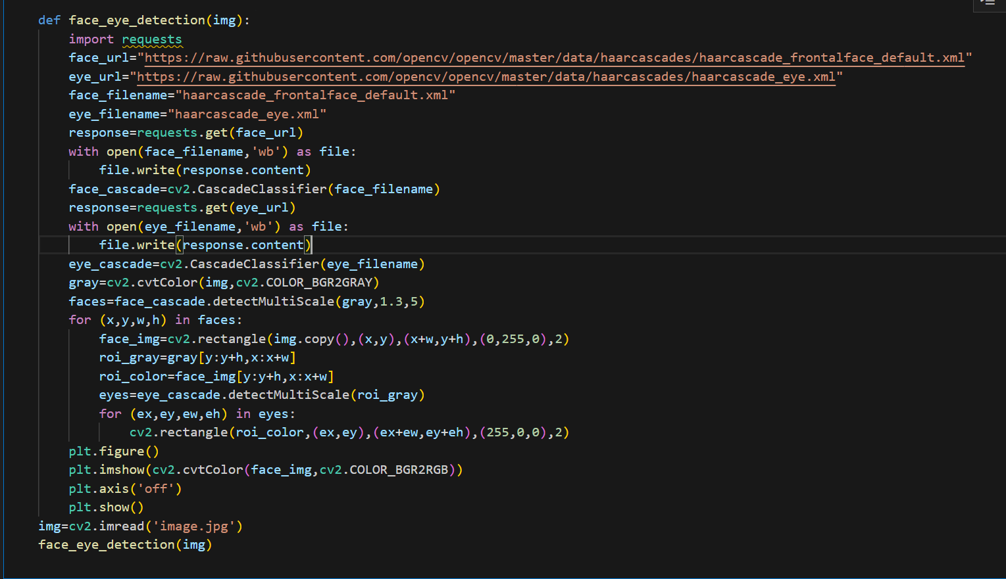
Face and eye detection and drawing boxes around them

Slide 52
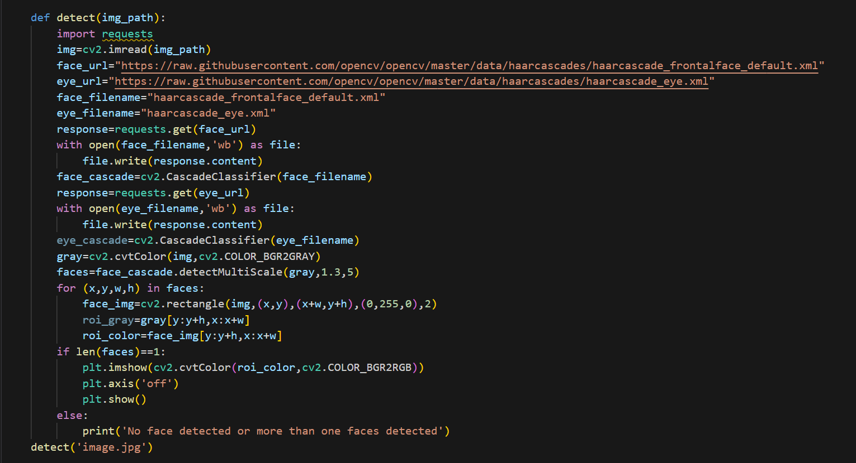
Image cropping based on facial features

Slide 53

meshroom
Meshroom is an open-source photogrammetry software that generates 3D models from multiple 2D images. It uses advanced algorithms to detect common features across the photos and reconstructs them into a 3D mesh. The software operates through an intuitive node-based interface, is fully customizable, and integrates with the AliceVision framework for processing. Meshroom is free to use and supports various export formats for 3D modeling, game engines, or 3D printing.

Slide 54
SUMMARY
This project, VISIONCRAFT, focuses on reconstructing 3D models of objects and environments using video data, combining computer vision techniques with tools like Python, OpenCV, and Meshroom.
Week wise topics:
Week 1: Fundamentals of Python programming, including data structures, NumPy for numerical computations, and Pandas for data manipulation.
Week 2: Basics of OpenCV for image and video processing, covering image transformations, edge detection, and contour analysis.
Week 3: Advanced techniques in contour detection, feature detection algorithms (SIFT, ORB, FAST), and 3D reconstruction using Meshroom.
The final assignment includes the 3D construction of an object using an approx. 15 sec video of the object and extracting 60-70 good frames (using contour and edge detection).

Slide 55
Thank you!

