Slide 1
VLS 731
VLSI Architecture Design
SneakySnake: a fast and accurate universal genome pre-alignment filter
Team Members:
Ananya Vundavalli (IMT2023537)
Talla Likitha Reddy (IMT2023550)
Arismita Mukherjee (IMT2023585)

Slide 2
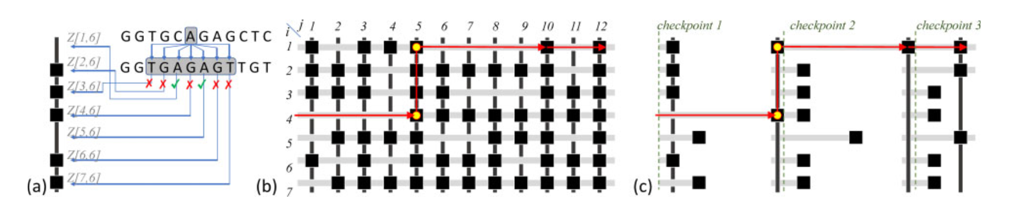
Recap

Slide 3

FPGA implementation (Modules)
Chip maze generator:
Takes a T-wide block of reference and query sequences and builds a (2E+1) × T grid of bits, where each bit is 0 if the characters match (free path) and 1 if they differ (obstacle), across all 2E+1 possible alignment shifts simultaneously.
Hardware equivalent: XNOR LUTs
Least Zero Count (LZC):
For a single row bitvector, counts how many consecutive zeros appear from the left before hitting the first number is the "escape segment length," i.e., how far the snake can move forward in that row before hitting an obstacle.
Hardware equivalent: Priority encoder
LZC Comparator tree:
Takes all 2E+1 LZC values in parallel and uses a hierarchical binary tree of comparators (log₂(2E+1) levels deep) to find the single largest escape length, the best row the snake should follow in a single pass.
Hardware equivalent: Binary Max Tree (Mux + Comparator LUTs)

Slide 4
4. Barrel Shifter:
After the best escape length x is found, shifts all 2E+1 row bitvectors right by x+1 bits simultaneously, discarding the matched segment and the one obstacle at its end, so the next pipeline stage starts fresh from the new checkpoint.
Hardware equivalent: Shift LUTs
5. Snake Stage:
Wraps the chip maze generator, LZC array, comparator tree, and barrel shifter together into one complete routing step, it receives the current maze state, finds the best escape segment, crosses one obstacle, and outputs the shifted maze ready for the next stage.
6. Snake Pipeline:
Chains Y identical snake stages in sequence, passing the shifted maze from each stage to the next, accumulating the total obstacle count across all Y stages to produce the obstacle count for one T-wide subproblem block.
7. Snake on Chip Top:
The top-level FSM that loads reference and query sequences block by block, feeds each T-wide block through the snake pipeline, sums obstacle counts across all M/T blocks, and finally asserts accept_o if the total obstacles ≤ E or reject otherwise.

Slide 5
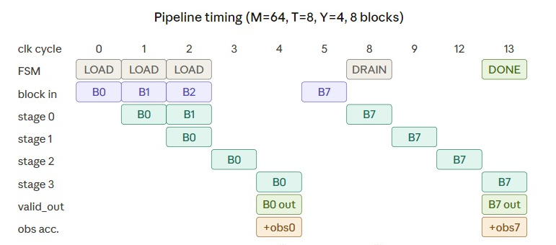
Pipeline
7

Slide 6
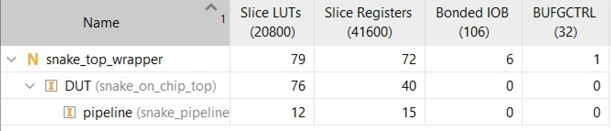
Resource Utilization

Slide 7
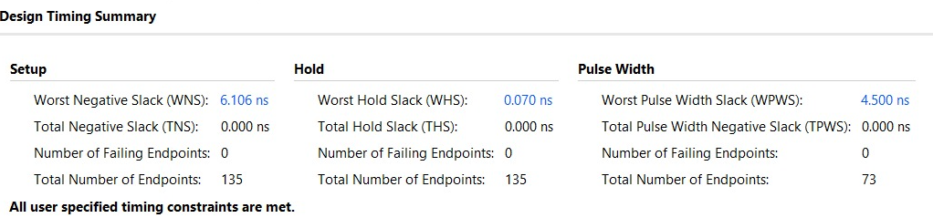
Timing Report

