Slide 1


Budweiser EDA
Anthony H. and Oluwadamilola O.
DS 6306 Group 2

Slide 2
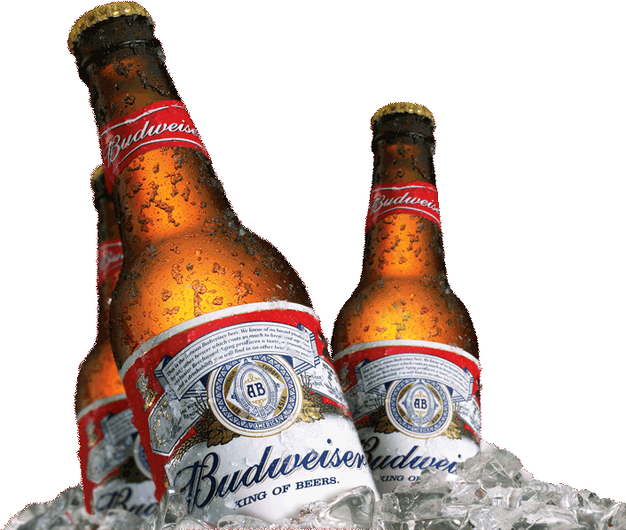
Agenda
Distribution by State
Missing Values
Mean ABV %
Mean IBU
Most Alcohol Beer
State with most Bitter Beer
Summary Statistics
Visualizations
KNN classification between IPAs and Ales.

Slide 3
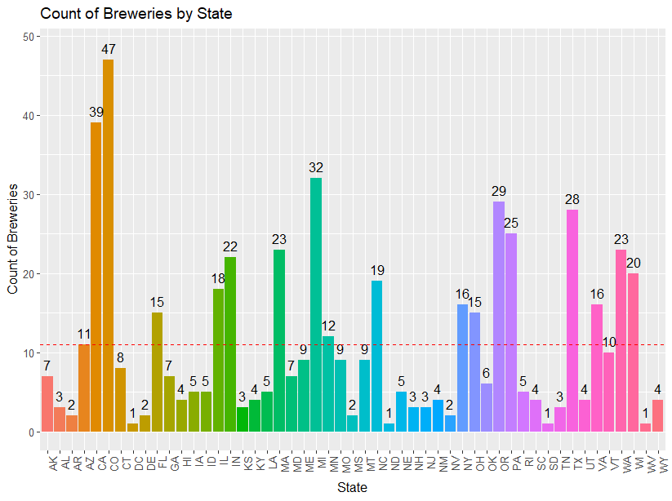
Colorado has the highest count of breweries by state.
DC, North and
South Dakota, and West Virgina have the lowest count with one each.

Slide 4
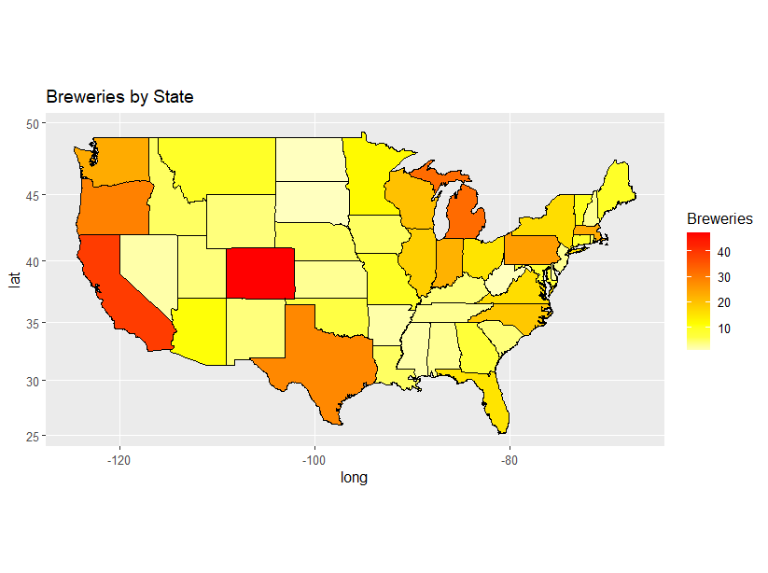
Distribution of Breweries by State

Slide 5
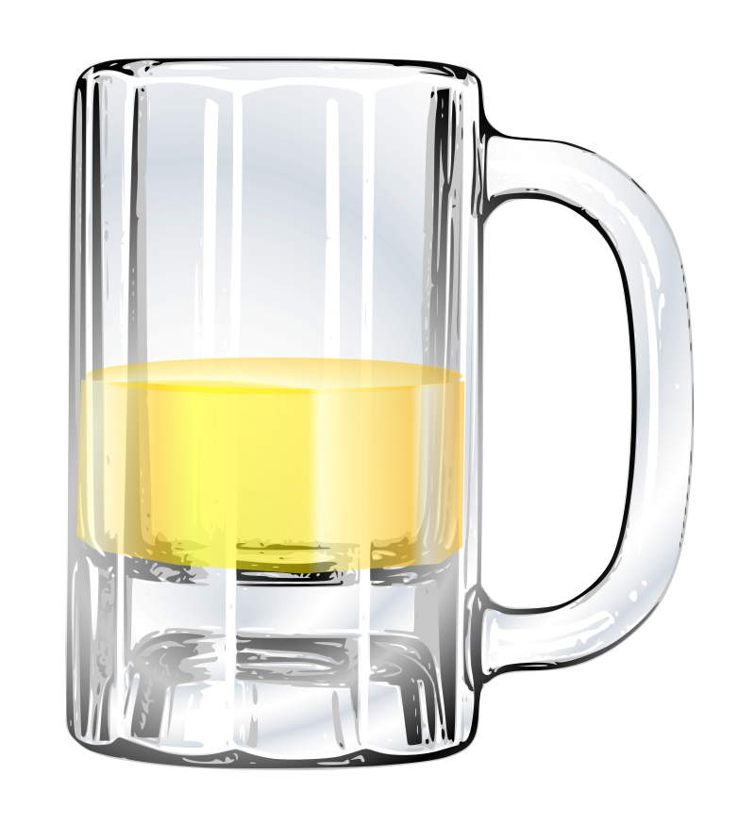
Missing Values Check
62 missing values from column ABV.
~3%
1,005 missing values from column IBU.
~42%
Not by Name, Beer_ID, Brewery, Style

Slide 6
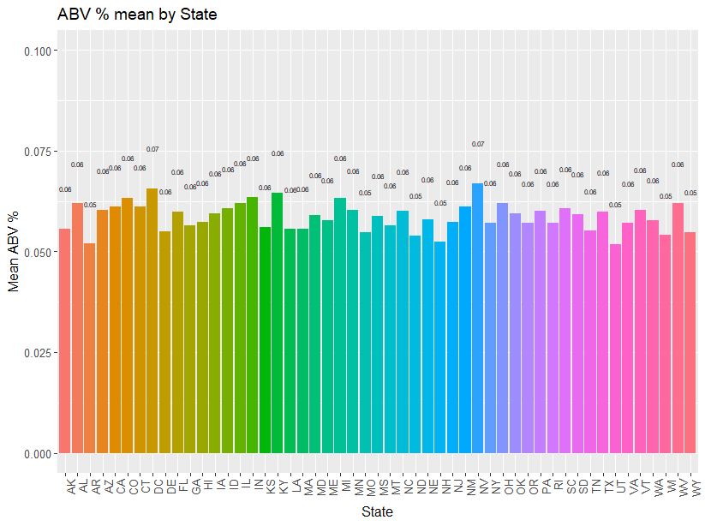
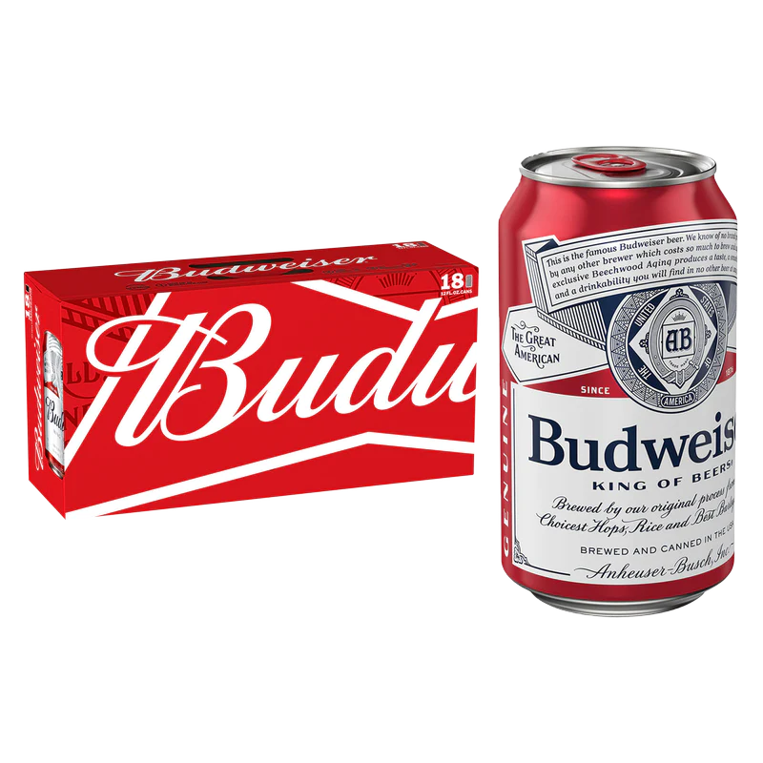
State with the Highest Mean ABV %
New Mexico has the highest mean Alcohol by Volume (ABV) %.
NM
Utah has the lowest.

Slide 7
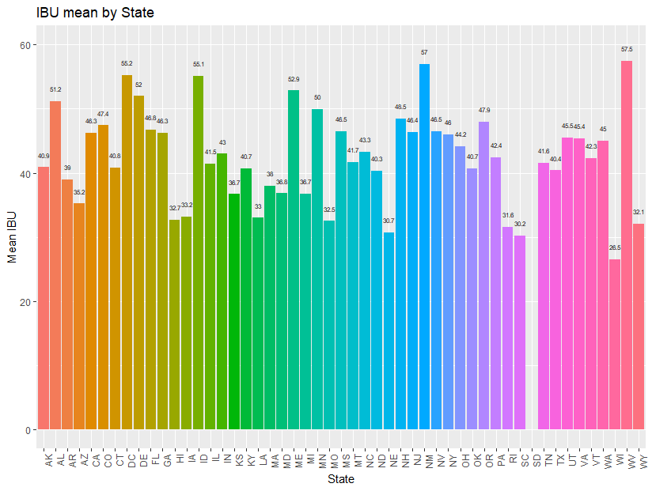

State with the Highest mean IBU
West Virginia has the highest mean of International Bitterness Units (IBU) recorded.
WV

Slide 8
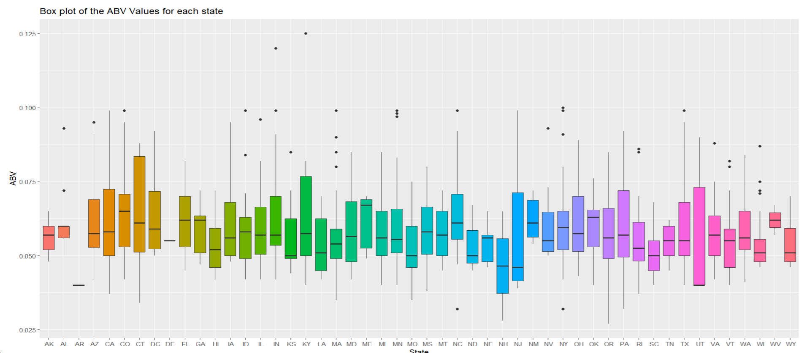

State with the Most Alcoholic Beer (ABV)
Kentucky has the highest Alcohol by Volume (ABV) % Recorded
KY, 0.125

Slide 9
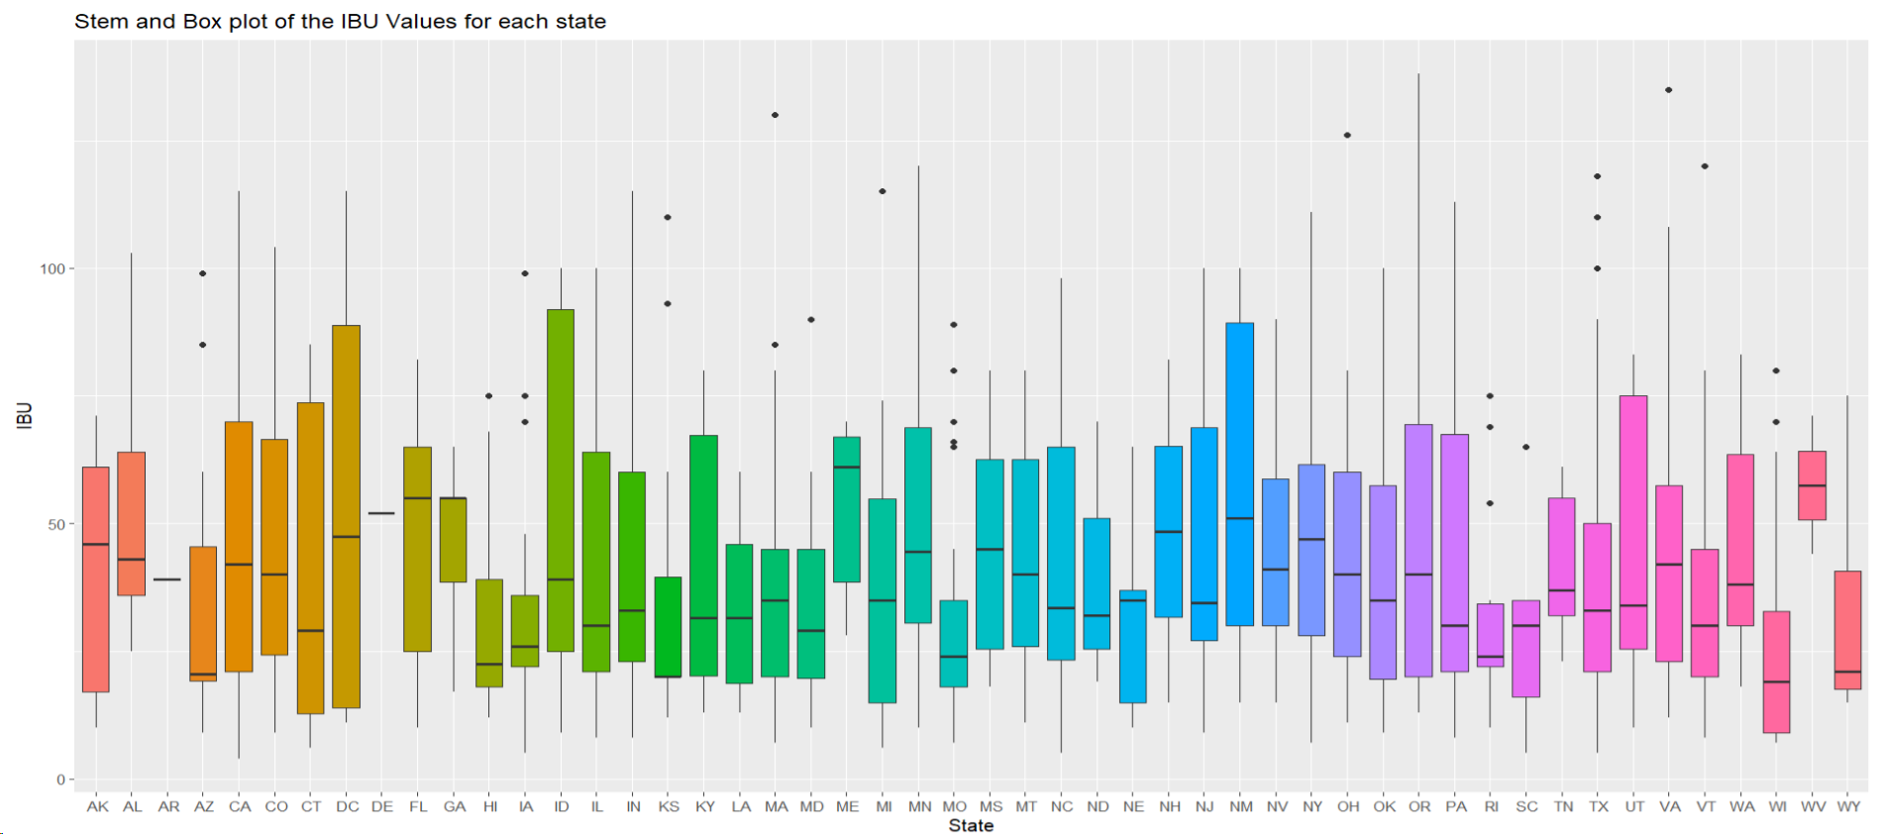
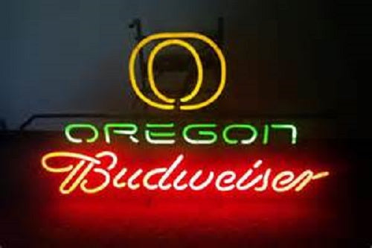
State with the Most Bitter Beverages (IBU)
Oregon has the highest International Bitterness Units (IBU) recorded.
OR, 138

Slide 10
Summary Statistics of the ABV Variable
Mean
0.05991
1st Quarter
0.05
3rd Quarter
0.068
Min Value
0.027
Median
0.057
Max Value
0.125

Slide 11
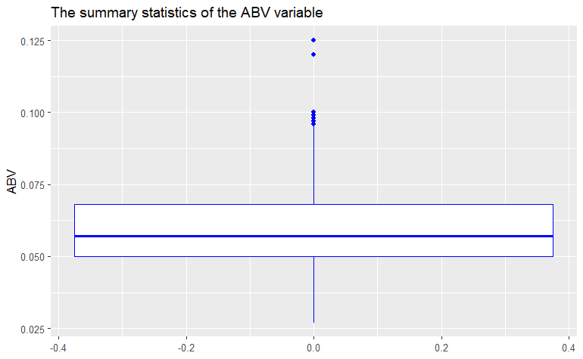
Summary Statistics of the ABV Variable
MAX = 0.125
Mean = 0.05991
3rd QUA= 0.068
MEDIAN = 0.057
1ST QUA= 0.05
MIN = 0.027

Slide 12
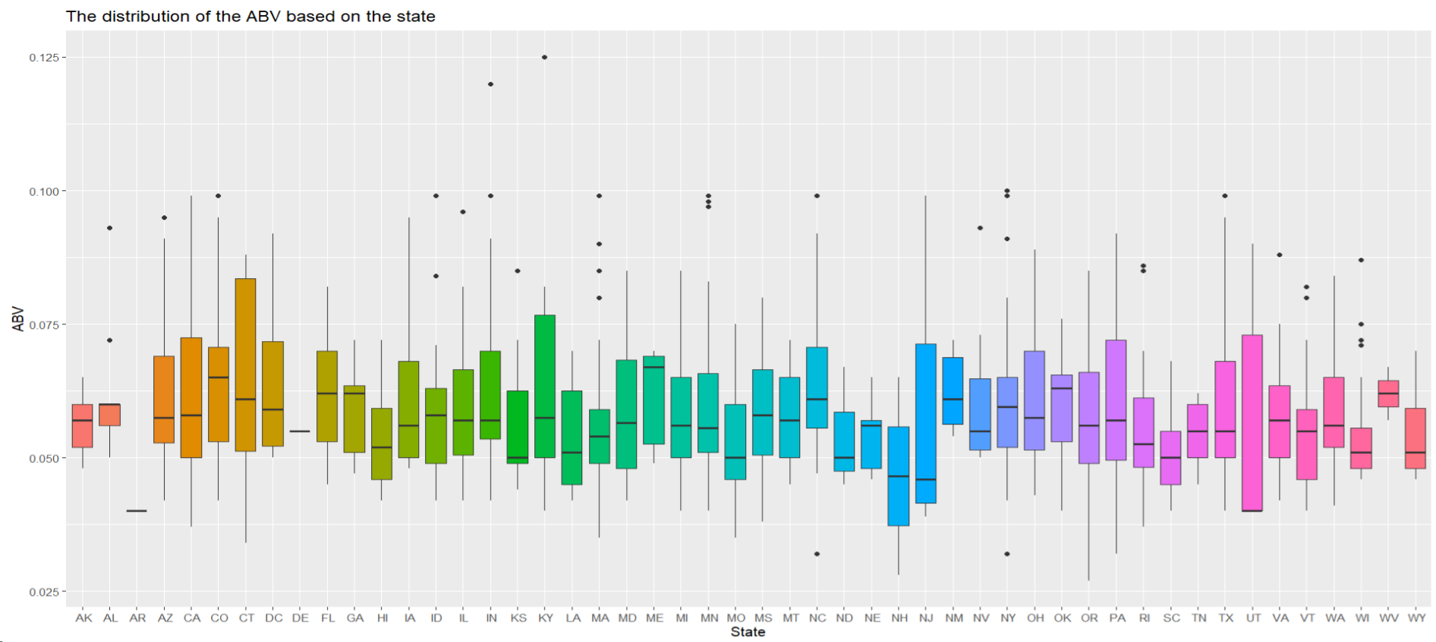
Data Visualization of ABV based on the States
Kentucky has the largest ABV value
Oregon has the lowest ABV value
Kentucky and Indiana are the states with outliers
Notes:
Dependent variable and independent variable; State with the highest Alcohol by Volume % is ; box plot to visualize the relationship; Determine the relationship between the ABV and States variable using a stembox plot

Slide 13
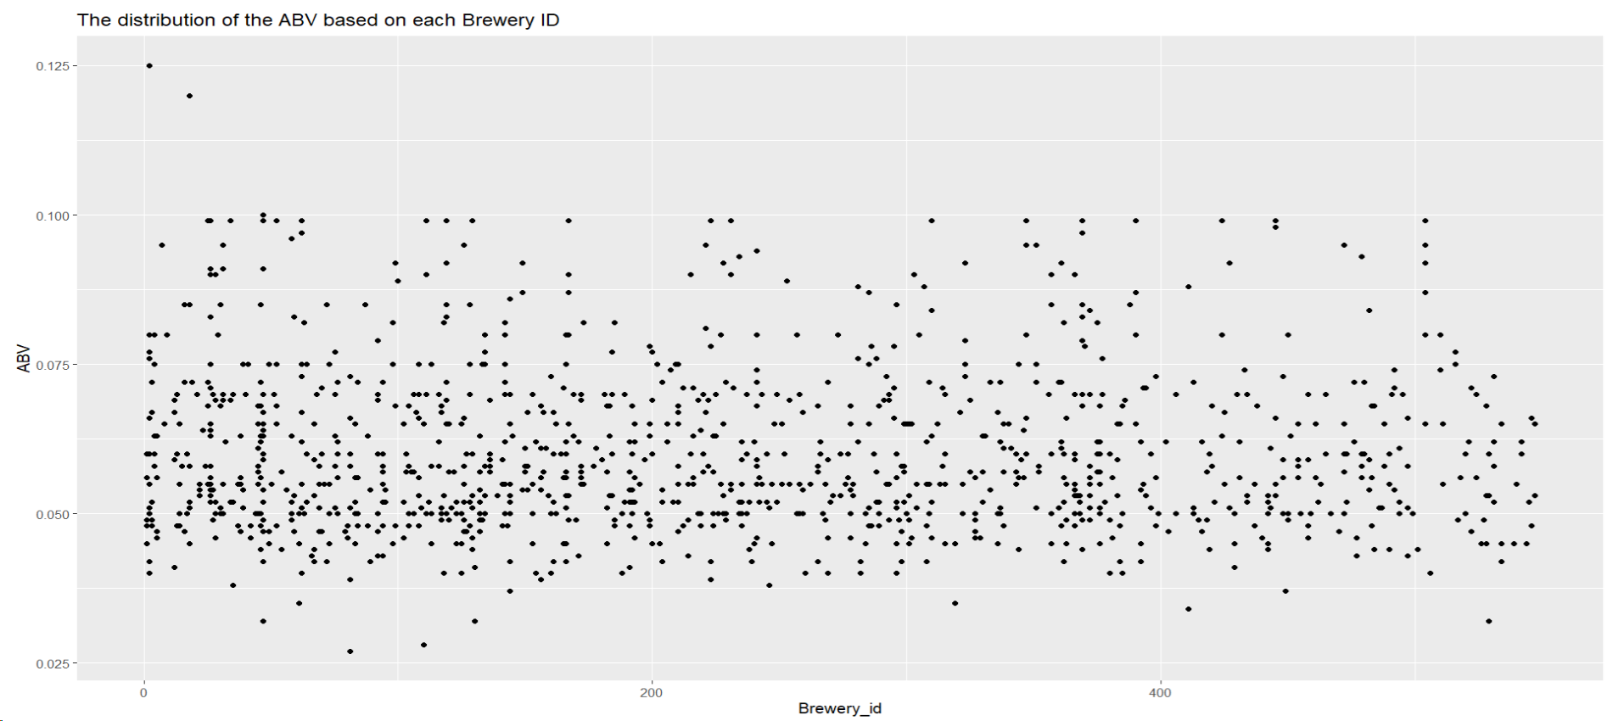
Data Visualization of ABV based on the brewery ID
Highest Brewery ID is 1
The lowest Brewery ID is 81
Notes:
Brewery ID with the

Slide 14
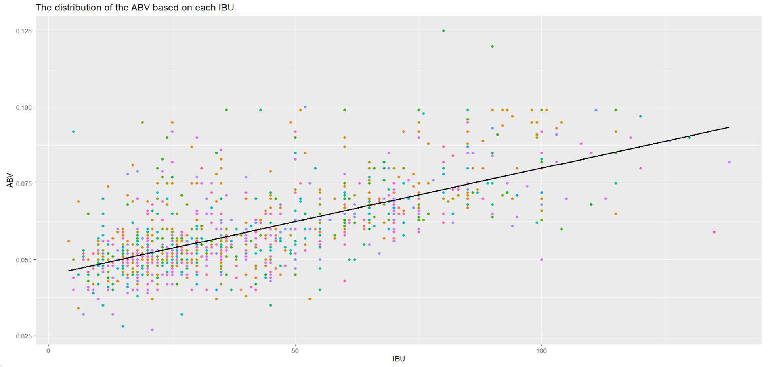
Data Visualization of ABV based on its Bitterness (IBU)
There is a positive linear relationship between the alcoholic content and its bitterness value
Notes:
Using a scatterplot and a fitted regression line

Slide 15
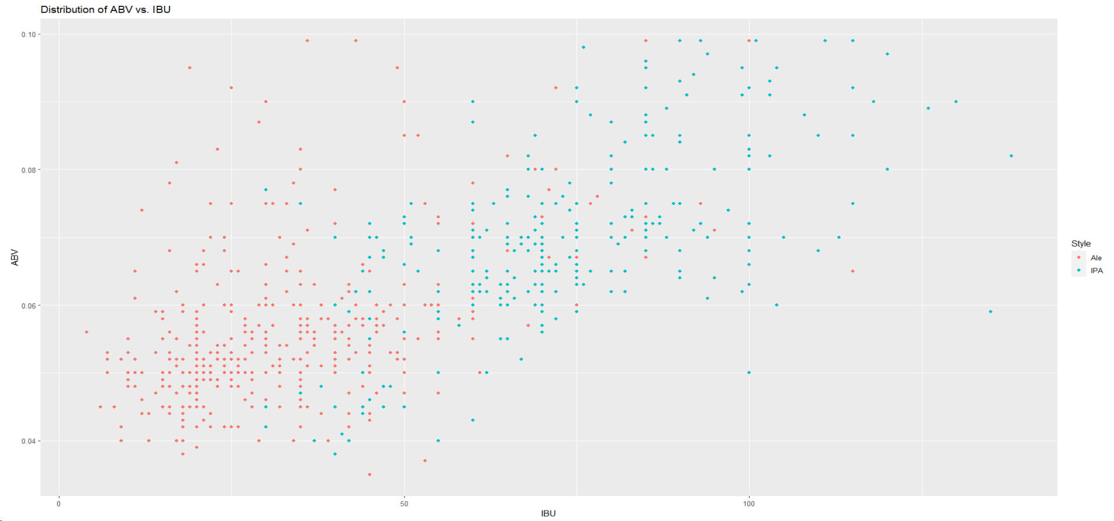
Investigating Differences Between the IPAs and Ales with Respect to the IBU & ABV variable using a Scatterplot
There is a noticeable difference between the Ale and IPAs in terms of the IBU & ABV variables
Notes:
Using a scatterplot and a fitted regression line

Slide 16
Investigating Differences Between the IPAs and Ales with Respect to the IBU & ABV variable using KNN
Accuracy : 86%
 | Ale | IPA
Ale | 95 | 17
IPA | 10 | 67
MissClassification Rate : 14%
Sensitivity: 90.4%
Specitivity: 79.8%
Notes:
Using a scatterplot and a fitted regression line

Slide 17
Investigating the relationship using a 2-sample t-test
P- value for the ABV
Pvalue < 2.2e-16
P- value for the IBU
Pvalue < 2.2e-16
Based on welch’s 2 sample t-test, there is overwhelming evidence to suggest that there is significant difference between the Ale and IPAs drinks in terms of their IBU & ABV.
Notes:
Using a scatterplot and a fitted regression line

Slide 18
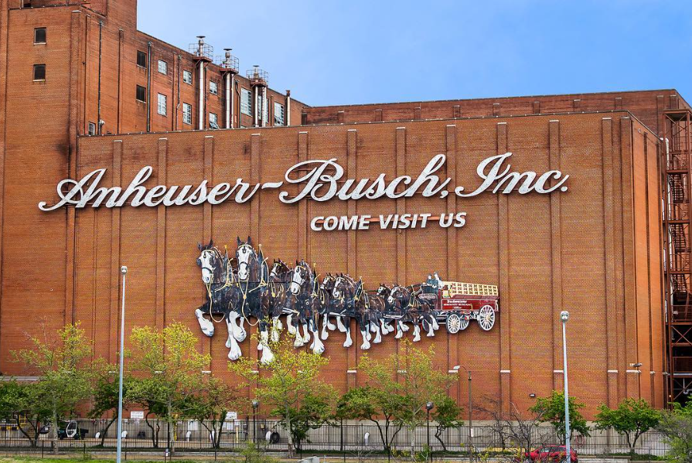
Q & A

Slide 19
Youtube link
https://youtu.be/UlyJONjs1g0

