Slide 1
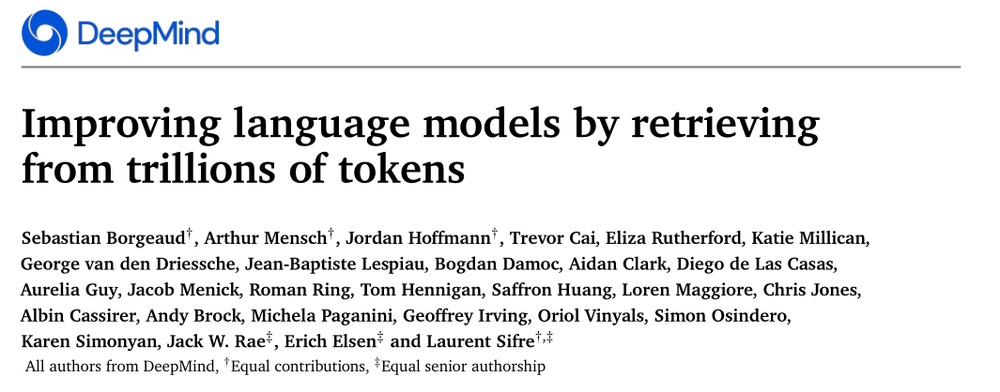

Slide 2
Limitation
Large performance improvements have come from increasing the model parameters.
The prediction results of model are uninterpretable.
Motivation
Inspired by the reliance of human brain on specialized memory mechanisms during learning, we suggest retrieval from a large text database as a complementary path to scaling language models.

Slide 3
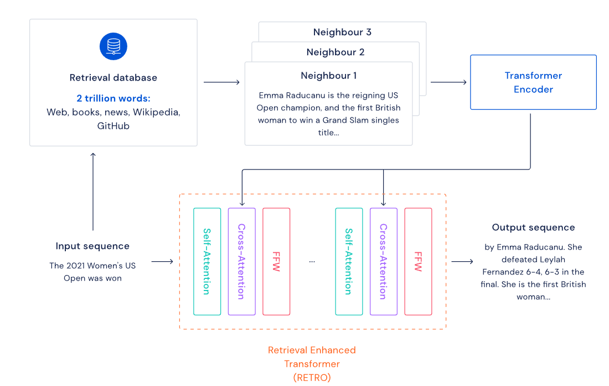

Slide 4
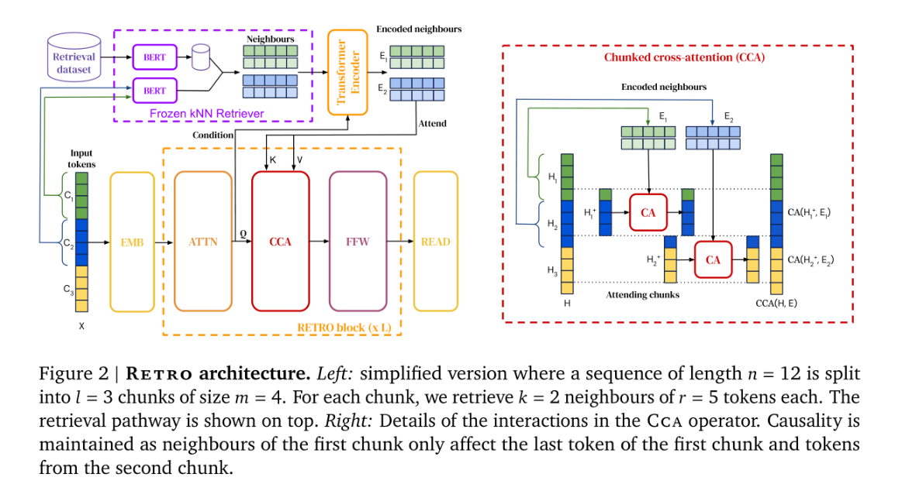

Slide 5
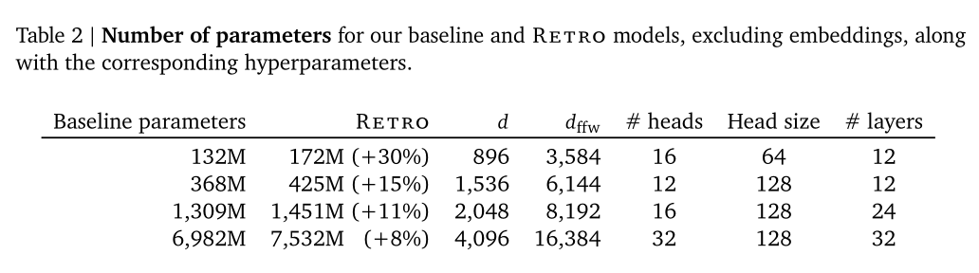

Slide 6
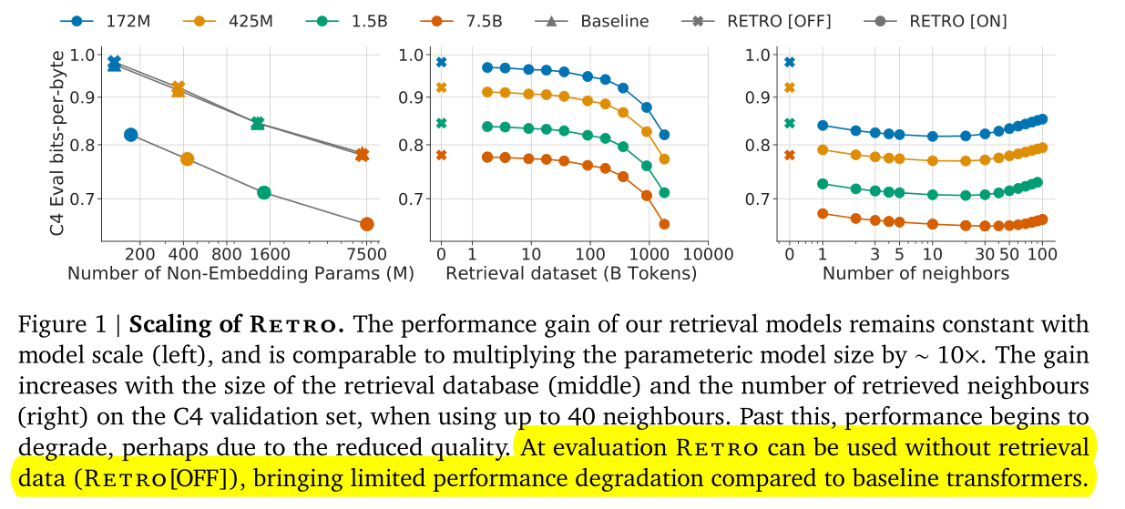

Slide 7
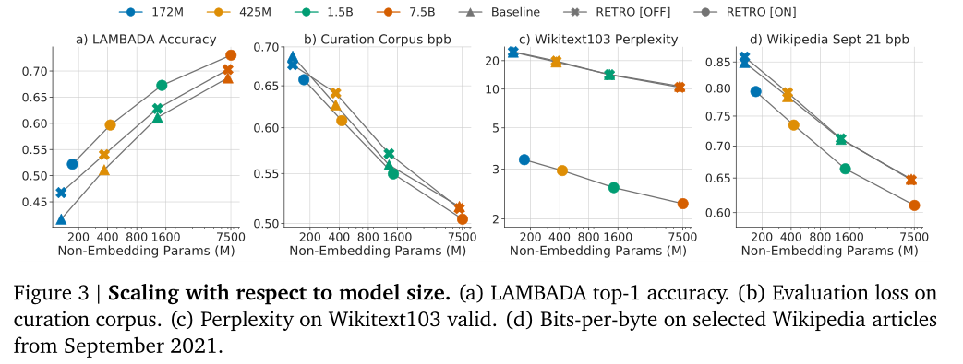

Slide 8
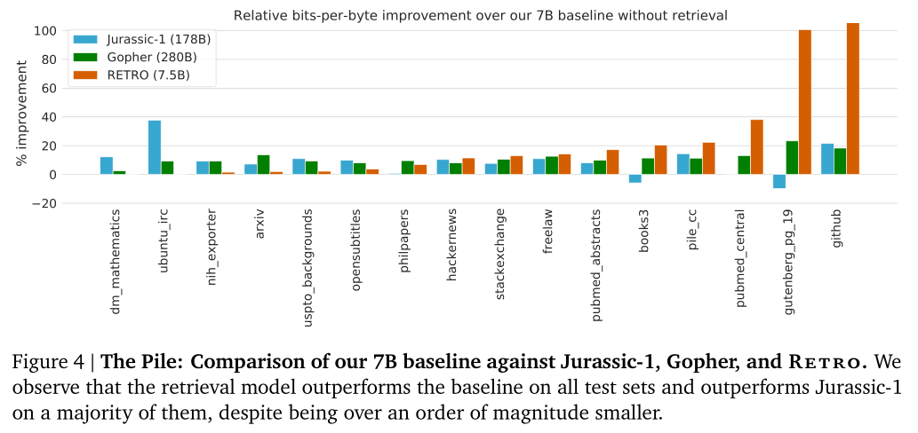

Slide 9
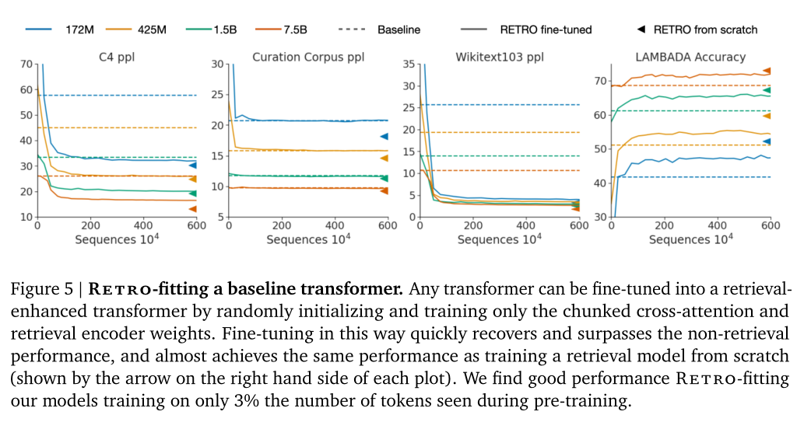

Slide 10
