Slide 1
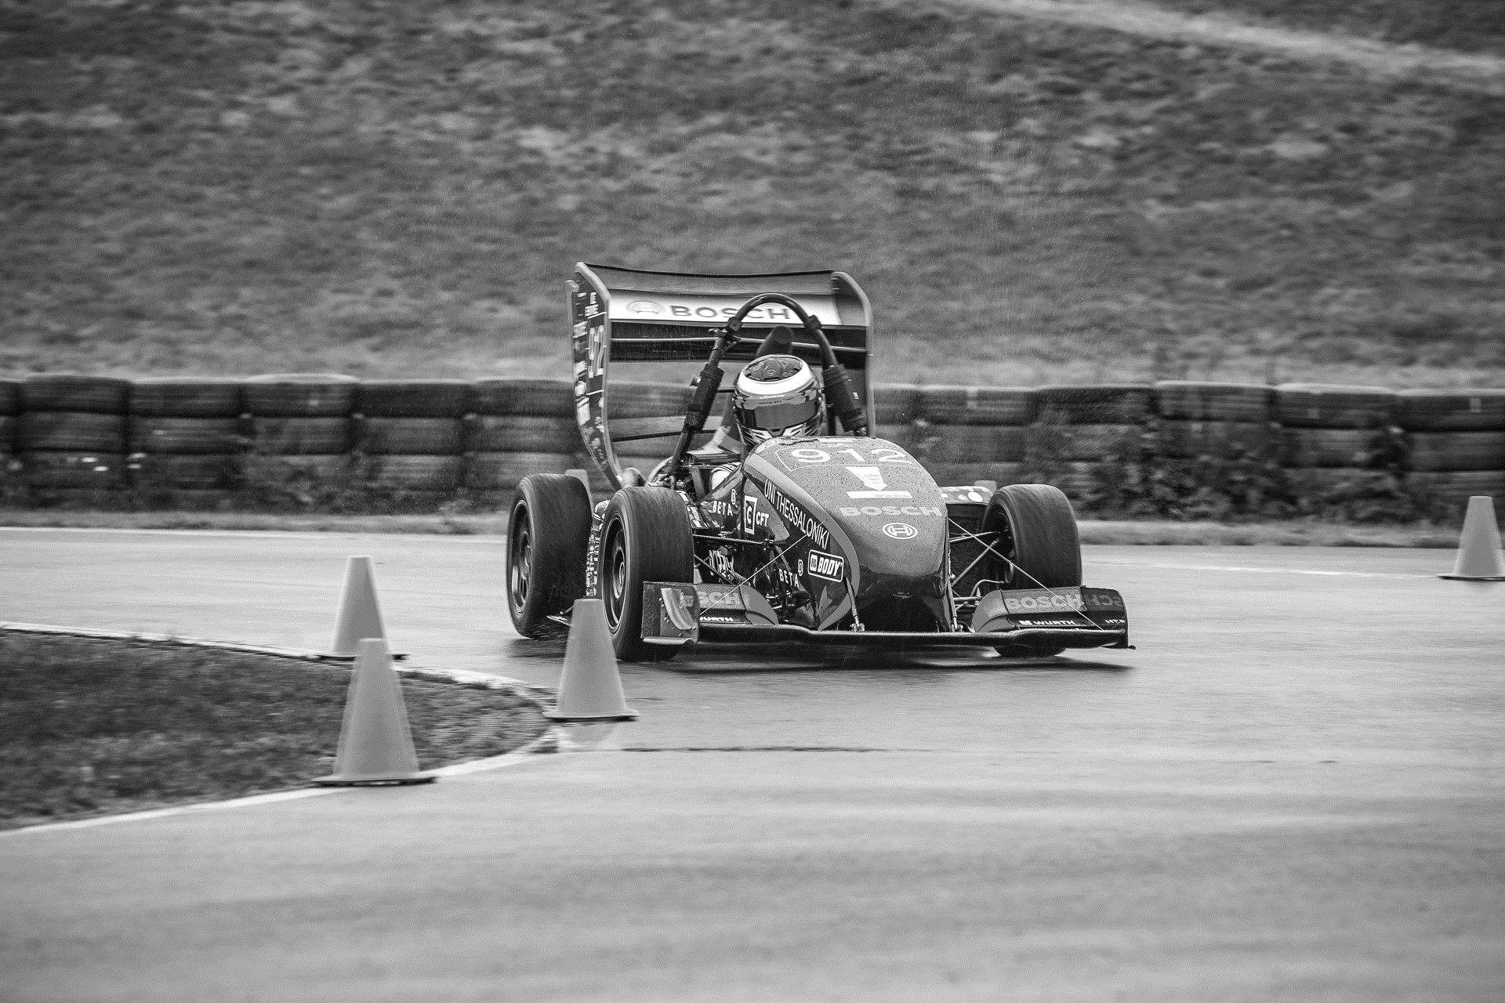

ΣΦΗΜΜΥ 12 Workshop Εισαγωγή στη ROS: Δημιουργία μοντέλου και αυτόνομη χαρτογράφηση
-Μηνάς Κοσμίδης
Φοιτητής Ηλ. Μηχ.
-Σωτήρης Μπαρλάκας
Φοιτητής Μηχ. Μηχ

Slide 2

What is?
Robot Operating System
Meta-operating system
Real-time Framework
Operating System Services
Open source

Slide 3
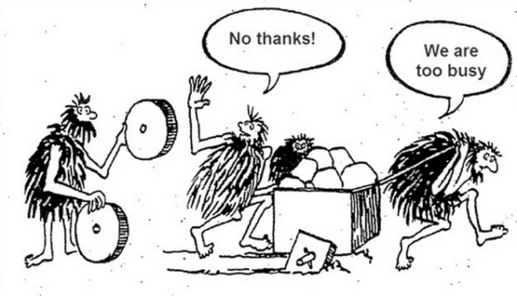
Before ROS…
Lack of standards
Little code reusability
Keeping re-coding:
Device drivers,
Standard algorithms,
Access to robot’s interfaces,
Management of onboard processes
….reinventing the wheel every time a new robot is built

Slide 4
So what is ROS?
“ROS is an open-source, meta-operating system for your robot”
http://wiki.ros.org/ROS/Introduction

Slide 5
Why?
Open source
Big Community
Rich documentation
Already implemented packages
Language-agnostic
General and reusable

Slide 6
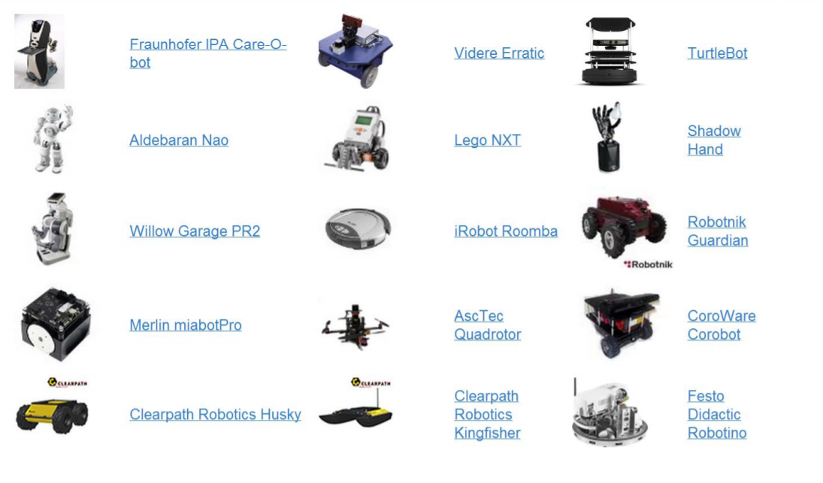
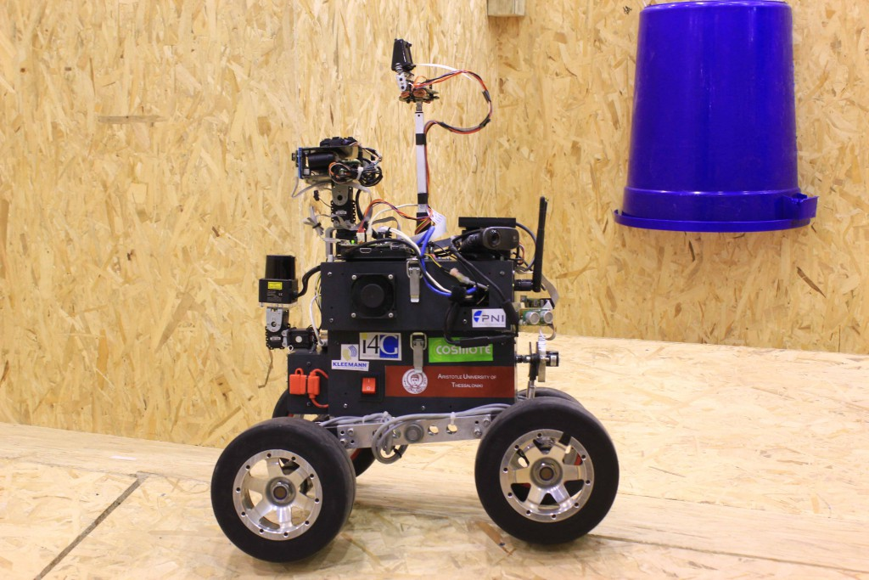
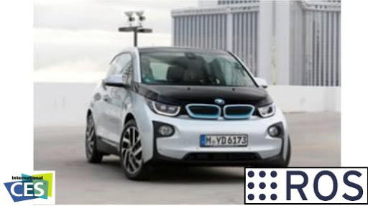
Robots that run ROS
From academia…
… to the Industry
And many others….

Slide 7
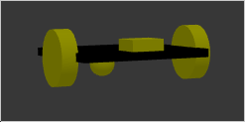
Our Robot
Differential-Drive Robot
Chassis
Laser_sensor
Right_wheel
Left_wheel
Caster_wheel
Right_rim
Camera_sensor

Slide 8
How does ROS work?
ROS Master
Topics
‘’ROS systems consist of many small programs (nodes) which
connect to each other and continuously exchange messages’’
Nodes
Messages
Actions & Services
Publishers & Subscribers

Slide 9
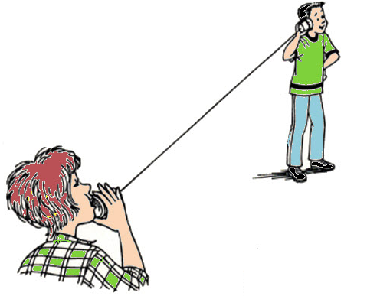
Publishers & Subscribers
Subscriber
Topic
Nodes
Publisher
Publishers
(sending data)
Subscribers
(receive data)
Message:
string ‘’It’s a secret!’’
Messages
Ex.
float64 temperature

Slide 10
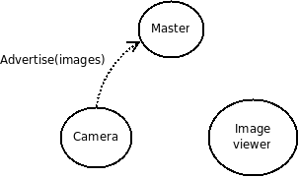
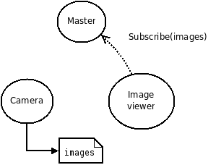
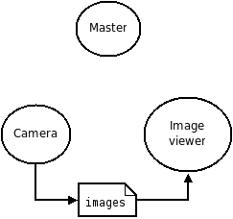
How Nodes communicate?
Camera publishes to “/images” topic
Master notifies Camera and Image viewer about each other’s existence so communication begins
Image Viewer subscribes to “/images” topic

Slide 11

What about topics?
Subscriber 1
“I want to catch up
on some gossip”
Message:
string ‘’It’s a secret!’’
Subscriber 3
“I want to communicate with aliens”
Topic 1: /gossip
Publisher
Topic 2: /alien_voices
Subscriber 2
“I want to catch up on some gossip”

Slide 12
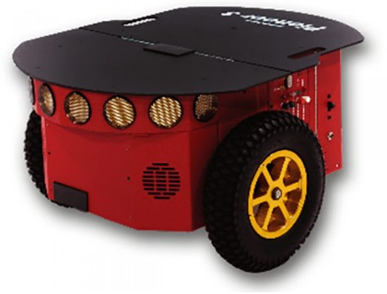
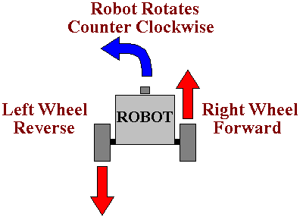
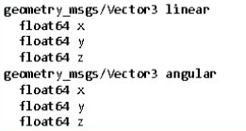
How differential plugin works?
It receives (subscriber) the desired linear (v) and angular (ω) velocities and calculates wheel rotation velocity
Differential Drive Robot
It subscribes for messages of type:
(to the specified topic)
Geometry_msgs/Twist
It also publishes odometry data..
(to another topic)

Slide 13
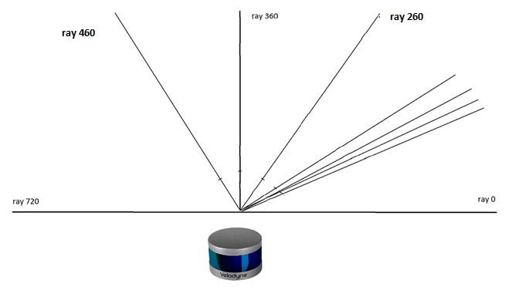
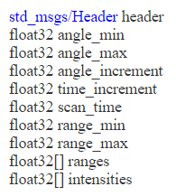
How LIDAR plugin works?
It publishes messages of type: (to the specified topic)
sensor_msgs/LaserScan
Ranges is an array with the distances [m] that each ray traveled until it reflects back by an obstacle

Slide 14
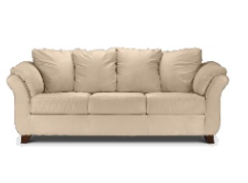
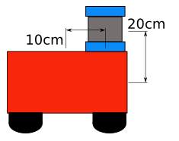
The importance of transformations
lidar
5 m
base frame
The measurements of the Lidar have to be transformed to the base_link frame for localization.
Same principle for mapping...

Slide 15
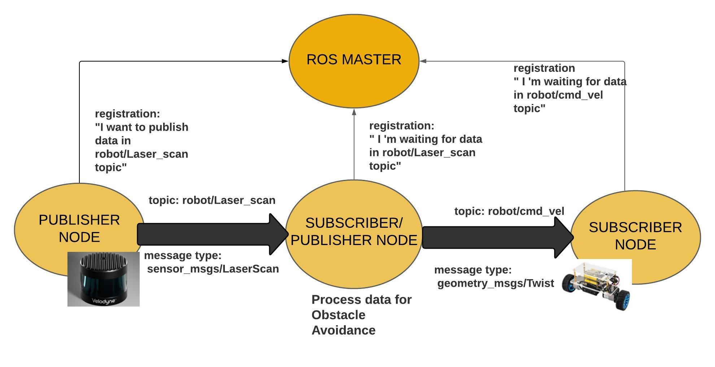
Our code architecture

