Slide 1
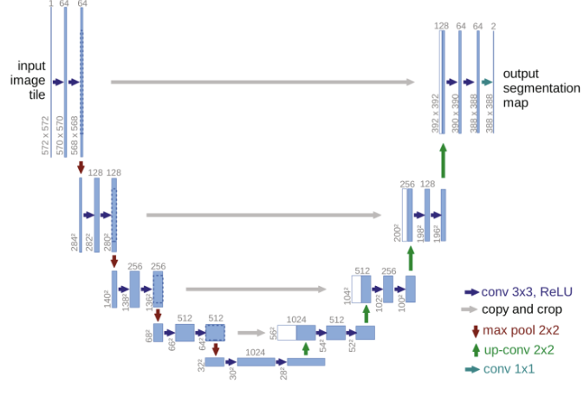
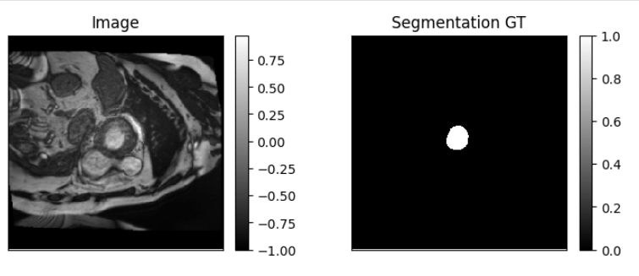
Image Segmentation based on U-Net
Our Goal: one-class segmentation
U-Net

Slide 2
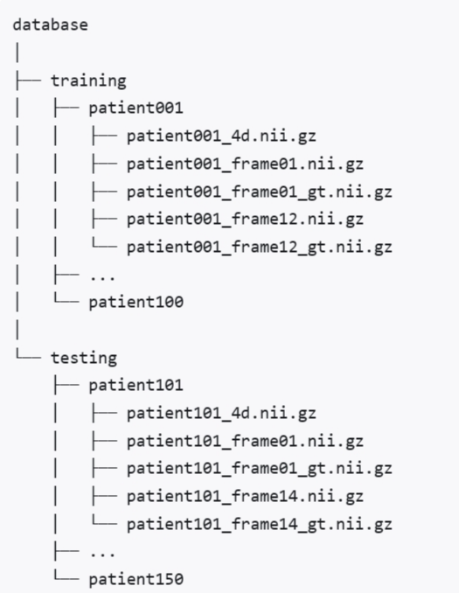
Automated Cardiac Diagnosis Challenge (ACDC)
This challenge took place during the MICCAI 2017 conference. It remained open until the end of 2022 for new submissions.
The goal of this contest was two-fold:
compare the performance of automatic methods on the segmentation of the left ventricular endocardium and epicardium as the right ventricular endocardium for both end diastolic and end systolic phase instances;
compare the performance of automatic methods for the classification of the examinations in five classes (normal case, heart failure with infarction, dilated cardiomyopathy, hypertrophic cardiomyopathy, abnormal right ventricle).
Notes:
ACDC (Automatic Cardiac Diagnosis Challenge) 是 MICCAI 2017 的一个挑战赛，旨在对心脏动态磁共振成像 (cine-MRI) 中的舒张期 (ED) 和收缩期 (ES) 帧进行左心室 (LV) 、右心室 (RV) 和心肌 (Myo) 分割。精确分割心脏图像对于评估心脏功能，如射血分数（EF）、每次搏动的血量（SV）、左心室质量和心肌厚度，这些进而为诊断和治疗心脏疾病提供关键信息。该数据集涵盖 150 个病例，分为 5 个子类：NOR (正常)、MINF (心肌梗死伴随收缩性心力衰竭)、DCM (扩张型心肌病)、HCM (肥厚型心肌病) 和 ARV (右室异常)，每类各 30 例。

Slide 3
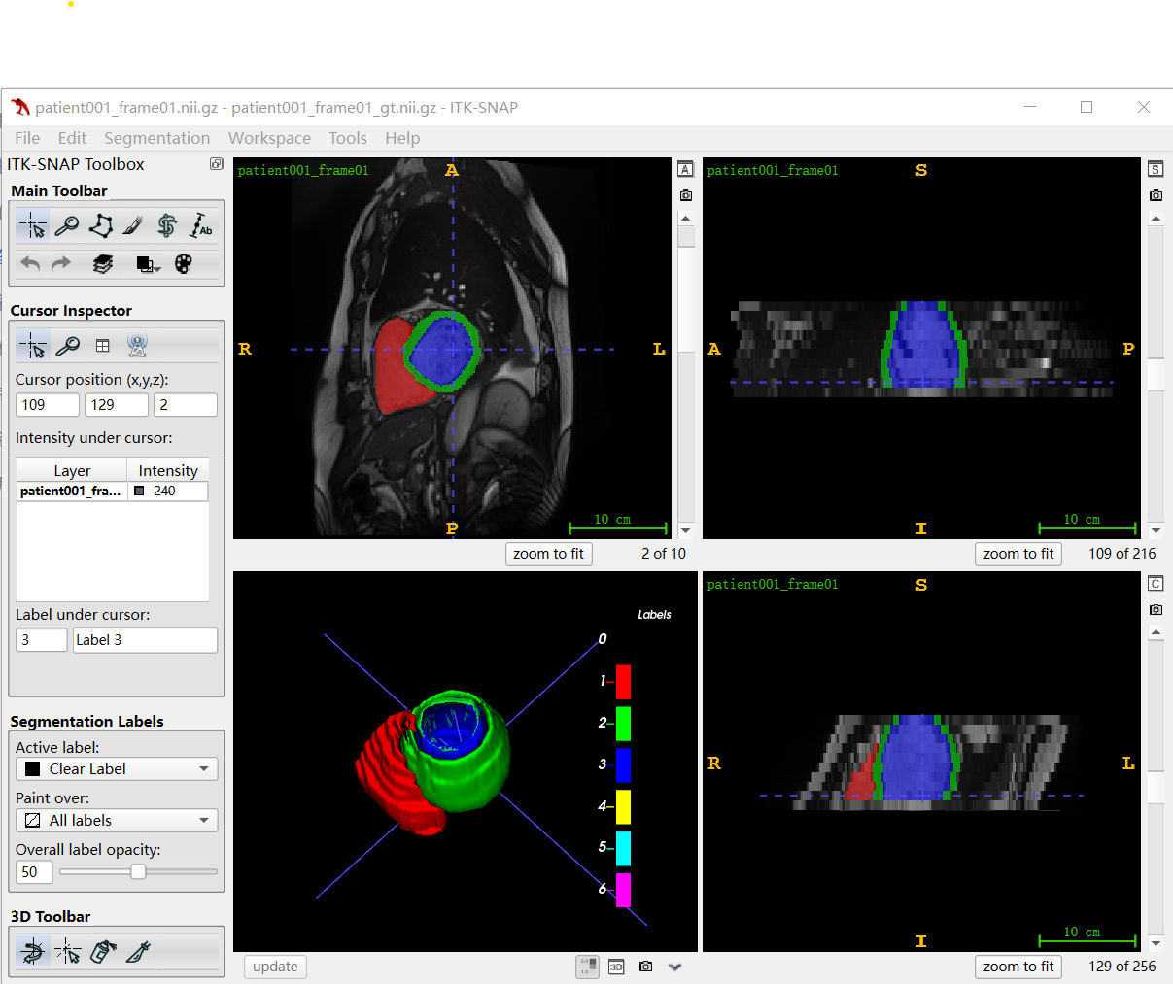
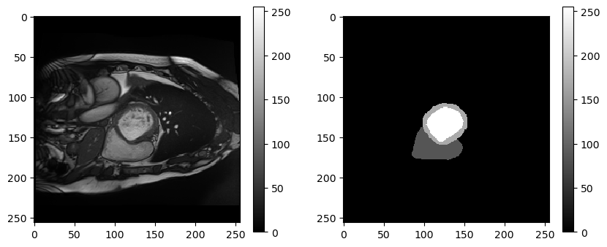
Automated Cardiac Diagnosis Challenge (ACDC)
[ 0, 85, 170, 255].
'0' is for background, '85' is for right ventricle(RV),
'170' is for myocardium(MYO) '255' is for left ventricle(LV)
Notes:
ACDC (Automatic Cardiac Diagnosis Challenge) 是 MICCAI 2017 的一个挑战赛，旨在对心脏动态磁共振成像 (cine-MRI) 中的舒张期 (ED) 和收缩期 (ES) 帧进行左心室 (LV) 、右心室 (RV) 和心肌 (Myo) 分割。精确分割心脏图像对于评估心脏功能，如射血分数（EF）、每次搏动的血量（SV）、左心室质量和心肌厚度，这些进而为诊断和治疗心脏疾病提供关键信息。该数据集涵盖 150 个病例，分为 5 个子类：NOR (正常)、MINF (心肌梗死伴随收缩性心力衰竭)、DCM (扩张型心肌病)、HCM (肥厚型心肌病) 和 ARV (右室异常)，每类各 30 例。

Slide 4
Part1 Data Preparation
Customize the dataset:
PyTorch provides the Dataset class that you can extend and customize to load your dataset. You need override the __len__() function that can be used to get the length of the dataset (number of rows or samples), and the __getitem__() function that is used to get a specific sample by index.
Data augmentation:
PyTorch provides various data augmentation methods, which can be found in torchvision.transforms.
Dataloader:
PyTorch provides the DataLoader class to navigate a Dataset instance during the training and evaluation of your model.

Slide 5
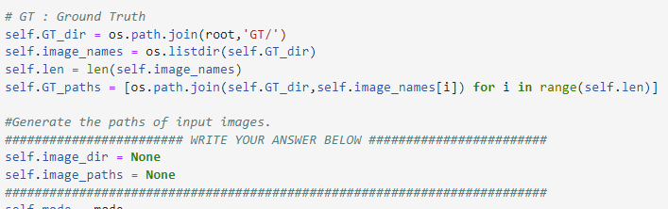
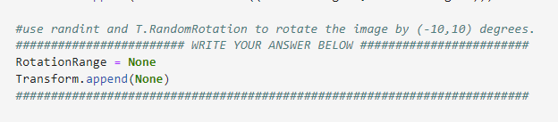
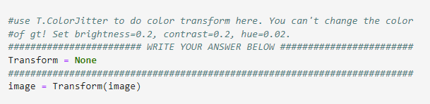
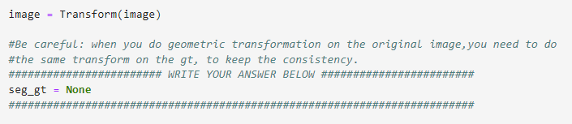
Part1 Data Preparation
ImageFolder
Check your datasets, construct ‘ImageFolder’, to get the data list and implement data augmentation.

Slide 6
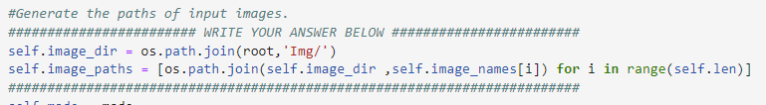
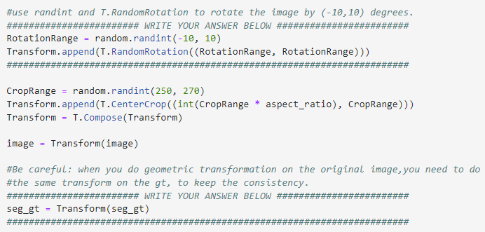
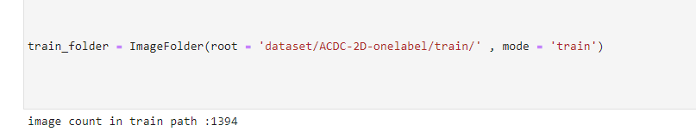
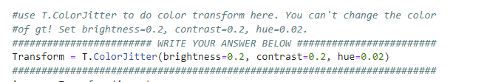
Part1 Data Preparation
ImageFolder（answers）
You will get:

Slide 7
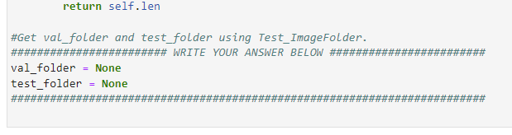
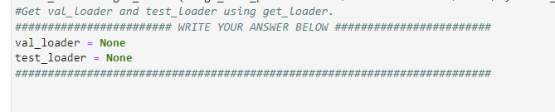
Part1 Data Preparation
Dataloader

Slide 8
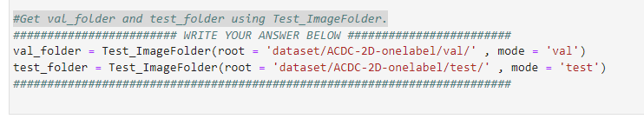

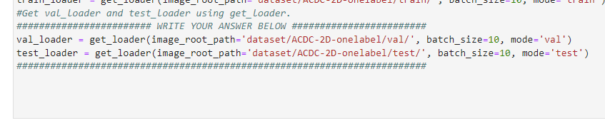

Part1 Data Preparation
Dataloader（answers）

Slide 9
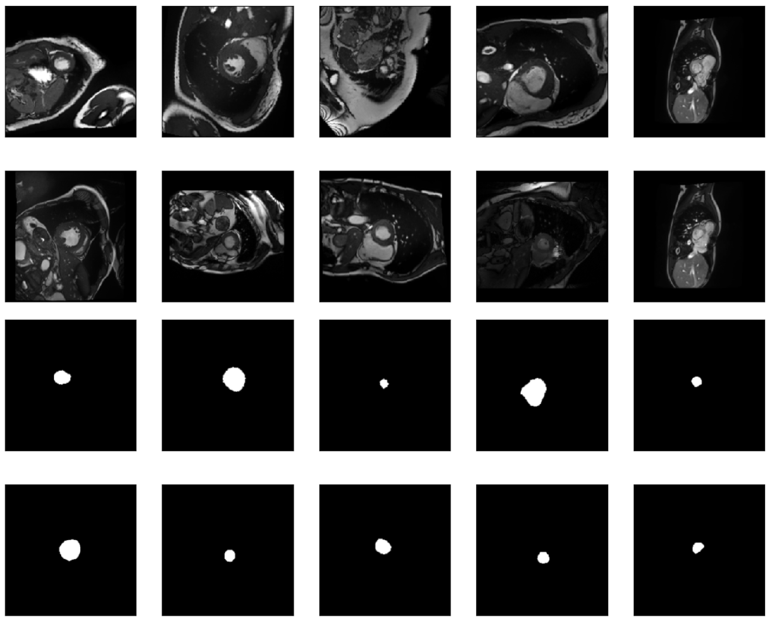
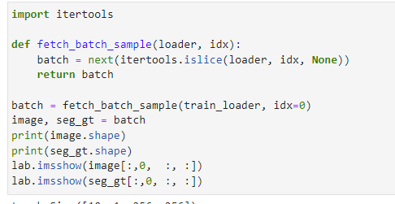
Part1 Data Preparation

Slide 10
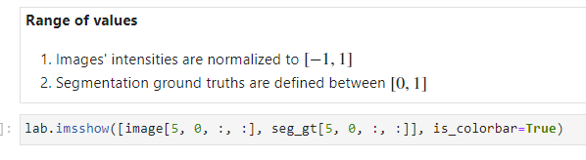
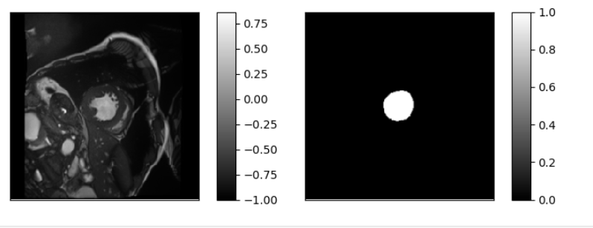
Part1 Data Preparation

Slide 11
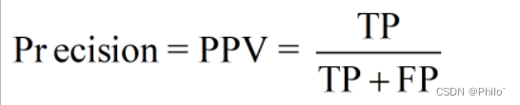
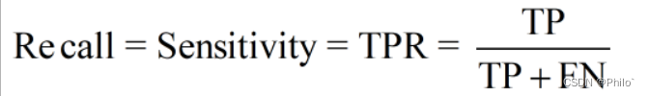
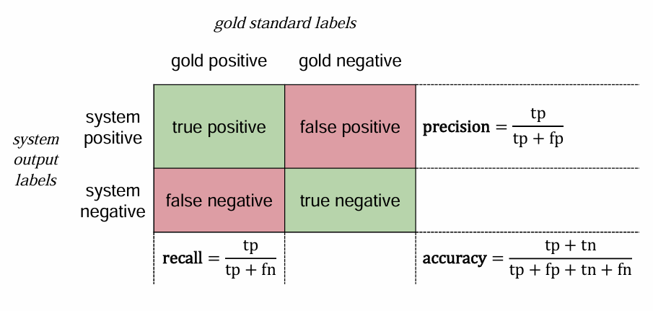
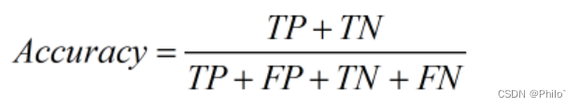
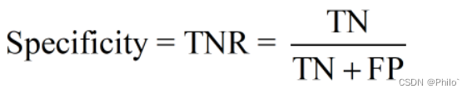
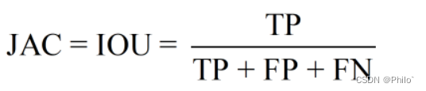
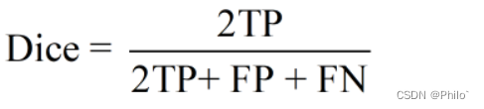
Part2 Evaluation Metrics for Segmentation Tasks

Slide 12
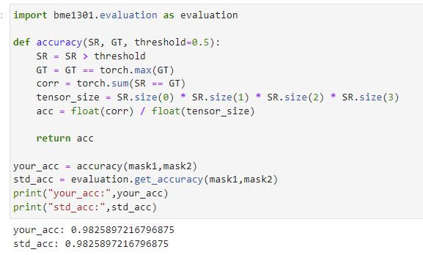
Part2 Evaluation Metrics for Segmentation Tasks
There is an example for the calculation of ‘accuracy’.
Implement ‘sensitivity’, ’ specificity’, ’ precision’, ’ F1 score’, ’ Jaccard similarity’, ’Dice Coefficient’.

Slide 13
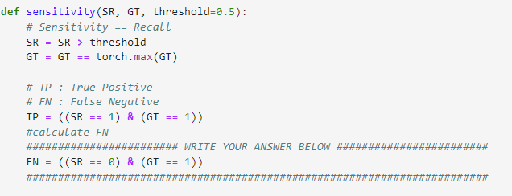
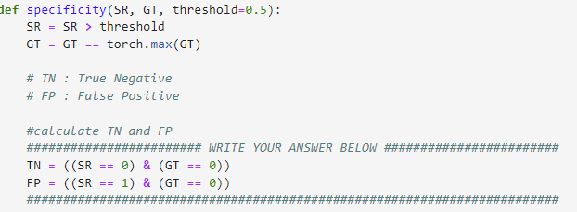
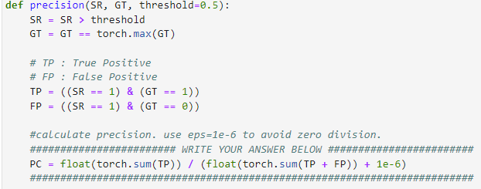
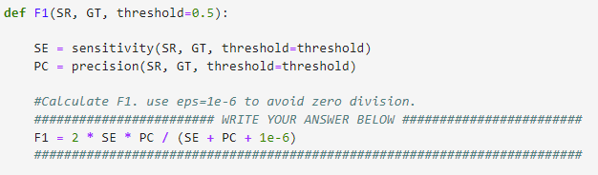
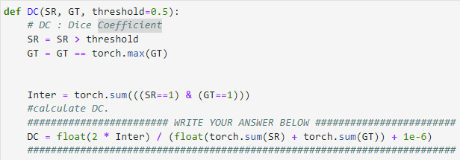
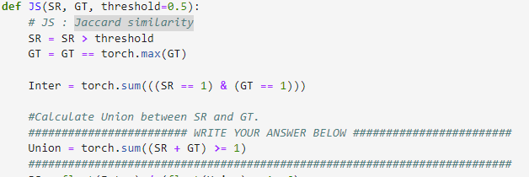
Part2 Evaluation Metrics for Segmentation Tasks (answers)

Slide 14
Part3 U-Net
The idiom for defining a model in PyTorch:
Define a class that extends the Module class.
The constructor of your class defines the layers of the model and the forward() function is the override that defines how to forward propagate input through the defined layers of the model.
Many layers are available, such as Linear for fully connected layers, Conv2d for convolutional layers, and MaxPool2d for pooling layers.
Activation functions can also be defined as layers, such as ReLU, Softmax, and Sigmoid.

Slide 15
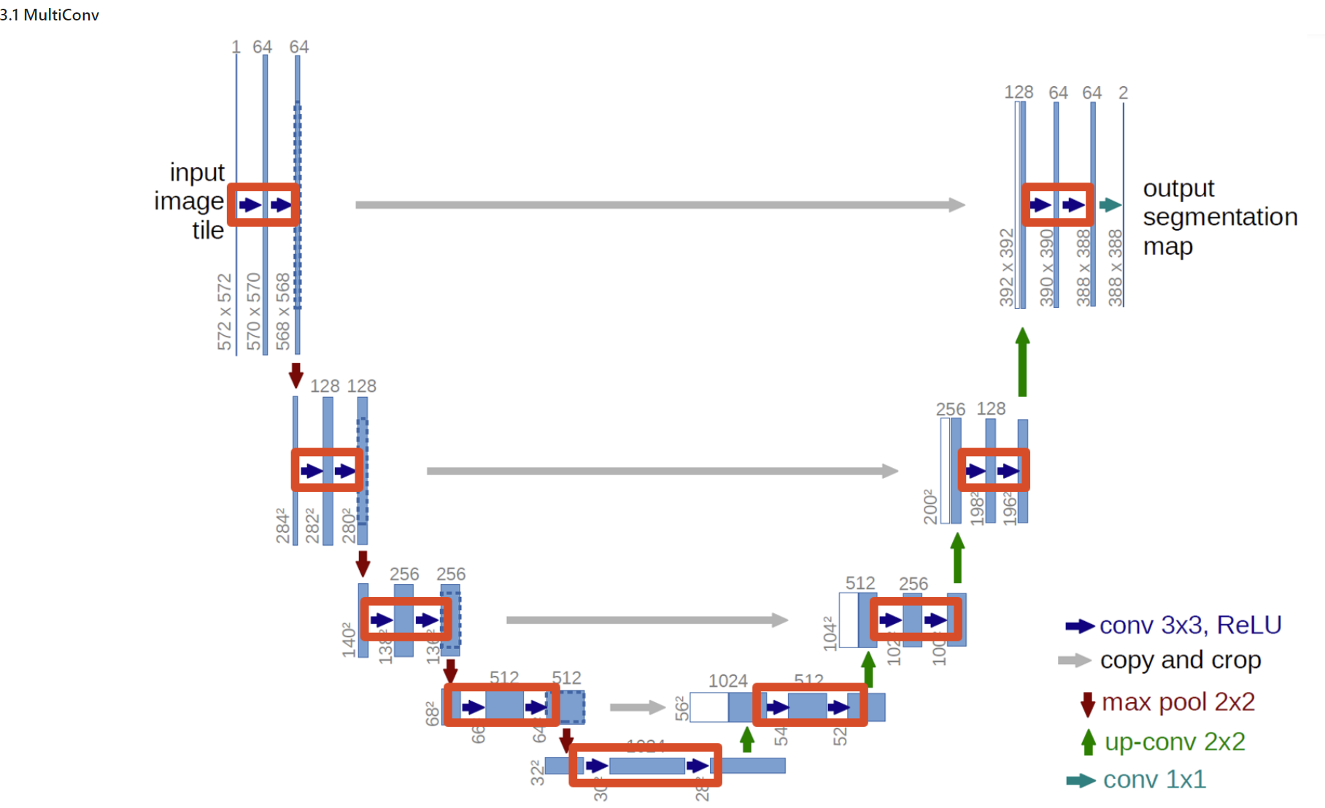
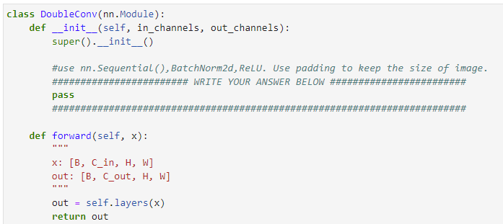
Part3 U-Net
DoubleConv

Slide 16
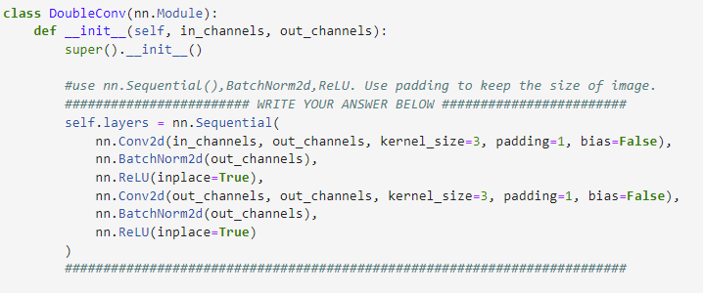
Part3 U-Net
DoubleConv (answers)

Slide 17
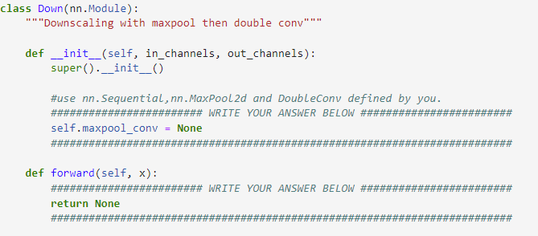
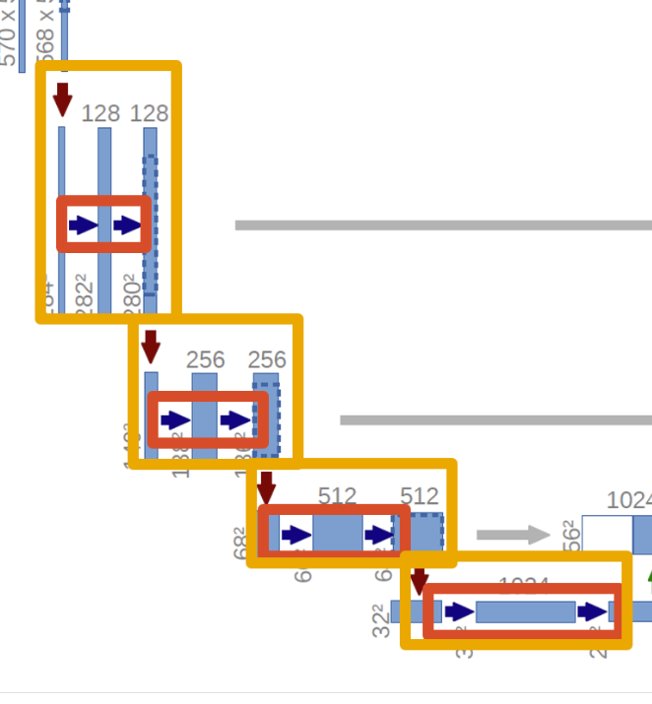
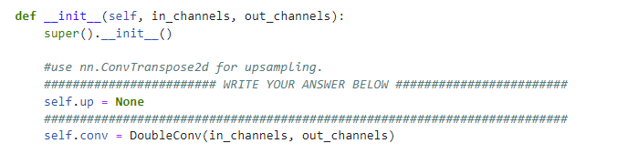
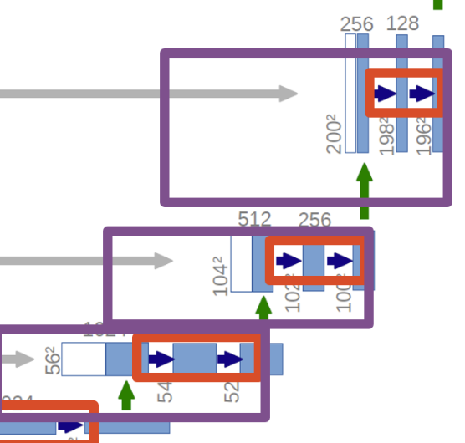
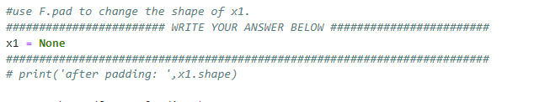
Part3 U-Net
Down/Up

Slide 18
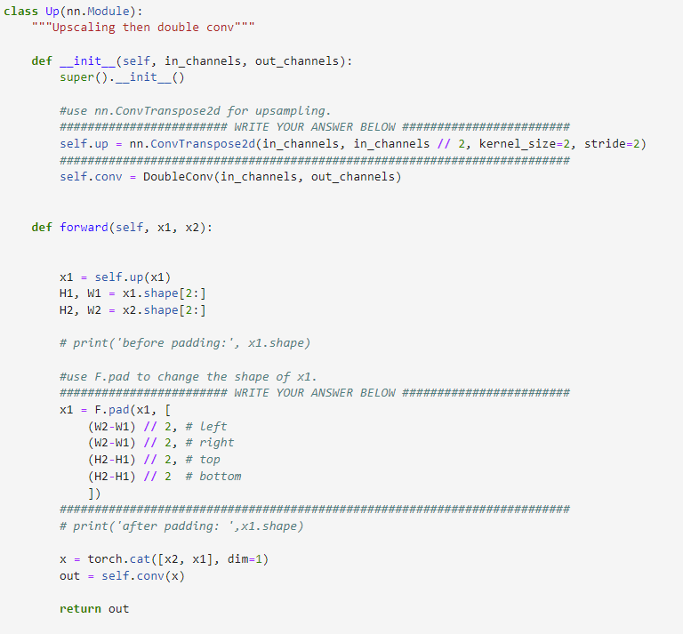
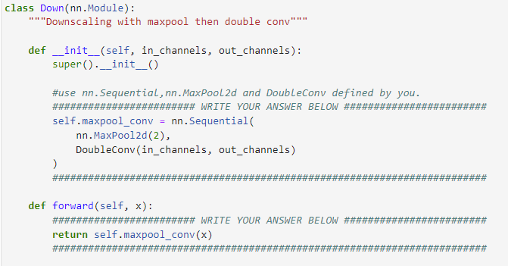
Part3 U-Net
Down/Up (answers)

Slide 19
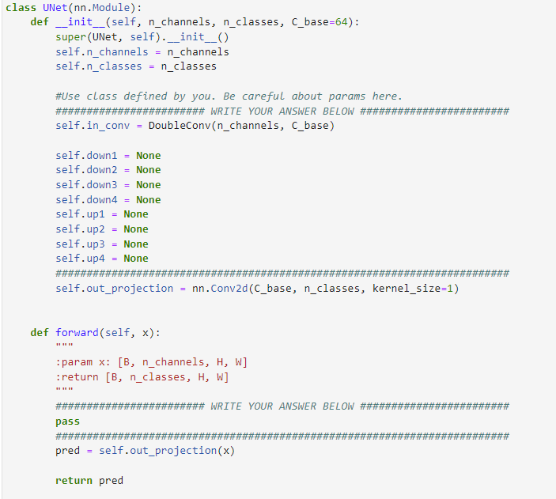
Part3 U-Net
Compose together

Slide 20
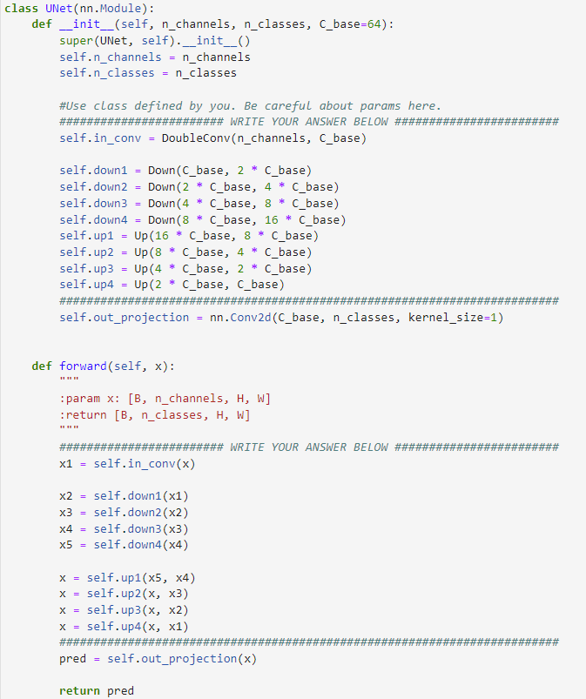
Part3 U-Net
Compose together (answers)

Slide 21
Part4 Binary cross-entropy
Common loss functions include the following:
BCELoss: Binary cross-entropy loss for binary classification.
sigmoid+BCEloss
CrossEntropyLoss: Categorical cross-entropy loss for multi-class classification.
softmax+CEloss
Notice: The CrossEntropyLoss provided in Pytorch has built-in softmax operation, so when using CrossEntropyLoss, there is no need to add an extra softmax activation function. However, the BCELoss in Pytorch requires a preceding sigmoid activation function.
MSELoss: Mean squared loss for regression.

Slide 22
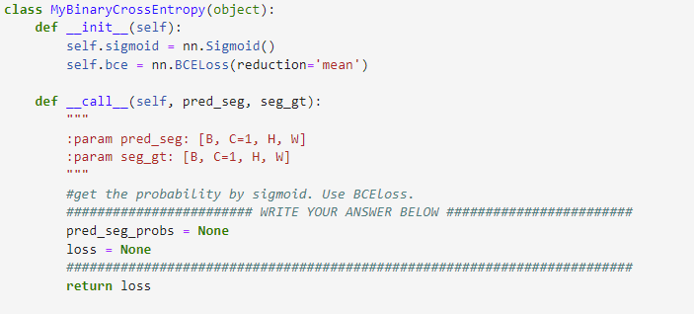
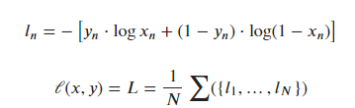
Part4 Binary cross-entropy

Slide 23
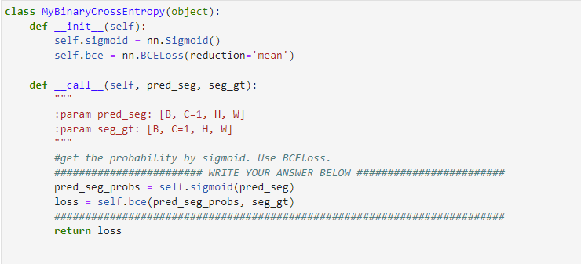
Part4 Binary cross-entropy (answers)

Slide 24


Part5 Train you segmentation network

Slide 25
Thanks!

