Slide 1


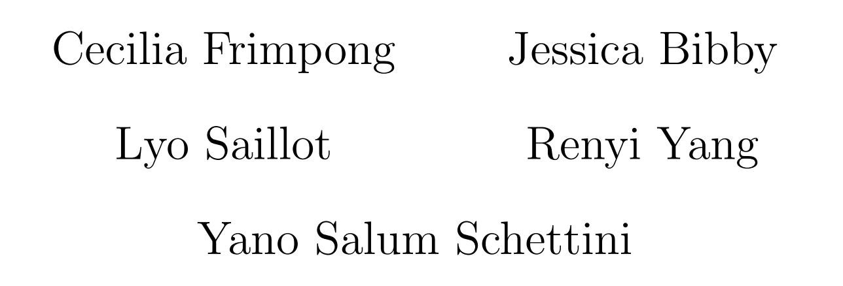
Data challenge 2026
Defective columns
Group - A
06/2026

Slide 2

Problem Introduction
Infrared Sensor Vertical Anomalies
The primary objective is to localize and repair defective column-wise structures inside 16-bit PNG infrared arrays. These defects stem from readout hardware anomalies and appear in three dynamic forms:
Noisy Columns
Blinking Columns
Fragmented Blinking
Persistently exhibit higher temporal noise compared to the background
Show sudden digital level shifts, either high or low frequency, over time.
Exhibit rapid temporal and spatial changes, with events appearing or disappearing per frame, possibly multiple times per column

Slide 3
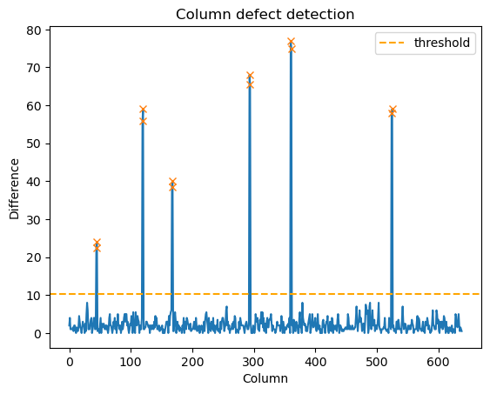
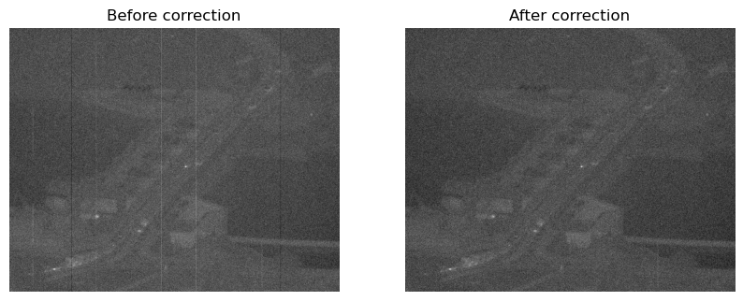
Detector 1: Difference in Median
Identifying Noisy Columns via Difference in Median in Infrared Frames
Concept
Defective columns have significantly higher or lower median pixel value than their neighbours. Noisy columns can then be detected with a high difference in median between consecutive columns.
Algorithm Steps
1
Median = np.median(img, axis=0)
2
Diff = np.abs(np.diff(median))
3
Threshold = 2.5 * np.mean(diff)
4
Noisy columns where diff > threshold
Performance: F1-score ≈ 0.26. Effective for isolated noisy columns. Misses groups of consecutive noisy columns, and small fragmented columns.
diff[i] = a[i + 1] - a[i]

Slide 4
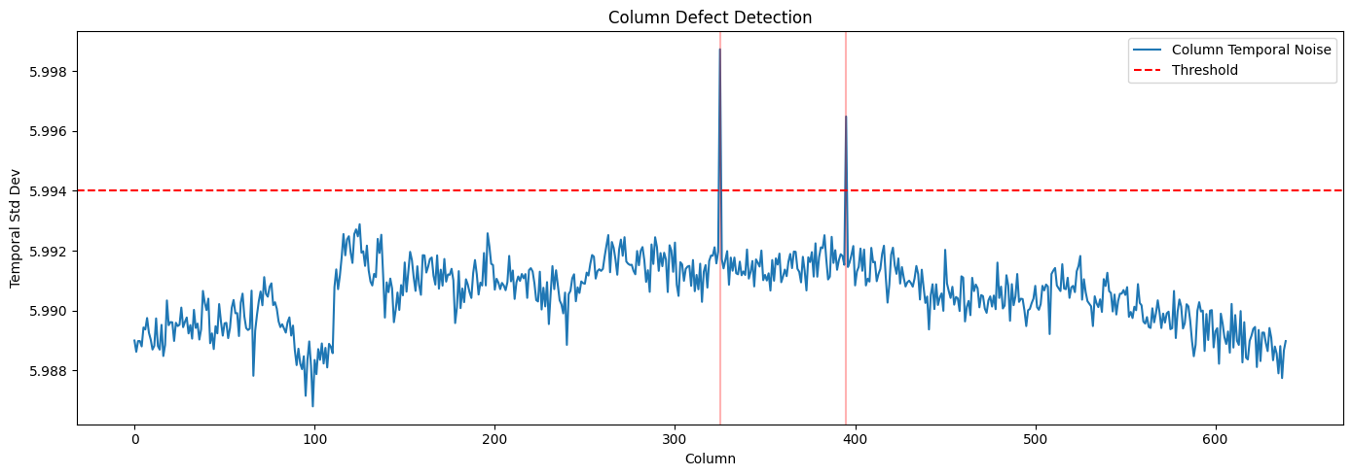
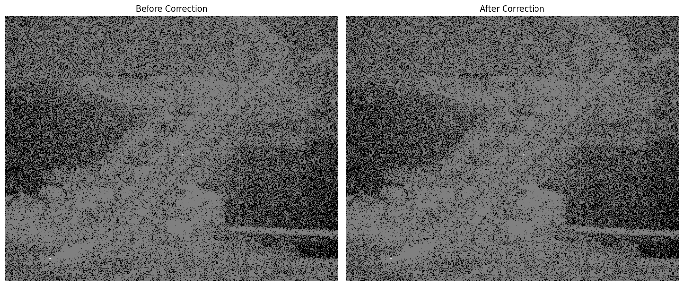
Detector 2: Temporal Standard Deviation
Identifying Noisy Columns via Temporal Noise Analysis in Infrared Sequences
Concept
Well-functioning columns vary primarily due to scene content and sensor noise. Noisy columns exhibit additional independent temporal variation, raising their standard deviation across frames.
Algorithm Steps
1
Stack loading: Read frames → 3D NumPy array (T, H, W)
2
Temporal std: np.std(stack, axis=0) per pixel
3
Column aggregation: np.mean(temporal_std, axis=0)
4
Threshold: column_noise > mean + k·std (k=3.0)
Performance: F1-score ≈ 0.5. Effective for prominent noisy columns; misses blinking & fragmented defects.
5
Correction: Median/mean interpolation from neighbors

Slide 5
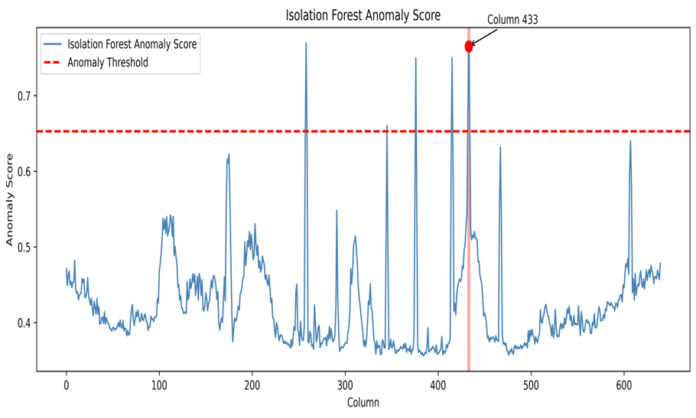
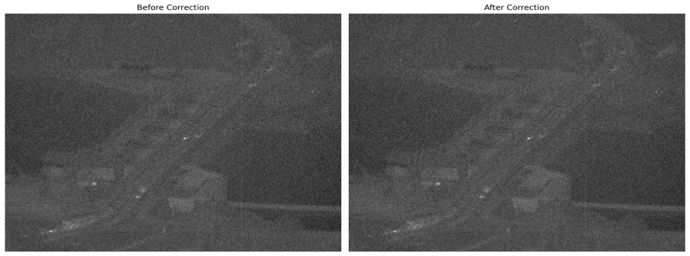
Detector 3: Isolation Forest
Identifying Noisy Column via Unsupervised Ensemble Partition Modelling
Concept
Compiles multidimensional statistical behaviors into a combined feature matrix per column. By treating columns as distinct observations, it avoids hard coded signal threshold
Algorithm Steps
1
Extract column-wise spatial and temporal statistical feature
2
Construct a feature matrix from the extracted descriptors
3
Compute anomaly scores for each image column
4
Validate detected defects against ground-truth annotations
Performance: Average score ≈ 0.49. Effective for detecting single isolated, defective column that stands out.
5
Correct defective columns using neighbouring-column interpolation.

Slide 6
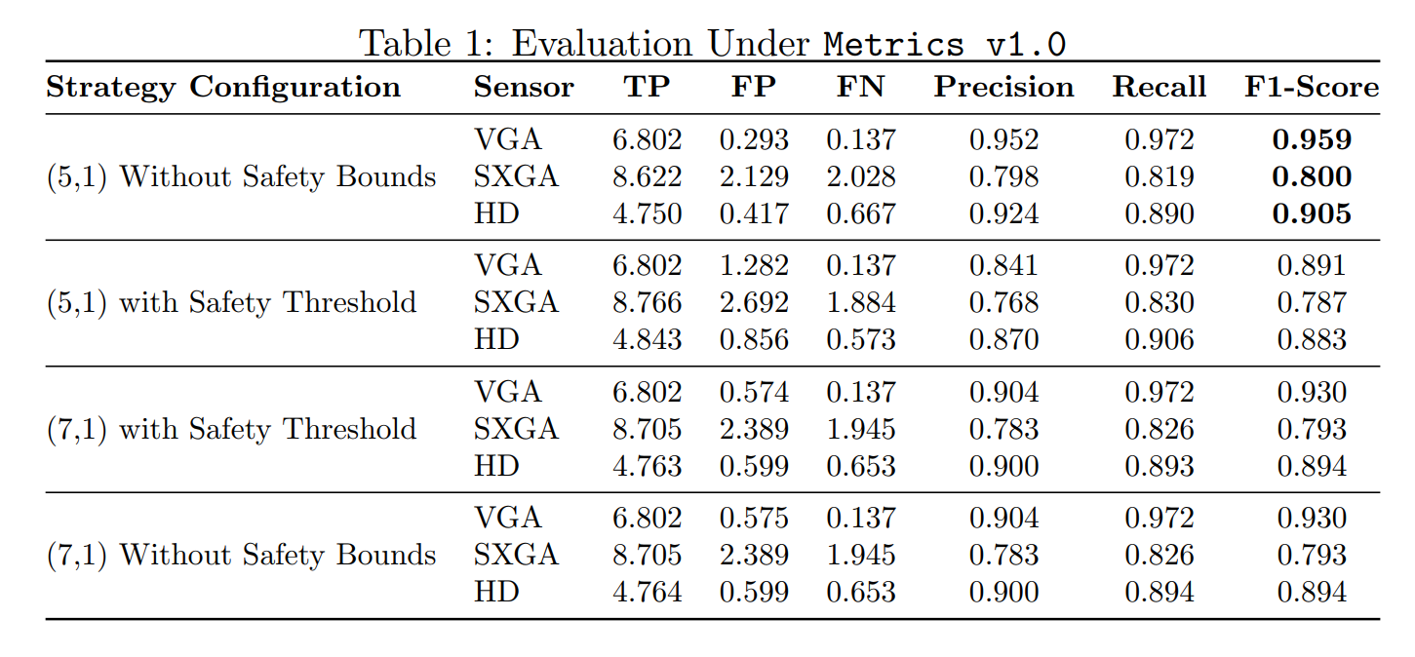
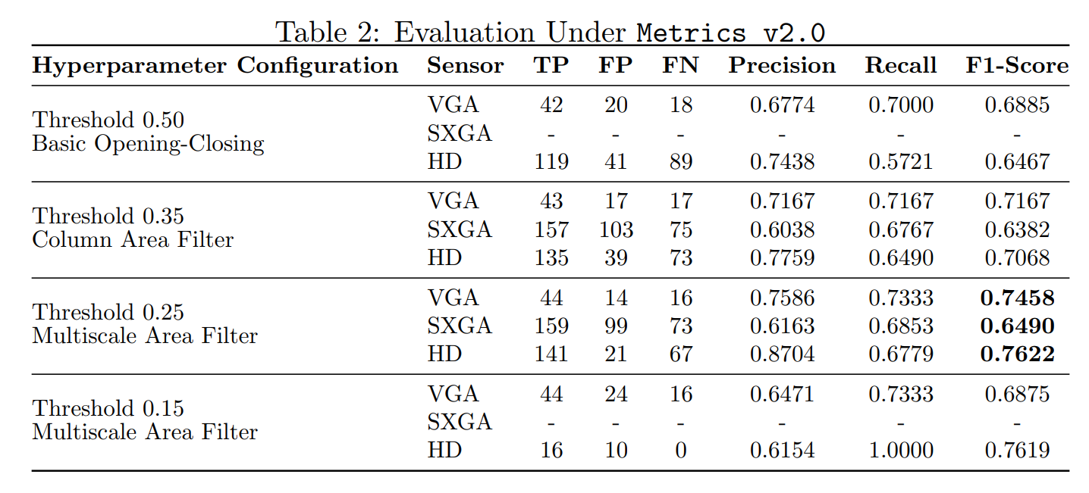
Detector 4: CNN
Identifying Noisy Columns via CNN
Concept
A 1D-CNN that designed for rapid column detection, optimized for resource-constrained camera.
A 2D-CNN that preserves the height dimension H,
allowing it to leverage localized vertical continuity.
Algorithm Steps
1
Dynamically sample 128 x 128 spatial patches
2
Conv2d with a kernel size of (7, 3) and padding (3, 1)
3
Conv2d with a kernel size of (5, 3) and padding (2, 1)
4
1 × 1 convolution mapped through a Sigmoid activation
Performance: F1-score ≈ 0.5. Effective for prominent noisy columns; bad at noisy blinking via frames.
5
Morphological Post-processing

Slide 7
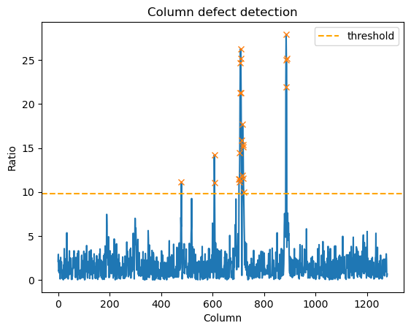
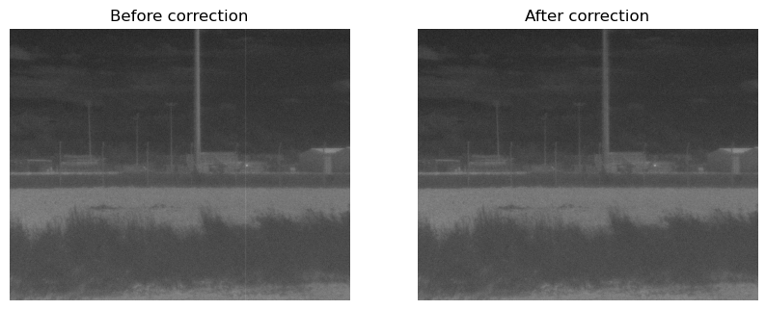
Detector 5: Local Mean
Identifying Noisy Columns via Local Mean of Medians in Infrared Frames
Concept
Modified version of the first detector to detect groups of noisy columns using local mean instead of the difference with the single previous column.
Algorithm Steps
1
median = np.median(img, axis=0)
2
local_mean = uniform_filter1d(median, size=20)
3
ratio = np.abs(median - local_mean)
4
threshold = 3 * np.std(ratio) + np.mean(ratio)
Performance: F1-score ≈ 0.57. Effective for noisy columns. Misses small fragmented columns. Our final version.
5
Noisy columns where ratio > threshold

Slide 8
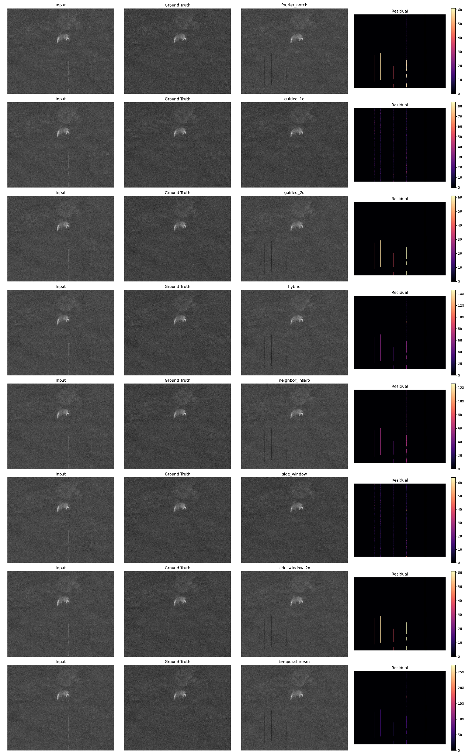
Correction - Evaluation & Failure Analysis
Visual comparison of all tested correction methods on SXGA sequence 1, column 3, frame 43.

Slide 9
Correction - Side-Window Filter
X_{correct} = X_{raw} - S
1D Processing
Side-Window Filter prevents edge blurring
Preserves raw infrared radiometric data
Shao et al. (2021). Infrared Physics & Technology.
He et al. (2025). IEICE Transactions on Fundamentals

Slide 10
Results
Sensor | F1 | RMSE_{𝑑𝑒𝑓𝑒𝑐𝑡𝑖𝑣𝑒} | RMSE _{ok} | Final Score
HD | 0.51 | 0.74 | 0.97 | 0.74
SXGA | 0.52 | 0.70 | 0.97 | 0.73
VGA | 0.70 | 0.73 | 0.99 | 0.80
Final total score: 0.75

Slide 11


