Slide 1
NIXL S3 over RDMA: KV Cache Offloading
End-to-End Benchmark Results
NIXL RDMA + Ceph RGW + DAOS | 100GbE RoCEv2 | 3-Node Cluster

Slide 2
System Architecture
3-Node Testbed:
hsc-12 (NIXL Client): Docker container, DRAM buffers, RDMA NIC (mlx5)
hsc-14 (Ceph RGW): S3 gateway, RDMA server, pre-registered 512MB staging buffer
hsc-21 (DAOS Storage): 4x NVMe SSDs, DAOS server with UCX RDMA transport
Network: 100GbE RoCEv2 (Mellanox ConnectX-5/6)
PUT Data Path (NIXL -> Ceph -> DAOS):
1. NIXL sends HTTP PUT with Content-Length=0 + x-amz-rdma-token header
2. Ceph RGW parses token, issues RDMA_READ to pull data from NIXL memory
3. Data lands in pre_buf_ (zero-copy), single atomic ds3_obj_write() to DAOS
4. HTTP 200 returned after DAOS write completes
GET Data Path (DAOS -> Ceph -> NIXL):
1. NIXL sends HTTP GET with x-amz-rdma-token header
2. Ceph RGW reads from DAOS directly into pre_buf_ (zero-copy)
3. Issues RDMA_WRITE to push data to NIXL memory
4. HTTP 200 returned, data already in NIXL buffer
Key Optimizations:
- Zero-copy: pre_buf_ shared between RDMA and DAOS (no memcpy)
- 1MB RDMA chunking with sliding window (max_qp_rd_atom=16)
- MD5 hash skipped (RDMA CRC provides hardware integrity)
- Content-Length=0 eliminates HTTP body-drain overhead

Slide 3
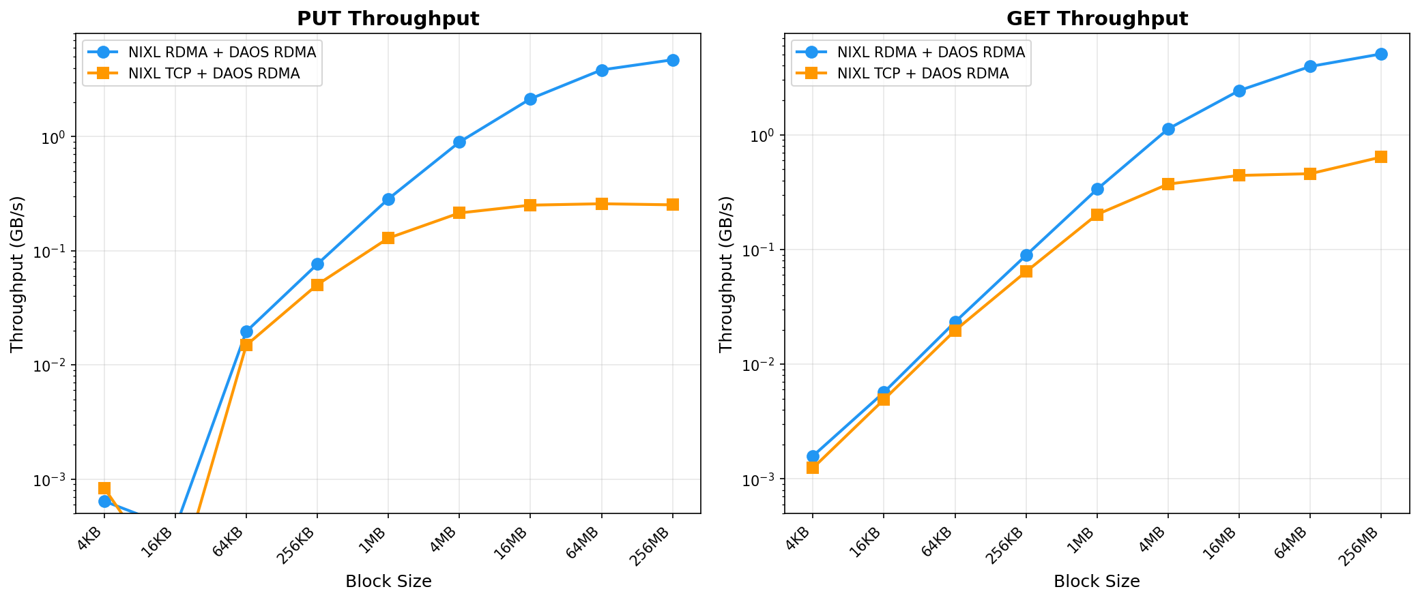
Throughput: NIXL RDMA vs TCP (DAOS RDMA backend)

Slide 4
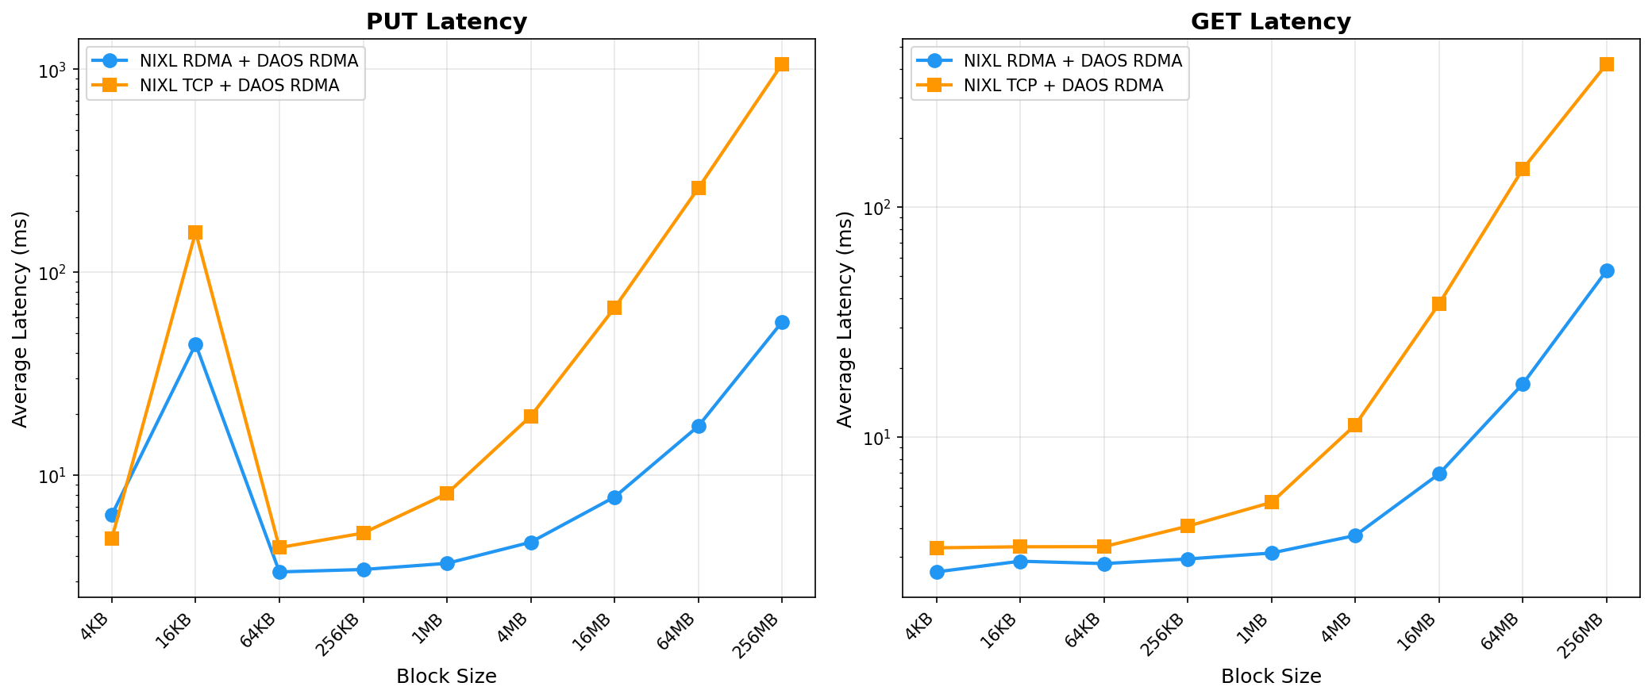
Latency: NIXL RDMA vs TCP (DAOS RDMA backend)

Slide 5
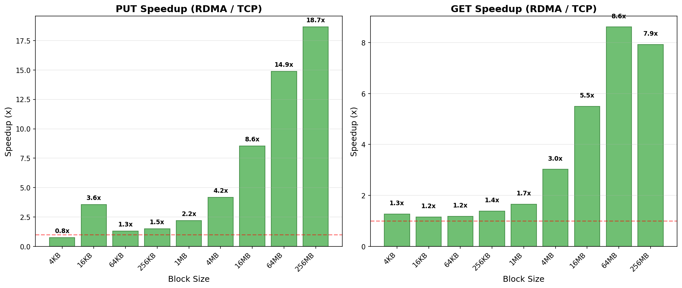
RDMA Speedup over TCP

Slide 6
Detailed Results: Throughput (GB/s)
Config | 4KB | 16KB | 64KB | 256KB | 1MB | 4MB | 16MB | 64MB | 256MB
RDMA+RDMA PUT | 0.001 | 0.000 | 0.020 | 0.076 | 0.285 | 0.897 | 2.15 | 3.85 | 4.72
RDMA+RDMA GET | 0.002 | 0.006 | 0.023 | 0.089 | 0.336 | 1.13 | 2.43 | 3.95 | 5.07
TCP+RDMA PUT | 0.001 | 0.000 | 0.015 | 0.050 | 0.129 | 0.215 | 0.251 | 0.258 | 0.253
TCP+RDMA GET | 0.001 | 0.005 | 0.020 | 0.064 | 0.202 | 0.372 | 0.442 | 0.458 | 0.640

Slide 7
Benchmark Configuration
Block Sizes: 4KB, 16KB, 64KB, 256KB, 1MB, 4MB, 16MB, 64MB, 256MB
4KB-64MB Configuration:
PUT: 12,000 iterations, 0 warmup, 12,000 prepop objects
GET: 8,192 iterations, 1,024 warmup, 12,000 prepop objects
Threads: 1 (sequential, single QP)
256MB Configuration:
PUT: 6,000 iterations, 0 warmup, 6,000 prepop objects
GET: 4,096 iterations, 512 warmup, 6,000 prepop objects
Data budget: 6000 x 256MB = 1.5TB < 2TB DAOS pool limit
RDMA Configuration:
Transport: Reliable Connection (RC), single QP per client
Chunk size: 1MB per RDMA WR (matches DAOS DFS_DEFAULT_CHUNK_SIZE)
Sliding window: max 16 in-flight WRs (max_qp_rd_atom=16)
Pre-registered buffer: 512MB on Ceph RGW (zero-copy for both PUT and GET)
Integrity: RDMA ICRC-32 hardware verification (MD5 skipped)
Ceph RGW:
Version: 18.2.7 (Pacific) with DAOS backend
rgw max chunk size: 67,108,864 (64MB)
Single-threaded beast HTTP frontend
DAOS:
Transport: UCX dc_x (RDMA) or UCX tcp
Pool: 2TB, 4x NVMe SSDs
DFS chunk size: 1MB (data striping)

Slide 8
Key Findings
Peak Throughput:
RDMA PUT: 4.72 GB/s | RDMA GET: 5.07 GB/s
TCP PUT: 0.26 GB/s | TCP GET: 0.64 GB/s
Speedup: PUT 18.3x | GET 7.9x
Per-request HTTP overhead: ~2.5ms (dominates for small objects)
Small objects (<1MB): latency-bound, ~400 req/s regardless of RDMA/TCP
Large objects (>16MB): bandwidth-bound, RDMA shows full advantage
Zero-copy design eliminates memcpy on critical path:
PUT: RDMA_READ -> pre_buf_ -> ds3_obj_write (same buffer)
GET: ds3_obj_read -> pre_buf_ -> RDMA_WRITE (same buffer)
Compatible with cuObject protocol (x-amz-rdma-token header)
Standard S3 API, backward compatible with TCP clients
Control plane: HTTP (auth, metadata) | Data plane: RDMA (payload)
Implications for KV Cache Offloading:
50GB KV cache (Llama 405B, 128K context):
RDMA: 9.9s | TCP: 78s | Recompute: minutes
S3 provides petabyte-scale capacity at commodity cost

