Slide 1
A.L. Agents
Brett Layman

Slide 2
What is AL Agents?
AL Agents is a program for modeling multi-agent systems:
Agents are autonomous and independently controlled
Agent behavior guided by neural networks (non-linear)
Populations of agents evolve
Useful for studying:
Evolution: rates, specialization, coevolution
Ecology: cooperation, competition, emergent phenomena
Other complex systems: economics

Slide 3
AL Agents Overview
Ecosystem creation
Create environment (2D land grid)
Distribute resources
Distribute populations of agents
Simulation
Turn based
agents interact with environment:
Consume or drop resources
Move (4 directions)
And interact with other agents:
Fight
Reproduce
Communicate

Slide 4
Previous Work on G.A. Based Ecosystem Models
Holland’s Echo model
Agents can trade, fight, and mate
String matching rules based on “phenotype”
Observed: arms races, symbiotic relationships
Ackley and Littman’s Evolutionary Reinforcement Learning (ERL) model
“Evaluation” and “action” neural nets
World contains plants, carnivores, and agents
Observed the Baldwin Effect
Bedau and Packard’s “Strategic Bugs” model
Bugs move, eat, and reproduce
Genes stored in look-up table of input-action pairs
Measured evolutionary activity by looking at gene use

Slide 5
Differences From Previous Work
AL Agents only contains agents and land spaces. There are no non-agent predators and plants.
Agents in AL Agents have a memory of past states, and can use this to guide future decisions.
AL Agents uses neural networks, but not reinforcement learning. Learning may be integrated via classical and operant conditioning.
There are explicit actions for fighting, mating, communicating, eating, moving, etc., but not for trading.
Many phenomena in AL Agents, including trading, are expected to evolve via communication between agents.
AL Agents could measure evolutionary activity by looking at how the weights in the neural nets change over time in a population. (randomly or based on a trend)

Slide 6
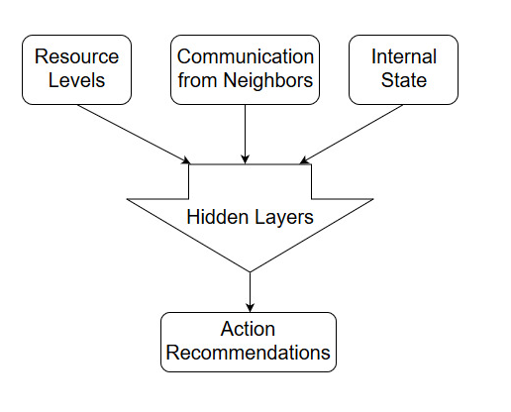
Neural Network Architecture

Slide 7
A Turn In the Life of an Agent
Feed inputs into neural networks, producing action suggestions.
Add actions to action priority queue.
Remove old actions from queue (optional).
Complete as many actions within time given.
Decrease or increase levels of different resources and health according to action costs and outcomes.
Move agent if a movement actions is performed. Produce new Agent if a reproduction action is performed.
If agent’s health drops to 0, the agent dies.

Slide 8
End Goals
The user will be able to create a custom environment, and populate it with custom agents and resources.
Populations of agents will learn over time via a genetic algorithm.
Agents will be able to perform actions such as: movement, reproduction, communication with other agents, adding and dropping resources, and attacking other agents.
The user will be able to visualize how resources and agents are distributed across the environment, as well as agent characteristics.

Slide 9
Timeline
December – January:
Start working on user interface
Verify that agent networks are working properly
Make simple simulation where agents move
Get agent reproduction to work
February – March:
Transition simulation to separate thread
Continue working on user interface
Train agents to learn a resource gradient
April – May
Display population statistics, or write them to a csv file
Demonstrate agent cooperation via communication
Incorporate memory inputs

Slide 10
Development Lifecycle
Iterative Model
Requirements -> design -> implementation -> testing.
First iterations more focused on requirements and design.
Layer iterations more focused on testing and implementation.
Overall design is refined and elaborated on over time.
One iteration may correspond to one use case:
Creating a agent
Populating a map with agents
Running one turn for a agent

Slide 11
References
D. H. Ackley and M. L. Littman. Interactions between learning and evolution. In C. G. Langton, C. Taylor, J. D. Farmer, and S. Rasmussen, editors, Artifcial Life II, pages 487{507, Reading, MA, 1992. Addison-Wesley.
M. A. Bedau and N. H. Packard. Measurement of evolutionary activity, teleology, and life. In C. G. Langton, C. Taylor, J. D. Farmer, and S. Rasmussen, editors, Artifcial Life II, pages 431{461, Reading, MA, 1992. Addison-Wesley.
J. H. Holland. Echoing emergence: Objectives, rough defnitions, and speculations for Echo-class models. Technical Report 93-04-023, Santa Fe Institute, 1993. To appear in Integrative Themes, G. Cowan, D. Pines and D. Melzner, Reading, MA: Addison-Wesley.
M. Mitchell and S. Forrest, “Genetic algorithms and artificial life,” Artificial Life, vol. 1, no. 3, pp. 267–289, 1995.

