Slide 1
Evolution of Intelligence and Complexity
Artificial Life for Artificial Intelligence INFO-I486/586 Aaron Kahn Kevin Millard Justin Hinman

Slide 2
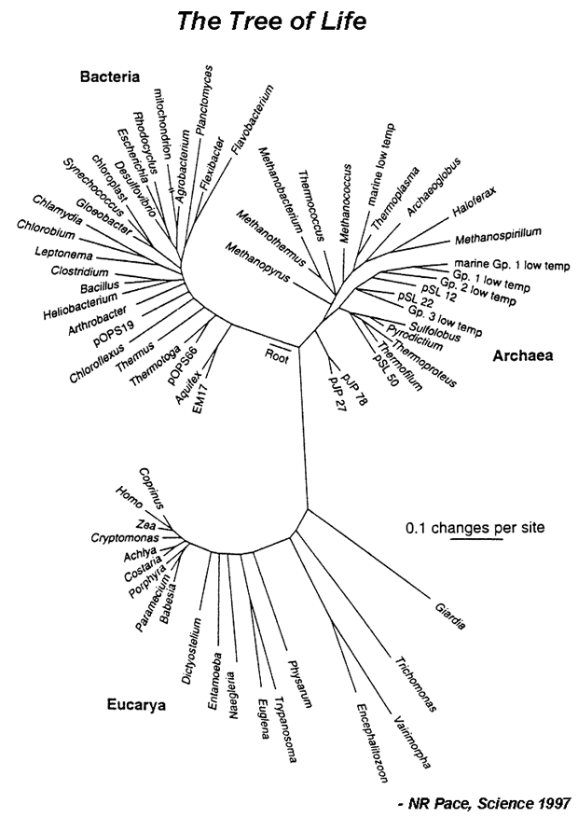
Evolution of Complexity

Slide 3
Evolution of Complexity and Intelligence of Biological Organisms
Instincts
Evolutionary of Self-Organization
Cliff Joslyn’s “Global Brain”
People are being linked together due to the internet in which we act like a single processing system that functions like a brain.
Collective Intelligence
Similar to Global Brain, but differs in that instead of only being linked because of the internet we are linked as social groups.

Slide 4
Measures of Human Intelligence
IQ tests
Two Theories:
Single Intelligence
General Intelligence
Multiple Intelligence
Proposed by Howard Gardner
9 basic types of intelligence
Visual, Verbal, Logical, bodily, musical, interpersonal, intrapersonal, naturalistic, and existential.

Slide 5


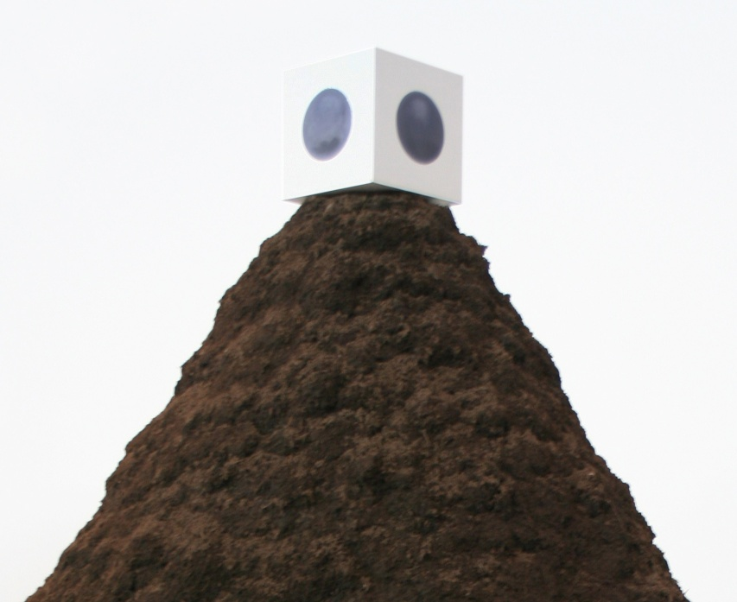
Future Evolution of Humanity?

Slide 6
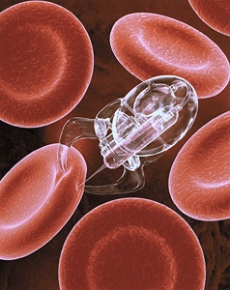
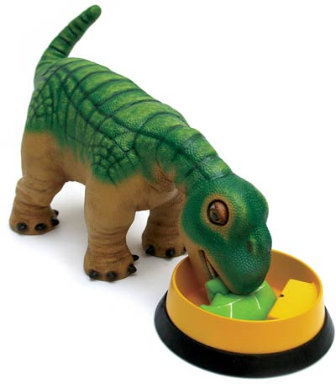
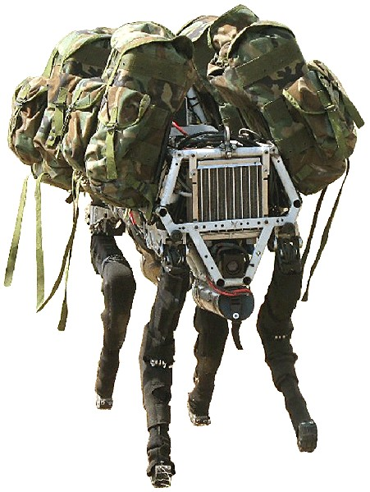
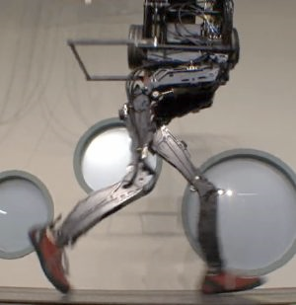
Complexity of Artificial Organisms
Aritificial Intelligence that does not try to emulate human intelligence.
Nanites
Pleo
Big Dog
Petman

Slide 7
Nanorobotics (Nanites)
Robots on a microscopic scale (10⁻⁹ meters).
Can self-replicate using materials from the environment.
Potential Uses:
Nanomedicine – inject nanorobots into patients to perform treatment on a cellular level.
Ending the world (gray goo) – hypothetical end-of-the-world scenario in which out-of-control self-replicating robots consume all matter on Earth while building more of themselves.

Slide 8
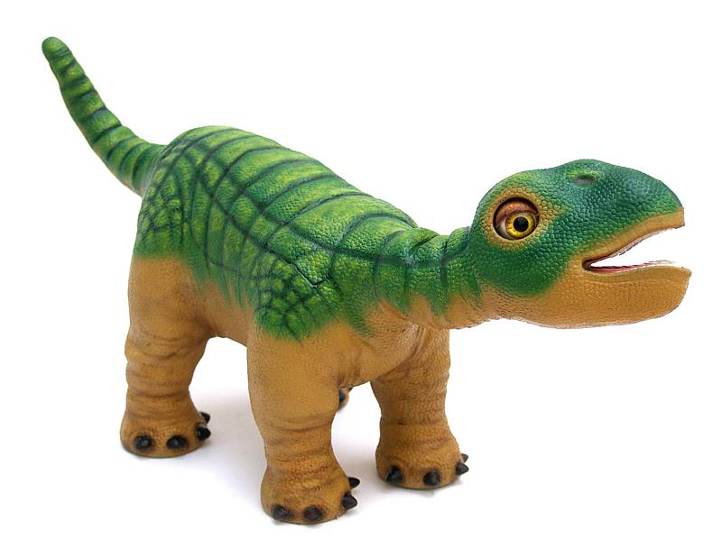
Pleo
Animatronic baby dinosaur toy (pet)
Learns from its experiences and environment
Develops an individual personality
Notes:
April 2009: Ugobe (creators of pleo) laid off all employees and filed for bankruptcy.
camera-based vision system (for light detection and navigation)
two microphones, binaural hearing
beat detection (allows pleo to dance and listen to music).
eight touch sensors (head, chin, shoulders, back, feet)
four foot switches (surface detection)
fourteen force-feedback sensors, one per joint
orientation tilt sensor for body position
infrared mouth sensor for object detection into mouth
two-way infrared communication with other Pleos
Mini-USB port for online downloads
SD card slot for Pleo add-ons
infrared detection for external objects
32-bit Atmel ARM7 microprocessor (main processor for Pleo)
32-bit NXP ARM7 sub-processor (camera system, dedicated audio input processor)
four 8-bit processors (low-level motor control)
http://www.youtube.com/watch?v=E0C55PEcj5E#t=02m30s
http://video.syfy.com/online_originals/dvice/dvice_tv/torturing-pleo/v198491

Slide 10
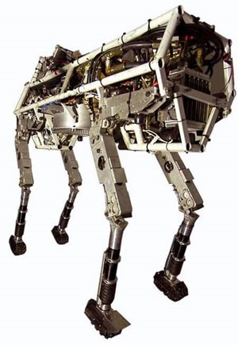
BigDog
Dynamically stable quadruped robot created by Boston Dynamics.
About the size of a small mule.
Funded by DARPA in the hopes that it will be able to serve as a robotic pack mule to accompany soldiers in terrain too rough for conventional vehicles..
Notes:
*3 Feet tall, weighs 240 pounds.
*Capable of traversing difficult terrain at 4MPH, carrying 340 pounds, and climbing a 35 degree incline.
*Big Dog is powered by a two-stroke, one-cylinder, 15-HP go-kart engine operating at 9,000 RPM.
*The engine drives a hydraulic pump, which in turn drives the hydraulic leg actuators.
*Each leg has four actuators (two for the hip joint, and one each for the knee and ankle joints), for a total of 16.
*Each actuator unit consists of a hydraulic cylinder, servovalve, position sensor, and force sensor.

Slide 12
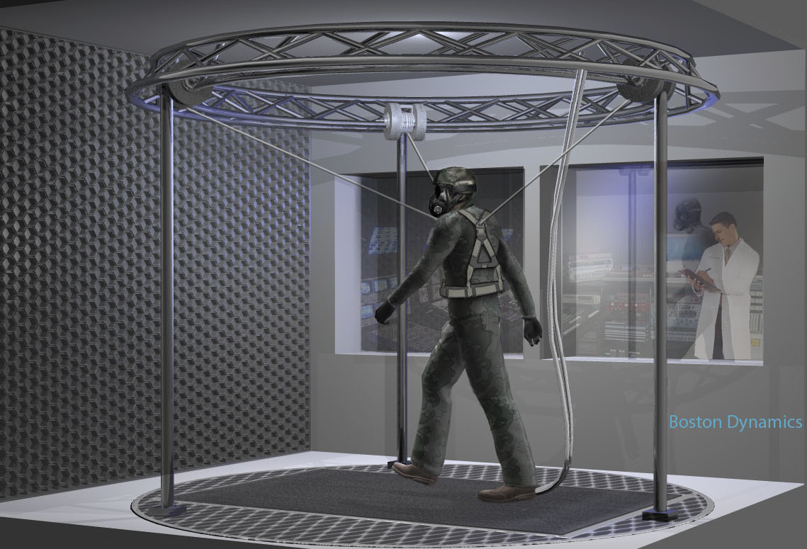
PETMAN
Robot that walks like a human, also from Boston Dynamics.
Used for testing chemical protection suits used by the US Army.
Notes:
*Natural, agile movement is essential for PETMAN to simulate how a soldier stresses protective clothing under realistic conditions.
*The robot will have the shape and size of a standard human, making it the first anthropomorphic robot that moves dynamically like a real person.
*The development program has a 13 month design phase followed by a 17 month build, installation and validation phase, with delivery of the robot taking place in 2011.

Slide 14
Complexity of Artificial Organisms
On the other side of the complexity spectrum, there are organisms that are clearly robotic, but start to give the illusion of “human” intelligence or actions
Sort of…

Slide 15
Speaking of building from the ground up…
Studying nature to improve complex artificial actions
Robots inspired by animals
Notes:
Shows how we should be starting with smaller, less complex organisms to create bigger, more complex orgranisms

Slide 17
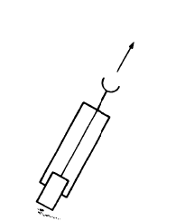
Braitenberg’s Vehicles
Complexity generated through simple vehicles that get progressively more complicated
Clearly not humanoid, but exhibit some intelligent behaviors
With more complexity, could it pass the Turing test?
Senses, memory, emotion…it’s possible

Slide 18
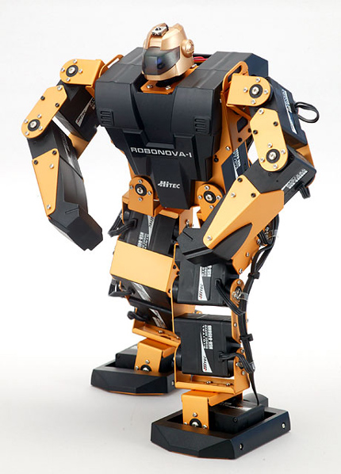
Robonova
Small robotics platform
16 motors and servos
Simulate a large variety of actions
Even more if a gyroscope and/or accelerometer are added
Given a bit more memory, could definitely lead to much more complex actions
Probably wouldn’t be able to pass the Turing test though
Notes:
If time, play the video <http://www.youtube.com/watch?v=5PK3YWcDzC4&feature=related>

Slide 19
Animatronics
“is the use of electronics and robotics in mechanized puppets to simulate life” ---Wikipedia
Common in theme parks, movies, television, etc
Motions and dialogs are all scripted (usually), but are so complex that they have been known to fool people at theme parks occasionally
For the ones that can carry on (limited) conversations, passing the Turing test is definitely a possibility

Slide 20
Robots
Varying levels of complexity depending on the robot, but some are getting even closer to emulating human intelligence, actions, and mannerisms
Just to name a few...
“Perfect Woman” Robot, Actroid Female Robot, TrueCompanion’s Roxxxy, Supermodel Robot
Robotic Musicians, Honda’s ASIMO, Mitsubishi’s Wakamaru, Robotic Chefs
Playing games (Soccer, Tetris, etc)
Notes:
Playing games: Soccer, Tetris (if time, Play Tetris video)
<http://www.youtube.com/watch?v=wY83EaE7svA>
Robotic musicians (Play Violin video)
<http://www.youtube.com/watch?v=EzjkBwZtxp4>
Play ASIMO video for sure.
<http://www.youtube.com/watch?v=Q3C5sc8b3xM&feature=related>
Wakamaru is a limited bot that can help the elderly and have some conversations; also calls for help if needed
Perfect Woman (more like animatronics from the video), Actroid Female Robot, Supermodel Robot, and Roxxxy are all designed to act/look/feel like real women.
Actroid is being marketed as a “realistic female andriod” (again, more like animatronics)
Supermodel Robot (minus the storm trooper getup) looks very close to real, and the motions are getting better
* Roxxxy is a sex bot, but marketed as a “companion bot”

Slide 21
Notes:
Actroid Female Robot

Slide 22
Notes:
Asimo

Slide 23
Notes:
Tetris-Bot

Slide 24
Where to from here?
Singularity
Closing comments

Slide 25
Links
Pleo
http://www.youtube.com/watch?v=E0C55PEcj5E#t=02m30s
Big Dog
http://www.youtube.com/watch?v=b2bExqhhWRI
PETMAN
http://www.youtube.com/watch?v=67CUudkjEG4
Robonova
http://www.youtube.com/watch?v=5PK3YWcDzC4&feature=related
http://therawfeed.com/pix/robonova-1.jpg
Animatronics
http://en.wikipedia.org/wiki/Audio-Animatronics
Tetris-Bot
http://www.youtube.com/watch?v=wY83EaE7svA
Robots Inspired by animals
http://www.youtube.com/watch?v=Tq8Yw19bn7Q
Dancing Sony Robots
http://www.youtube.com/watch?v=9vwZ5FQEUFg
Asimo
http://www.youtube.com/watch?v=Q3C5sc8b3xM&feature=related
Supermodel Robot
http://www.youtube.com/watch?v=vUpBNSyWAaU&feature=channel
"Perfect Woman"
http://www.youtube.com/watch?v=i2wYWAlg8Do&feature=related
Actroid Female Robot
http://www.youtube.com/watch?v=WbFFs4DHWys&feature=related
Robot Chef
http://www.youtube.com/watch?v=CNSKMGurrPI&feature=related
Wakamaru
http://en.wikipedia.org/wiki/Wakamaru
Robot Violinist
http://www.youtube.com/watch?v=EzjkBwZtxp4

