Slide 1
An Introduction to Artificial Life:
Applications in Software
By: Joy Jung, Adam Cox, James Denton

Slide 2
What is needed to create artificial life software?
Artificial intelligence for our intelligent agents
(Artificial) Life, as we know it…
Simulated environment (this implies physics too)
Evolutionary models
Genetic Algorithms [see future presentation]
Fitness Functions (what our agent must accomplish in its life, and thereby evolve toward, such as distance traveled, # of offspring, height jumped, etc…)
Crossover & Mutation

Slide 3
Artificial Intelligence
(Remember there are many accepted definitions, but here are a few that summarize it well)
“…the science and engineering of making intelligent machines, especially intelligent computer programs…”
~John McCarthy
“…the capability of a device to perform functions that are normally associated with human intelligence, such as reasoning and optimization through experience.”
“…the ability of a computer or other machine to perform those activities that are normally thought to require intelligence.”

Slide 4
Artificial Life
“…the study of man-made systems that exhibit behaviors characteristic of natural living systems.”
~Langton
“…is a field of study and an associated art form which examine systems related to life, its processes, and its evolution through simulations using computer models, robotics, and biochemistry.”
~Wikipedia

Slide 5
AI vs. ALife
Langton would remind us of problems with Artificial Intelligence:
AI is based off of systems we don’t yet understand (the brain)
Top-down approach too difficult: trying to build the final result of eons of evolution.
ie. An advanced neural network of humanoid complexity. (Commander Data)
Artificial Life has advantages over AI because:
Bottom-up approach: Let evolution do the work.
“Life will find a way…”
Focus on instilling our agents with mechanisms of behavior, which are known and understood.

Slide 6
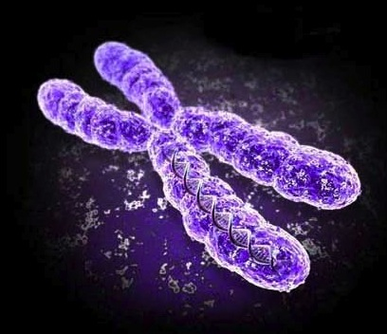
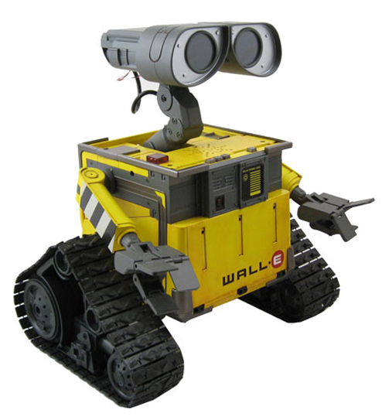
Artificial Life: Types
Wet Artificial Life:
Genetic Engineering
Plant/Animal Breeding
Synthetic Organisms
Mycoplasma laboratorium
Hard Artificial Life:
Hardware
Robotics
And finally, Soft Artificial Life, the focus of this presentation.
Applications in Software →

Slide 7
Artificial Life Software allows..
..the implementation of artificial intelligence in visual medium to create graphical characters (agents) that exist in simulated environments.
..a means to study biology by applying evolutionary models that evolve aspects of our graphical agents such as body shape or neural complexity.
..a unique method to observe emergent properties of life, biology, and evolution.

Slide 8
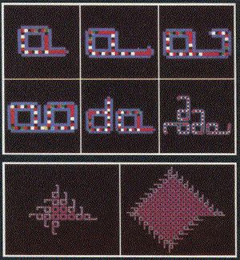
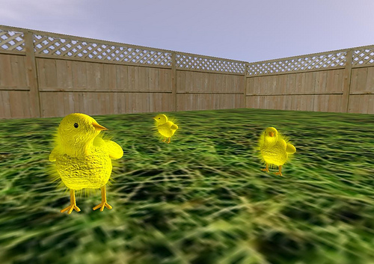
Artificial Life Software: Examples
aLife software is abundant, and spans the range from simple cellular automata in java applets, to entire 3D worlds. Some examples might include:
Polyworld, Boids, Swarm, Netlogo, Framesticks, …
aLife software links: http://alife.org/links.html
We are going to examine these three examples in depth:
Sugarscape
Avida
Breve

Slide 9
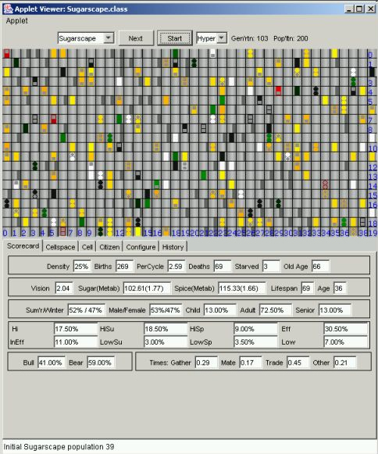
Sugarscape
Social Science
Model of human’s social behavior
JAVA
J. Epstein and R. Axtell

Slide 10
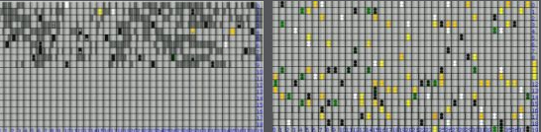
Sugarscape
“artificially intelligent” agent-based social simulation

Slide 11
Avida
Avida is an artificial life software platform to study the evolutionary biology of self-replicating and evolving computer programs (digital organisms).
A full-fledged research platform with the flexibility to address diverse questions relating to the physics of the living state.
Digital organisms are subjected to external pressures or environments and forced to adapt.
With the help of the avida system, we are able to test theories of molecular evolution, and influence theory formation itself.

Slide 12
Avida-Ed
One of the most rewarding things to do with faster evolution is to use it for teaching students principles of evolutionary biology.
The Avida-ED Project puts an educational version of Avida together with supporting curricular materials for use in undergraduate biology lab courses.
Guided exercises built around such inquiry-based experiments can also help students learn about the nature of scientific evidence and reasoning.

Slide 13
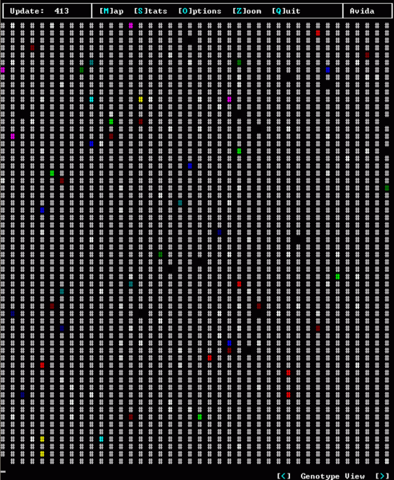
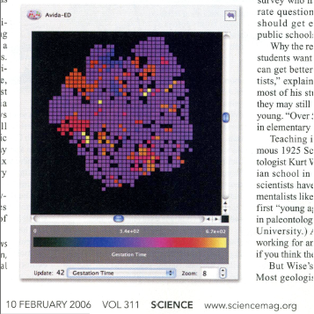

Slide 14
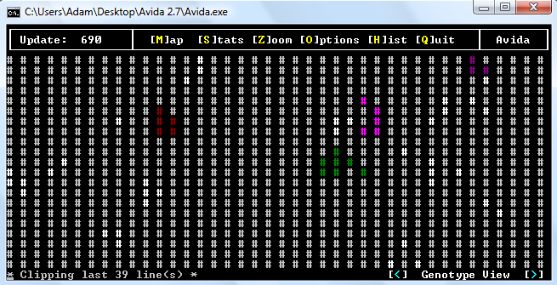
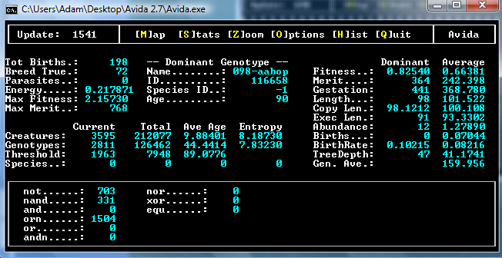

Slide 15
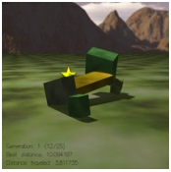
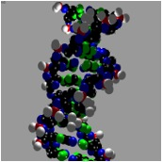

Breve
A simulation environment, allows users to define behaviors and interactions of different agents in a simulated 3D world and observe emergent behaviors.
Agent behaviors are Programmable by the user: either in python or the “steve” scripting language.
Simulations occur in the 3D world in continuous time, and includes realistic collision detection and physics.

Slide 16
Breve
Breve is free and open-source software
http://www.spiderland.org/breve
Available for: Mac OSX Linux Windows
Breve also has built-in capacity to record movies of the simulations run.

Slide 17
Breve + Braitenberg
A number of demo simulations are included with Breve. One such set of demos are modeled after Braitenberg’s vehicle #2. Two examples:
Cowardly vehicle #2: Will attempt to avoid red balls.
Aggressive vehicle #2: Will attempt to charge right through through red balls.
Both incarnations of vehicle#2 are simple, having only 2 wheels and 2 sensors. The sensors are linked to the wheels and guide the behavior of the vehicle.

Slide 18
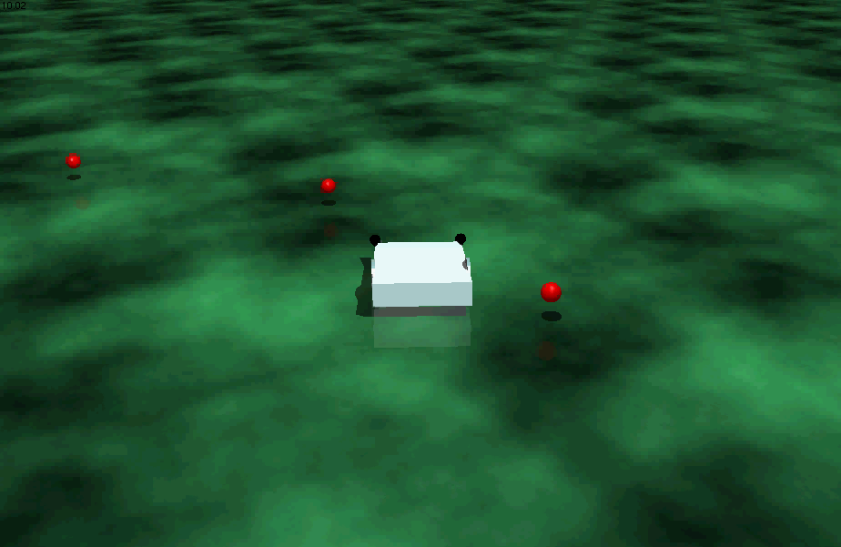
Braitenberg Movies:
Cowardly vehicle#2:

Slide 19
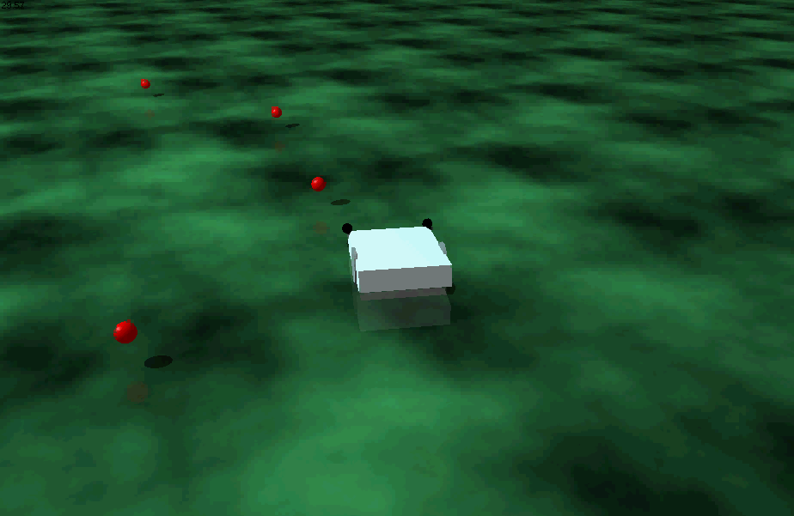
Braitenberg Movies:
Aggressive vehicle#2:

Slide 20
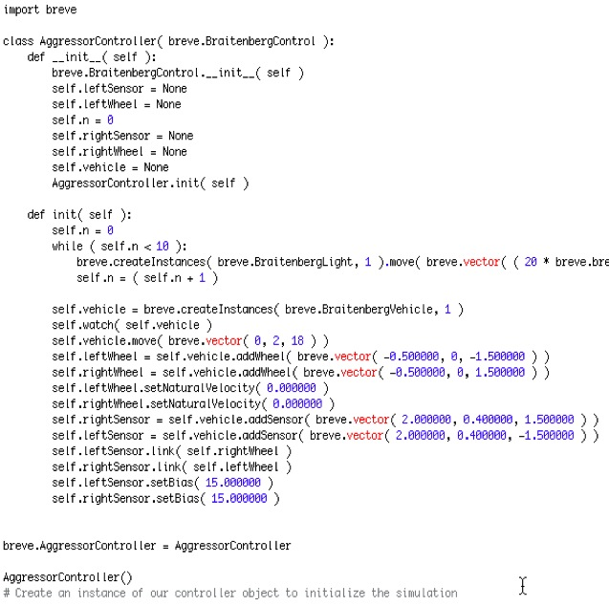
Breve: coding an agent
Python code for aggressive Braitenberg vehicle#2:
*To code your own Braitenberg vehicles in Breve, refer to this step-by-step guide:
Building Braitenberg Vehicles

Slide 21
Breve
Youtube video compilation of virtual Breve creatures.
Evolved by a group of students for their class project in Evolutionary Computation at University of Coimbra.
Life As It Could Be

Slide 22
The End
Any Questions?
Bibliography:
Wikipedia: http://en.wikipedia.org/wiki/Artificial_life
Langton: Langton, C. G., Artificial Life, preface to Artificial Life, The Proceedings of an Interdisciplinary Workshop on the Synthesis and Simulation of Living Systems held September, 1987 in Los Alamos, New Mexico, Santa Fe Institute Studies in the Sciences of Complexity Proc. Vol. VI., edited by C. Langton, Addison Wesley, Redwood City, CA, 1989
Farmer & Belin: Farmer, J. D., and A. d’A. Belin, "Artificial Life: The Coming Evolution" In Artificial Life II, edited by C. Langton, C. Taylor, J. Farmer, and S. Rasmussen. Proceedings of the Artificial Life II Conference (in 1990), Santa Fe Institute Studies in the Sciences of Complexity Proc. Vol. X. Addison-Wesley, Redwood City, CA, 1992
Braitenberg: Braitenberg, V. Vehicles: Experiments in Synthetic Psychology
Avida: http://sourceforge.net/projects/avida/
Sugarscape: http://sugarscape.sourceforge.net/
Breve: http://www.spiderland.org/breve
Images:
Chromosome: extracted from aLife flyer, M. Steinmann
Wall-E: Pixar
Evolving Sion Chickens, Second Life: http://sionchickens.ning.com/

