Slide 1
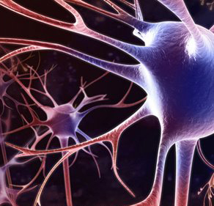
Neural Networks
Bethany Sweet, Ben Kovitz

Slide 2
What this talk is about
Real-world applications
How they work

Slide 3
1. Real-world applications

Slide 4

Aston-Martin V-12 engine
Misfires are bad
Recognizes patterns
Turning of crankshaft
Engine combustion
To collect training data, they drove the car around and forced misfires
Trained with 70% of data, tested with 30%
Chip price: $5
Notes:
$189,000 (new; pre-owned, maybe less)

Slide 5
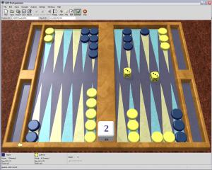
Backgammon
1979 – BKG 9.8 defeats Luigi Villa
First computer program to beat human world champion at any board game
Fuzzy logic
1989 – Neurogammon wins Computer Olympiad
Supervised learning
1992 – TD-Gammon
Reinforcement learning: temporal difference learning
Present – Jellyfish, Snowie, GNU Backgammon
Comparable to best human players

Slide 6
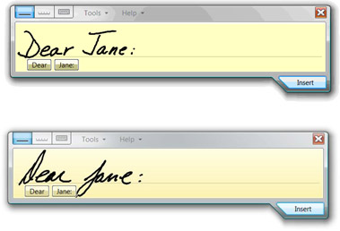
Optical character recognition
The USPS has been using OCR machines to sort mail since 1965
OCR Training Demo

Slide 7
2. How they work

Slide 8
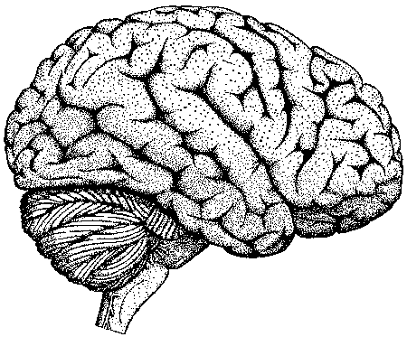
How They Work
Computation
Biological neurons: 10 ms per step, logic gates: < 1 ns per step
Hundred-step rule
All the neurons contribute to each step at once
Each neuron listens to its “advisors”
All knowledge is encoded as connection weights: “how much weight do I give to this advisor?”
Learning
By example: You don’t tell them what to do, you show them
Each example adjusts the weight given to each “advisor neuron”
Notes:
Say only a little about the bio neurons.
10 ms. In the time it takes you to do one step, the Intel Core 2 Duo processor in your laptop can do 10,000,000 steps.
Now, it takes you less than a second to come up with a response to almost anything.
Something like 200-400 ms to recognize a word.
That means that you don’t have time to do a million steps. In fact…
2. Hundred-step rule: How are you able to do in 100 steps what a Von Neumann computer can’t do in a billion steps? …
3. All contribute at once: just go on to next.
4. Advisors, distributed representation. OK, so now we know how neural nets can compute (some)
hard things super-fast. The next question is, how do you get a neural net to perform the right
computation? Its has to learn. And how does it learn? By example.
5. By example: Not like a step-by-step program. You never explicitly represent
the mapping from inputs to outputs.
OK, so how is it possible for stupid computational devices to learn from example?
If you show an ordinary computer an example, it will just sit there.
Neurons can handle sloppiness and noise. Von Neumann style is brittle.

Slide 9

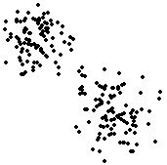
Learning by Example
Rolled-up newspaper
Listen more to advisors who told you right on this example, listen less to advisors who told you wrong
Well-suited to supervised and reinforcement learning
Clustering
Whichever advisors were the best detectors of the current example become the experts on “nearby” examples
Well-suited to unsupervised learning
Notes:
Zillions of variations, but the learning algorithms boil down to these two basic strategies.
“Rolled-up newspaper” is not a standard term (yet).
TELL THE STORY BEFORE CLICKING
Draw Asim, Ben, Jessica on the whiteboard
Punjabi Kebab Restaurant
The moral of the story: then click.
1. Now explain that the input nodes are always advising “Do it!” whenever
their sensor gets activated. This is how information gets into the network. The other
nodes then have to determine when to listen to these inputs and when to ignore them.
Now, how do you know whether you were right or wrong? You need some external
input to tell you that.
2. Well-suited. Teacher, pain/pleasure, fitness function.
DON’T CLICK YET.
Everyone who’s ever trained a dog understands learning by rolled-up
newspaper. Clustering is less obvious fundamental learning method, but at least as important.
How many clusters do you see here? I see two. If you frame this as a step-by-step
problem, it’s hard and computationally intensive. Here’s how neural nets do it…
3. Advisors team up when they’re responding to the same things, and increase their specialization
when they’re responding to different things.
Clustering: stereotyping

Slide 10
Competitive learning
Set-up:
To make n clusters, make a “league” of n neurons. Each neuron takes inputs from all sensors.
Randomize the weights.
Computation:
Whichever neuron in the league has the highest sum of input signals (input × weight) outputs a 1. All other neurons output a 0.
Learning:
After each example, the “winner” transfers weight from its weaker inputs to its stronger inputs.
Notes:
This is the simplest form of competitive learning. There are many, many variations.
For each of the three steps, read it, and then do it on the whiteboard.
“League” is not a standard term.
Starting with random weights is a very common technique in neural nets.
You can track moving clusters this way.

Slide 11
The end

Slide 12
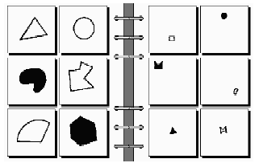
Bongard problem #2

Slide 13
TD-Gammon
During play:
Every turn, examine all legal moves and all legal responses, and plug each board position into the neural net’s evaluation function. Pick the move that yields the board position that comes out the best.
Training:
Look at the entire sequence of moves in an actual game. Using the current eval function, evaluate the board position after each move.
Whenever the evaluation at time t differs from t+1, update the net by back propagation to make the evaluations closer.
Feed in the final result of the game (win, lose, by how much). This corrects the eval of the final position, which corrects the eval of the preceding position, and so on back to the start of the game.

