Slide 1
Neural Networks
Association and Hebb

Slide 2
Donald Olding Hebb (July 22, 1904 – August 20, 1985)
Born in Nova Scotia, Canada
Both parents were physicians
During childhood, attended a Montessori school
Brother became a physician
Sister earned Ph.D. from McGill
Ph.D. in Psychology, Harvard, 1936

Slide 3
Hebb Continued
Originally wanted to be a novelist
Had little inhibition as a young adult
Stricken with TB in 1931 (while Master’s student at McGill)
The Integrative Action of the Nervous System – Charles Scott Sherrington
Conditioned Reflexes – Ivan Pavlov
Considered to be the father of neuropsychology

Slide 4
Hebbian Theory
Neurons that fire together, wire together; the more the fire, the thicker the wire
Often generalized Δw_{i} = ηyx_{i}
Δw_{i} = change in the i^{th} pre-synaptic weight
η = learning rate
y = post-synaptic response
x_{i} = i^{th} pre-synaptic input
Change in pre-synaptic weight can be positive or negative
Unstable (weights can increase or decrease without bound)

Slide 5
Modifications to Hebbian Theory
Oja’s rule
Δw_{i} = ηy(x_{i} - w_{i}y)
Stable (weights normalized to [-1, 1])
Sanger’s rule (Generalized Hebbian Algorithm)
Δw_{ij} = ηy_{j}(x_{i} - Σw_{ik}y_{k})
Applies to networks with multiple outputs
Anti-Hebbian learning
Neurons that fire together, drift apart

Slide 6
Unsupervised Learning
Supervised learning algorithms (e.g., backprop) train a neural network to produce a target output pattern given some input pattern
In unsupervised learning, there is no target pattern
So what does unsupervised learning “learn”?
Typically performs the same task as an auto-associative (target = input) network: data compression, dimensionality reduction, clustering, and data visualization
Applications include vision, robotics, PCA/ICA, signal separation, and anomaly detection

Slide 7
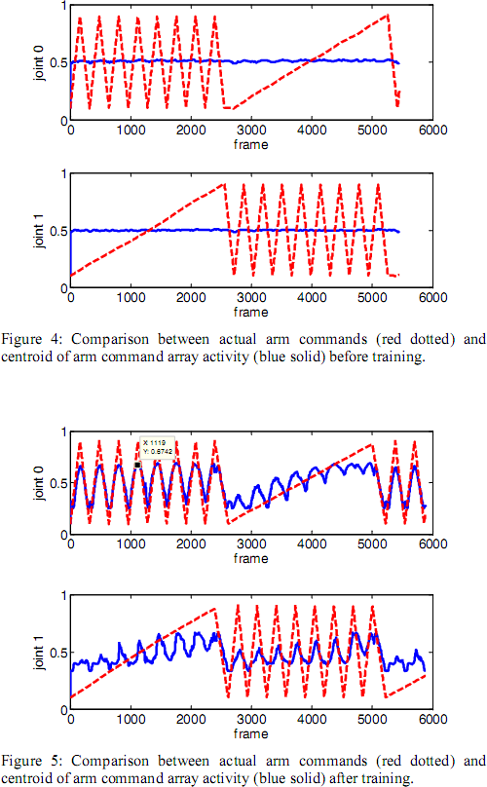
Applications: Vision and Robotics
“Learn to Point” system
Robotic arm “learns to align its sensory and motor maps so that it can successfully reach the tip of its arm to touch the point where it is looking”
http://www.youtube.com/watch?v=gPfcOvVxzZU
http://www.youtube.com/watch?v=L7kZEp4R8BQ
Source: http://personalpages.manchester.ac.uk/staff/p.dudek/papers/wang-biocas2009.pdf

Slide 8
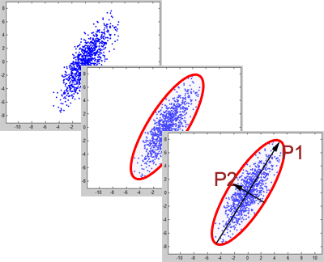
Applications: Principal Component Analysis
“Takes your cloud of data points, and rotates it such that the maximum variability is visible”
“Identifies the most important gradients”
“Variable reduction procedure”
Source: http://blog.peltarion.com/2006/06/20/the-talented-drhebb-part-2-pca/

Slide 9
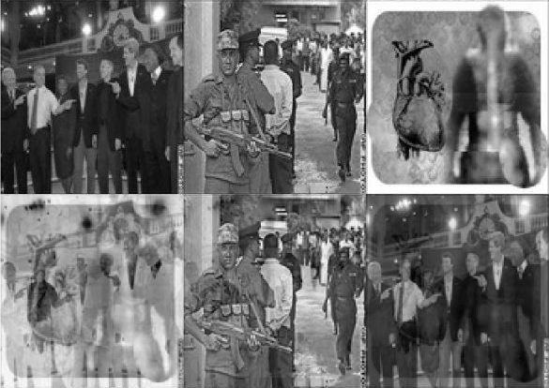
Applications: Independent Component Analysis
Special case of blind source separation
Separates a multivariate signal into its subcomponents, assuming the independence of those components
Source: http://www.stanford.edu/~dgleich/projects/pca_neural_nets_website/index.html

Slide 10
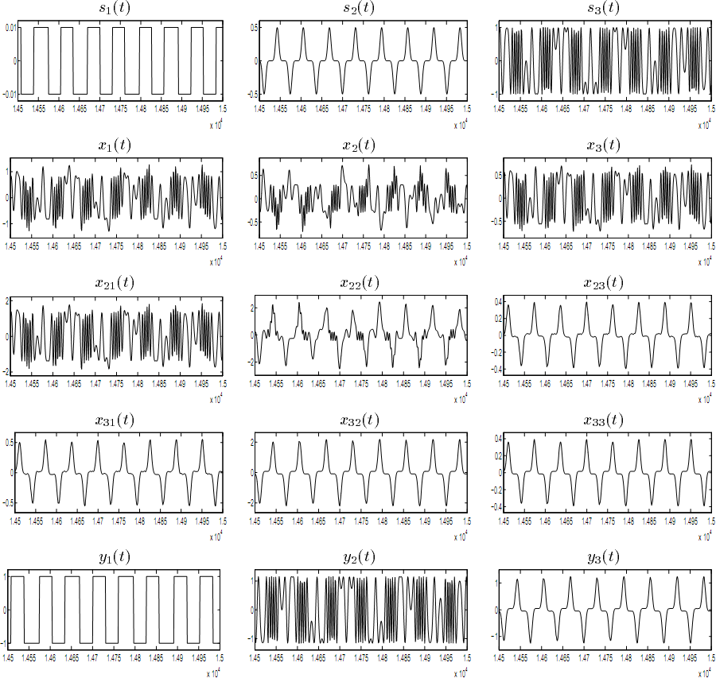
Applications: Signal Separation
Biomedical signal processing (ECG or EEG)
Speech recognition (“cocktail party problem”)
Image enhancement
Telecommunication
Source: http://citeseerx.ist.psu.edu/viewdoc/download?doi=10.1.1.52.8656&rep=rep1&type=pdf

Slide 11
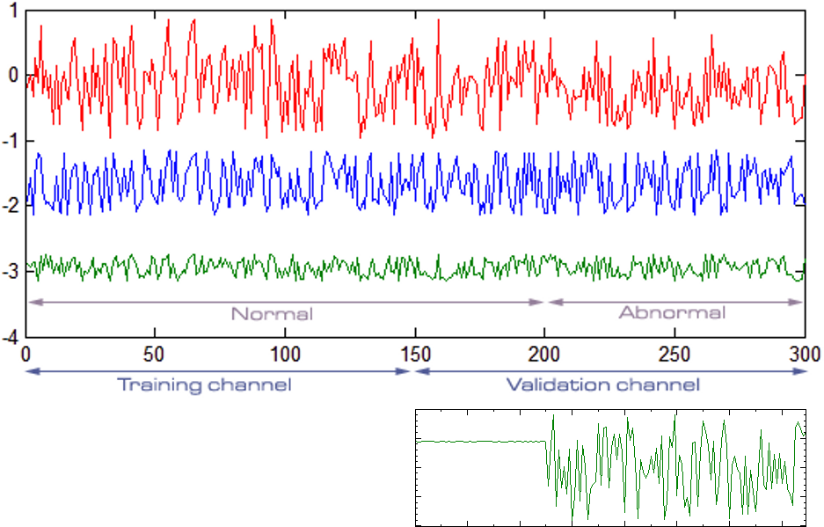
Applications: Anomaly Detection
“When a Hebbian layer is presented with an input pattern it has already seen, it will trigger a strong response”
“Now should we invert that, we get a novelty filter: a filter that detects new or anomalous patterns”
Source: http://blog.peltarion.com/2006/05/11/the-talented-dr-hebb-part-1-novelty-filtering/

Slide 12
Questions?

