Slide 1
Information Theory Applications
Dimitar Nikolov, John Ramsey, Brian Hensel

Slide 2
Outline
Measuring similarity
Cryptography
Medical imaging
N-Grams

Slide 3
Measuring Similarity
Traditional measures
Cosine similarity
Dice Coefficient
Distance-based measures

Slide 4
Measuring Similarity
Goal: domain independence
Assumptions
I(common(A, B)) and I(description(A, B))
sim(A, B) = f(common(A, B), description(A, B))
sim(A, A) = 1
sim(A, B) = weighted sum of sub-similarities

Slide 5
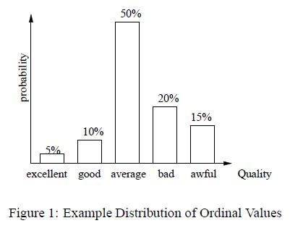
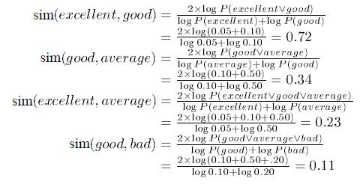
Measuring Ordinal Similarity

Slide 6

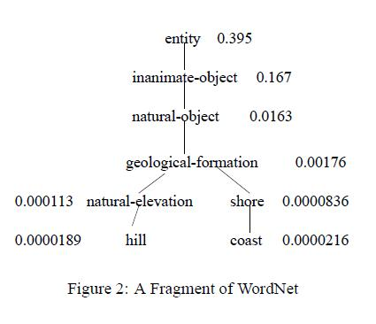

Measuring Semantic Similarity

Slide 7
Measuring Similarity - Conclusion
Applicability to other representations & domains
Words
Feature vectors
... and any domain for which a probabilistic model can be defined.
Achieved: a domain independent similarity measure
Lin, 1998, An Information Theoretic Definition of Similarity

Slide 8
Cryptography
The practice and study of hiding information. Modern cryptography intersects the disciplines of mathematics, computer science, and engineering.

Slide 9
Cryptography Basics
Cryptography provides four main types of services related to data that is transmitted or stored.
Confidentiality
Integrity
Authentication
Non-repudiation

Slide 10
Why Information Theory and Cryptography?
In cryptography and in communication as a whole it is vital that bits be transferred with as little error as possible.
Shannon was concerned with ``messages'' and their transmission, even in the presence of ``noise'‘
Noise can cause errors, but with the assistance of code that utilizes selection based on probability, error rates can be lowered to near 0%.

Slide 11
Entropy and Channel Noise
The entropy is just the weighted average of the number of bits required to represent each message, where the weights are the probabilities that each message might occur.
Such a representation of the probability of bits is…

Slide 12
If p = 1 then there are no errors in transferred bits, however if the p = .5 you can not say whether a bit will be a 0 or a 1
Probability | Channel Capacity
0 or 1 | 1.00000000000000
.05 or .95 | .713603042884044
.1 or .9 | .531004406410719
.15 or .85 | .390159695283600
.2 or .8 | .278071905112638
.25 or .75 | .188721875540867
.3 or .7 | .118709100769307
.35 or 65 | .065931944624509
.4 or .6 | .029049405545331
.45 or .55 | .007225546012192
.5 or .5 | .000000000000000

Slide 13
Further Applications
A use of information theory in cryptography is to derive results on the provable security of a system even in the presence of attackers with infinite computing power.
An example of that is using information theory to lower the bounds on necessary key sizes to attain a certain level of pertained security in data transfers.

Slide 14
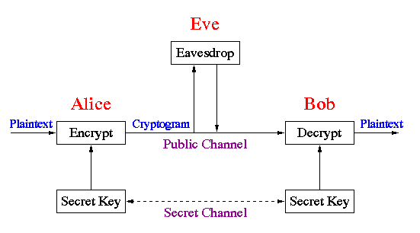
Flowchart!!

Slide 15
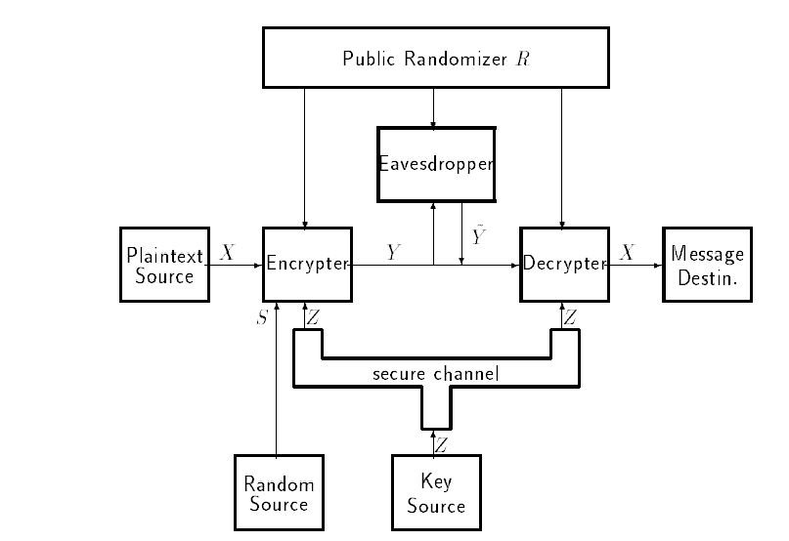
Flowchart 2!!

Slide 16
Other Applications
Quantum Cryptography
Generates keys based on sender and receiver quantum interactions.
Gambling Applications (Card counting and roulette prediction)
Shannon & Thorp mobile computer, MIT Blackjack team.

Slide 17
Medical Imaging – Information Theory
Look at one case of Information Theory used in Medical imaging(produced by a group of individuals from Shanghai University)
Medical Image Registration based on Mutual Information

Slide 18
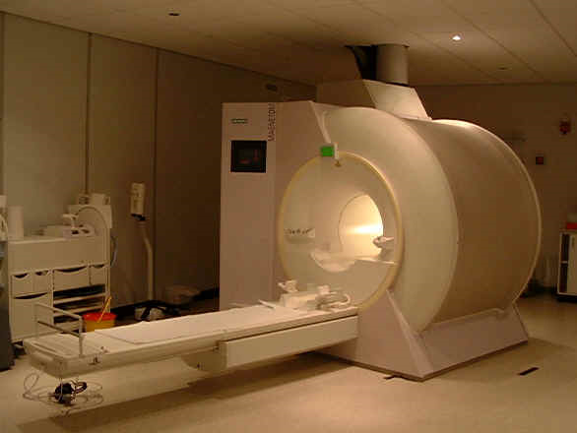
MRI Machine

Slide 19
What is Image Registration ?
The process of determining the spatial transform that maps points from one image to points on the second image. (1) Anrong Yang,
To solve image registration problem, different frameworks have been put foreword.
ie: general learning, adaptive filtering, object oriented
In this case they created a new framework called ‘rapid medical registration framework’
The 4 components of their registration framework:
1. Interpolator
2. Measurer
3. Optimizer
4. Transformer

Slide 20
Image Registration Problem….
The problem with registration is to find the optimal transformation which best aligns the input images.
During the process of registration the measurer compares grayscale intensity values in the fixed image against those in the moving image.

Slide 21
Mutual Information
Mutual Information is used as a measure in medical imaging
Mutual Information is … widely used
Computes the mutual information between two images, and measures the amount of information one random variable tells about another random variable. (intensity in one image of the intensity of another image)
Advantage of Mutual information, allows complex mapping between two images can be modeled. (due to the actual form of the dependency does not have to be specified)
Entropy is used to measure information content of each partition of an image.

Slide 22
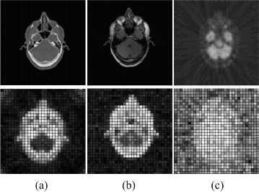
Mutual Information continued…
Entropy is used to measure information content of each partition of an image.
To express entropy, medical images are divided into small blocks or entropy maps.
Blocks with higher entropy are shown with higher intensity
Entropy maps of CT, MR, PET images

Slide 23
Registration Framework
Input data: 2 images, fixed image and moving image
- Can be represented by f(X) and m(X) , X is a position in an n-dimensional space
Output is the result image r(X)
- The output shows the difference between the fixed image and the moving image (after the registration process)
Measurer component is optimized and is represented by p(f, T(m))
Transformer component T(X), shows spatial mapping
Interpolator, used for evaluating moving image intensities.
In conclusion can be shown by the formula
T* = argmax p(f, T(m))
T
T* - represents the optimal transformation which best aligns the 2 input images.
f – represents the fixed image
T(m) – represents the transformation on the moving image, m

Slide 24
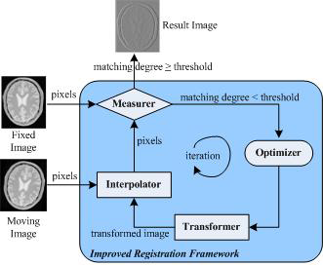
Their registration Framework

Slide 25
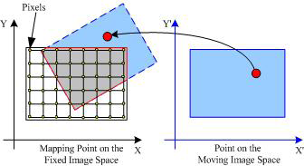
Interpolator and Spatial transform
Shows a point on the moving image mapped from one space to a fixed image space by a transform (being mapped to a nongrid position. )
Shows the overlap area between the images in the red ouline
Interpolation is used to evaluate the image intensity at mapped position

Slide 26
Measurer
Measurer shows how well the a fixed image is matched by transformed moving image
They used Mutual Information as their main measure method.
Because…MI Is more precise in registration compared to other measures, such as normalized correlation.
In registration the marginal and joint probabilities must be estimated from image data.

Slide 27
Optimizer
Adjusts the moving image to be closer and closer to the fixed image during iterations.
To do this they used evolutionary algorithms and genetic algorithms,

Slide 28
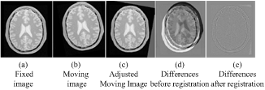
Their results from their framework
Example

Slide 29
Conclusion
Image registration is the process of determining spatial transform which mapping points from one image to a points on a second image.
Mutual information is used widely in medical image processing.
In this case they used mutual information to calculate the shared information between two images, MI measures how much information a random variable tells about another random variable.

Slide 30
Medical Imaging - Sources
http://images.google.com/imgres?imgurl=http://www.dundee.ac.uk/medther/tayendoweb/images/mriscnr.jpg&imgrefurl=http://www.dundee.ac.uk/medther/tayendoweb/images/mriscanner.htm&usg=__ABwGhPduX4fPGpjzMBT0_-A6Ass=&h=440&w=586&sz=18&hl=en&start=1&um=1&itbs=1&tbnid=VplPodw45CUgJM:&tbnh=101&tbnw=135&prev=/images%3Fq%3Dmri%2Bmachine%26um%3D1%26hl%3Den%26sa%3DN%26tbs%3Disch:1
MRI image
‘An improved Medical Image Registration Framework Based on Mutual Information’ Anron Yang, Caixing Lin, Chen Wang, Hongqiang LI’ Shanghai China

