Slide 1

Complexity

Slide 2
What is Consciousness?
Tononi:
consciousness corresponds to the capacity of a system to integrate information.

Slide 3
Tononi Consciousness
This claim is motivated by two key properties of consciousness:
Differentiation
the availability of a very large number of conscious experiences
Specialized processing in different neural regions
Integration
the unity of each such experience.
Combining specialized processes to create whole experience

Slide 4
“
”
The whole is bigger than the sum of the parts Aristotle
Non-linear Complex System
As Thanksgiving Dinner
Taste of food
Differentiation
Good Feeling
Sight of decor
Integration
Being with family
Pleasure of conversation
Ambiance
Smell of turkey

Slide 5
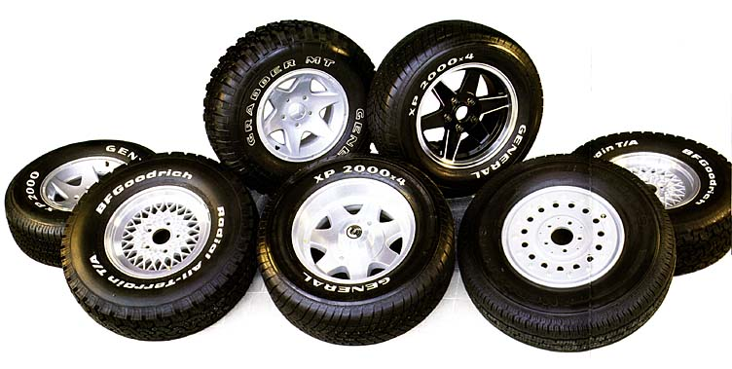
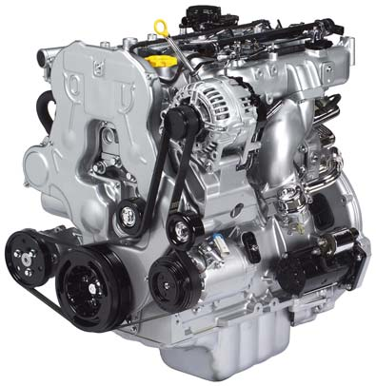
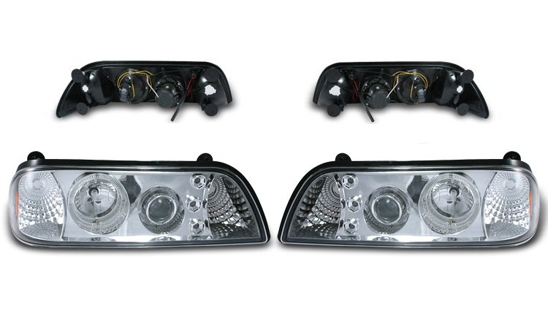
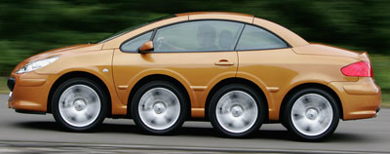
Local and Global Neural Processing As Factories
Differentiation/Local:
Factory A makes wheels
Factory B makes engines
Factory C makes headlights
Integration/Global:
Toyota buys wheels, engines, headlights to assemble a car.

Slide 6
Tononi
Theory states that the quantity of consciousness available to a system can be measured as the Φ value of a complex of elements.
Φ is the amount of causally effective information that can be integrated across the informational weakest link of a subset of elements.

Slide 7
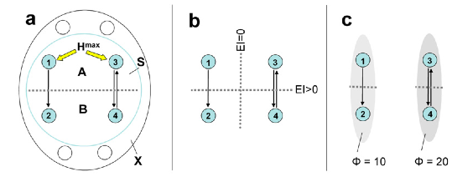
Theory states that the quantity of consciousness available to a system can be measured as the Φ value of a complex of elements.
Φ is the amount of effective information that can be integrated across the informational weakest link of a subset of elements.
Φ score reflects complexness in a system

Slide 8
To Tononi, there are two problems:
The first is understanding the conditions that determine to what extent a system has conscious experience.
What tolerance do the sensors have?
Parameter input increases ability to output consciousness.
Understanding the conditions that determine what kind of consciousness a system has.
What type of sensors are being used

Slide 9
The first is understanding the conditions that determine to what extent a system has conscious experience.
What tolerance do the sensors have?
Parameter input increases ability to output consciousness.
Low level of consciousness vs High level:
Notes:
Goal oriented
Conditions are determined after task is defined

Slide 10


Slide 11
Homer Simpson
Cigarette Smoke Scent
Color of food

Slide 12
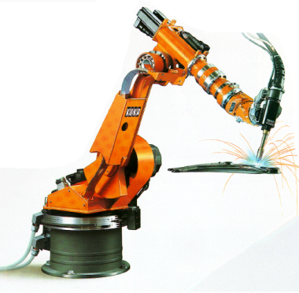
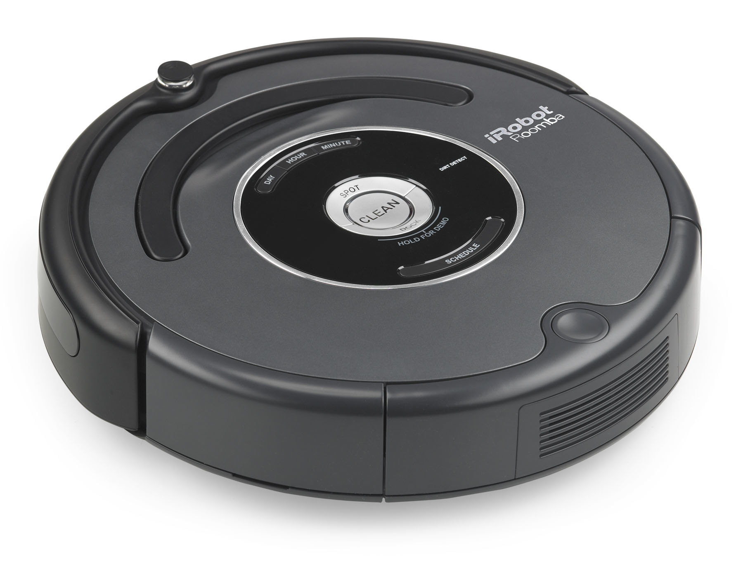
Understanding the conditions that determine what kind of consciousness a system has.
What type of sensors are being used
Bump Sensors
Position Sensors

Slide 13
Neural Complexity (C_{N})
Picking up a cup
Finger control, wrist control, muscle force control--local
3 parts of brain interact as global interaction
Work together as a system to perform action of grasping cup

Slide 14
Neural Complexity (C_{N})
“A measure for brain complexity”
A concept called neural complexity (C_{N}) that describes the interplay between local properties/activities and global interaction (that leads to behaviors) in the brain.

Slide 15
Two Views:
Localizationist view:
the brain is functionally specialized—certain brain areas are responsible for certain behaviors
in authors’ words: functional segragation
Individual parts of a car are tested to determine quality
Holistic view:
brain activities have to be integrated (at the neuronal level as well as the behavioral level) to produce coherent output, e.g. a smooth action.
Overall experience while driving…. Is it quiet, smooth, durable….
interaction of elements is used to determine quality

Slide 16
Objectives:
Show that local specialization and global interaction in the brain can be formulated within a unified dynamical framework (i.e. C_{N}).
One model to express both local and global processing. Cn Model
To use C_{N} to analyze some principles of neuro-anatomical organization.
How the brain parts are linked.

Slide 17
Theory
Given a system X with n elementary components, using entropy and mutual information theories to characterize the system, specifically:
Segregation and integration are characterized in terms of deviations from statistical independence among the elementary components. This is the measure of C_{N}.
Segregation and integration are scored in terms of independence among components.

Slide 18
Theory
C_{N} is low when elementary components are either totally independent (e.g. dilute gases) or total dependent (e.g. crystal);
C_{N} is high for systems whose components are independent in small subsets and become increasingly dependent in bigger subsets (e.g. the human brain, where specialization and integration both happen).
A high C_{N} refers to high density of connections, strong local connectivity, patchiness in the connectivity among neuronal groups, and a large number of reentrant circuits.

Slide 19
Validation
Ran computer simulations to validate the theory. Theory-based computer simulations produced results similar to human data from MRI studies.

