Slide 1
Simulated Evolution
Carter Diebold
Brendan Thorpe

Slide 2
What is Simulated Evolution?
Shaping evolution to reach a specific goal.
Using models to monitor behavior or analyze fitness.
Aesthetic selection

Slide 3
Blind Watchmaker
Watch them evolve
Create watches
http://www.youtube.com/watch?v=mcAq9bmCeR0

Slide 4
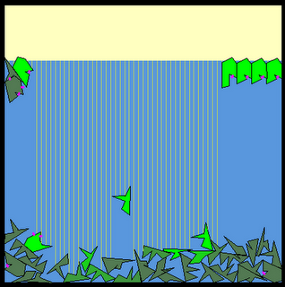
Scott Schafer’s VatLife
“Critters” have randomly generated genomes to dictate shapes and logic.
Attempt to gain the most “sunlight” which will give them energy.
The highest energy subjects are periodically mated.

Slide 5
Demo
http://www.scottschaferenterprises.com/vatlife/main.htm

Slide 6
Music Genome Project
Tim Westergren
Started at Stanford in 2000
Created for
Promotion of unknown music
Listeners limited to radio and personal collection
Users to identify music they will like
Classical Music enthusiast

Slide 7
Music Genome Project
Pandora
Categorization of music on 400 attributes
Stations based on artists or songs
Stations populate based on fitness
User opinion of population changes fitness
Stations are evolved to personal optimization

Slide 8
Screen Saver Evolution
Electric Sheep
Project from 1999
Uses fractal frame algorithms to translate code into images
Sheep are a product of aesthetic evolution, an idea from Karl Sims

Slide 9
Screen Saver Evolution
Electric Sheep
Created by Randomness, Crossover, Mutation, Human Post
Server maintains the flock
Flock is continuously updated
Sheep are rated, created and destroyed within flock
21% human designed
79% evolved

Slide 10
Works Cited
http://scottschaferalife.blogspot.com
http://www.wisegeek.com/what-is-the-music-genome-project.htm
http://arstechnica.com/tech-policy/news/2011/01/digging-into-pandoras-music-genome-with-musicologist-nolan-gasser.ars/2
http://draves.org/aoae07/draves-aoae07.pdf

