Slide 1
Complexity
Xin Shuai

Slide 2
Main Points
1. What’s complexity?
2. Different measures for complexity
3. Application of Complexity to Alife research

Slide 3
Disorganized vs Organized
Disorganized complexity
A system with many components
no relation among components
can be handled by statistics
Organized complexity
A system with many components
Intricate relations among components
Hard to predict with existing theory

Slide 4
Complex vs Complicated
Complex is NOT equivalent to Complicated!!
Complicated: A whole electric circuit of a machine, The blue print of a satellite…
Complex: The transformation of a social network, the evolution of a ecological system
……

Slide 5
No unique definition about complexity
The definition of complexity is highly dependent of its context! No unique definition is agreed on.

Slide 6
Different complexity measures
1.Computational complexity: the amount of computational resources required for execution of an algorithm
2.Algorithmic complexity: the length of the shortest program to output a string
3.Information-theoretic complexity: defined on the information theory. Most useful to Alife research.
4…….

Slide 7
Complexity & Alife
1. Explain emergent new biological traits during evolution
2. Evolve coordinated sensorimotor behavior

Slide 8
Darwinian theory was challenged by weak explanation of sudden emergence of new trait, because the evolution of organisms is gradual
Maybe we can think of the problem in term of complexity

Slide 9
Genomic Complexity
Charles Ofria studied the gradual evolution of complexity and sudden emergence of complex features on Avida platform
They defined the genomic complexity as the sum of Shannon information of each genomic position
---A site that can take on all possible symbols without affecting fitness contains no information
---Likewise, a site that cannot be altered without reducing fitness encodes the maximum amount of information

Slide 10
Results
They demonstrated that when a new traits (EQU operation in Avida) emerges, the whole genomic complexity will increase only a little.
The complexity associated with the new traits comes from:
Existing traits
Once functional but now defunct traits
Newly incorporated information

Slide 11
Conclusion
The new complex traits can emerge by utilizing preexisting genomic complexity. Therefore gradual complexity increase is enough for new traits to evolve.

Slide 12
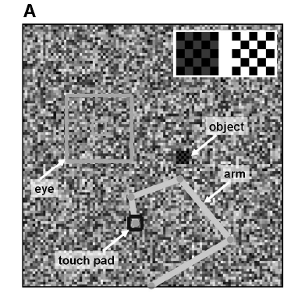
Sensorimotor Behavior
Olaf’s research
Task Formulation
A 2D area with each pixel displaying a random color at each time step
A simple object with constant red color & tactile feature moves randomly
A simulated arm with “eye” and “touch pad”. In the center of “eye” exists a fovea region of the same size with the moving object
Task: the arm is required to catch the moving object using the sensor data it captures

Slide 13
Neural structure of the creature (arm) consists of:
Sensory data from visual & tactile inputs
A visual attention system: select a salient location
Motor units : control actions of eye and touch pad
Genome of the creature consists of 11 alleles that collectively control the sensorimotor behavior
Sensory data was collected from fovea of “eye” and touch pad, resulting sensory time series X(t), which each variable xi(t) corresponding to a single “sensor” (pixel or tactile)

Slide 14
Cost Function
Behavioral:
Maximizing foveation time
Maximizing touch time
…..
Information-theoretical:
Maximizing mutual information
Minimizing entropy
Maximizing complexity

Slide 15
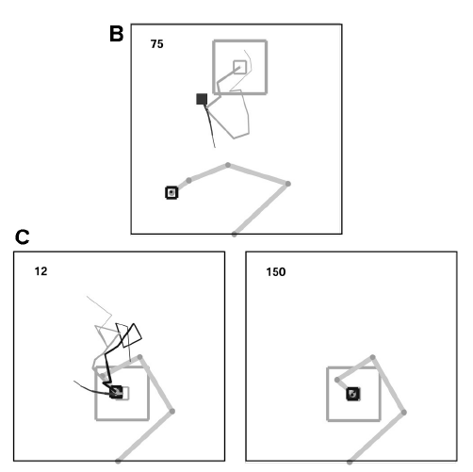
Before evolution, eye movement and occasional contact with the moving object shows will not lead to foveation and tracking movement, which are advantageous in capturing the object.
After evolution, the arm always tracked the eye movement. When the object was acquired by the eye, foveation and tracking will immediately happen.

Slide 16
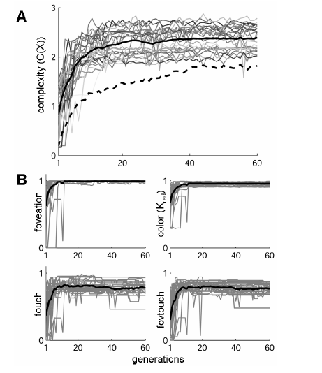

Slide 17
Extend to Polyworld
Can we use the complexity as the cost function to guide the evolution in PolyWorld?
Not so simple
Finally, the PolyWorld is dominated by “spinners” with extremely high complexity but quite naïve behavior.

Slide 18
Some speculations
Complexity value should be closely coupled to evolutionary advantageous behavior
There’s no single specific task defined in PolyWorld like grasping a moving object
The environment in PolyWorld is far more complex than a simple 2D area

