Slide 1
Neural network and Information theory
Presenters:
Chao Ji, Yubin Zou, Rhaad Rabbani

Slide 2
Outline
Theory
Demo
How to construct a neural network based on matlab

Slide 3
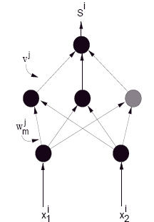
An application of info theory
Work by Rudi Setiono and Huan Liu
Goal # 1: Finding optimal number of hidden
units for backpropagation learning
For a given number of hidden units,
minimize error by adjusting weights:
Error is
where S_{i} (a real number) is output using current weights,
and t_{i} (0 or 1) is target, on input x_{i}.
Better convergence minimizing cross-entropy
Increment number of hidden units if minimum error unacceptably high
Benefits of having optimal number of hidden units

Slide 4
An application of info theory
Goal # 2: Feature selection
Calculate information gain for each feature
Select only those features that have an above-average information gain to train your network
Coming up next: How quality of training affected by # of hidden units …

Slide 5
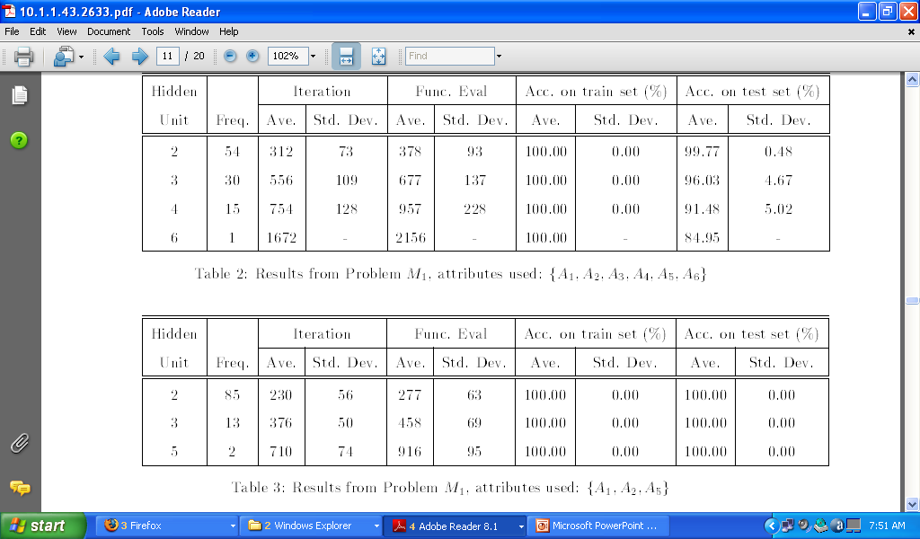
Feature selection example

Slide 6
Learning identity function
Identity function
Input: 8 binary vectors
v1= (1, 0, 0, 0, 0, 0, 0, 0)
v2= (0, 1, 0, 0, 0, 0, 0, 0)
……
v8= (0, 0, 0, 0, 0, 0, 0, 1)
Output: same as input
… …

Slide 7
Learning identity function
Trained using standard Backprop algorithm
Question: given fixed number (i.e. 8) of input and output units, how many hidden units are needed to learn the identity function ?
Demo

Slide 8
Learning identity function
It turns out that it is necessary to have #(hidden units)>= 3
Output values of each individual hidden unit

Slide 9
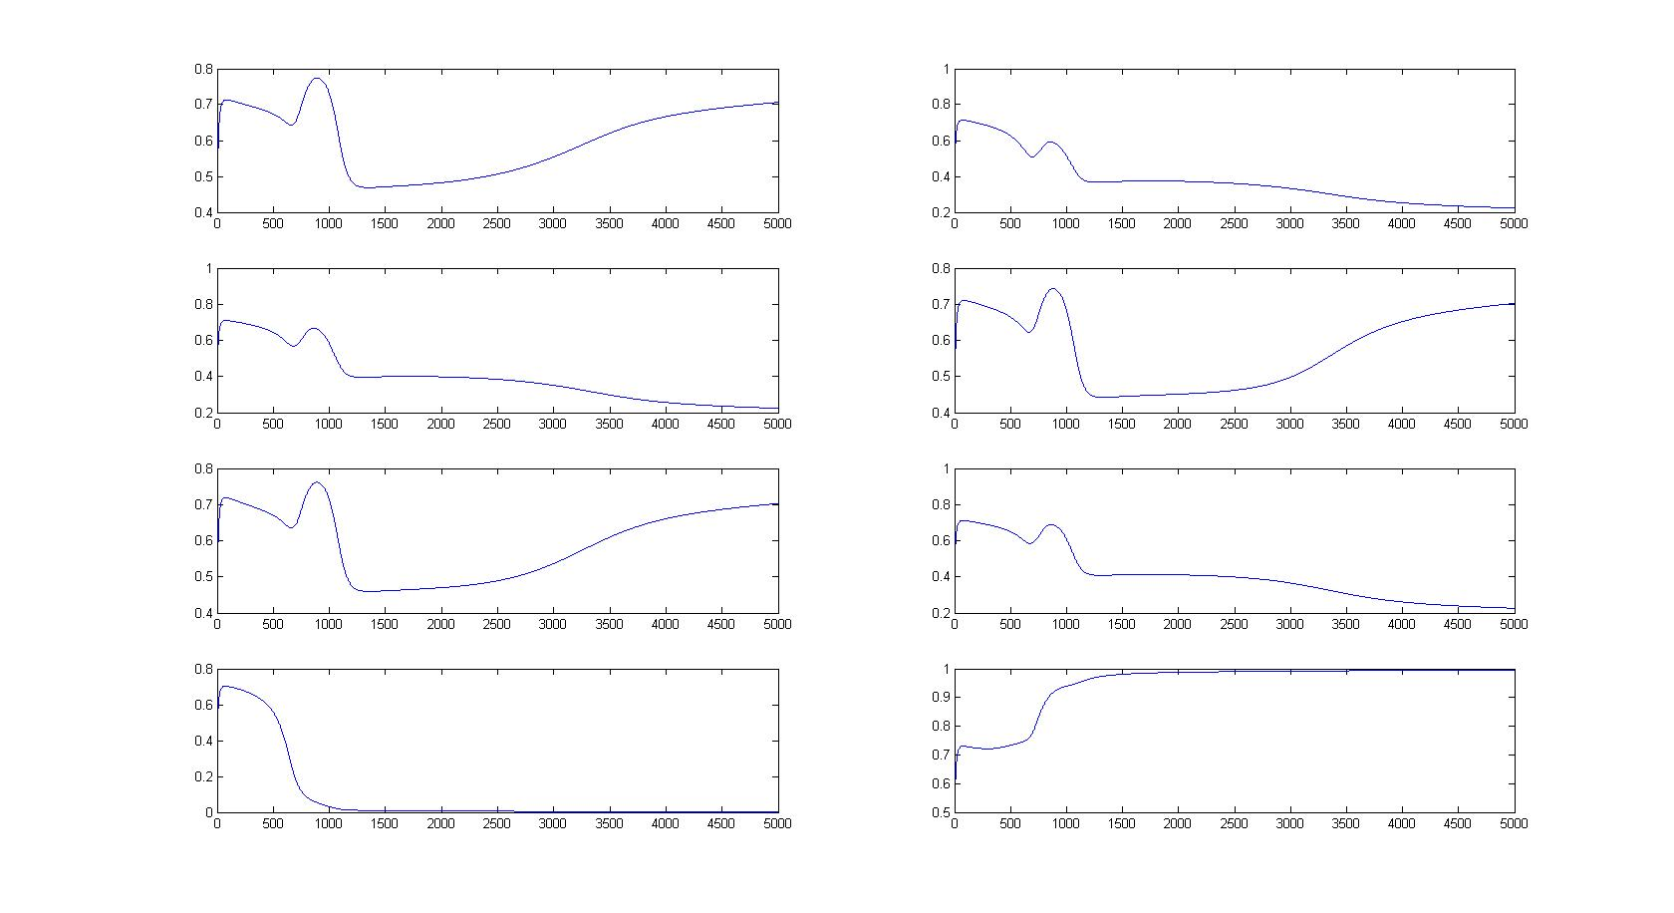
Learning identity function
#(h)=1

Slide 10
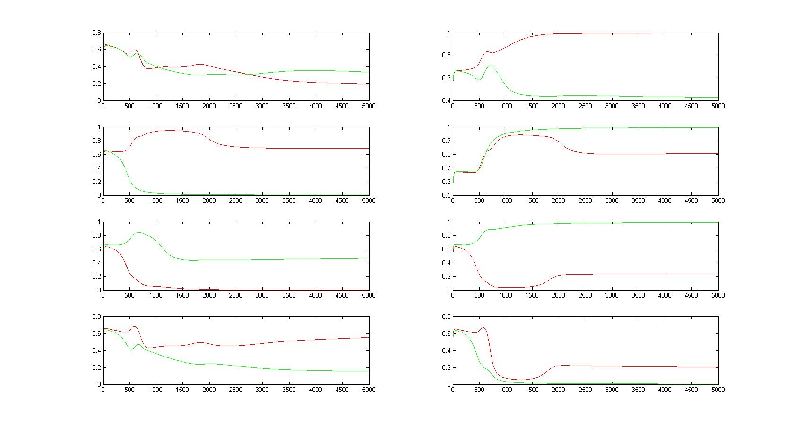
Learning identity function
#(h)=2

Slide 11
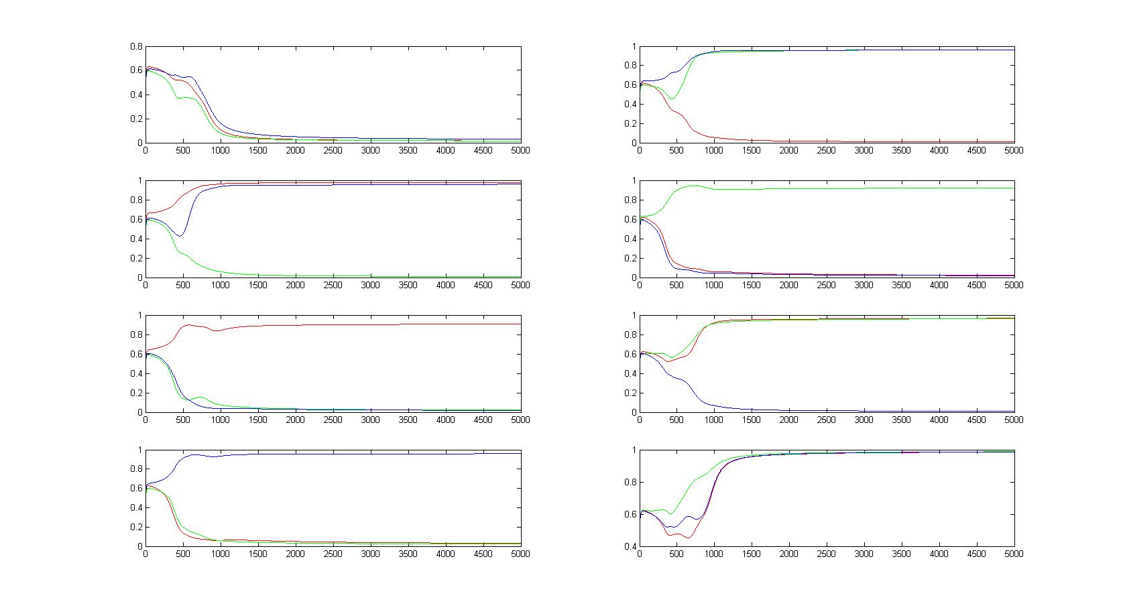
Learning identity function
#(h)=3

Slide 12
Learning identity function
Conclusion
Given sufficient hidden units, the neural network has the ability to encode different output classes using hidden units.

Slide 13
Neural network and Matlab
Neural Network Toolbox
Neural network Fitting tool (nftool)
solving a data fitting problem, solving it with a two-layer feed-forward network trained with Levenberg-Marquardt
Neural network Pattern Recognition tool (nprtool)
solving a pattern-recognition classification problem using a two-layer feed-forward network with sigmoid output neurons.
Neural network classification/clustering tool (nctool)
solving a clustering problem using a self-organizing map
Unsupervised learning
http://www.mathworks.com/access/helpdesk/help/toolbox/nnet/gettings.html

