Slide 1
Evolution of Learning and Complexity
Dan Nate and Katie Carney

Slide 2
Collective Learning
“Development of knowledge is attributed to the system of human agents interacting dynamically with artifacts.”
“Illustrates the process of interaction between people and technologies in order to determine how to best represent, store and provide access to digital resources and other artifacts.” – J. Fadul

Slide 3
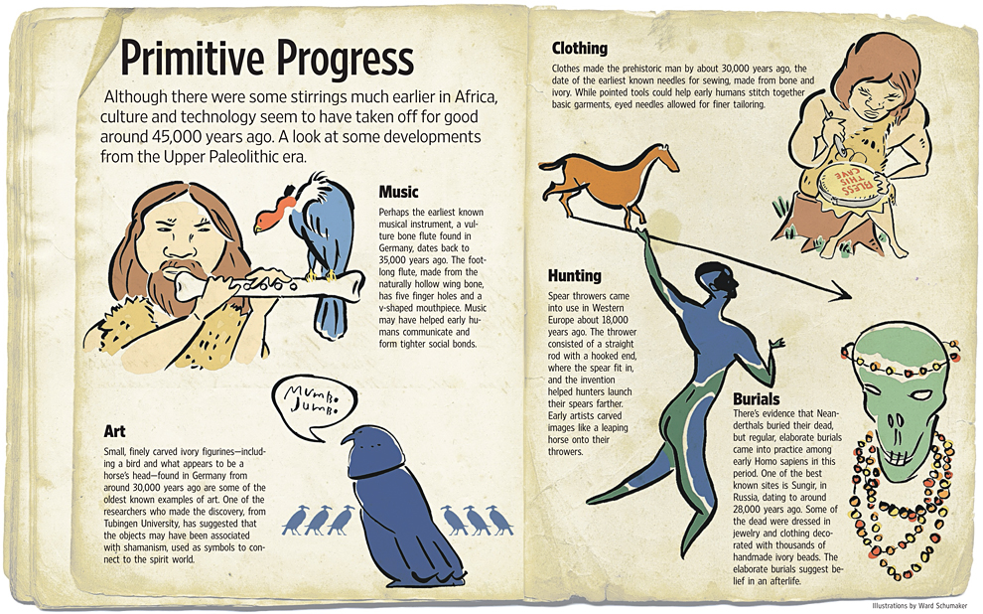

Slide 4
Collective Learning
Interaction between individuals
Size of population
Individuality
Sugarscape is a useful tool for looking at modeling how societies can function

Slide 5
Evolutionary Software
Von Neumann machine and Stanislaw Ulam - CA
John Conway – Game of Life
Craig Reynolds – Agent-based modeling
Christopher Langton – AL
Joshua M. Epstein and Robert Axtell – larger scale model – Sugarscape
Ron Sun – Agent based models of human cognition

Slide 6
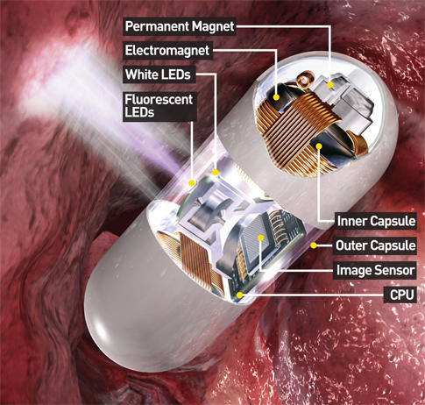
Endoscope Camera
Created by a Gastroenterologist and a guided missile designer
Pill Demo

Slide 7
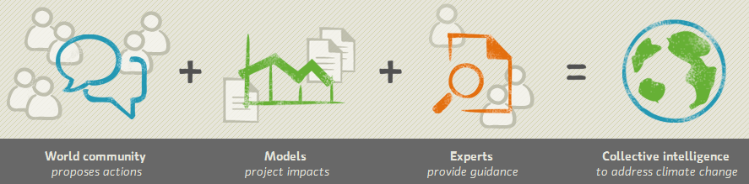
Current Intelligence
Google, Wikipedia, Twitter, along with other social media - Crowdsourcing Zak Fish
MIT combating climate change issues using crowdsourcing – Climate CoLab Project

Slide 8
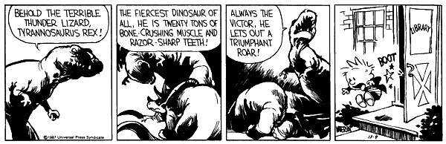
ADHD
Weaker “braking” mechanisms within the brain
5% of population
Necessary for the advancement of society

Slide 9
Complexity
The increase of genetic information or that of the organizational complexity of a system
Netlogo is a tool used to model the development of complexity within systems
When evolving complexity, smaller mutation rates is more beneficial than greater mutation rates. The higher the mutation rate, the more it is inhibited.

Slide 10
Trypanosoma brucei
Sleeping sickness virus
Carried in Tsetse flies in Africa
Survival of bacteria depends on constant complex changes due to two different habitats – insect stomach and mammalian bloodstream

Slide 11
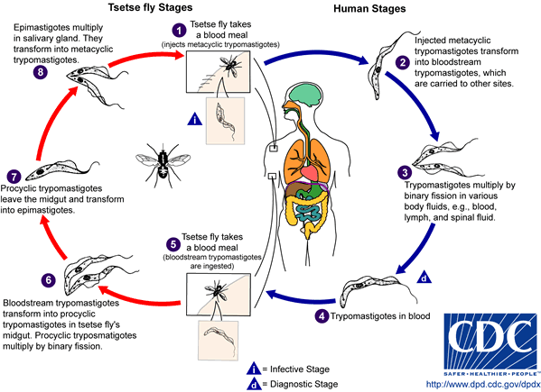

Slide 12
Sources
http://incsub.org/soulsoup/?p=55
Endoscope - http://www.popsci.com/node/19963
http://borntoexplore.org/evolve.htm
http://copingkoala.wordpress.com/category/calvin-hobbes/
http://www.biology-direct.com/content/3/1/11
http://climatecolab.org/web/guest/home
http://www.ncbi.nlm.nih.gov/pubmed/12100445
http://sugarscape.sourceforge.net/
http://ccl.northwestern.edu/netlogo/
http://www.youtube.com/watch?v=Buyub6vIG3Q&feature=related
http://www.cogsci.rpi.edu/~rsun/clarion.html

